Slide 1
Risk, Rates, Person time
Alex Mutuku
Mark Otiende

Slide 2
Session Objectives
Distinction between risks and rates
How to calculate rates and person time
How to calculate and interpret confidence intervals for rates
How to compare two rates using rate ratio

Slide 3
Definitions
Risk
Rate
Person time

Slide 4
Definitions
Risk
Probability of death in five years following diagnosis of Prostate cancer is
defined as the proportion of times that this would occur among a large
number of men diagnosed with prostate cancer.
The probability is then said to be the risk of death in the five year
following diagnosis of prostate cancer
Notes:
Probability of the occurrence of a particular event equals the proportion of times the event would occur in a large number of similar repeated trials

Slide 5
Definitions
Rate
Measured in follow up studies and are the fundamental measure
of the frequency of occurrence of an outcome over time.
Measures the number of new events that occur per person unit time.
e.g.
the incidence rate of prostate cancer is 74.3/100000 men/year
Mortality rate for children less than five years in Kilifi county is 30 per 1000 child-years

Slide 6
Definitions
Person time
Period of observation/follow-up-time. Starts when an individual joins
a study and stops when they experience the outcome of interest, or
are lost to follow-up of the follow-up period ends, whichever happens first

Slide 7
Definitions
Person time
1
E
2
D
Subject
3
4
W
5
D
0
1
2
3
4
5
6
Time since diagnosis
(D=died, E=emigrated, W=withdrew, = reached the end of follow-up without experiencing the event of interest)

Slide 8
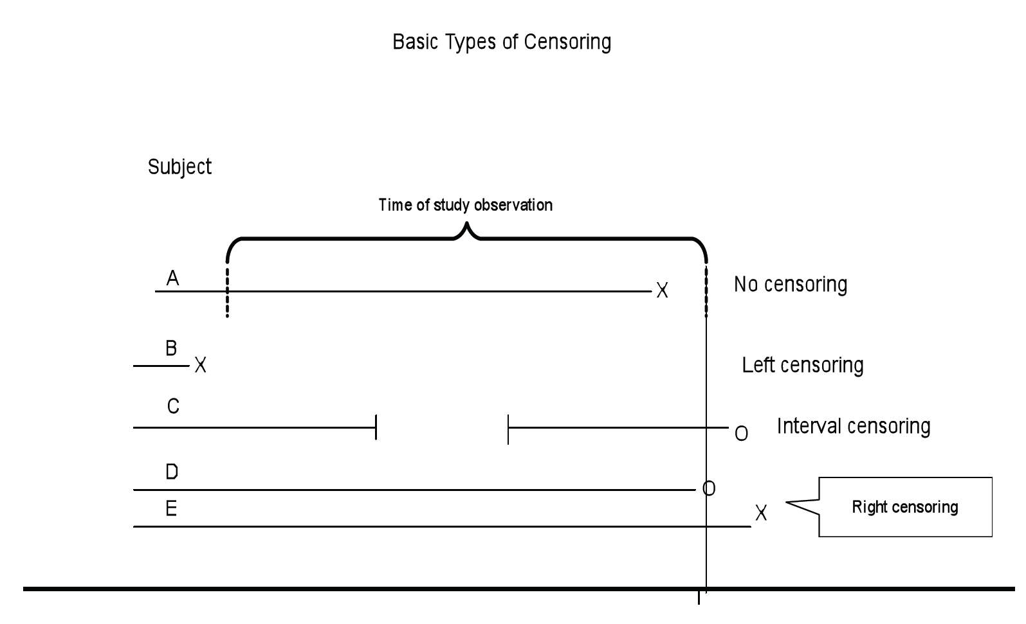
Definitions
Person time
Period of observation/follow-up-time. Starts when an individual joins
a study and stops when they experience the outcome of interest, or
are lost to follow-up of the follow-up period ends, whichever happens first
Censoring
Notes:
Period of observation/follow-up time/period at risk.
Often measured in years when it is called person-years-at-risk

Slide 9
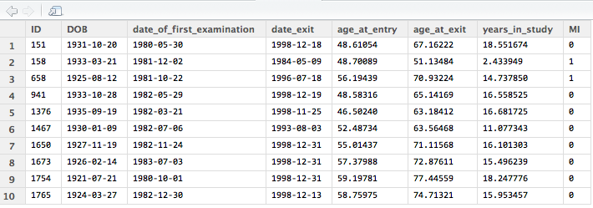
Calculating person-time and rates

Slide 10
Calculating person-time and rates
Person-years
Rate is estimated from the study data by dividing the total
number (d) of events observed by the total (T) of the individual
person-years of observation.

Slide 11
Confidence Interval for a rate
Notes:
Events follow a poisson distribution with mean (x) and variance (x).
It can be shown that we do not need to explicitly (on its own) consider thus variation in T
CI is can be derived from the s.e. in the usual way. However, it is preferable to work on the log scale and derive CI for the log rate and then antilog this to give a CI for a rate. The rationale is, this takes into account the constraint that the rate must be greater than or equal to 0. i.e if the se is large and the log is small the lower limit will end up including values <0 which should not be the case

Slide 12
Confidence Interval for a rate
Notes:
Events follow a poisson distribution with mean (x) and variance (x).
It can be shown that we do not need to explicitly (on its own) consider thus variation in T
CI is can be derived from the s.e. in the usual way. However, it is preferable to work on the log scale and derive CI for the log rate and then antilog this to give a CI for a rate. The rationale is, this takes into account the constraint that the rate must be greater than or equal to 0. i.e if the se is large and the log is small the lower limit will end up including values <0 which should not be the case

Slide 13
Confidence Interval for a rate
Error Factor, EF
Notes:
Events follow a poisson distribution with mean (x) and variance (x).
It can be shown that we do not need to explicitly (on its own) consider thus variation in T
CI is can be derived from the s.e. in the usual way. However, it is preferable to work on the log scale and derive CI for the log rate and then antilog this to give a CI for a rate. The rationale is, this takes into account the constraint that the rate must be greater than or equal to 0. i.e if the se is large and the log is small the lower limit will end up including values <0 which should not be the case

Slide 14
DeskWork

Slide 15
Comparing two rates
Rate difference
Rate Ratio
Confidence Interval for rate ratios

Slide 16
Rate Difference
Difference in rates of occurrence between two
groups (exposed/non-exposed) in the population.
Notes:
RR is an important indicator for causation. A RR above 10 would strongly suggest a causal relationship
Risk difference has a high public health implications than risk ratio. A high RR may not be of public health importance if the disease is very rare. The risk difference however measures direct disease burden and need for health services

Slide 17
Rate Ratio

Slide 18
Confidence Intervals for Rate Ratios

Slide 19
Z-test for the rate ratio
Example
Notes:
Wald test

Slide 20
Practical

Slide 21
Review of Practical

