Slide 1



BRAINLY CORE
2026
PARTNERSHIP HQ WEBSITE
BRAINLY HQ
Prepared by :
Mod Galaxxieyy

Slide 2

BRAINLY CORE
02
INTRODUCTION
Welcome to Partnership HQ. This website helps people connect, work together, and grow. We also give support, ideas, and opportunities for better partnerships.

Slide 3
BRAINLY CORE
03
ABOUT US
Partnership HQ is a project made to help people build strong connections and teamwork. Our goal is to create a friendly and helpful community where everyone can share ideas and succeed together.
Prepared by :
Claudia Alves

Slide 4

BRAINLY CORE
04
CATEGORIES ON THE WEBSITE
Put the following:
Projects
Partners
Services
News and Updates
Contact
Prepared by :

Slide 5
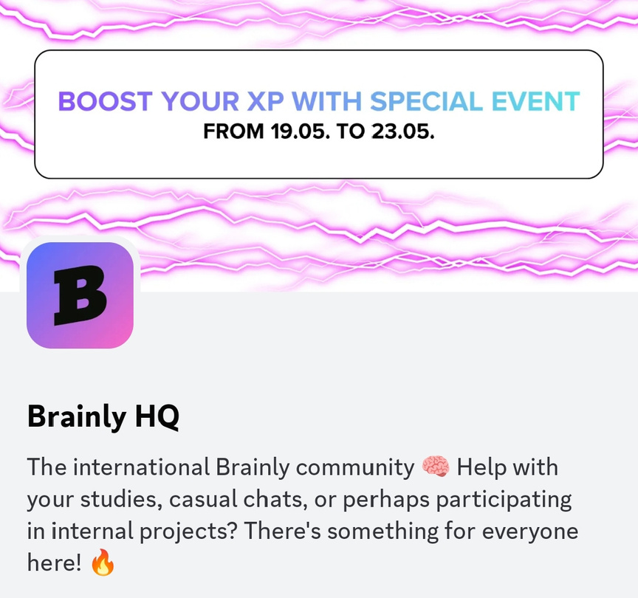
BRAINLY CORE
05
WHAT WE OFFER
We offer support for teamwork, project planning, communication, and partnership building. We also provide updates and opportunities that can help people improve their projects and ideas.
Prepared by :
Claudia Alves

Slide 6

BRAINLY CORE
06
REQUIREMENTS
People who want to join should be respectful, active, and willing to cooperate with others. They should also follow the rules and goals of the project.
Prepared by :
Claudia Alves

Slide 7
BRAINLY CORE
07
MISSION
VISION
Our mission is to help people build better partnerships through teamwork, trust, and communication.
Our vision is to create a community where people help each other grow and succeed together.

Slide 8
BRAINLY CORE
08
THANK YOU!
STAFF: MOD GALAXXIEYY

