Slide 1

Personal Booklist
ITC 4214 Internet Programming
Alexandros Synetos Konstadinidis
Orestis Papadopoulos

Slide 2

contents
sorting algorithm
jQuery effects
Bootstrap extras
functions per page
demonstration

Slide 3
Bubble Sort Flowchart
“So fast it can run an infinite loop in 6 seconds”

Slide 4

jQuery Effects
fading text
making text of links bold
animating cards

Slide 5
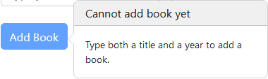
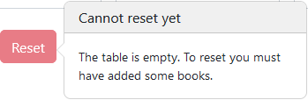


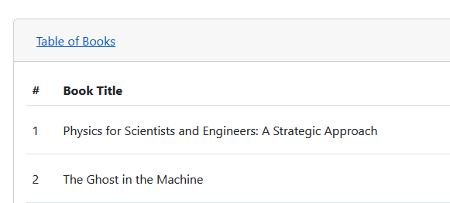
Bootstrap Extras
popovers
accordion

Slide 6
Functions
Index Page
About Page
enable/disable button
set table visibility
sort/reset table
create/delete row
set font bold/normal
change text value
animate card

Slide 7
demonstration
“I saw my life flash before my eyes
and all I could see was a close tag”

