Slide 1
Autistica Turing Platform
Requirements list

Slide 2
Contents
Platform pages and page-flows: content, community evidence, sources and resources
Landing Page
Sign-up flow
Sign-in
Enter experiences flow
View others’ experiences page
View own experiences page
Moderation flow
Settings page
About page
Additional design considerations
Style
Help
Accessibility

Slide 3
Landing Page
Navigation bar
* Login/sign-out
* Help
* Links to other pages
* Accessibility icon
* Text-to-voice/voice-to-text options
* Crisis support – we make it clear we don’t provide this but can link to other places
Title
Strapline
Engaging visual imagery or video
OH, Autistica and ATI logos
Call to actions
* sign up
* enter experience
* read experiences
* find out more
Information on:
* Project summary (inc. sensory processing)
* How it works – step by step
* Main goals – how it will help
* Autistic-first space with autistic community
* Reassurance about data: anonymous, you choose, no selling for profit
Get in touch
Give feedback

Slide 4
Naming and straplines
Although it’s not so much participatory science, Zooniverse has some examples of good simple taglines, calls to actions, and explanations for citizen science projects: https://www.zooniverse.org/
Sensory processing for accessible community environments I-SPACE
investigating sensory processing for accessible community environments
USPACE – understanding sensory processing for accessible community environments
Ideas for names:
(many existing websites, platforms, etc. for autistic people use Aut or Autis as a prefix – so this may be a familiar and effective pattern to adopt)
AutSPACE (sensory processing * autism * changing environments *)
BetterSense
SenseBook
SenseSpace
AutMirror
AutAuthors
Ideas for straplines:
“Building a better world for autistic people.”
“Improving environments for autistic people”
” Make spaces make more sense by sharing your stories”

Slide 5
Sign-up Flow
Sign-in integration with Open Humans: email and password
Explanation of why they’re going to Open Humans
Sign-up questions:
* Are you autistic?
* Are you the parent or full time carer of someone autistic?
* Are you answering on behalf of someone else?
* Option to describe other connection to autism (free text box)
option to sign up straight away or answer more questions
Additional demographic questions: *Ethnicity *Education *Income bracket *Gender identification *Sexuality
option to prefer not to answer for each question; option to self-describe for each question Sign up confirmation
easy navigation from confirmation page
Option to create a shared account?

Slide 6
Sign-up Flow
(A d): “I think it would be useful to create age brackets, because it would be extra data for the research…it could be that certain sensory processing difficulties present to the greatest severity in a particular age group – I think that would be very useful to capture”
(R T d): “you do need to consent to Open Humans holding your data, but you can use your Facebook or Google accounts to connect to Open Humans
(A d): sequential navigation, “it’s got to be… logical…if you do this option, take you to the next option”

Slide 7
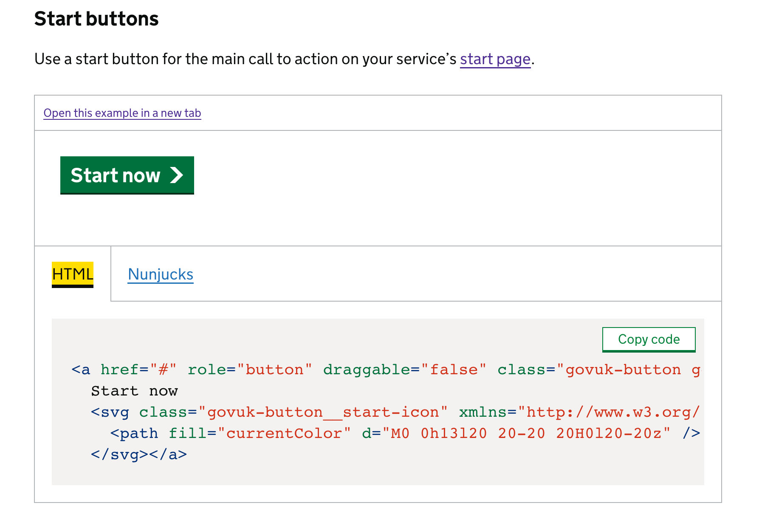
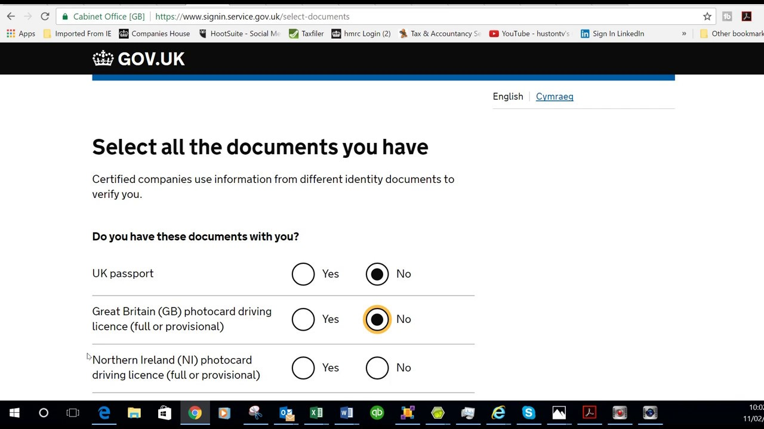
Sign-up Flow
* Fujitsu have created an integration with the Open Humans signup process which collects email and password for login purposes
* Gov.uk has open source code freely available for individual, well-evidenced and user-tested components that could be used for the sign-up flow
* Laura Crane may be able to provide ideas on how best to ask demographic questions
* Free reusable open source code for typeform-style surveys: https://github.com/ohmyform/ohmyform

Slide 8
Sign-in Flow
Take user details and log them into their private account via Open Humans
Explanation of why signing up via Open Humans (drop down?)
Help for forgotten usernames and passwords/for problems signing in
(check Open Humans process)

Slide 9
Enter experiences Flow
Asks user to enter experience
Asks user what would have made their experience better
Takes input
* free text
* structured input
* record videos
* record voice
* Option to upload extra files or other as supplement
Save option
Change permissions:
* for researcher
* share online
* share online only with autistic people
Add tags option
Review option
Submit option – let’s you skip the suggestions button
* consent (radio) button – second consent that appears if you’ve uploaded a video or a voice – research suggestion if not okay with consent statement
Suggestions button – continues to what would have been better page
Confirmation page
Easy navigation from confirmation page

Slide 10
Enter experience flow
Have different input options
(A g): “we want to make it as accessible to as wide a scope of the autistic community as we can”
(A d): “accommodate as many different preferences and styles for providing input within the realms of what’s actually achievable”
(A g): “…accommodate as many different preferences and styles for providing input within the realms of what’s actually achievable…some people would prefer the free text option…but others would like to be guided down a more structured process”
Free text
No word limit (A P d): “please don’t put a word limit, and especially not seeing it count down, because it’s very horrible
Structured input
(A d): split the question up: “Where were you? What time was it? What happened? What effect did it have? and What would you like instead?
(A P d): “you could give options for options, so you could say, for example, ‘would you like a template?’”
(A d): split the question up: “Where were you? What time was it? What happened? What effect did it have? and What would you like instead?”
Record (vid or speak); upload;
(A d): Have a non-verbal means of inputting information
(A d): “…having the option to…upload photos, or pictures, or voice recordings of people.”
Upload options
(A g): upload pictures of situations that were a problem, so that organisations can go onto the platform and easily see what to change, “because visual things can have much more impact than just…a dense script”

Slide 11
Have a question about solutions or ideas for improvements/what would have made it better
autistic people want to be part of the solution.
(A d): “…it’s crucial to have a field that can capture…learning and solutions”
(A d): there are two important aspects: what can autistic people do to change their environments, and what can autistic people do to protect themselves from their environments.
(A g): “if you’re autistic you want to know…[how] are other autistic people with their expertise…dealing with it? Have they got something to solve the problem?”
(A d): “I want to be able to say and this is what I think would have helped – you know, it may be that it’s not possible to do the thing, you know we can’t probably make the tube quieter very easily, but we do have ideas about what might help and we should be including those”
Able to save drafts and input experience after event
(R T d): drafts could be saved but would stay private, and would only be accessed by the person writing them
Other features - Hashtag
(P A d): highlight that as an option, “because I’m still very used to the hashtag”
Tag or hashtag option for people to search for experiences
Give clear confirmation once experience has been submitted.

Slide 12
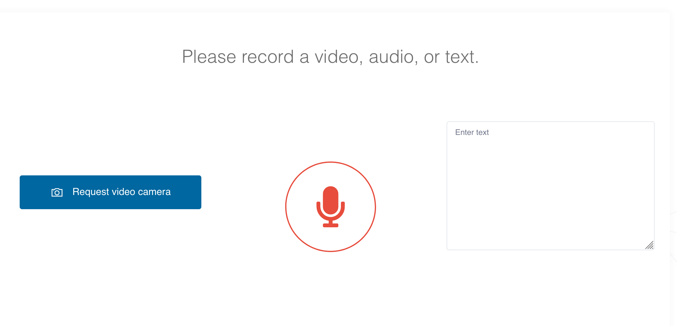
Enter experiences
Crisislogger: https://crisislogger.org/

Slide 13
View other’s experiences Page
Search function
Filter options
* Autistic-only
* Child-friendly (tag for adult content)
* No distressing experiences (tag for sensitive content)
See different kinds of input option
* All, or selection of:
* Text
* Videos
* Sound recordings
* Images
Display experiences
Option to flag for moderation
Sort by options
* Date
* Relevance
Option to save to personal page

Slide 14
View other’s experiences Page
Be able to search
Be able to filter out distressing experiences/self-censor
(A d): may cause additional stress: “don’t particularly want to be aroused, as it were, by reading about things”
(A d): include option to moderate out distressing or negative experiences: “if I’m feeling particularly stressed and I’m going to go on a platform, I don’t want to be reading…a lot of what went wrong on your day, I’d rather click on a button that filters to the – what happened, and what went well, and who accommodated you well”
Be able to filter autism-only experiences
Desire for an autism first space
Desire for relevance
(A d): “that would be good…if you’re an autistic person who wants someone to relate to…you can always filter it through to see personal perspectives, whilst…parents might be looking for a different thing”
(A d): “it’s very difficult to make a place welcoming to autistic people when you also have a lot of neurotypical people explaining about autistic people”

Slide 15
My Experiences Page
Private page
Shows list of experiences submitted or saved by user
Show status of experiences
Shows date or time stamp of when experience submitted
View full experiences
Edit experiences
Add tags
Change sharing permissions for experiences:
* Publish openly
* Only for research
* Only for autistic people
Delete experiences
Export button - share page with someone else or email to self
Allow someone else to edit/co-create page – toggle consent
View and edit tags created by machine learning algorithm as well as own

Slide 16
Crisis Support Page
Need other help
* Link to different websites which can offer advice on:
* medical issues
* diagnostic issues
* anxiety issues
* general autism information (Autistica)

Slide 17
My Experiences Page
(P A d): important to deliver on promises: prior experience of being incentivised to use an app (Molehill Mountain) because it promised to give a mood graph, and was frustrated when this wasn’t offered
Data visualisations
(A d): have graphs linking data
· (A P d): would help to trace causes and correlations based on patterns of occurrences
· (A P d): “…with the accumulation of data…you begin to see connections in your own life – and that adds value, you know you were talking about increments of value, but increments of value going both ways”
Be able to share page with others
(A d): make it something that an autistic person could use with their mentor – help create plans

Slide 18
Moderation flow (suggested steps)
User
Clear code of conduct written by autistic people
Guidelines for entering experiences on behalf of others
Things to consider when sharing experiences
Can see process steps clearly
Ability to see progress of own experiences being moderated
Information on moderation timelines (2-5 days?)
Ability to get in touch to ask for clarification or express concerns
Ability to flag comments for moderation
Ability to give feedback easily on code of conduct and make suggestions for improvements
Option to apply to be a moderator?
Moderator
Signup and onboarding process
Clear code of conduct
Clear process and steps
Can view an experience and assess it anonymously
Can publish experience if appropriate
Can reject experience if appropriate
Can invite people to become moderators?

Slide 19
Moderation flow
Clear code of conduct written with Autistic people based on existing models
(A d): clear instructions, “I think you need to have a very, very clear set of rules”
(A d): rules should use autism-friendly language
(A d): Should reflect people who contribute “I think that it should be a mixture of people, people who are autistic and maybe parents of autistic people, because then it’s a wider scope…if there are gonna be parents, guardians, etcetera…who are contributing, advocating for the autistic person that they care for, that are in their lives…then there needs to be people who are also in that category to moderate, not just coming from an autistic person and vice versa”
(A d): important to have more than one person look at each comment
(R T d): This could be a branching option, where moderators could select other moderators, and is therefore quite scalable
(R T g): try to make sure that panel is representative of, not just autistic people but different cross-sections, because they will have more diverse lived experience
(R T g): “that could be a key feature of the platform’s code of conduct”
(A d): “I think that needs to be a feature in there somewhere, think about how you word it”
(A d): use existing guidelines as template: “I wouldn’t want to start from scratch, obviously, I’d want to know what is the process for moderating social media, what are the rules, and how might we want to tailor that to this circumstance”

Slide 20
(A d): Should reflect people who contribute “I think that it should be a mixture of people, people who are autistic and maybe parents of autistic people, because then it’s a wider scope…if there are gonna be parents, guardians, etcetera…who are contributing, advocating for the autistic person that they care for, that are in their lives…then there needs to be people who are also in that category to moderate, not just coming from an autistic person and vice versa”
(A d): important to have more than one person look at each comment
(R T d): This could be a branching option, where moderators could select other moderators, and is therefore quite scalable
(R T g): try to make sure that panel is representative of, not just autistic people but different cross-sections, because they will have more diverse lived experience
(A d): “it’s very difficult to make a place welcoming to autistic people when you also have a lot of neurotypical people explaining about autistic people”
(R T g): “that could be a key feature of the platform’s code of conduct”
(A d): “I think that needs to be a feature in there somewhere, think about how you word it”
Use existing model
(A d): use existing guidelines as template: “I wouldn’t want to start from scratch, obviously, I’d want to know what is the process for moderating social media, what are the rules, and how might we want to tailor that to this circumstance”
(A d): “I think you have to work on the basis, unfortunately, that every single corner of the internet which doesn’t have moderation just seems to fill up with Nazis, they’re everywhere, and it happens in the most unlikely places, so I would say at least for the first couple of times you need to moderate the users”
(P d): debates about autistic identity: “you can easily cause offense. very, very quickly, so there’s a danger that you could just get into whirlpools of this kind of stuff”)

Slide 21
Moderation flow
Adapt existing code of conduct (e.g. AutAngels code of conduct: https://www.autangel.org.uk/), Autistica’s) with autistic people and parents
Co-create guidance for answering experience on behalf of others
What we should moderate for:
* Take out personally identifying information
* Moderate for: sexist, racist, discriminative language or language harmful to autistic people
* Compromising information
* Have autistic moderators
* Moderators should also tag potentially distressing experiences, and adult content
Next Step: collaboratively create a code of conduct and define moderation process concretely

Slide 22
Settings Page
View profile
Change signup information answers
Customise platform
* colour palette
* contrast,
* text size
* default input mode
* default view modes
Accessibility settings
Help with platform
Need other help
* Link to different websites which can offer advice on:
* medical issues
* diagnostic issues
* anxiety issues
* general autism information (Autistica)
Get in touch
Logout

Slide 23
Settings Page
Chris has designed and researched lots of accessibility features
He has also designed a useful settings menu
Also help functions
“Get in touch” should go via. Open Humans system so that it remains anonymous

Slide 24
About Page: suggested content * Project news and updates
* Testimonials
* How it works
* Our main goals * Overview of project
* Sensory processing info * About our community
* Autistic citizen scientists
* Researchers
* Organisations
* Alan Turing Institute
* Autistica
* Open Humans * How AutSPACE was created (participatory science) * Code of Conduct
* Guidelines on sharing on behalf of others * How we moderate – simple diagram * What happens to your data – simple diagram, privacy notice and GDPR
* Open Source (and link to GitHub repositories)
* Get in touch
* Give feedback
* Newsletter sign up
* Resources/links to external resources for concerns, e.g. welfare concerns

Slide 25
About Page
(R T d) show videos of people contributing in different ways and maybe for different reasons on the about page – “I’m imagining a vignette…of three different people…who take part for different reasons, with the idea that you should totally see some aspect of yourself across those three”)
Include lots of useful information
* Up-to-date with current research and proposals
* Info about individuals involved
* Info about participatory science and how it wa built
* Refer to other website for crisis management tools, calm, help etc.
Make clear not interested in profit
* (A g): Concerns about commercial use: “[put] a ringfence around potential commercial uses, because this is intelligence which commercial interests might want to get their hands on”
* (A i): “people might be wary of contributing, because they might think people just want to make money out of my vulnerabilities”
Lots of people prone to information overload – make this clean, and divide into near, clear sections!
h) What would help?
(A d): “if you were concerned about the welfare of someone… a section if you need advice or if you need help”

Slide 26
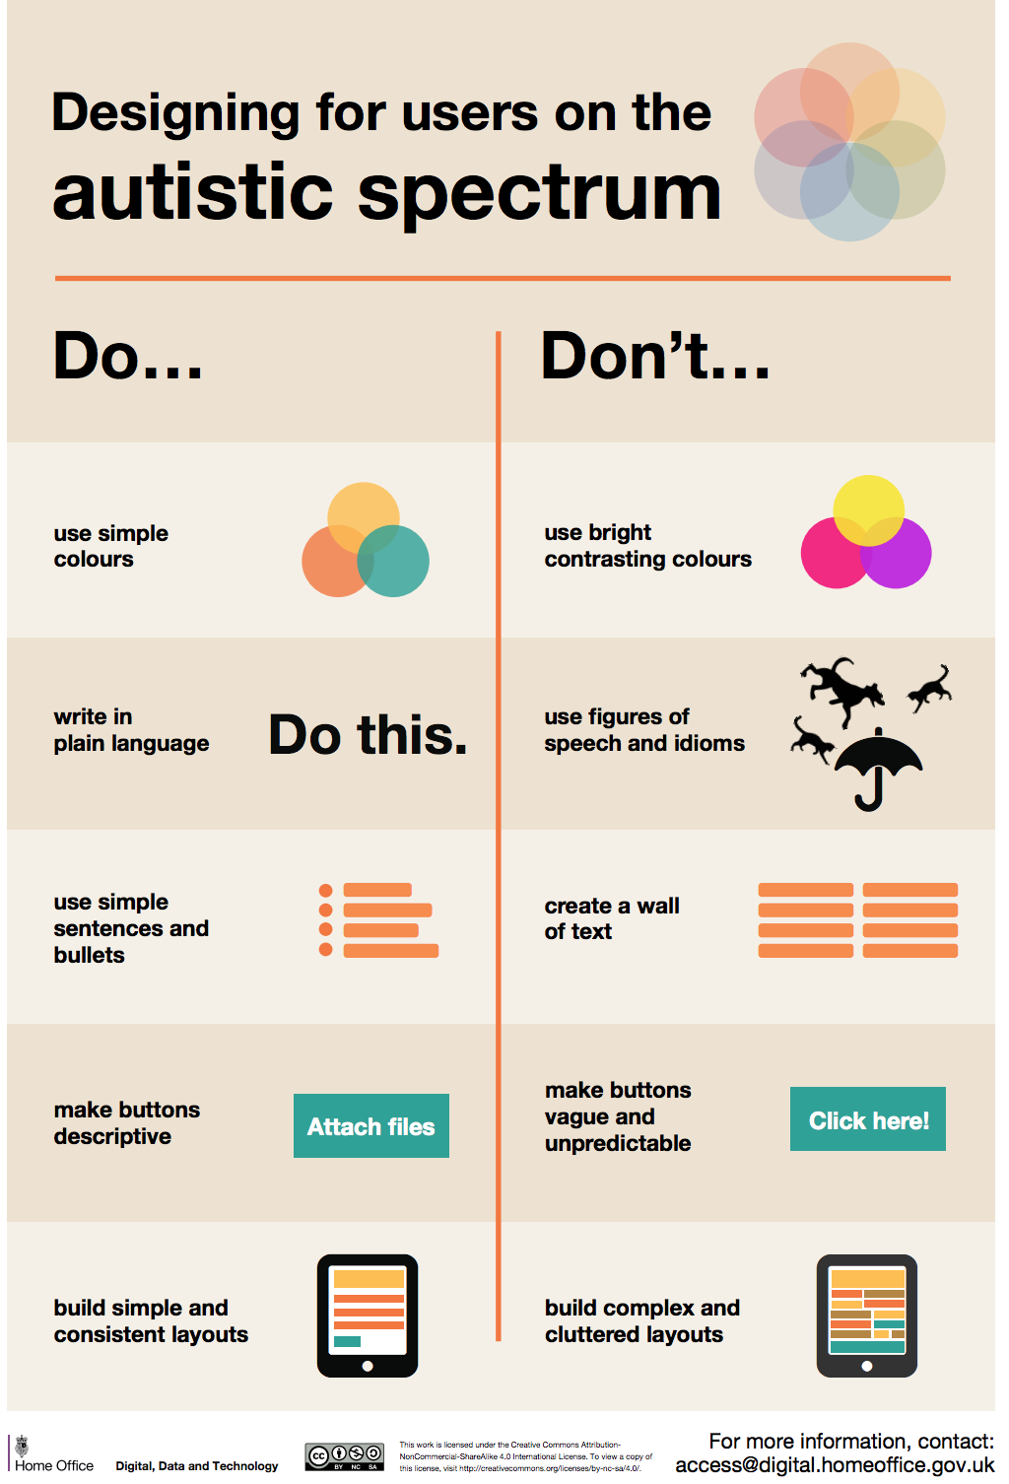
Additional design considerations
* autistic people can be overwhelmed by too much information on one page: clear, clean, logical and sequential design.
* simple words, no metaphors (get help from Rebecca Sterry)
* step-by-steps and diagrams
* accessible (incorporate Chris’ work)
* not too high contrast (too bright a screen can cause pain to some autistic people)
* adapts to different screen sizes well (phone, website, ipad)
* option to ask real people for help
* must contain voice-to-text and screen reader capabilities
* make motivation salient
* no word limits/counts
* no bewildering alerts or prompts that may provoke anxiety
* no time countdowns
* Help and guidance options

Slide 27
Additional design considerations
(A P d): “that actually matters to me because I… switch between android and iPad, and It’s how I choose to live my life, but it can be annoying when things don’t work out”
(A d): bring one thing up at a time
(A d): “just one thing or question or visual per page, and then…press next”
Back-to-top button
(A d): “the words used, or any writing used” should be “well-spaced out and in a good font that anyone could read - and obviously a screen reader could pick out as well”
(A d): make a button you can press for help to come up
(P d): Have a tagline: “this is what we’re looking for, this is what we want from you, and this is what we’re going to do, and don’t be afraid to repeat yourself just literally on every page like, this is what we want, this is what we need from you, this is what we expect from you”
(A d): “I’m very prone to information overload, so I would want from my point of view this default interface to be as plain and un-distracting as possible…I wouldn’t want something that was busy and distracting, it just needs to be focussed on the content.
Blog by an autistic UX designer: https://uxmastery.com/researching-designing-for-autism/

Slide 28
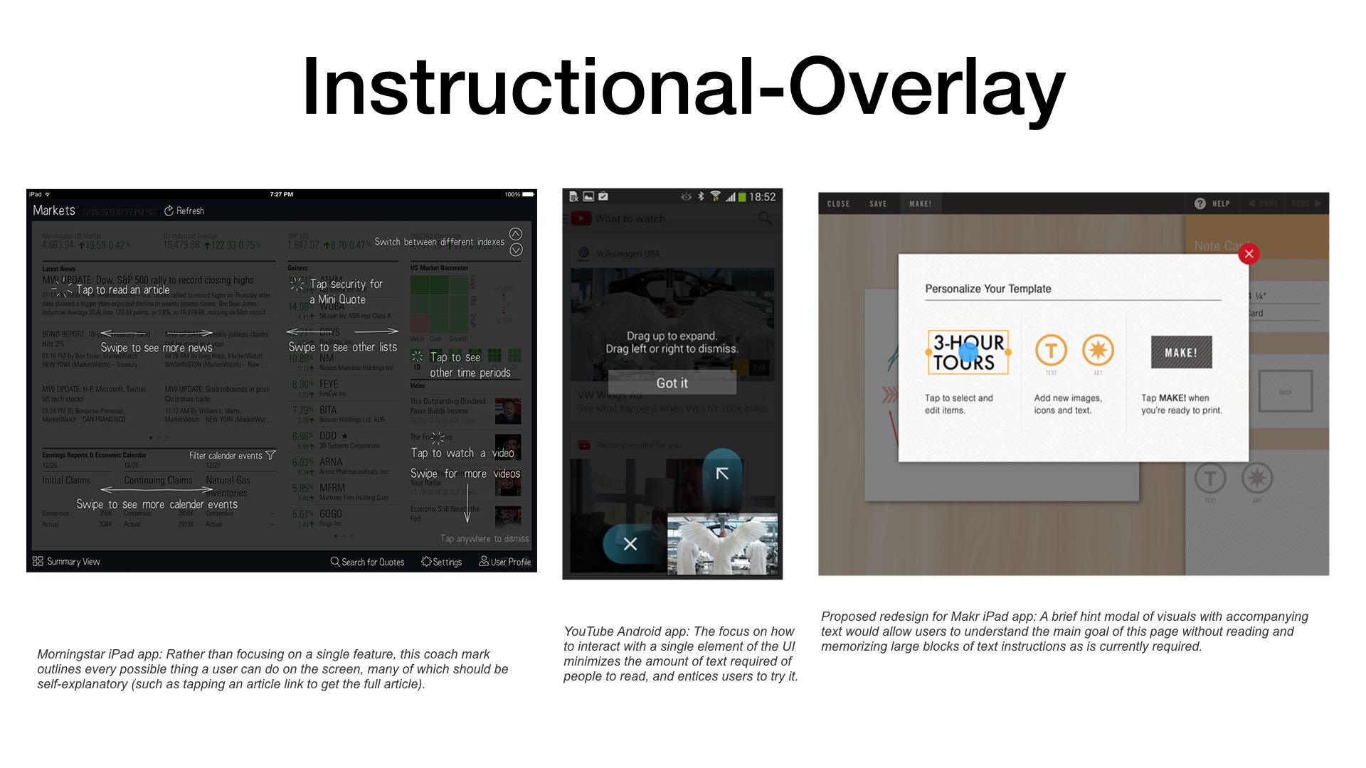

Slide 29
Additional design considerations
Use Chris’ Accessibility Menu: https://5wwsja.axshare.com/#g=1&p=1-settings
Screen reader options: https://5wwsja.axshare.com/#g=1&p=0-home-light-screen-reader-option-2

Slide 30
Next Steps:
Determine first iteration of platform components
Create visual wireframe
Retrieve useful design work and code from Fujitsu team
Find existing open source code which can be used or adapted
Write text for pages (and test)
Autism researchers’ – input
Co-create code of conduct
Co-create guidelines for entering on behalf of others
Define moderation process for platform
And recruit moderators
Define moderation process for research submissions
Create prototype (and test)
Get ethics approval to collect data
Turn prototype into working website
Launch
Publicise
Iterate

Slide 31
Simple Story:
User: Autistic adult, mid-thirties, in full time work
Desire: To use the platform to share with researchers her experience with the morning commute.
Journey:
1. After work, goes to landing page, logs in,
2. Goes to “share experience” page.
3. Enters text: “The sound is painful on the train so I wear noise cancelling headphones:
4. Presses submit
5. Receives confirmation story is submitted.
6. Can then add another experience, or edit the text or sharing permissions of the one already submitted.

Slide 32
Navigation Bar
QUESTION TEXT
CREATES TAG FOR JSON FILE
IF SHARE PUBLICLY OR WITH AUTISTIC USERS GOEES TO A MODEERATOR
Write:
Share for research
Share publicly
Share with autistic users
STORES AS JSON FILE IN BACKEND OH (SQL) DATABASE + “MY PAGE”
USER GOES TO CONFIRMATION PAGE
SAVE
SUBMIT
STORES TEXT AS JSON FILEE AND TEXT + OPTIONS APPEARS IN “MY PAGE”
Notes:
If no text is added, file cannot be submitted – user is reminded to enter text in text box
If no sharing option is selected, user is presented with choices again when they click submit. If they again choose not to share with anyone, there story will be saved on “My Page”

