Slide 1
Multi-label actor-action classification
Team: VisualCortex
Members: Bin Yang, Ruitao Lin, Zhexin Xu

Slide 2
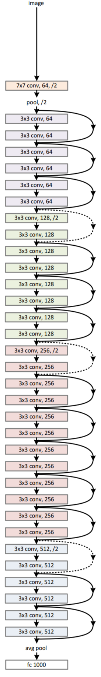
PCD
Conv1
Bn1
Relu
Maxpool
Image
Layer1
ResNet 152
Obtain feature vector
Avg_pool
Layer2
Base feature
FC
Feature detector
Softmax
Layer3
Output
Layer4
Top feature
ResNet 34, from He et al, Deep residual learning for image recognition.

Slide 3
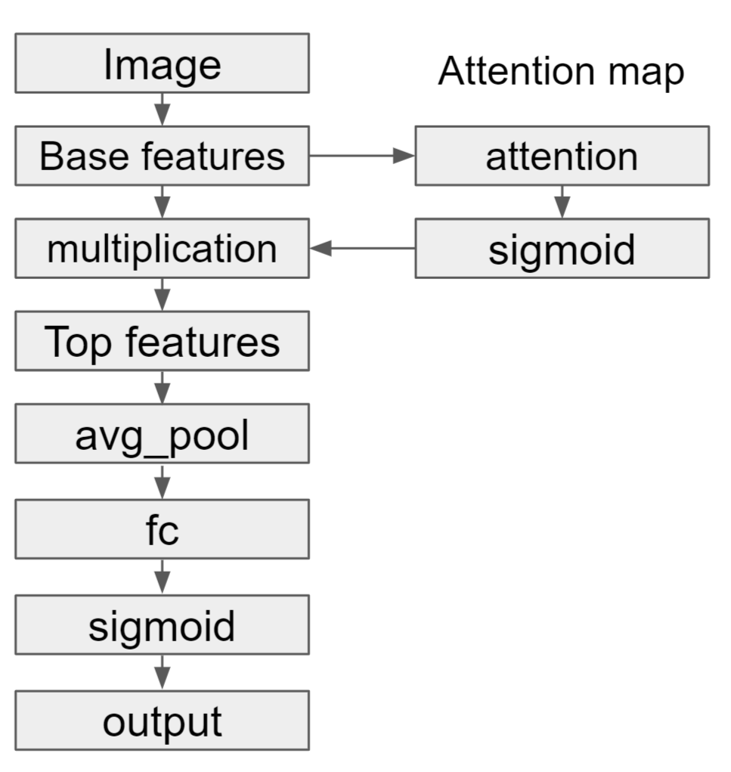
PCSA

Slide 4
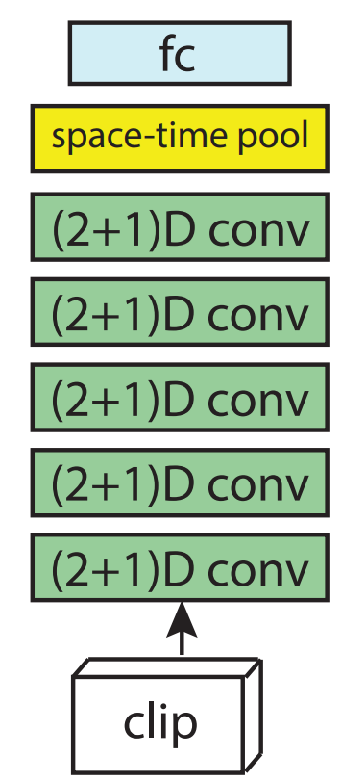

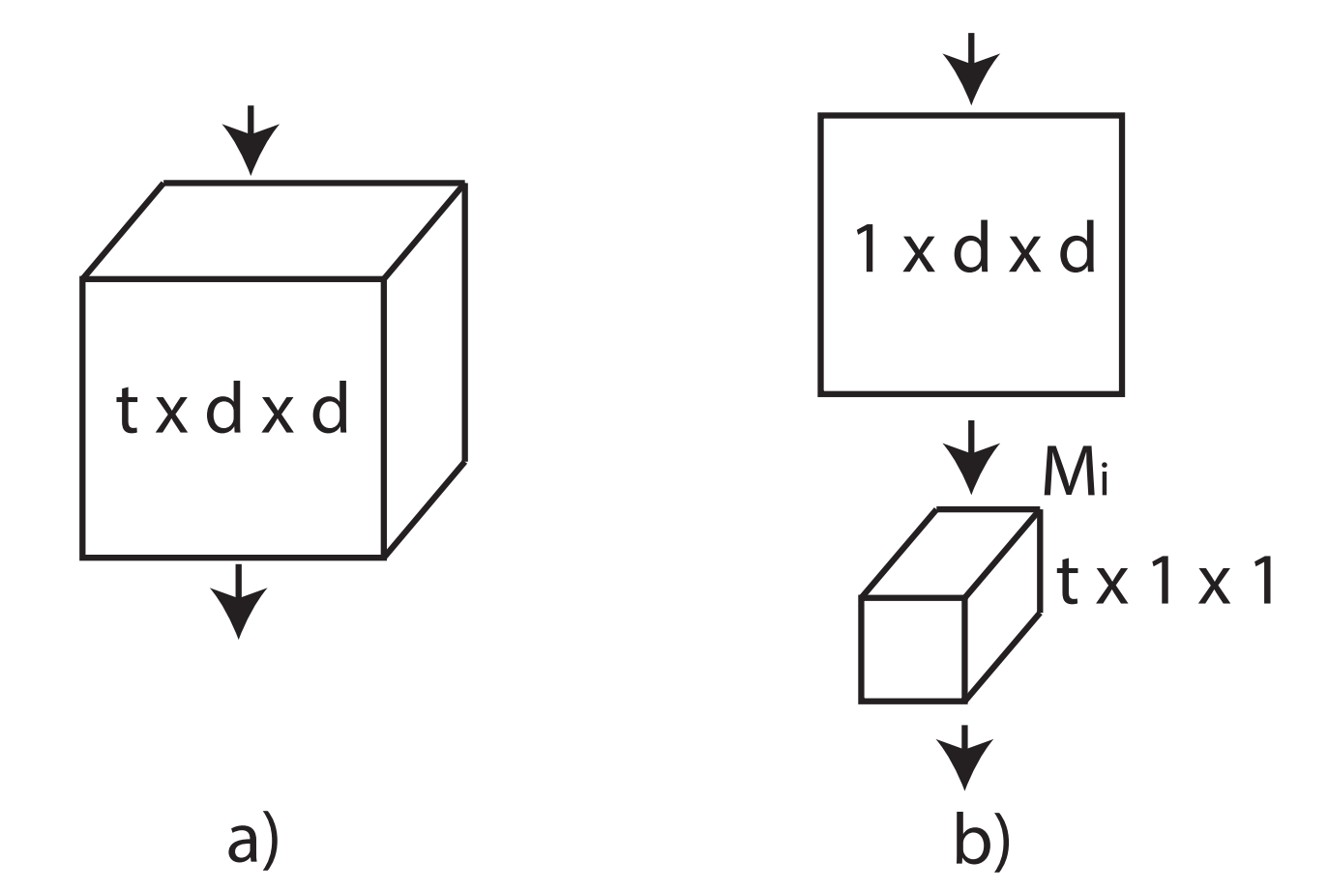
PCD-R(2+1)D
43 classes
1
0
...
Softmax
Detectors
2048×86
R(2+1)D
with initial parameters trained on Kinetics-400
3D Conv
(2+1)D Conv
R(2+1)D-18
PCD-R(2+1)D
Tran et al. 2017. A Closer Look at Spatiotemporal Convolutions for Action Recognition

Slide 5
Novelty

Slide 6
Performance

