Slide 1
Mental Health Prediction based on Smartphone Usage using Machine Learning
Submitted in the partial fulfillment for the award of the degree of
BACHELOR OF ENGINEERING
in
COMPUTER SCIENCE AND ENGINEERING
WITH SPECIALIZATION IN INTERNET OF THINGS
Submitted by:
NIMIT GARG (21BCS4626)
REYAAN SACHDEVA (21BCS5381)
Under the Supervision of:
MR. ANKUR SHARMA
Department of AIT-CSE
DISCOVER . LEARN . EMPOWER

Slide 2
Outline
Introduction to Project
Project Scope & Objectives
Project Implementation Plan
Methodology used
Features Analysis of Project
Results and Outputs
Conclusion
Future Scope
References

Slide 3
Introduction to Project
This project endeavors to build a predictive model for mental health estimation based on phone usage by analyzing diverse lifestyle factors, particularly stress levels. The dataset includes information from participants, considering age, gender, and occupation (Student, Corporate, Others), among other factors. Employing different machine learning models, the project aims to correlate these inputs with self-reported stress scale responses and physiological indicators.
Focused on stress prediction as a proxy for mental well-being, the project emphasizes ethical considerations, ensuring participant privacy. Real-world applications span personalized interventions in counseling, corporate wellness programs, and targeted healthcare strategies, addressing the critical intersection of mental health awareness and technology's role in stress comprehension.

Slide 4
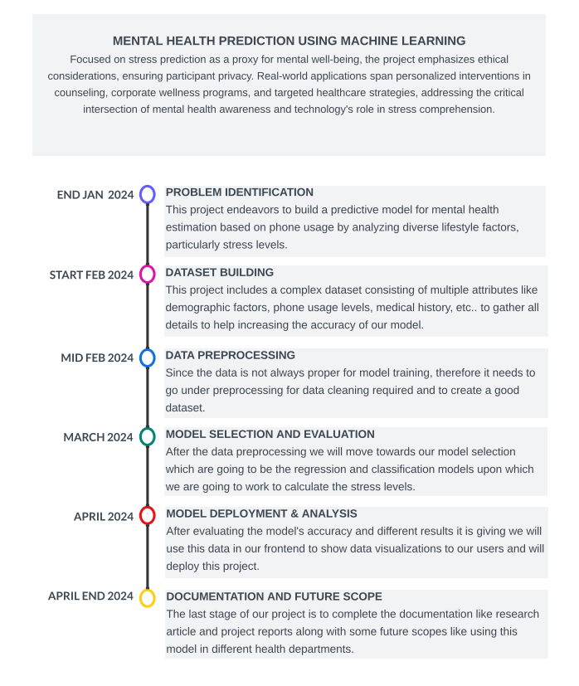
Project Timelines

Slide 5
Project Scope & Objectives
Comprehensive Data Collection
By gathering diverse data from different datasets available and survey from participants, including age, gender, occupation, sleep patterns, physical activity, and dietary habits, the project will encompass a wide range of lifestyle factors to ensure a comprehensive dataset for mental health analysis.
Development of Predictive Model
Build a machine learning classification model to predict individuals' mental health based on sas-sv scale and utilize advanced algorithms to establish correlations between lifestyle factors, stress responses, and physiological indicators.
Ethical Data Handling
Prioritize ethical considerations, ensuring participant privacy and responsible data handling and implement stringent data protection measures to safeguard sensitive information and comply with ethical guidelines.

Slide 6
Project Scope & Objectives
Real-world Applications in Mental Health
Provide practical applications for mental health support in counseling, psychology, and medical science. The project's outcomes will extend to personalized interventions, wellness programs, and healthcare strategies, addressing the real-world implications of mental well-being.
Intersection of Technology and Mental Health Awareness
Address the evolving role of technology in enhancing mental health awareness. The project acknowledges the critical intersection of technology and mental health, emphasizing the potential for technology to contribute to a deeper understanding of stress factors and mental well-being.

Slide 7
Methodology used
Data Collection
Gathered raw data from various sources, like surveys and generated using ai platforms encompassing phone usage metrics and self-reported user information.
The attributes included in the dataset contains demographic data, medical histories, screen times, their interpersonal and social attributes, etc.
Data Preprocessing
Conducted meticulous manual correction of data entries to rectify inaccuracies and enhance dataset quality.
Addressed outliers and inconsistencies through careful examination and correction procedures.
Introduced a systematic categorization scheme for sleep duration, classifying data into distinct ranges for analytical clarity.
Applied a similar approach to screen time, categorizing usage patterns into ranges to facilitate meaningful analysis.

Slide 8
Methodology used
Model Evaluation
Utilized a set of predefined metrics to evaluate the different model's performances accurately, to decide the suitable classification model, i.e. Gaussian Naive-Bayes model, Random Forest and SVMs which could be used.
Metrics included accuracy, precision, recall, and errors, providing a comprehensive understanding of the model's predictive capabilities.
Employed cross-validation techniques to assess the model's consistency and reliability across different subsets of the data.
Limitations and Future Work
Acknowledged inherent limitations in the methodology, such as potential biases in the dataset and assumptions made during model development due to the synthetic data used.
Identified areas for future improvement, including the exploration of additional features and the incorporation of more diverse datasets and found out the areas where real time implementation can be done.

Slide 9
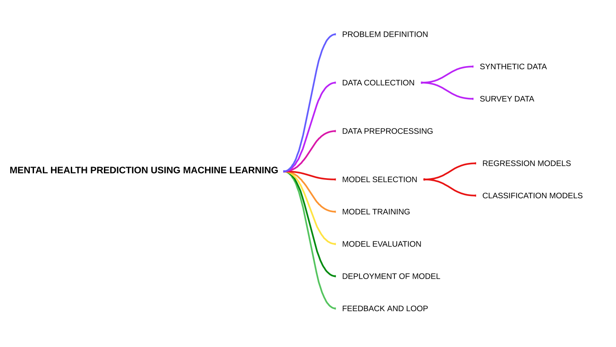

Slide 10
Characteristics Identification
Data Attributes
We have different types of data attributes collected in multiple scales like PHQ-9, GAD-7 and SAS-SV.
For example - Demographic Attributes like name, age, gender, etc. , Different binary attributes related to these questionnaires like in PHQ-9, we have taken 9 different scores one for each question , in GAD-7 we have taken 7 scores 1 for each question.
If we talk about the SAS-SV we have used different demographic attributes like name, age, gender, and then attributes like Screen Time, Social Engagement,etc.
Machine Learning Algorithms
We are using different classification algorithms like random forest classifiers (RFCs) and Support vector machines (SVMs).
In SVMs we have used different kernels like polynomial, gaussian and linear to find the model with best accuracy and precision.

Slide 11
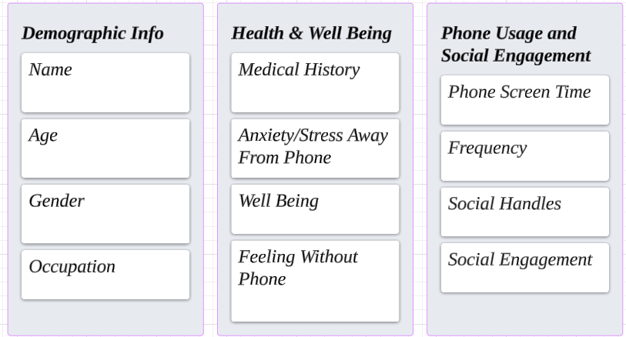
Characteristics Identification

Slide 12
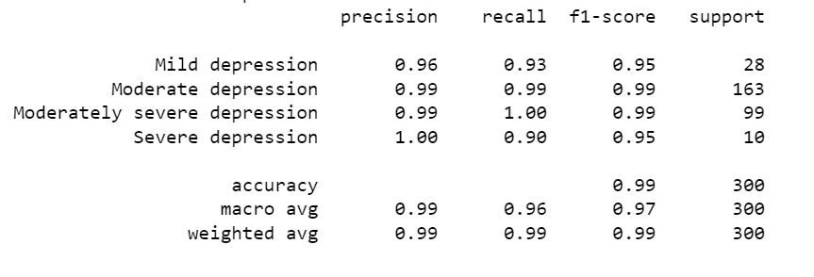
Characteristics Identification
Evaluation Metrics
We have used model classification report for defining the evaluation metrices of each model used.
Different matrices included in this classification report are accuracy, precision, recall, etc..

Slide 13
Features Analysis
Phone Usage Metrics
Screen Time: We are analyzing the screen times of users as they tell us about the phone usage habits of a user which are the main focus of our project.
App Categories: We will analyze the different categories of apps used by user to indicate the bad usage which can be avoided to improve their mental health.
User-Provided Information
Field of Study: Field of study plays a important role as it signifies the amount of usage a user should have like in marketing and computer science the usage is itself going to be high as compared to other fields thus contributing in model building.
Sleep Duration: Sleep duration plays a significant role in deciding different effects on mental health of a user. Less sleep duration for continous days can have a bad impact on our mental health increasing stress, anxiety and depression levels.

Slide 14
Features Analysis
Feature Engineering Insights
Expected Screen Time Usage: We have calculated a value names expected screen time usage which depends on field of study like for marketing , business and computer science fields the expected screen time is supposed to be high as compared to other fields.
Categorized Sleep Duration: We have also categorized the sleep duration in multiple ranges like below 5 hours, 5-9 hours and above 9 hours to make it easy to apply conditional changes.
Visualizations & Iterative Analysis
Correlation Heatmaps: We will be using different correlation matrices and heatmaps to visualize the different features and how they are connected to each other and when these different features are combined they are more likely to act better when used in a model.
Continuous Refinement: At last continous feedbacks from users and iterative analysis of features would make model more and more better in the future and will be applicable in different real time application.

Slide 15
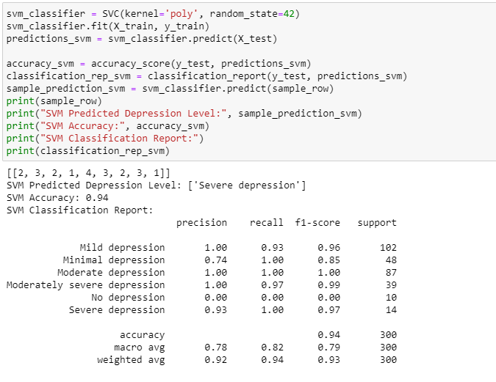
Results and Outputs
PHQ-9

Slide 16
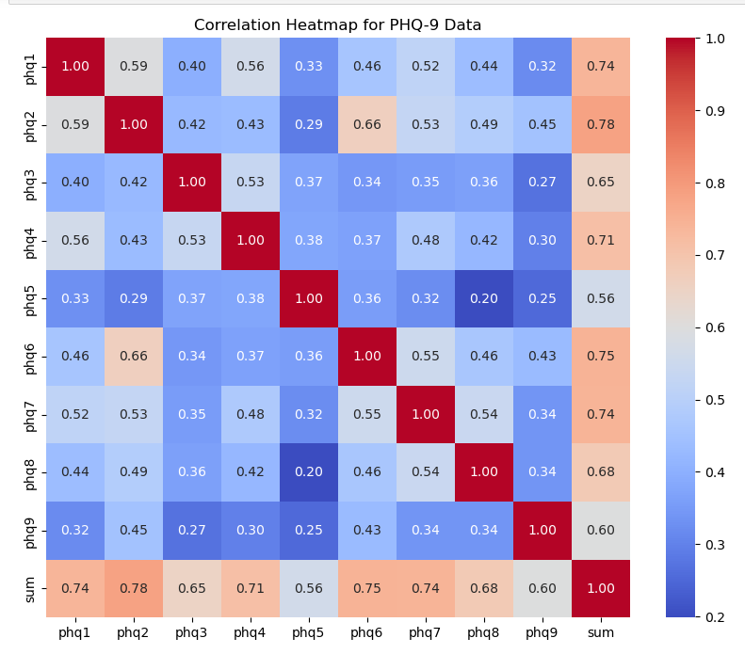
Results and Outputs

Slide 17
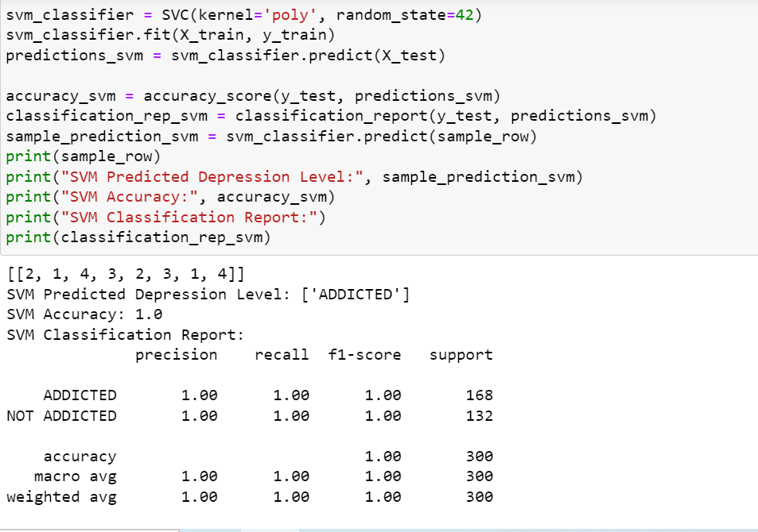
Results and Outputs
SAS-SV

Slide 18
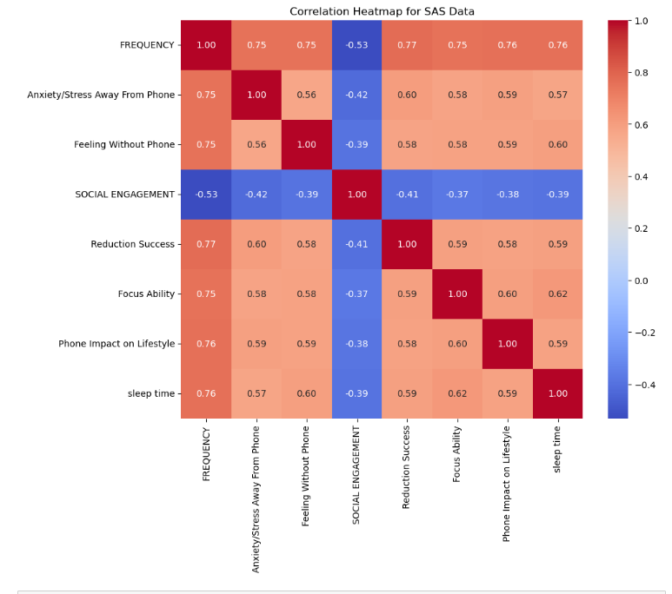
Results and Outputs

Slide 19
Conclusion
Predictive Modeling for Mental Health Assessment: Leveraging machine learning techniques, we explored predictive models for mental health assessment using three widely recognized scales: SAS-SV for smartphone addiction, PHQ-9 for depression severity, and GAD-7 for generalized anxiety disorder.
Clinical Utility and Implications: The predictive models demonstrated promising performance in detecting and assessing mental health conditions, offering potential benefits for early intervention and personalized treatment planning.
Future Directions and Considerations: While our study yields valuable insights, further research is warranted to enhance model accuracy, generalizability, and interpretability. Future efforts may focus on refining predictive algorithms, validating models across diverse populations, and integrating additional psychometric scales for comprehensive mental health assessment.

Slide 20
Future Scope
Longitudinal Studies and Real-Time Monitoring: Conduct longitudinal studies to track changes in mental health symptoms over time and develop real-time monitoring systems for early detection of relapse or deterioration.
Incorporation of Advanced Analytics Techniques: Investigate advanced analytics techniques such as deep learning, natural language processing (NLP), and graph analytics to uncover hidden patterns, relationships, and risk factors in mental health data.
Collaboration with Mental Health Professionals and Stakeholders: Foster collaboration between data scientists, mental health professionals, policymakers, and community stakeholders to co-create innovative solutions, address emerging challenges, and promote mental health awareness and advocacy.

Slide 21
References

Slide 22
THANK YOU!

