Slide 1
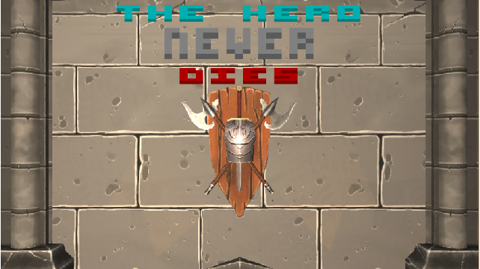
DESIGN, PUBLICATION AND PRODUCTION OF A MINIMUN GAME

Slide 2
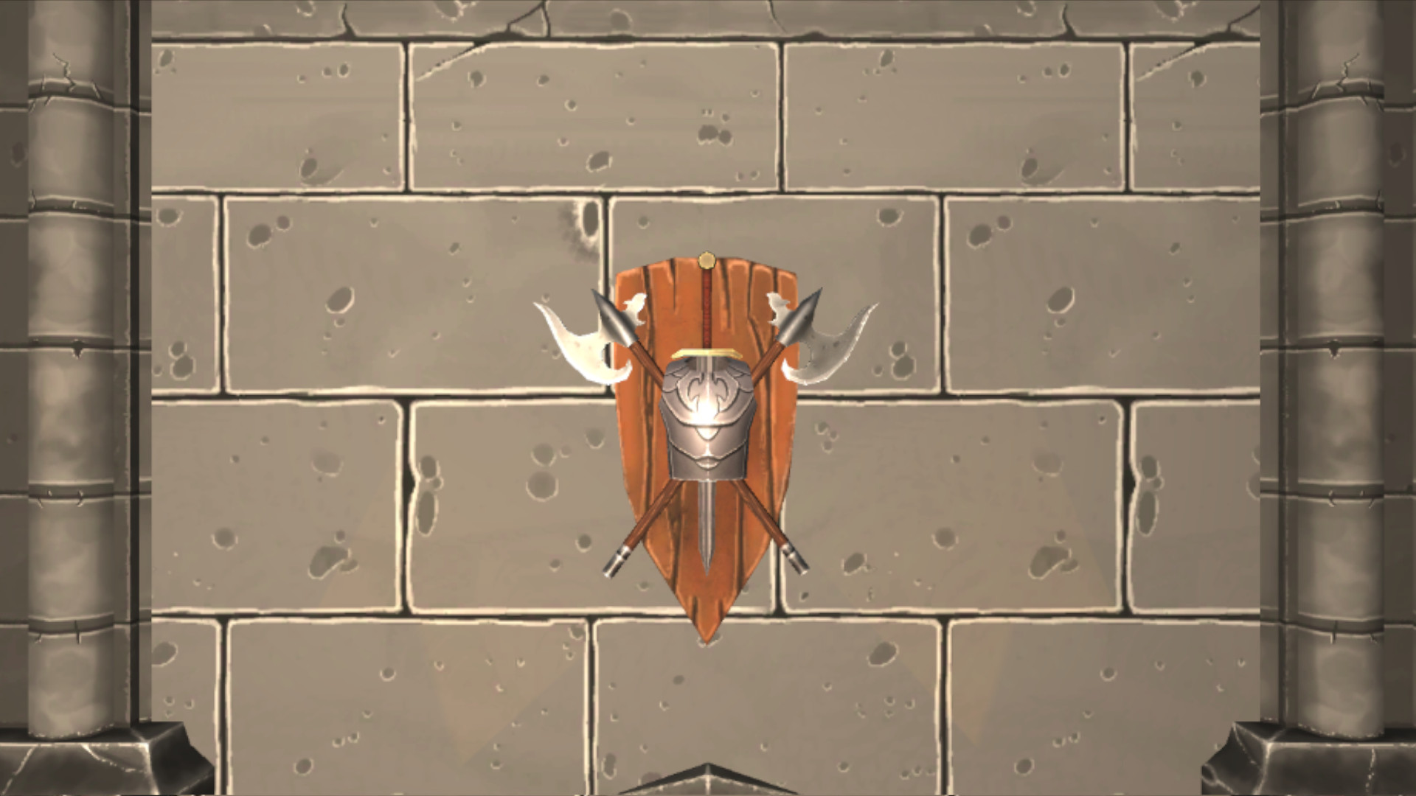
BASIC IDEA
“BECOME THE FINAL BOSS”
Reverse the traditional roles of protagonist and villain in videogames by making the player take control of a character that would be the Final Boss in any other game.

Slide 3
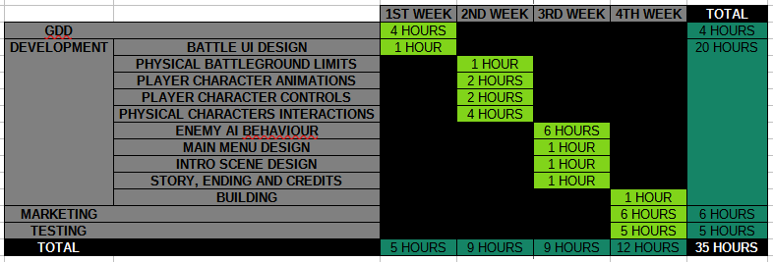
DEVELOPMENT

Slide 4



MARKETING

Slide 5
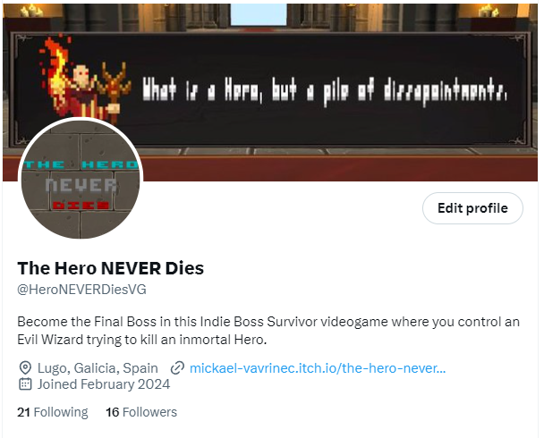
TWITTER

Slide 6
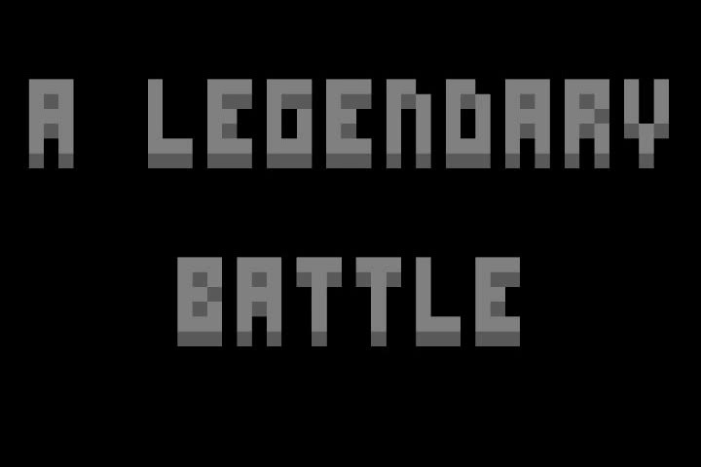
YOUTUBE

Slide 7
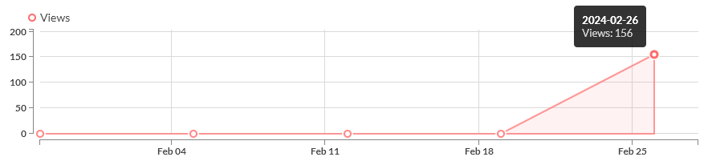
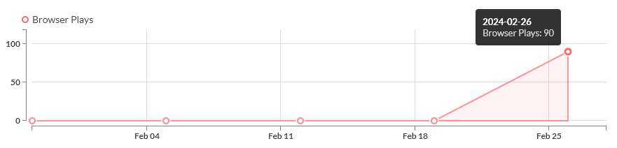
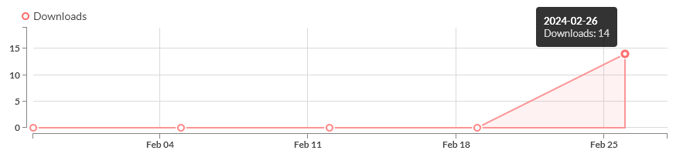
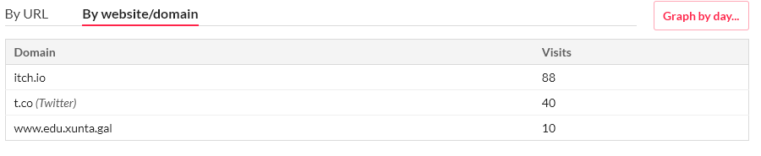
ITCH.IO

Slide 8
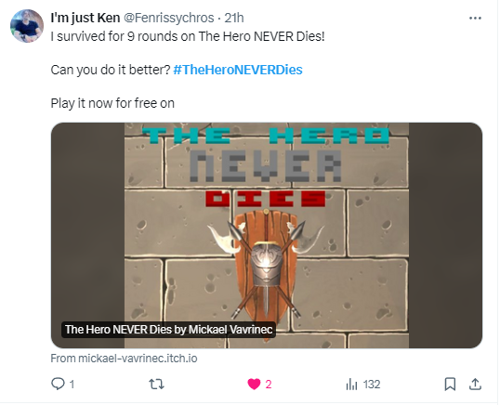
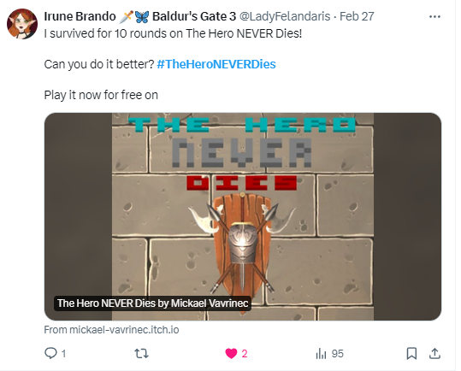
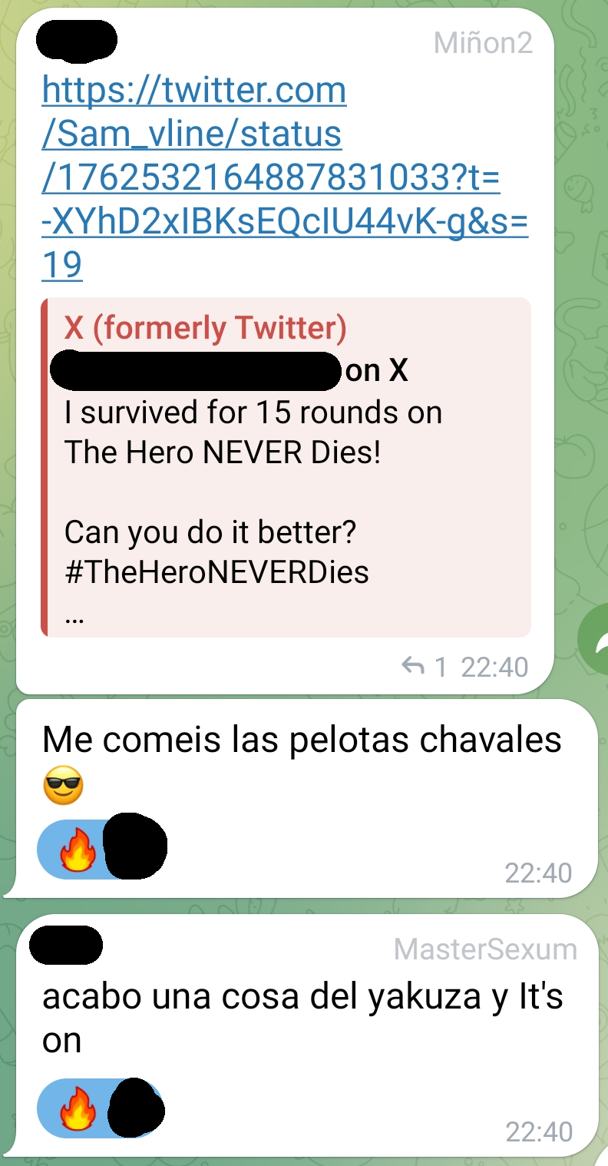
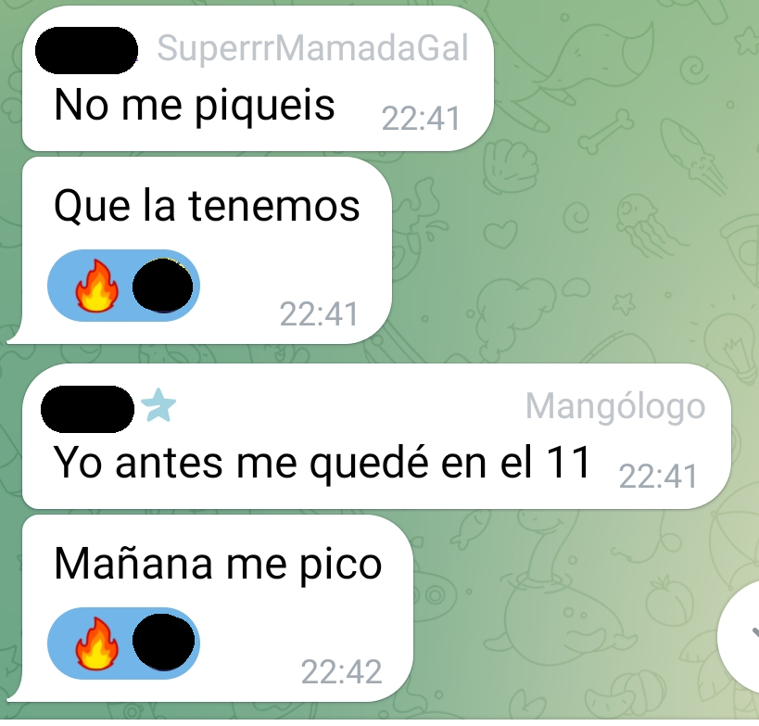
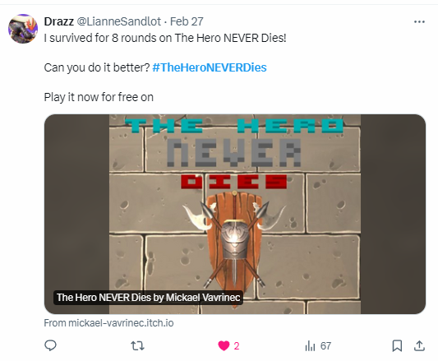
RECEPTION

Slide 9
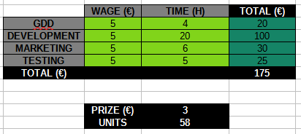

KPI AND COSTS

Slide 10
CONCLUSIONS
PROS
CONS
Positive reception and good feedback.
Marketing was mistaken with a professional one.
Motivated to keep working on the project.
Narrative was a failure.
Marketing could have been not enough.
Players had a poor User Experience.

