Slide 1
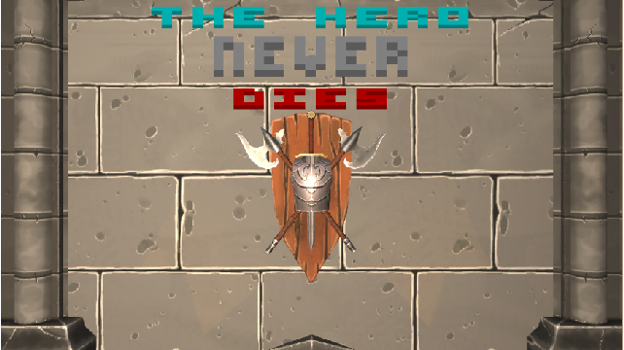
PROXECTO DE DESEÑO, PUBLICACIÓN E PRODUCCIÓN: O XOGO MÍNIMO

Slide 2
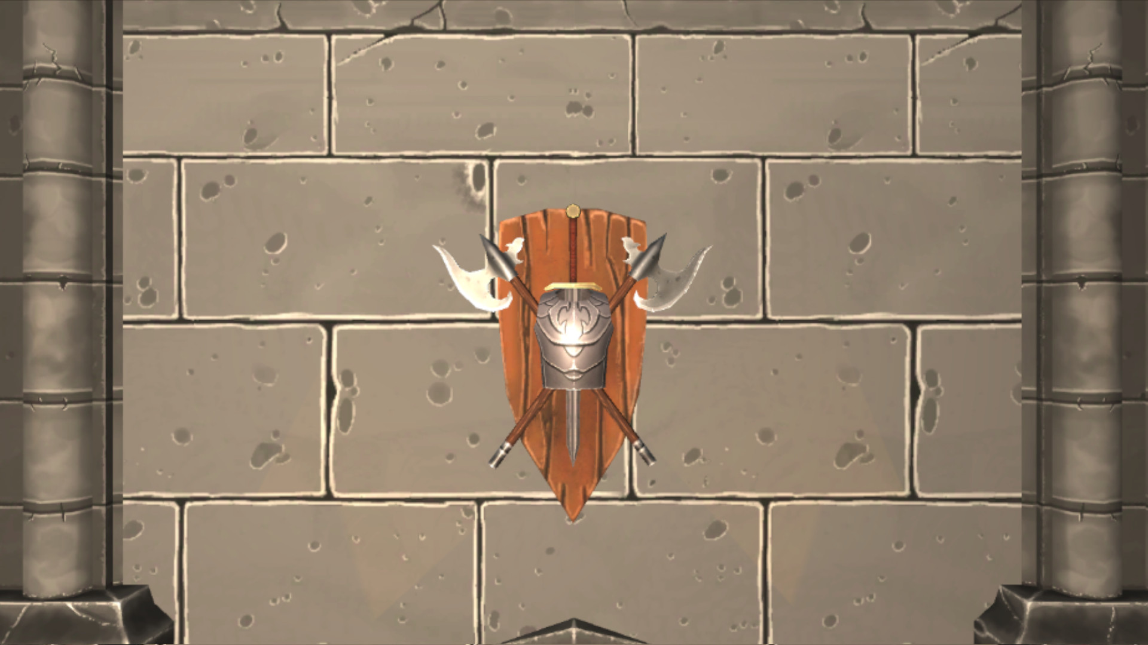
IDEA MÍNIMA

Slide 3
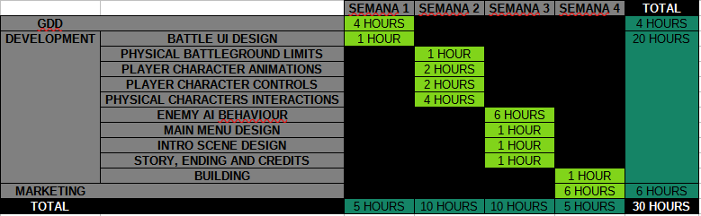
DESARROLLO

Slide 4



MARKETING

Slide 5
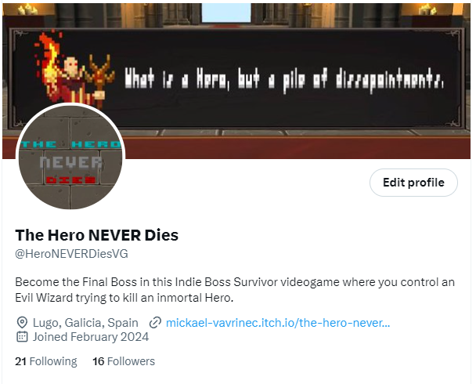
TWITTER

Slide 6
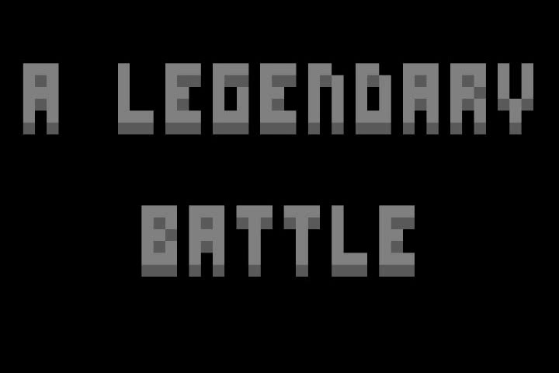
YOUTUBE

Slide 7
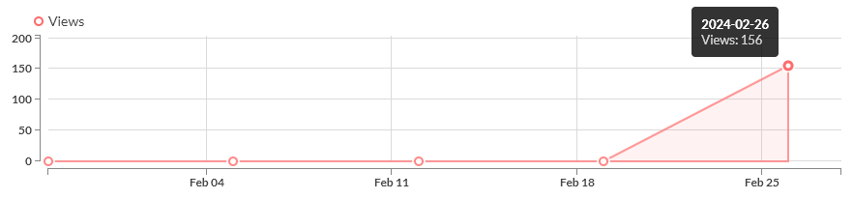
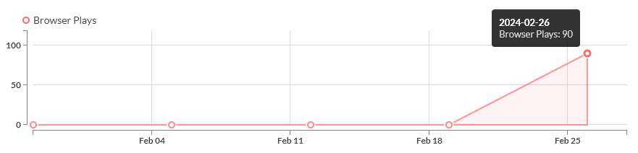
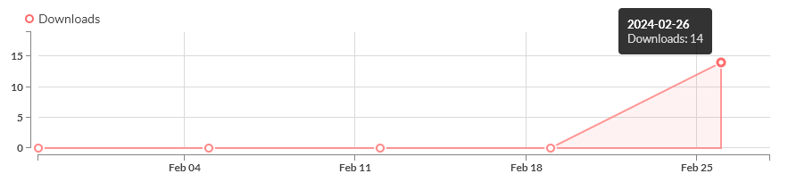
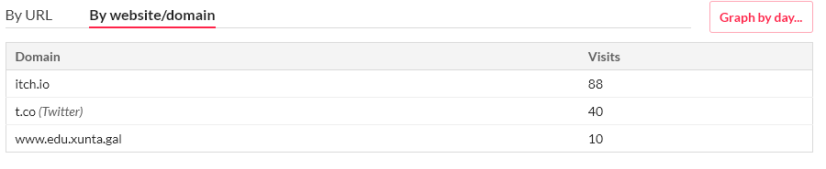
ITCH.IO

Slide 8
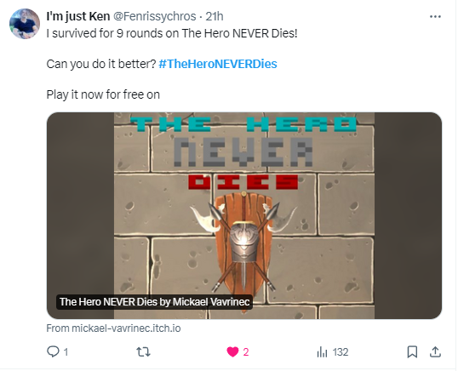
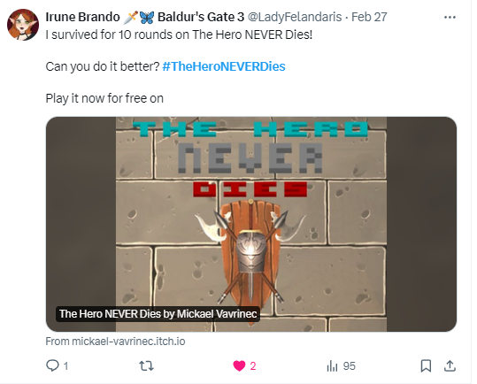
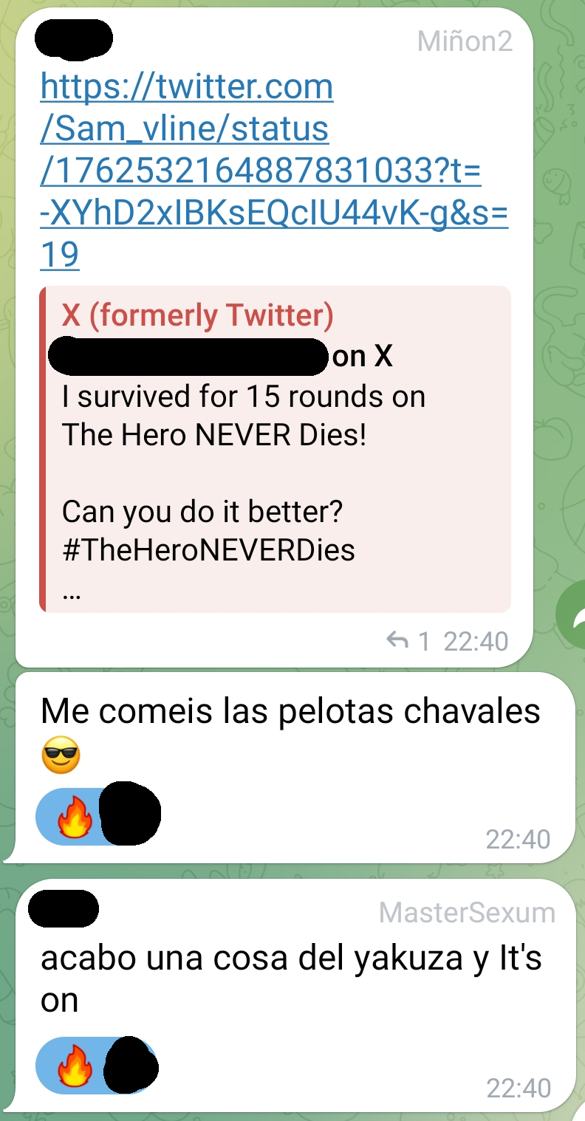
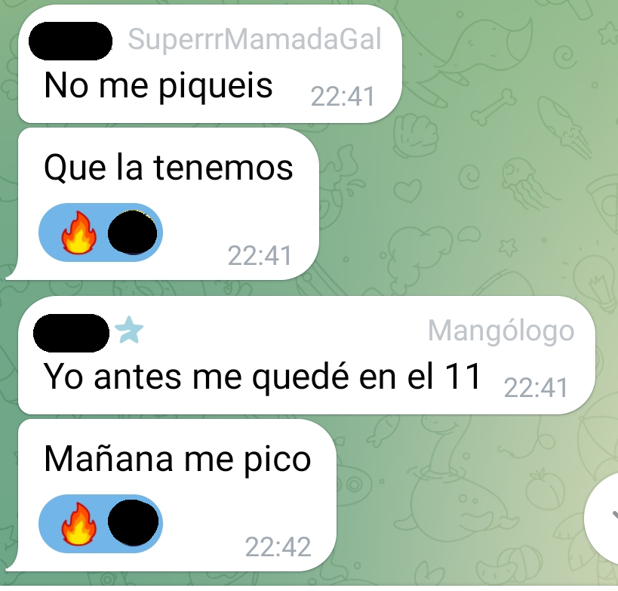
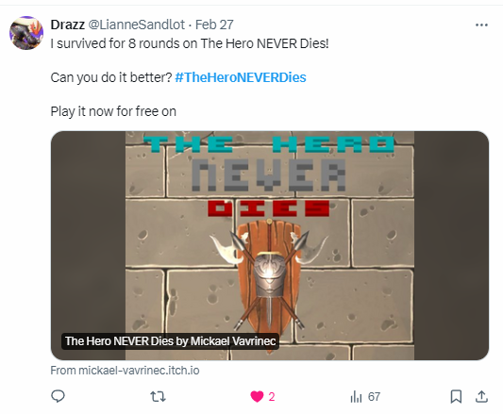
RECEPTION

Slide 9
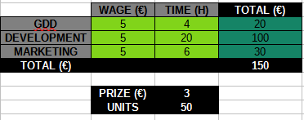

KPI + Costs

Slide 10
CONCLUSIONS
PROS
CONS
Positive reception and good feedback.
Marketing was mistaken with a professional one.
Motivated to keep working on the project.
Narrative was a failure.
Marketing was not enough.
Players had a poor User Experience.

