Slide 1
Intelligent Scheme Classification under PMGSY
IBM AICTE PROJECT
Presented By: Braj Narayan Awasthi
Student Name: Braj Narayan Awasthi
College Name: Babu Banarasi Das University
Department: Computer Science Engineering

Slide 2
OUTLINE
Problem Statement
Proposed Solution
System Development Approach
Algorithm & Deployment
Result
Conclusion
Git-hub Link
Future Scope
References
IBM Certifications

Slide 3
Problem Statement
Government agencies and planners struggle to efficiently classify thousands of rural infrastructure projects under different PMGSY schemes (PMGSY-I, II, III, PM-JANMAN, RCPLWEA). Manual classification is slow, error-prone, and not scalable for large-scale implementation.

Slide 4
Proposed Solution
The proposed system leverages IBM Watsonx.ai AutoAI to automate the classification of rural infrastructure projects under various PMGSY schemes. It ensures faster, scalable, and accurate categorization using machine learning.
Key Components:
Data Collection: Historical project data sourced from AI Kosh, including features like cost, road length, state, district, number of works, etc.
Data Preprocessing: Cleaning, handling missing values, encoding categorical data, feature scaling, and generating derived metrics. PCA used for dimensionality reduction.
Model Training (AutoAI): IBM AutoAI automatically selects the best classification pipeline. Final selected model: Snap Random Forest Classifier with ~92.2% accuracy.
Deployment: The trained model is deployed using Watsonx.ai Runtime as a REST API for real-time predictions.
Evaluation: Confusion matrix analysis shows high per-class accuracy (PMGSY-I: 95.8%, PMGSY-II: 95.7%, PM-JANMAN: 100%). Enables quick, consistent, and reliable classification.

Slide 5
System Approach
The project uses IBM Watsonx.ai AutoAI to classify rural infrastructure projects under PMGSY schemes
System Requirements:
Platform: IBM Watsonx.ai Studio (Cloud)
Runtime: Watsonx AutoAI Runtime (Python 3.x)
Storage: IBM Cloud Object Storage (Lite Plan)
Libraries & Tools:
AutoAI (automated model building & tuning)
Scikit-learn (used internally)
Pandas, PCA, Feature Transformers (via AutoAI pipeline)

Slide 6
Algorithm & Deployment
Algorithm Selection:
The AutoAI system selected Snap Random Forest Classifier, a robust ensemble learning algorithm known for handling high-dimensional data and preventing overfitting. It was chosen for its high accuracy and interpretability on structured classification tasks.
Data Input:
Key input features included:
NO_OF_ROAD_WORKS_COMPLETED
EXPENDITURE_OCCURED_LAKHS
COST_OF_WORKS_SANCTIONED_LAKHS
LENGTH_OF_ROAD_WORK_COMPLETED_KM
NO_OF_BRIDGES_SANCTIONED, STATE_NAME, DISTRICT_NAME

Slide 7
Training Process:
AutoAI automatically:
Performed data preprocessing (missing value handling, encoding, scaling)
Conducted automated hyperparameter tuning
Performed train/test split and cross-validation
Ranked multiple pipelines and selected the best-performing one
The final model achieved ~92.2% accuracy across multiple PMGSY scheme classes.
Prediction Process:
The trained model is deployed as an online REST API using Watsonx.ai Runtime.
Users can input new project data (cost, work completed, location, etc.) via JSON format.
The model returns the predicted scheme label (e.g., PMGSY-I, II, III, PM-JANMAN).
Prediction is near-instant and can be integrated with dashboards or reporting tools.

Slide 8
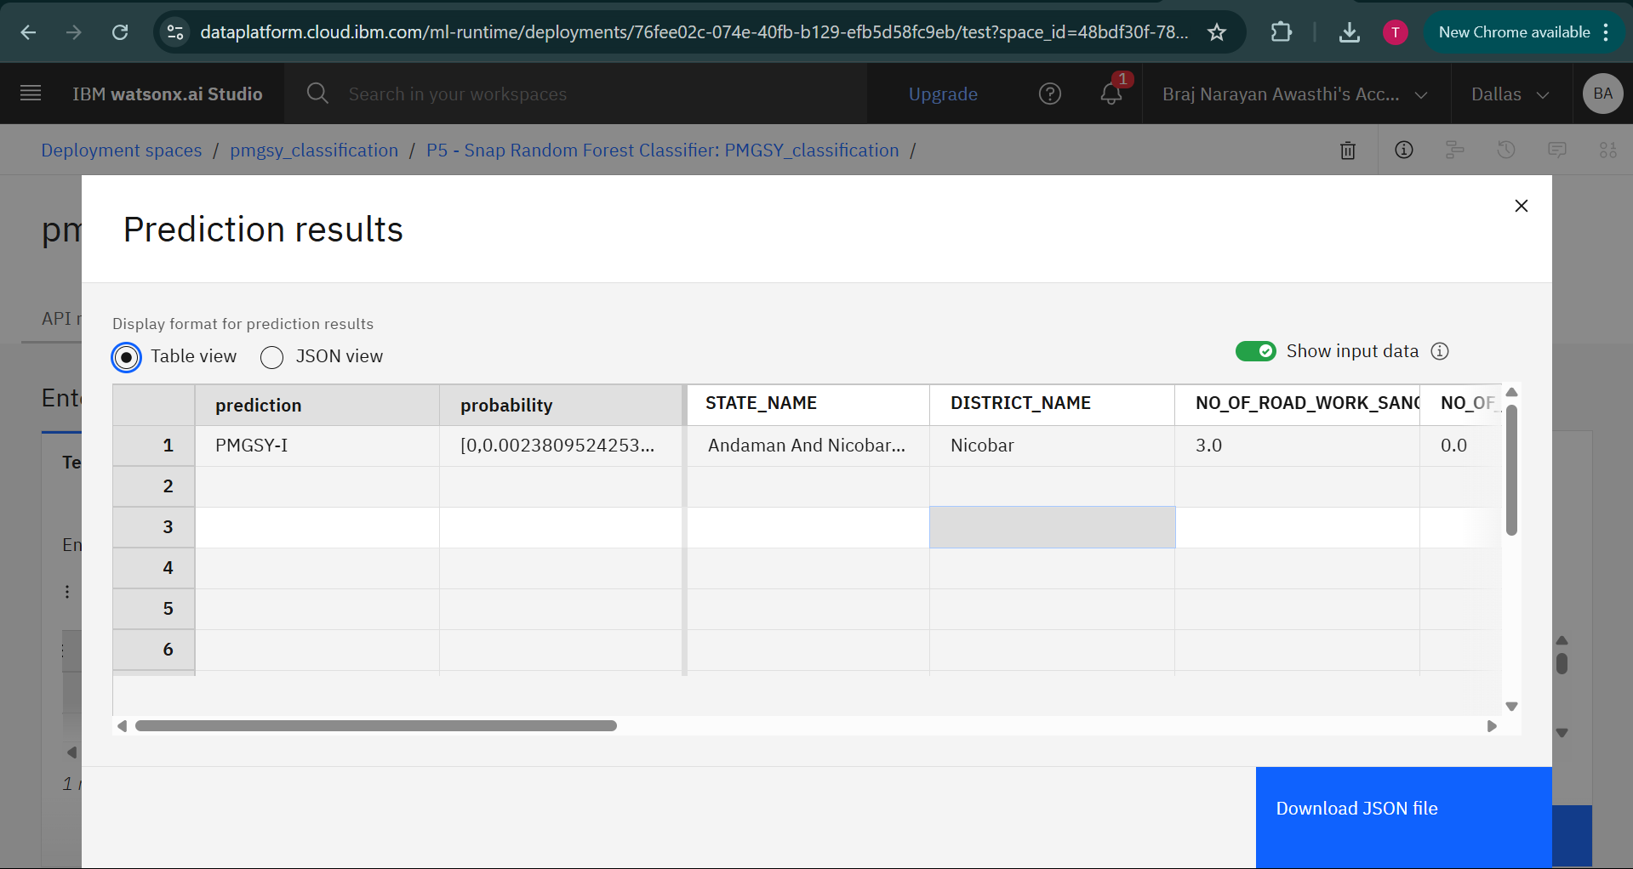
Result

Slide 9
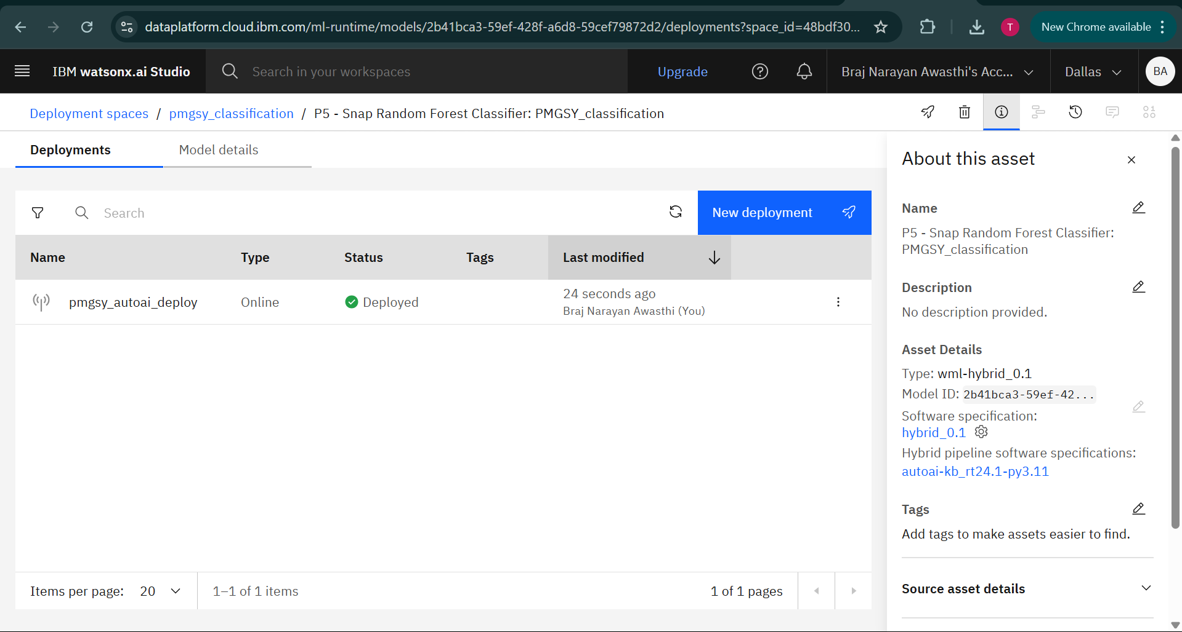
Result

Slide 10
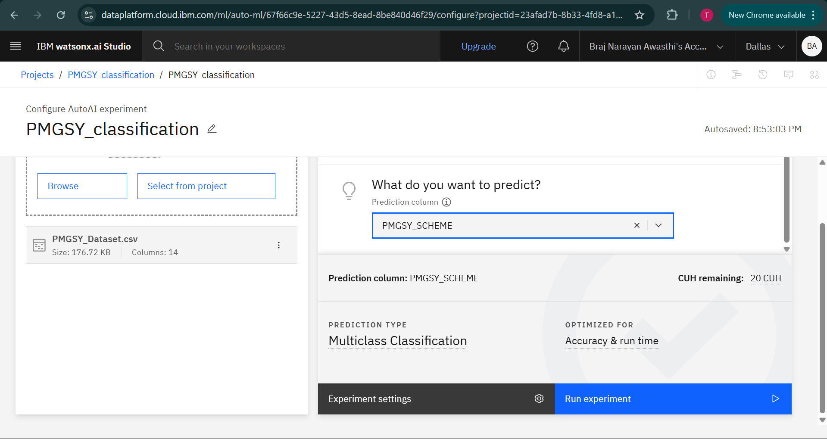
Result

Slide 11
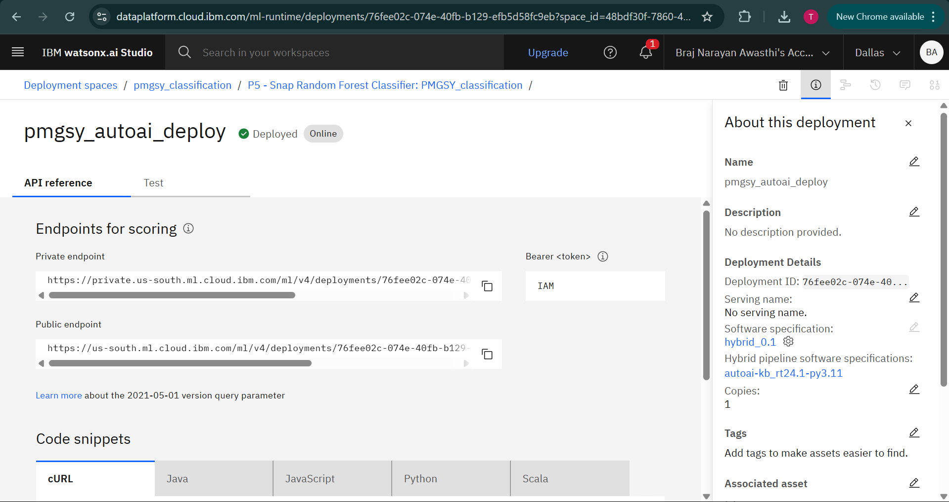
Result

Slide 12
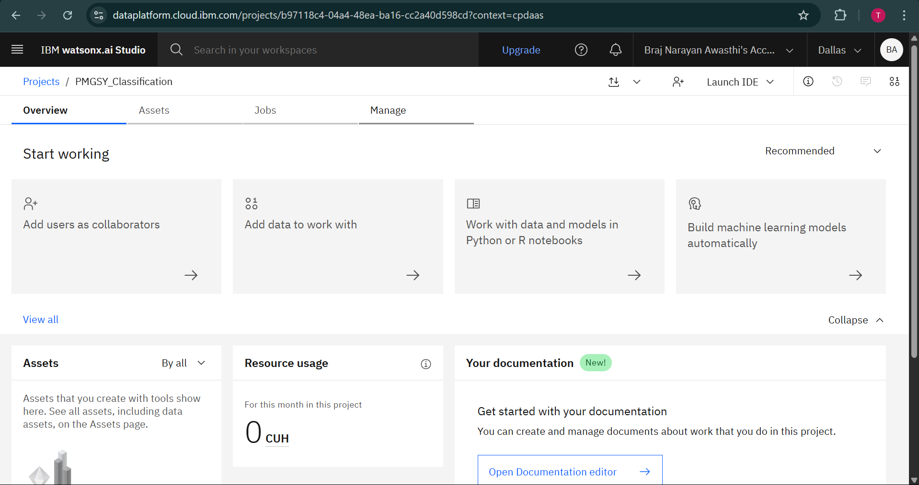
Result

Slide 13
Conclusion
The model built using IBM Watsonx AutoAI achieved ~92.2% classification accuracy.
It successfully automated the classification of rural infrastructure projects under PMGSY schemes.
The system is scalable and cloud-based, making it suitable for real-world deployment.
It enhances transparency, speed, and reliability in government project monitoring.
Minor issues like class imbalance can be improved with targeted retraining and data augmentation.

Slide 14
GitHub Link
https://github.com/Braj-01/IBM_Cloud_PMGSY_ML_Classification

Slide 15
Future scope
Use advanced ML techniques like ensemble stacking or class balancing to handle minority
class predictions better.
Expand the system to cover multiple states or infrastructure categories beyond PMGSY
Integrate with government dashboards for direct reporting, visualization, and policy decision support.
Explore edge deployment or integration with IoT sensors for live rural development tracking.

Slide 16
References
AI Kosh – Pradhan Mantri Gram Sadak Yojna (PMGSY) Dataset. Retrieved from: https://aikosh.indiaai.gov.in/web/datasets/details/pradhan_mantri_gram_sadak_yojna_pmgsy.html
IBM Watsonx.ai Documentation – IBM Knowledge Center. Retrieved from: https://www.ibm.com/docs/en/watsonx
PMGSY Official Website – Ministry of Rural Development, Government of India. https://pmgsy.nic.in/
Scikit-learn: Machine Learning in Python – Documentation. https://scikit-learn.org/stable/
Pandas: Python Data Analysis Library – Documentation. https://pandas.pydata.org/docs/
IBM AutoAI – IBM Watson Studio Overview. https://www.ibm.com/cloud/watson-studio/autoai

Slide 17
IBM Certifications

Slide 18
IBM Certifications

Slide 19
IBM Certifications

Slide 20
THANK YOU

