Slide 1
Access Management Portal
State Transition Diagram
Submitted By: Braj Kishor
Part of Group AB

Slide 2
My Contributions
Selection of the project.
Understanding and discussing the domain and its functional and technical requirements.
Understanding the workflow involved for the use case.
Drawing the State transition Diagrams for various use cases of the project.

Slide 3
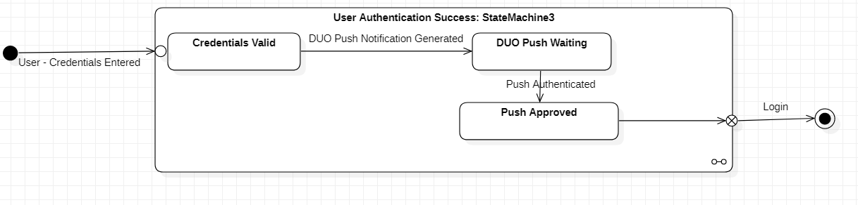
State Transition Diagrams
Use Case: User Login To Portal

Slide 4
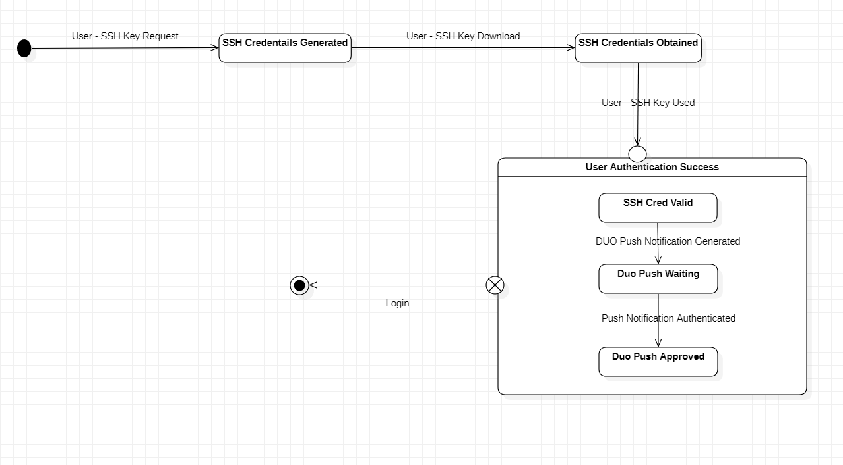
State Transition Diagrams
Use Case: User Login to Bastion Host

Slide 5
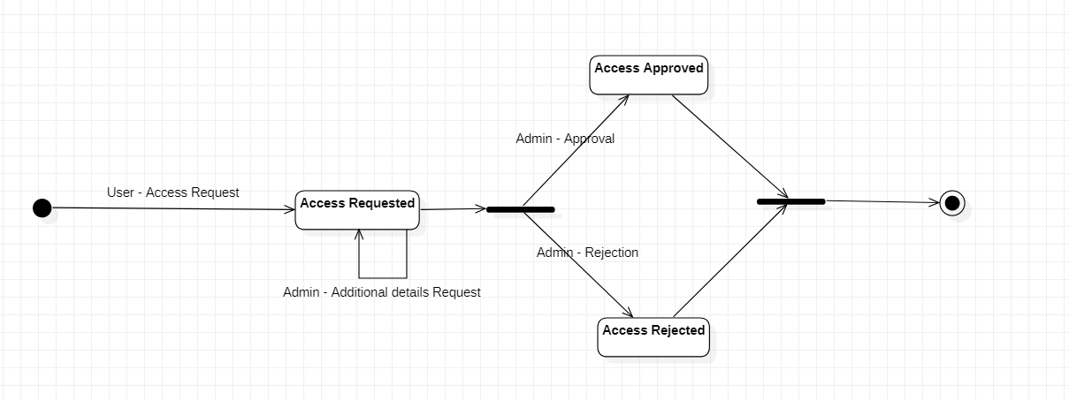
State Transition Diagrams
Use Case: User Request for Bastion Host Access

Slide 6
My Learnings: Braj Kishor
Learnt in-depth and implemented the various components and objects involved a state transition diagram.
Understood the difference between state transition diagram (focus on state) and flowchart (focus on events).
Learnt various other diagrams involved in UML design, mainly Use Case Diagrams, Sequence diagram and Class diagram.
Learnt about various aspects of 2 factor authentication by the interaction with the team of this project.
Learnt to draw various type of diagrams on Star UML as part of this project

Slide 7
State Transition diagram Star UML Model file
https://drive.google.com/file/d/1z_i3HAcbkGEYr_ibkEAeYQofBjlmlAzB/view?usp=sharing

