Slide 1
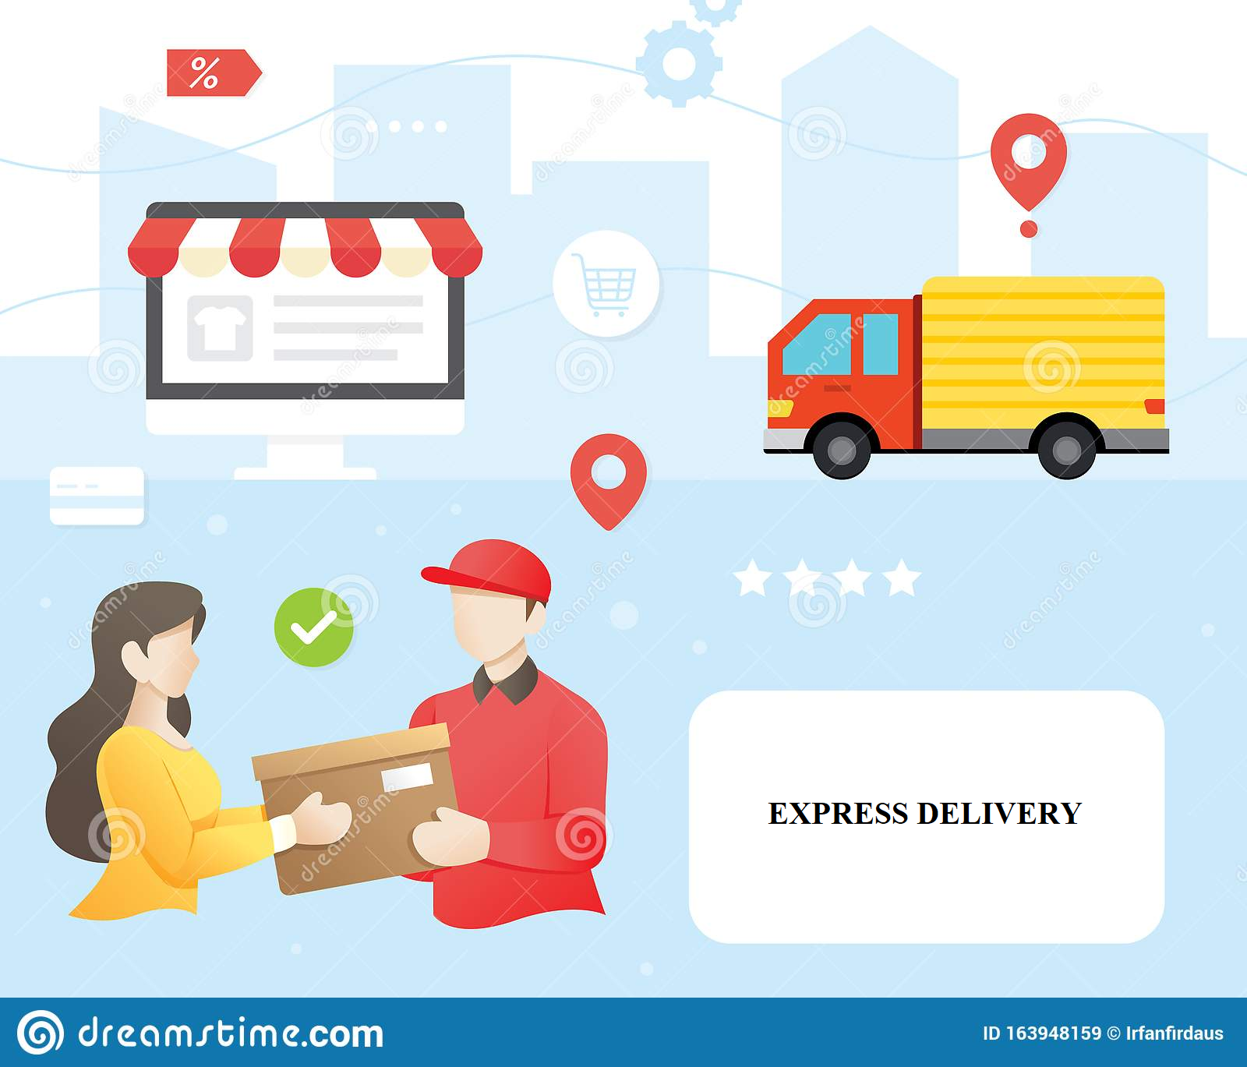
ECom Express Mobility Solution Service Accountability Transmission Handheld Instrument (SATHi)
WILP BITS PILANI SA Assignment 2
BY:-
BRAJ KISHOR (GROUP 74)
PARTHIBAN S. (GROUP 74)
RITU PRIYA (GROUP 74)
SAMEER FAROOQ B. (GROUP 74)

Slide 2
About ECom Express Mobility Solution
Ecom Express is an end-to-end logistics solutions provider to the ecommerce industry.
The work done here discusses about the Mobility solution presented by the ECom Express (SATHi), an android based mobile app and it’s integration with the ERP solutions.
The SATHi App integrates with the ERP solution at the End Delivery Centre and facilitates delivery to the End Customer.
The Main User for this App are the thousands of delivery Associates for whom the app provides tracking, distribution, navigation and payment services.
At the same time, it facilitates the business real-time tracking, payment and updates on the delivery items which can be shared with customers.

Slide 3
TOP 3 ASR
1.Performance - Real time data processing
The primary requirement of the application is to track the delivery process,
which directly associates with the real time tracking. Consider the below tracking scenarios in a standard delivery:
Package shipped from the retailer dispatch location.
Package reached the respective city’s distribution centre.
Package being picked up by field delivery force.
Package reaching the customers’ location.
As mentioned above, these are the steps for a happy flow path of any delivery process, and it is extremely crucial to track the
real time data for each of the step, in order to adhere to the service level agreement.
At the same time there could be many common cases where the package delivery gets delayed due to various
reasons like, package misplaced, package destroyed, unavailability of field force, unavailability of customers etc.
In these scenarios the real time data gathering is extremely crucial to make decisions for a seamless order completion.
Hence, one of the primary requirements that should be considered during the architecture
of SATHi is the real time data processing performance.

Slide 4
TOP 3 ASR
2.Configurability: Seamless onboarding of business partners
Ecommerce applications are very dynamic when it comes to associating with various vendors and business partners.
Depending on the locations and products there are various types of retailers and delivery partners chosen.
For example, the ecommerce company might have external vendors as delivery partners, or they can have their own delivery channels, there could be various retailers supporting various products.
All of them have to be integrated in a way that with minimum configurability the partners for the entire business model could be on boarded to the app.
For e.g., let’s consider a scenario as per which:
A new delivery channel has been added to the vendors list and the contract is under review, waiting for final confirmation.
The vendor profile should be easily created with the SATHi app without adding any additional cost to the company.
Though the profile should be disabled till the contract is confirmed.
On the basis of contract negotiation, the enabling/disabling of the vendor should be seamless and in minimum time.
Hence, it is very crucial for the app to ensure that the configuration to add the various actors of the business model is seamless.

Slide 5
TOP 3 ASR
3.Security – Partner’s and customers sensitive information must be protected
As per the requirement, the application would hold many sensitive information about the customers and the delivery field officer like:
Contact Details -phone number, email.
Address of home/office/others of the customer.
Real time availability at home/office/other location of the customer/
Real time navigating route of the delivery officer.
These are sensitive information and could be misused by the malicious components of the society, hence the security is key for the application.

Slide 6
Tactics for Performance
Controlled resource demand
•Role based information management would be the best choice for optimum application performance.
The application will be available on the mobile devices and would be functioning for a single role at one point of time.
Depending on the kind of information that would be needed by various user roles the features could be designed to respond in the most optimum way.
For e.g., from a device the user would be onboarded either as a customer, a delivery partner, a retail partner or an admin
Hence to ensure that the required information reaches the user in the most relevant fashion, below considerations must be done during architecture e design, for e.g. consider the below scenario
A navigation route to be enabled for the delivery partner would be available only on demand(a button trigger) and a consolidated optimum route covering all customers that are planned for delivery for the day would be visible.
.For a customer, the navigating route will be enabled only on demand(a button trigger) and when the delivery partner is on the direct way to that customer.
For the admin, the navigating route would be enabled in three ways: as customer(what customer sees), as delivery partner or a holistic view.
The feature could be designed in a way that the navigation distance could be calculated to and from each actor and only the relevant information could be transmitted as needed or an amalgamation of all the actors could be given for holistic view.
This would help to optimize the computation efficiency; as only relevant query would be processed.

Slide 7
Tactics for Performance
Incremental Information Process.
The application UX could exploit the incremental information load for the customer. This would reduce the computational overhead from the backend system.
Let’s consider a scenario as per which a customer selects one of the order ids to track delivery, in that case instead of showing the entire delivery related information on the screen at one go, the high-level information could be provided and an option to get further details could be provided on the screen.
For e.g.,
•Customer selects the order to be tracked.
•Based on the order id, the app can make a call to get the high-level order info like number of items included in the delivery and the expected delivery date for each
•Along with that a link to check real time location of the order could be given, on select of which the exact place of the order –delivery hub, in transit, with delivery executive etc. could be shared.
•Similarly an event could be designed on trigger of which the delivery agent information could be shared, or in case delivery is in route to the customer’s link the map view could be shared.
•This kind of flow should be designed carefully though in order to avoid multiple clicks as that would impact the UX experience but could be designed in a way that it makes the optimum utilization of modularized code and thereby decreasing the computational overhead.

Slide 8
Tactics for Configurability
Plug n Play.
The application must be configurable in a way that the business partners could be onboarded through the existing ERP system solutions.
This application is an extension on top of the existing business model for any ecommerce application, hence the onboarding exercise should be minimum not only from partners point of view but also the business point of view.
For e.g., if a contract has been cancelled with a delivery partner/retailer then with minimum configuration the disabling of the partner should be executed.
The exercise should be seamless to the customer as well and the app should be immediately able to identify the ongoing business with the disabled components and raise alerts to concerned authority and provide features to business that could help them to track the closing of all the associated business with the disabled partner.
This would ensure that there are no loss incurred by the business due to SATHi app management.

Slide 9
Tactics for Security
Encryption.
The application resides on the handheld device and various sensitive information are present in the application, so a strong encryption is extremely crucial.
Consider below scenario which could help us to estimate the vulnerability of the users, in case the security is compromised upon:
> The delivery agent is in his route to deliver an order on Cash of delivery and the app contains the location of delivery agent as well as customer , if this information is leaked to the black net it could be sold within seconds and could lead to unwanted consequences.
The encryption of the information shared between the app and the server should be constantly upgraded and changed to avoid malicious attackers to use it for their purposes.
The authentication and authorization modules should be handled in an encrypted fashion which should be changed in regular intervals.
The default settings of the application to be changed periodically and could include an authorized path(user driven or app installer driven) to ensure the integrity of the message transmissions.

Slide 10
Context Diagram

Slide 11
Module Decomposition Diagram
SATHi App
Business Modules
Run-Sheets
Schedule Delivery
Navigation System
Payment
Digital Authentication
Partner Configuration
Technical Modules
ERP Integration
Voice Call/SMS Notification
Email Notification

Slide 12
Module Responsibilities
Module | Responsibilities
Run-Sheets | List of Pending deliveries for a Delivery boy with the following information Product Details with Amount Due Customer, Address Delivery boy can either accept this request for delivery or reject so that it will re-assigned to others by the office staff Note: it is based on assignment in the ERP by the Office staff
Schedule Delivery | Schedule specific time for delivery with the End Customers for Delivery
Navigation System | Connected to Maps and enabling the route map from the delivery centers to the customer location
Payment | Enables payment option in Cash or Electronic Payment through Payment Gateway (G-Pay, BHIM, Credit card, etc..)
Digital Authentication | Proof of Delivery is captured through scanning the govt issued cards and a Digital Signature. This module will also capture the geo-coordinates at the time of digital Signature
Partner Configuration | Enables configuration of new partners (Delivery Centers, Delivery Boys) by the office staff
ERP Integration | Integration of Mobile app to the ERP devices to collect/receive the following information Run sheets, Customer information, Proof of Delivery, Run sheet Acceptance/rejection, Collection details.
Voice Call | Enables contacting customers directly from the app so that contact numbers are not compromised.
SMS Notification | SMS Alerts are sent based on the Delivery Schedule and successful delivery.

Slide 13
Component & Connection Diagram

Slide 14
Deployment Diagram
Handheld Deployment View
ERP Deployment View
Cloud
Web server / App Server
SATHi App Interface
Firewall
SATHi Configuration
SATHi Adapter Srv
Run- Sheets
Delivery Schedule
Sync Service
Load Balancer
Web server / App Server
Navigation
HTTPS
Server cluster / farm
Digital Authentication
Email/SMS notification Srv
Transportation Management
Push Receiver
Payment
Payment Gateway
Web server / App Server
ERP User Interface
Inventory Management
Finance
VOIP Call/SMS Notification provider
Sqlite
Store
G-Pay
BHIM
CARDS
Primary
Backup
DB server
DB server

Slide 15
C & C Message Exchange

Slide 16
Working of the system
The ERP solution is mainly responsible for the tracking and audit of the delivery from the pickup processing centres to delivery centres.
The Mobility Solution SATHi interfaces with the ERP solution once the product reaches the final delivery centre.
Using the ERP, the office staff assigns the field employee for each delivery. These are slotted according to priority, travel distance and availability estimates of the end customer.
The integration is possible due Microservices based architecture of ERP. The SATHi Adapter Service with configurations runs as a service interfacing with the ERP solution.
This service exposes REST APIs interfaces to be consumed by the ERP solution to push delivery distribution notifications via Push Notification, SMS and Email.
The SATHi mobile app on the android platform of each delivery executive is a hybrid type Application.
The Client app is registered with the Operating system push notification service (OSPNS) of the platform, in this case the Google Cloud Messaging (GCM) and relies of this for Push Notifications.

Slide 17
Working of the system
Additionally the partner gets SMS and Email as well on his registered contact details.
Following this, the delivery executive opens the mobile app and accesses his account to see the deliveries assigned to him along with the consignment details like current product location, delivery location, time slot, customer contact details etc.
For this, the mobile app directly uses the ERP solutions APIs to get the details.
These details are synced from server and stored locally on the delivery executives mobile app in the local database (Sqlite).
The mobile app provides scheduling services for the delivery executive to arrange his deliveries as per his current location, customer availability, allocated timeslots and his convenience.
The mobile app uses the native location service of the mobile and Google Map integration to provide navigation route for to the end customer location.
The Mobile App uses Intent based IPC for communication between modules of the app and the native services
Once the delivery executive reaches to the customer, he uses the mobile app to register the detail in the run sheet.

Slide 18
Working of the system
The mobile app also has integration with VOIP and SMS gateway service of the company to interact with the end customer.
The application has payment service module which is integrated with various payment gateways such as Google Pay, BHIM and others which is used to collect payment.
Following this, the executive uses the mobile camera to scan barcode, and takes customer digital signature on the mobile map. All these details are stored along with the current location details of the executive.
The run sheet data, payment data, delivery data and delivery proof such as customer sign, barcode etc are stored locally on the local db (sqlite) and at the same time sent to the server which is then persisted in ERP solution.
In case of no internet connection, the data is stored locally and then a job for synchronisation using JobScheduler is created. Once the device connects to internet, this data is synced.
The mobile app also provides periodic tracking of the delivery executive. This is done using the location service on the mobile.

Slide 19
Architecture Patterns Used

Slide 20
Architecture Patterns Used

Slide 21
Learnings: Braj Kishor

