Slide 1
AGENDA
About Me
Achievements
Craft Builder Project – System Design
Braj Kishor
Senior Staff Software Engineer

Slide 2



Braj Kishor
Senior Staff Software Developer
Education
Skills
Experience
M.Tech
2020-2021
BITS Pilani
M.Tech Software Systems
& Data Analytics
11 years of Full Stack Software Development
Web Application, API and Microservices
Python, Golang
Node.js, React.js, Polymer.js
AWS & GCP
Machine Learning basic
Systems Engineer
Infosys Ltd
2013-2015
Sr. Staff Software Engineer
Palo Alto Networks
2022-Present
Product Engineer
Edge Verve Systems
2015-2018
Staff Software Engineer
FireEye Cybersecurity
2018-2022
B.Tech
2008-2012
Uttar Pradesh Technical
University
B.Tech Computer Science

Slide 3
Achievements
Copilot Chatbot for Security Posture Analysis
Allows InfoSec teams to do queries in natural language
Uses AI model to convert Human queries into SQL one
Tuned model returns templated output
Security data is hidden from the model
Crypto Mining and Crypto Jacking detection Engine
Uses ML trained models for pattern detection based on System indicators and Network activity
Continuous monitoring, reporting and blocking capability
Includes visualisations
https://github.com/Braj-120/cryptominingdetection
Remote Desktop Remediation And Script Execution Engine
Allows Infosec teams to take remotely access any machine in their organisation to do remediations and threat hunting
Allows Bulk remediation
Allows Remote Script Execution
Modelled with High Security and auditing features
Additional Achievements
Palo Alto Networks AI Hackathon 2023 2nd Place Winner
FireEye Hackathon 2020 & 2021 Winner
Assist-Edge Robotic Process Automation Dashboard

Slide 4
Designing a Mailchimp Marketing Trends Engine
Craft Builder Project – System Design

Slide 5
AGENDA
Use Case
Requirements
Assumptions
Basic Volume Estimations
High Level Design
API Design
Detailed Design
Security Considerations
Other Considerations
Final Thoughts

Slide 6
Use Case
Objective: To provide businesses with actionable insights by identifying and analyzing the latest marketing and social media trends.
Key Benefits:
Identify Trends: Automatically tracks emerging marketing trends from various online sources.
Aggregate Insights: Organizes and evaluates trend data for clear, actionable insights.
Visualize Trends: Presents trends through intuitive dashboards with charts and summaries.
Seamless Integration: Directly integrates insights into Mailchimp for enhanced email marketing and campaign strategies.
Why It Matters:
Stay Ahead: Quickly adapt to new opportunities and shifts in consumer behavior.
Enhance Campaigns: Leverage up-to-date trends to optimize marketing efforts and improve results.

Slide 7
Requirements - Functional
Data Collection
Web Crawlers & APIs: Extract data from websites, social media, and forums.
Obey Crawling limits & Rules
Scheduling: Manage and schedule data crawling tasks.
Data Freshness: Ensure data is refreshed frequently to keep up with latest trends
Trend Detection & Analytics
Detection: Identify and categorize emerging trends based on specified topics.
NLP & ML: Extract keywords, sentiment, and rank trends. Ranking can take various considerations like user base, Geographical limits etc
Data Storage and Refresh: The identified trend must be stored and refreshed periodically
Tag Cloud: Visualize key terms and topics with a tag cloud to highlight the most prominent keywords.
Add new categories, tags, searches and seeds for crawling

Slide 8
Requirements - Functional
Mailchimp Integration
APIs: Allows Search by Category, Tags, Keywords, Visualization, etc on the Mailchimp UI
Tag Cloud Extension: Adds tag cloud visualization on the Mailchimp UI. The user can apply filters.
Highlighting Keywords: Use AI to analyze the UI content at runtime and highlight keywords to click and get insights.
Visualization: Build in as part of Mailchimp UI platform
Dashboards
Tag Cloud
Reports

Slide 9
Requirements – Non Functional
Scalability
Horizontal Scaling
Even load distribution, even for popular categories
Performance
Realtime responses for searches, trends and visualizations
Availability
Reliability
Security
Localization

Slide 10
Assumptions
No Media Crawling – This will require a whole new domain of Media Processing ML Models
Custom Pretrained ML/NLP/AI Models
Data Freshness time limit is 24 hours
Sudden updates are possible where a trend explodes in popularity
Depth limit is configurable but fixed before each run
Initial Seed Categories and Websites are added. These can be updated or new entries can be added before each run.

Slide 11
Assumptions - UX Examples
User can search terms – “Interesting Tshirt Design” or “Most happening Places”
The Systems generates top responses like “Blue Printed Tshirt”, “Celebrity X tshirt” etc or “Pubs in Indranagar”, “Bali – Most beautiful place on earth” etc
Can be extended to search by chatting and search by voice
User can search category like Fashion, Travel, Sports, Cars, Health, etc
System list top trends in that Category
User can visualize most recent trends (in a category or general), track specific trends to see how they grew and their popularity. They can drill down as needed.
A Tag Cloud extension UI is present on right left side of their Mailchimp UI. This is adaptive and predictive. Depending on current context, relevance information like location, recent searches, it updates itself
Tag highlighting – When user if compiling a mail template, system can highlight certain keywords and update tag cloud based on the content, allowing user to hover and visualize from the template screen.

Slide 12
Basic volume estimation
1. Web Crawling Volume
Assumptions:
Number of sources crawled: 100,000 websites, social media platforms, blogs, forums, etc across various categories like Fashion, Transport, Travel etc
Average number of pages per source: 100 pages per source per day.
Average size of each page (HTML + metadata): 100 KB.
Average number of relevant data points (e.g., articles, posts) extracted per page: 5.
Calculations:
Total pages crawled per day = 100,000 sources * 100 pages/source = 10,000,000 pages/day.
Total raw data processed per day = 10,000,000 pages/day * 100 KB/page = 1 TB/day.
Total relevant data points extracted per day = 10,000,000 * 5 data points/page = 50,000,000 data points/day.
Attributes for WebCrawler Meta Data
Source ID
URL
Forward Link Array
Category
Metadata
Title
Publication Date
Author
Language
Page Content
Crawl Timestamp

Slide 13
Basic volume estimation
2. For Extracted Data Points – Intermediate Step storage requirements
Assumptions:
Average size of each data point: 2 KB (text only).
Calculations:
Total relevant data volume per day = 50,000,000 data points/day * 2 KB/data point = 100 GB/day.
Attributes for the data points extracted by crawler
Data Point ID
Source ID
Category
Keyword Obj
Keyword
Frequency
Ranking Score
Related Keywords
Extracted Texts
Metadata
Extraction Timestamp.

Slide 14
Basic volume estimation
3. Data Storage Volume – For Processed Trends
Assumptions:
Data retention period: 1 year (365 days).
Average size of each data point: 2 KB (text only).
5 Data points leads to one Trend Tag on Average
Calculations:
Total relevant data volume per day = 10,000,000 data points/day * 2 KB/data point = 20 GB/day.
Annual storage requirement (before compression) = 20 GB/day * 365 days = 7.3 TB/year.
Attributes for the Trend Tag after processing and analyzing data points
Trend ID
Trend Tag (Name)
Source Metadata
Category
Description
Keywords Set
Sentiment Score
Trend Score
Relevance Metadata
Geographical data.
Demography data
Related Trends.
Metadata
Trend Emergence Date
Last Updated Timestamp.

Slide 15
Basic volume estimation
4. API Request Volume from End Users – Network Stats
Assumptions:
Number of active Mailchimp users: 13,000,000 users.
Number of active Mailchimp users accessing trends per day: 1,000,000 users.
Average number of requests per user per day (e.g., API calls, dashboard views): 10 requests/user/day
Calculations:
Average Daily Requests: 1,000,000 users * 10 Request/user/day = 10,000,000 Requests/Day
Average Request Per Second = 10,000,000 / (3600 sec/hour) = 278 requests / seconds approx.
Peak Request Per second at 1.5x = 417 requests / second

Slide 16
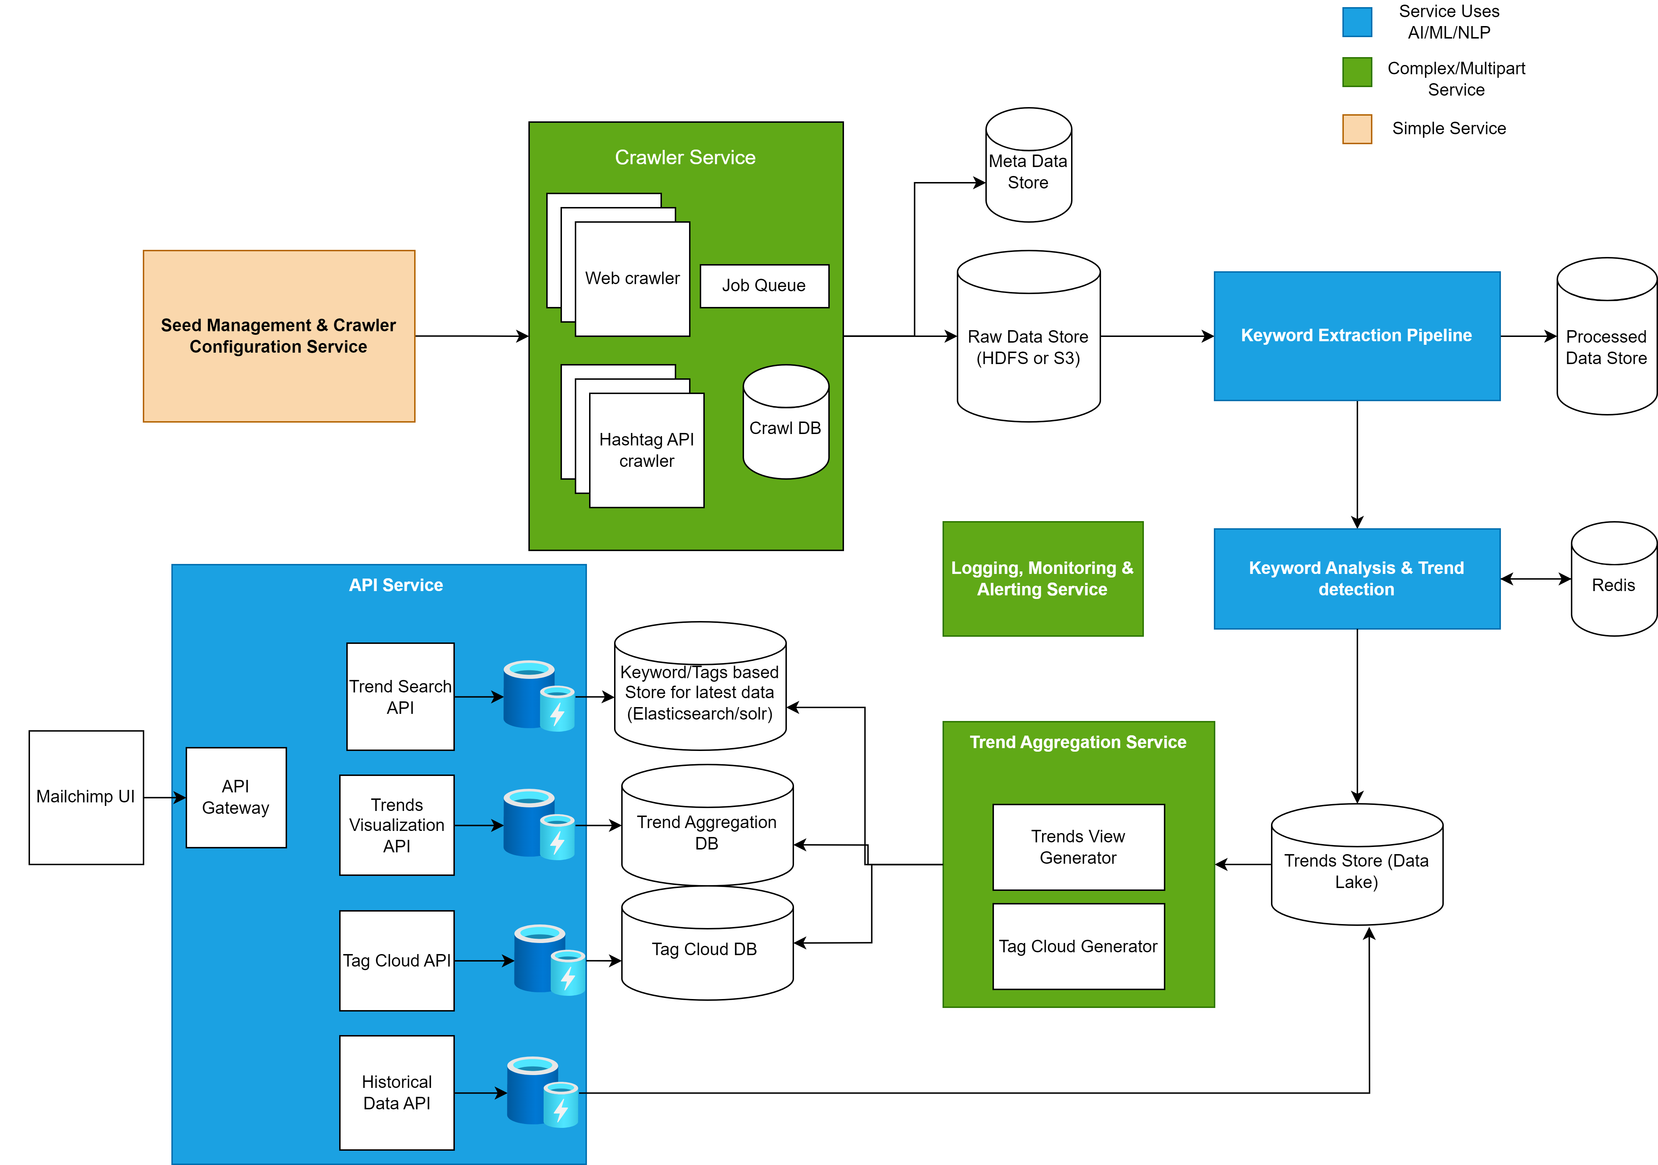
High Level Design

Slide 17
API design
Search by Category/Trend Tag/Keyword
GET /api/search?query=<value>&limit=100&offset=0&date_range=last_30_days&sort={key: trend_score, desc: true}&relevance_meta={}
Get All Trend Tags By Category – Sorted by Trend Score
GET /api/trends/category/:category_name?limit=100&offset=0&date_range=last_30_days&relevance_meta={}
Tag Cloud API
GET /api/tags/cloud?term=<value>&limit=100&date_range=last_30_days – Term is optional
GET /api/tags/:tag_id/related_trends – Fetch related trends for a given tag
Tags Highlight API – Lists all Trends tags which can be highlighted in a template text
POST /api/tags/list
Body: {“text”: <>}
Visualization & Historical Data APIs
GET /api/trends/latest?category=<value>&keywords=<>value&date_range=last_30_days – To Get top trending items. category or keyword are optional
GET /api/trends/:trend_id?date_range=last_30_days – To show the trend pattern in last x days
GET /api/trends/historical?date_range=last_30_days – To show overall trend pattern in last x days

Slide 18
Detailed design
Seed Management & Crawler Configuration Service
API Based Design
Add/Remove/Modify Seed websites
Add/Remove/Modify Categories
Manage Crawler Configuration like Crawl Depth, Ignore list, Cron Schedule
Stores data in SQL database which is used by Crawler
Admin only feature
Users can request additional categories or websites through Admin

Slide 19
Detailed design
Scheduling and Job Run
Runs Pipeline Every 24 Hours per domain/website
Scheduler service ensures that each domain is scheduled once per 24 hours
Can run on custom events such as new category, on-demand run, sudden updates
We can use Kubernetes Job Scheduler
Triggers Crawler pipeline by dropping set of domains in the queue
Uses Staggered approach
Split domains in Equal subsets based on category and relevance and run each subset
Single Job Run – When the entire pipeline finishes for one set of domains dropped in pipeline
Dynamic Scheduling - Can use an ML Feedback loop to reschedule certain websites if they are trending
Active monitoring to ensure fault tolerance
Why 24 Hours – It’s balance between Trend freshness and Crawling Rate Limits for websites and API

Slide 20
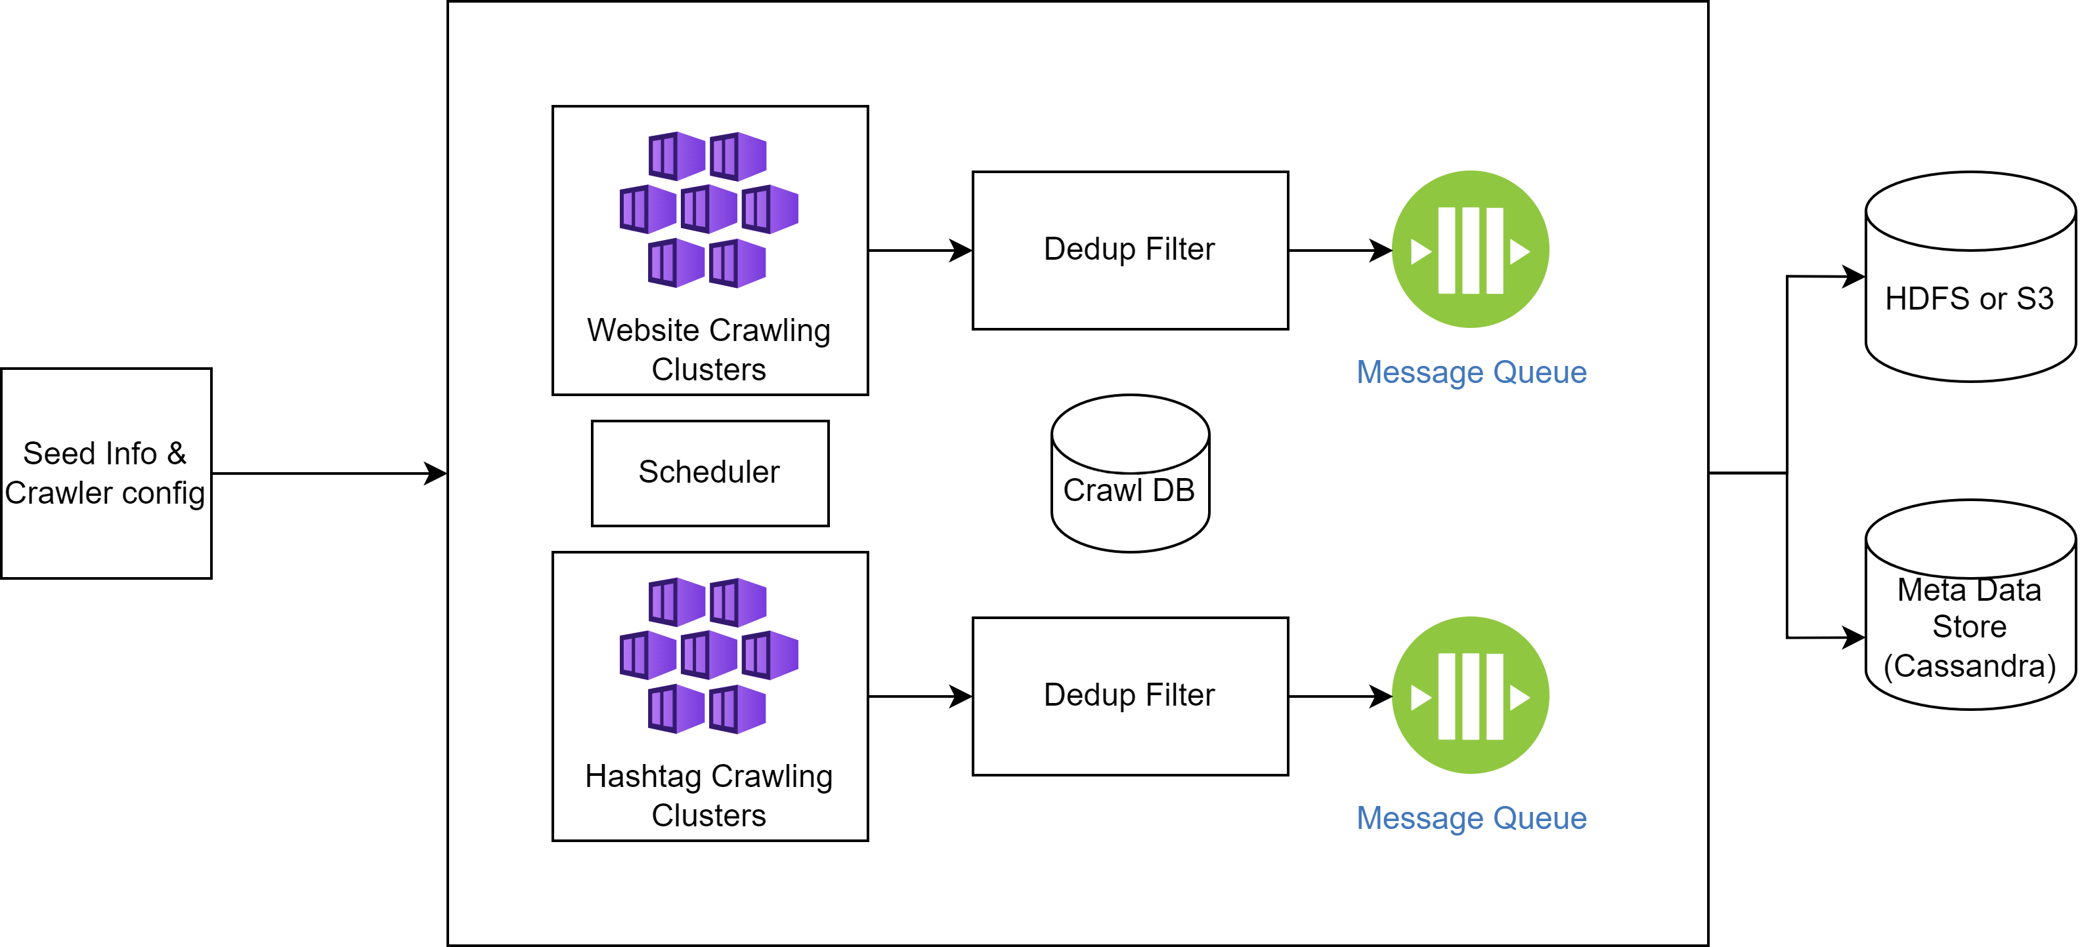
Detailed design
Crawler Service
2 Pipelines
Website Crawling Pipeline
Hashtag-Based Crawling Pipeline
Key Considerations
Parallel Processing
Mitigate Hot Partitions (Famous trends)
Avoid duplicate URLs
Obey compliance limits
Fault Tolerance
Notes:
https://github.com/BruceDone/awesome-crawler

Slide 21
Detailed design
Crawler Service
For Web crawler – Apache Nutch or Scrapy with distributed deployment plugins
Extracts links and Text content
For Hashtag Crawler – API based Crawling or Custom Scarpy
Deployed on Kubernetes clusters
Pods auto scale based on Queue size or consumer lag
Can use Custom controller or HPA with Prometheus or KEDA
Dedup links using
Bloom Filter
Consistent Hashing with Redis store
Distributed Message Queue like Kafka or SQS for URL Queue (Which supports partitioning)
Partition using Consistent Hashing of random set of domains
Can include prioritization based on user defined rules
Notes:
https://github.com/BruceDone/awesome-crawler

Slide 22
Detailed design
Crawler Service
Each Partition can be assigned to multiple pods
Dynamic Mapping with Rebalancing based on queue load using Zookeeper or Custom Controller
Alternative use Round Robin partition reads with skip empty partition
Mitigate Hot Partition Overload by such load balancing
Maintain state using Crawl DB – etcd, Consul or DynamoDB
Maintains Current Depth, Queue offsets etc
Obey compliance rules
Robot.txt & Disallowed URLs
X-Robot-Tag, Do-Not-Track Headers
Rate limits & Time limits
Uses Kubernetes monitoring.
Failed Pods are resumed using state stored in Crawl DB
Store extracted content in HDFS or S3 and Meta data in Cassandra. This can be further pushed to next stage queue.
Notes:
https://github.com/BruceDone/awesome-crawler

Slide 23
Detailed design
Crawler Service
Security Considerations
Authentication:
For social media APIs, the crawler securely handles OAuth tokens and ensures that these tokens are refreshed and managed securely.
For Websites, if login is needed for crawling, the credentials must be stored securely. Possibly try to explore password less access.
Blacklisting Links: Certain websites may contain malicious or irrelevant links. Such links must be black listed and ignored.
Domain Reputation Service
ML Based URL Pattern Matching – Ignore dynamically generated URLs with suspicious payloads
Throttling: Ensures that requests are throttled to avoid triggering security measures on target websites or social media platforms.
Data Privacy: Ensures that all collected data is stored securely, with sensitive information redacted or anonymized as necessary.
GDPR & CCPA Compliance
Notes:
https://github.com/BruceDone/awesome-crawler

Slide 24
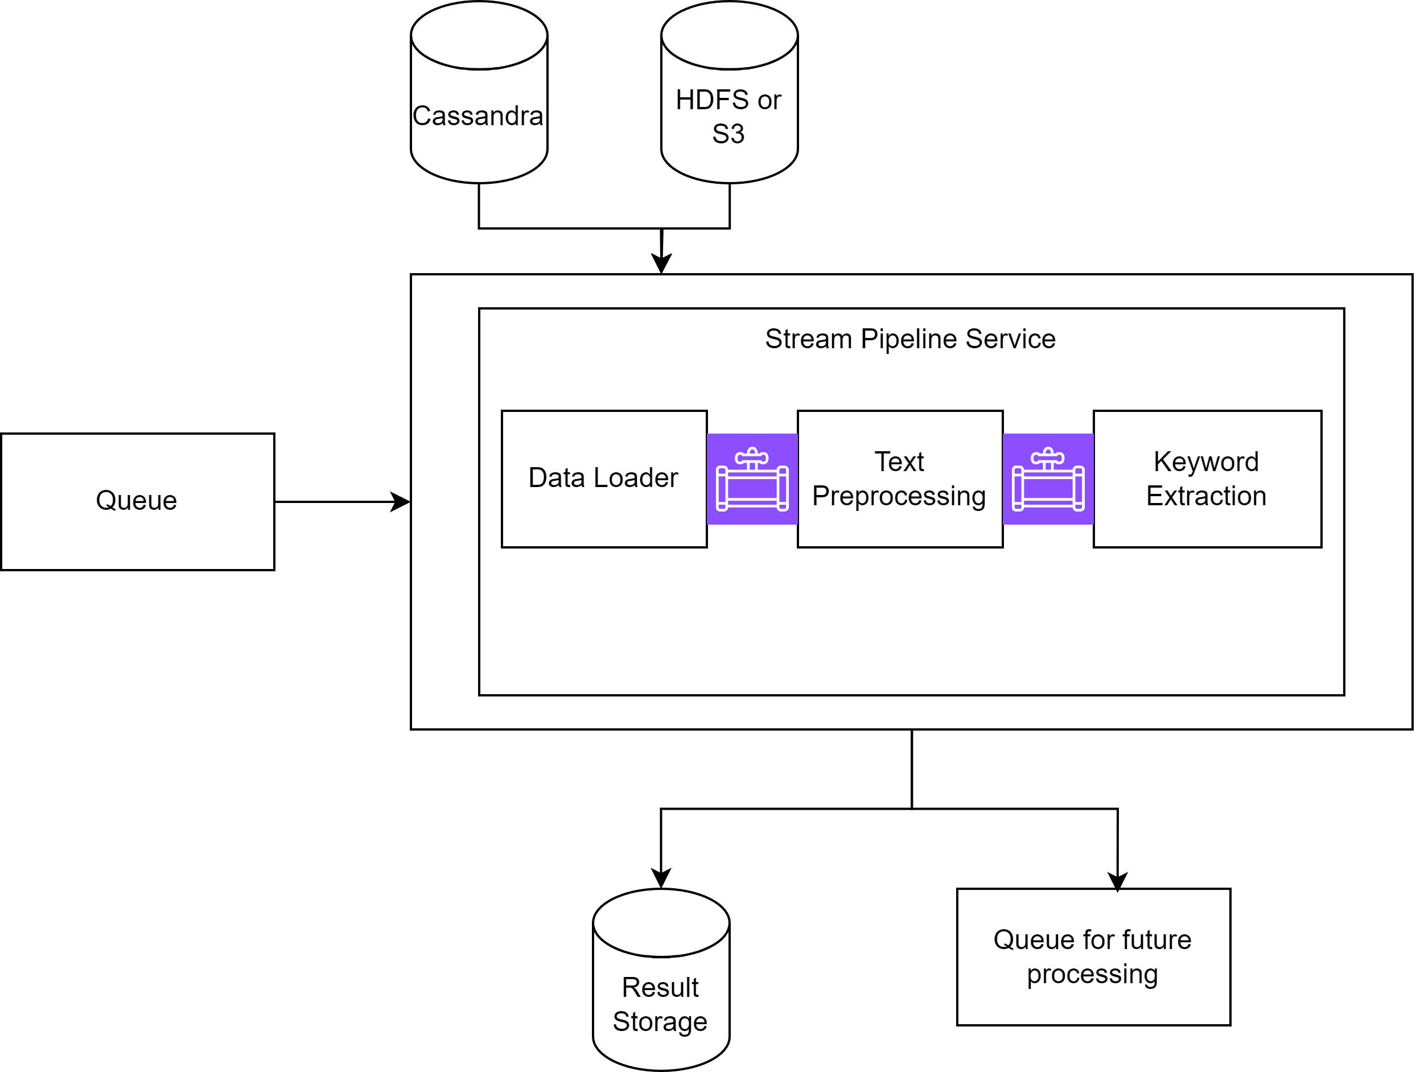
Detailed design
Keyword Extraction Pipeline – Extract Keywords, Ranks them, Generates data points
Uses Partitioned Queue as input source
Partitioned to get higher throughput by parallel processing. Partitioned using Consistent Hashing with n partitions
Queue can be populated by
last stage
By using Change Data Capture event on Cassandra.
Use Kafka Connect to pull the data from HDFS/S3
Use Data Streaming ETL technologies to extract keywords
Kafka Streams, AWS Kinesis, Apache Flink, GCP Dataflow, Apache Spark
Run multiple parallel consumer instances per partition
Auto Scaling by increase consumer instance based on queue load dynamically
Uses monitoring Data Replication, Exactly-Once Semantics and Checkpointing
Notes:
https://github.com/BruceDone/awesome-crawler

Slide 25
Detailed design
Keyword Extraction Pipeline
Stages -
Text Processing – Tokenization, Stop word Removal, Stemming/Lemmatization and normalisation.
Using SpaCy or NLTK python libraries
Keyword extraction by ranking – Use Contextually aware algorithms
Use Category and Metadata of the extracted content to get contextual information
Statistical Approach such as
TF-IDF method
Machine Learning based such as
TextRank
BERT – Has Contextual understanding, etc
Correlate related keywords as a single set
Choose highest ranking words as trending keywords from that text content. Store freq, rankings.
Push the processed data to the next stage pipeline (Message Queue) as well as store in DB (Cassandra, DDB)
Notes:
https://github.com/BruceDone/awesome-crawler

Slide 26
Detailed design
Keyword Analysis and Trend Detection – Aggregates Keywords into Trends, Does Scoring.
Stream Input using Partitioned Queue – Partitioned using Consistent Hashing with n partitions for parallel processing. Uses keywords object with timestamp as composite key for hashing
Ensures similar keywords are distributed across partitions.
Stages
Keyword Embedding – Streaming embeddings like Word2Vec, BERT
Stream Clustering – Online K-Means or Streaming DBSCAN. Done to group similar keywords into single tag
Sentiment Analysis - For each cluster, for each stream input, perform sentiment classification and scoring
Uses TextBlob or Any other pretrained AI Model
Trend Scoring – Uses clusters, Category, Rankings of keywords, Relevance, Frequency, Metadata, Sentiment Score etc to calculate Trend score of each cluster
Uses streaming aggregations, Map-Reduce etc to converge to Trend score per cluster
Uses NLP/ML techniques to determine relevance and decode relevance factors.
Uses Weighted Score Formula for Summarizing and calculating score.
Notes:
https://github.com/BruceDone/awesome-crawler

Slide 27
Detailed design
Keyword Analysis and Trend Detection
Trend Normalization (Tagging) – Each Cluster is finally tagged with appropriate name, and a record with relevant attributes like, keywords, sentiments, category, metadata etc is created
Use NLP for label generation or identification
Identify Related Trends
Correlate with Recent past runs.
Trend Storage – Trend Stored in a Data lake or OLAP DB (BigQuery/Athena/SnowFlake DB) once the Current Run is complete. Supports SQL like querying
Uses streaming Pipeline technology.
Uses In-Memory Cache DB with persistence like Redis to store tag cluster information. Can be further complemented by Cassandra/DynamoDB.
Uses DB Replication (Eventual Consistency but High Availability), Checkpointing
Hot Trends/Repeated Keywords will lead to large queues (Hot Partitions). Auto scale consumer instances on such partitions
Triggers completion Notification when queue becomes empty
Notes:
https://github.com/BruceDone/awesome-crawler

Slide 28
Detailed design
Keyword Analysis and Trend Detection
Emerging Trends – Feedback Loop
If Certain Trends rise faster than a threshold limit during a specific run, then (Compared to its history)
Identify Related Trends using NLP/AI Models
Determine related websites and seed hashtags
Reschedule these websites/hashtags for a fresh run using Dynamic Scheduling
Notes:
https://github.com/BruceDone/awesome-crawler

Slide 29
Detailed design
Trend Aggregation Service
Runs at the end of Single Run
Short Running Job, triggered By Notifications.
Can use Kubernetes Jobs, AWS Lambda, or GCP Functions
Populates User Data Layer. This Layer acts a Data Cache for End Users
Increases API Performances and Decreases Latency
Ensures High Availability
Custom Data Schema tailored for API
Stores Latest Trends data into Elasticsearch DB or Solr with Indexing
Allows fast String based searches like Keywords, Category, Tags
Stores Historical data in aggregated views. Uses SQL with indexing on time fields, category, trends scores etc
Allows fast loading of various Trends for Visualizations and Dashboards
Generates Tag Cloud based on Trend Score
Inbuilt Monitoring. Stateless Execution with Retry mechanism.
Notes:
https://github.com/BruceDone/awesome-crawler

Slide 30
Detailed design
Tag Cloud Service
Generates a Tag Cloud
Aggregates tags as JSON documents with their Tag Name, ID, Link, Score, Category and Relevance metadata
Stores JSON documents in MongoDB or DocumentDB
Indexes data on Tag Name, Score and Category
Trends Tag Cloud APIs
Allows fetching Top tags, with additional filtering criteria like Category, Relevance
Tag listing is adaptive and predictive. Depending on the current context like recent searches, usage pattern, current content being compiled for an email template, geographical and demographical relevance, it keeps updating itself.
Allows fetching relevant tags
Notes:
https://github.com/BruceDone/awesome-crawler

Slide 31
Detailed design
API Service
Uses API Gateway and ALB
Highly Scalable Micro-Services using Kubernetes Pods, (AWS Lambda, GCP Cloud Functions can hit limits)
This architecture ensures High Availability
Uses Redis/Memcached for Caching with TTL set to 1 hour for lower latency. LRU Eviction method
Access control using Either Session Token (For Mailchimp UI) or JWT Tokens from IDPs
Search & List APIs
Uses ML/NLP to extract relevant keywords from the search term and then searches them in latest trends data (Elasticsearch DB or solr)
Adaptive, is context aware and uses recent searches as relevance
Some relevance meta is passed in API like user preferences, some are extracted directly like location info, while search history is stored and used for further calls.
Sorts output on the basis of Trends Score, Sentiment Score and Relevance
Paginated data
Can be extended to search by chat or voice
Notes:
https://github.com/BruceDone/awesome-crawler
Why 1 hour TTL – Trends won’t change in an Hour. But for a user, usually sessions last an hour while doing exploratory work.

Slide 32
Detailed design
API Service
Visualization APIs
Uses SQL, paginations and limits
Uses pre-generated aggregated views for most relevant data
Most reports and dashboard uses these views
Historical Data APIs
Can allow slicing and dicing historical trends by allowing direct access to the data lake
Tag/Keyword Highlighting API
Uses ML/NLP to do analyse currently entered text to find relevant tags/keywords
Predictive Highlighting - Can try to predict additional tags which user may enter
Returns all such tags with keyword mapping for highlighting
Adaptive, context aware
Notes:
https://github.com/BruceDone/awesome-crawler

Slide 33
Detailed design
Logging, Monitoring & Notification Services
Logging & Monitoring
Uses inbuilt logging and monitoring services complemented by Prometheus for metric scraping and reporting for Kubernetes clusters
Health APIs based health checks
Uses AWS/GCP inbuilt Logging and Monitoring services (CloudWatch, LogExplorer)
Uses inbuilt logging and monitoring dashboards of Data streaming services, Kafka, Flink, Spark etc exposes such service.
Custom Monitor – A Special Monitor metric which tracks the volume of data being flown through pipelines. This metric is scarped and reported to Prometheus for reporting and Notifications
These can be piped to Prometheus or ELK stack for logging, monitoring and Notifications
Notifications Services
Use Prometheus AlertManager, SNS, or other queues complemented with Slack, Email notifications
Stage monitors queue length (back pressure) to notify completion of stage/run to all services
Stage Notifications are reported internally & Externally. Used for triggering next stage, next run etc
Notes:
https://github.com/BruceDone/awesome-crawler

Slide 34
Security Considerations
Apart from the previously mentioned considerations
Logging and Auditing
Use SSL/HTTPS for communication
Principle of Least Privileges
Use Service accounts for pipelines and services
Limit permission and access to data stores
Data Integrity
Schema Validations
Origin of trends must be trackable.- Use timestamps and IDs for this
NLP & AI Model Security Considerations
Be careful with 3rd Party owned Models – They can use our data for training
Don’t expose Sensitive data
Models must be trustworthy. Sandbox Testing must be done.
Prefer Owned (Hosted) Models when possible
Notes:
https://github.com/BruceDone/awesome-crawler

Slide 35
Other Considerations
Here we summarise the various techniques used for
Performance Considerations
Parallel Execution
Queue Partitioning
Auto Scaling
Multi Instances
Streaming pipelines
URL Deduping
Caching
Efficient Storage
Partitioned storage
Indexing
Custom Views
Notes:
https://github.com/BruceDone/awesome-crawler

Slide 36
Other Considerations
High Availability, Fault Tolerance & Reliability
Use Distributed and Multi Instance Systems
Effective load balancing
Automatic failover
Hot Partition Management
We can get hot partitions but effective load balancing can mitigate the risks
Effective State Management and Storage
Try to be state less if possible
Health checks
Database replications
Stream Checkpointing
Exactly once semantics – Ensures data consistency
Redundant Monitoring and Notification System
Consistent Hashing
Historical Correlation, Threshold points
Notes:
https://github.com/BruceDone/awesome-crawler

Slide 37
Other Considerations
UX Considerations
Seamless Integration
Dynamic Tag Cloud, Keyword Highlighting, etc ensures user can get insights while building their email template or marketing campaign
Trend Categorization
Highlight and prioritize relevant categories
Trend Searches
Advanced filtering
Autocomplete, predictive searches
Trend Visualization
Relevant easy to use to interactive and customizable reports
User preference & Usage pattern
Use this as relevance data for all APIs
Notes:
https://github.com/BruceDone/awesome-crawler

Slide 38
Other Considerations
UX Considerations
Performance and Low latency
Responsive UX Design
Tooltips and guides
User feedback
This is critical as we will need to improve our accuracy and create a feedback loop
Report Issues, Survey forms
Notes:
https://github.com/BruceDone/awesome-crawler

Slide 39
Final Thoughts
Training the Models
Use Pre-Trained Models where possible
Focus on Tuning existing models
Train custom models for simple ML problems like Classifications
Can make chatbot
Chatbot can allow chat based or voice based chatting for trend discovery and slicing and dicing
Chatbot can easily integrate with Mailchimp UI or integrate with existing
Data Accuracy and Relevance – Feedback model
Continuous retraining & Improvements of models
Capturing feedback
Actionable Insights – Propose how to use trends, predicting future
Adaptability
We can swap, replace, modify and adapt systems as needed. (Use Open source systems, Cloud Infra etc)
Notes:
https://github.com/BruceDone/awesome-crawler

Slide 40
Thank You
Notes:
https://github.com/BruceDone/awesome-crawler

