Slide 1
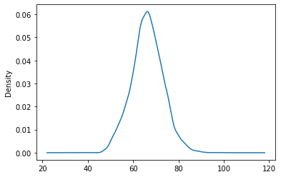
The distribution of Overall rating for all players

Slide 2
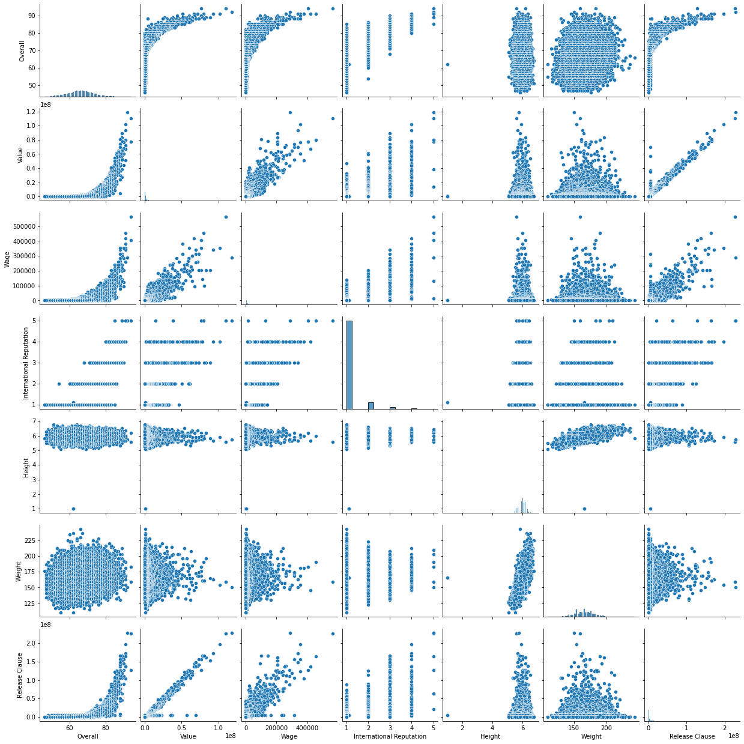
Pair plots for the Numeric variables:

Slide 3
Table containing the top 20 players ranked by Overall score and whose contract expires in 2020
ID | Name | Overall | Potential | Value | Wage | Age | International Reputation | Skill Moves | Position | Height | Weight | Release Clause
3 | 193080 | De Gea | 91 | 93 | 72000000.0 | 260000.0 | 27 | 4.0 | 1.0 | GK | 6.333333 | 168.0 | 138600000.0
6 | 177003 | L. Modrić | 91 | 91 | 67000000.0 | 420000.0 | 32 | 4.0 | 4.0 | RCM | 5.666667 | 146.0 | 137400000.0
8 | 155862 | Sergio Ramos | 91 | 91 | 51000000.0 | 380000.0 | 32 | 4.0 | 3.0 | RCB | 6.000000 | 181.0 | 104600000.0
5 | 183277 | E. Hazard | 91 | 91 | 93000000.0 | 340000.0 | 27 | 4.0 | 4.0 | LF | 5.666667 | 163.0 | 172100000.0
13 | 168542 | David Silva | 90 | 90 | 60000000.0 | 285000.0 | 32 | 4.0 | 4.0 | LCM | 5.666667 | 148.0 | 111000000.0
21 | 179813 | E. Cavani | 89 | 89 | 60000000.0 | 200000.0 | 31 | 4.0 | 3.0 | LS | 6.083333 | 170.0 | 111000000.0
24 | 138956 | G. Chiellini | 89 | 89 | 27000000.0 | 215000.0 | 33 | 4.0 | 2.0 | LCB | 6.166667 | 187.0 | 44600000.0
31 | 190460 | C. Eriksen | 88 | 91 | 73500000.0 | 205000.0 | 26 | 3.0 | 4.0 | CAM | 5.916667 | 168.0 | 141500000.0
39 | 164240 | Thiago Silva | 88 | 88 | 24000000.0 | 165000.0 | 33 | 4.0 | 2.0 | RCB | 6.000000 | 181.0 | 44400000.0
50 | 175943 | D. Mertens | 87 | 87 | 45000000.0 | 135000.0 | 31 | 3.0 | 4.0 | RF | 5.583333 | 134.0 | 76500000.0
52 | 171877 | M. Hamšík | 87 | 87 | 46500000.0 | 125000.0 | 30 | 3.0 | 3.0 | LCM | 6.000000 | 174.0 | 79100000.0
49 | 189332 | Jordi Alba | 87 | 87 | 38000000.0 | 250000.0 | 29 | 3.0 | 3.0 | LB | 5.583333 | 150.0 | 77900000.0
46 | 193041 | K. Navas | 87 | 87 | 30500000.0 | 195000.0 | 31 | 3.0 | 1.0 | GK | 6.083333 | 176.0 | 62500000.0
64 | 191043 | Alex Sandro | 86 | 86 | 36500000.0 | 160000.0 | 27 | 3.0 | 3.0 | LB | 5.916667 | 176.0 | 60200000.0
71 | 184087 | T. Alderweireld | 86 | 87 | 39000000.0 | 150000.0 | 29 | 3.0 | 2.0 | RCB | 6.083333 | 179.0 | 75100000.0
73 | 177509 | M. Benatia | 86 | 86 | 30000000.0 | 160000.0 | 31 | 3.0 | 2.0 | CB | 6.166667 | 207.0 | 49500000.0
75 | 135507 | Fernandinho | 86 | 86 | 18000000.0 | 185000.0 | 33 | 3.0 | 3.0 | CDM | 5.833333 | 148.0 | 33300000.0
102 | 171919 | Naldo | 85 | 85 | 9000000.0 | 38000.0 | 35 | 3.0 | 2.0 | CB | 6.500000 | 201.0 | 15300000.0
104 | 168609 | Miranda | 85 | 85 | 15500000.0 | 96000.0 | 33 | 3.0 | 2.0 | CB | 6.083333 | 172.0 | 26400000.0
103 | 170890 | B. Matuidi | 85 | 85 | 26000000.0 | 145000.0 | 31 | 3.0 | 2.0 | LM | 5.916667 | 165.0 | 42900000.0

Slide 4
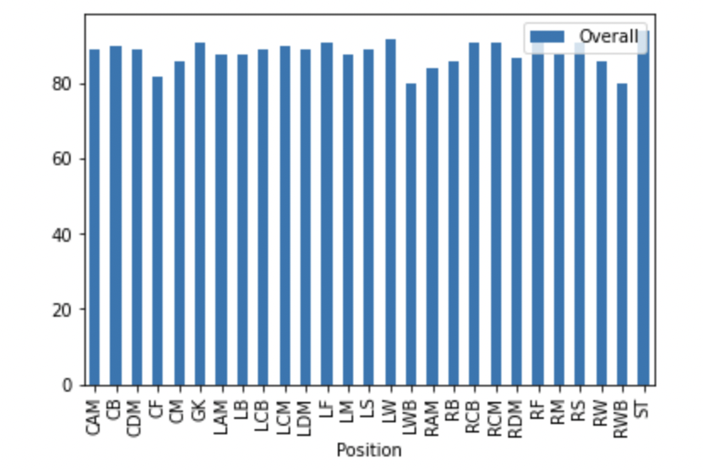
Top players by Overall rating for each unique position
Position | Name | Overall
CAM | Álvaro Peña | 89
CB | Zhu Jiayi | 90
CDM | Óscar Valentín | 89
CF | Z. Sanogo | 82
CM | Óliver Torres | 86
GK | Óscar Whalley | 91
LAM | Y. Ono | 88
LB | Ángel | 88
LCB | Íñigo López | 89
LCM | Z. Kalmár | 90
LDM | Zeca | 89
LF | T. Matsuura | 91
LM | Óscar Plano | 88
LS | Yoo Seung Min | 89
LW | Álvaro Bustos | 92
LWB | Y. Tanaka | 80
RAM | Y. Cabrera | 84
RB | Óscar Gil | 86
RCB | Ícaro | 91
RCM | Óscar | 91
RDM | Zheng Zhi | 87
RF | Zhang Xizhe | 94
RM | Álvaro Jiménez | 88
RS | Z. Ibrahimović | 91
RW | Élton | 86
RWB | Yang Kuo | 80
ST | Éder | 94

Slide 5
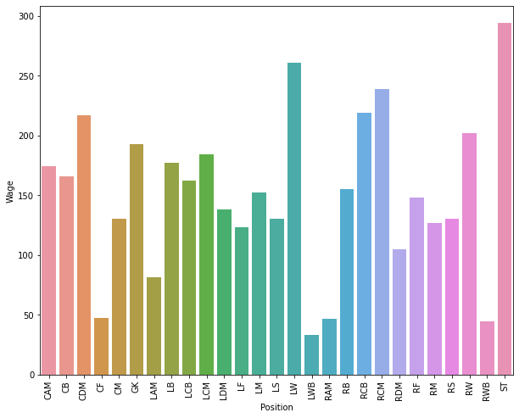
The average wage one can expect to pay for the top 5 in every position
Average wage to be paid to top 5 players by position is as follows:
Position
CAM 174000.0
CB 166000.0
CDM 217000.0
CF 47400.0
CM 130600.0
GK 192800.0
LAM 81600.0
LB 177200.0
LCB 162000.0
LCM 184400.0
LDM 138000.0
LF 123200.0
LM 152600.0
LS 130200.0
LW 261000.0
LWB 33000.0
RAM 46600.0
RB 155400.0
RCB 219000.0
RCM 238600.0
RDM 105000.0
RF 148000.0
RM 126400.0
RS 130400.0
RW 202000.0
RWB 44200.0
ST 294000.0

