Slide 1
User Engagement Analysis For RESTARANT SUCCESS
By Brajendra Kumar Pathak

Slide 2
About Yelp
Yelp is a web and mobile platform that functions as a crowd-sourced local business review site. Users can submit reviews, photos, and tips about businesses, while also browsing information and ratings left by others

Slide 3
AGENDA
Problem Statement
Research Objective
Hypothesis
Data Overview
Analysis and Findings
Recommendations

Slide 4
Problem Statement
In the fiercely competitive landscape of the restaurant industry, grasping the nuances that drive business triumph becomes paramount for all involved parties. With the utilization of the Yelp dataset as its foundation, this undertaking endeavors to delve into the intricate interplay between user interaction (comprising reviews, tips, and check-ins) and the pivotal metrics of business prosperity (encompassing review count and ratings) within the realm of restaurants.

Slide 5
Research Objective
Quantify the correlation between user engagement (reviews, tips, check-ins) and review count/average star rating
Analyze the impact of sentiment on review count and average star rating.
Time Trends in User
Engagement

Slide 6
Hypothesis
Higher levels of user engagement (more reviews, tips, and check-ins) correlate with higher review counts and ratings for restaurants.
Positive sentiment expressed in reviews and tips contributes to higher overall ratings and review counts for restaurants.
Consistent engagement over time is positively associated with sustained business success for restaurants.

Slide 7
Data Overview
This dataset is a subset of Yelp and has information about businesses across 8 metropolitan areas in the USA and Canada.
The original data is shared by Yelp as JSON files and is also available on Kaggle.
The five JSON files are business, review, user, tip and checkin.
The JSON files are stored in the database(SQL) for easy retrieval of data.

Slide 8
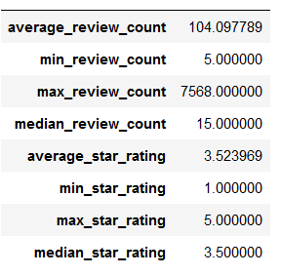
Analysis and Findings
Out of 150k businesses, 35k are restaurants business and are open.
Table showing distribution of business success metrics (review count and average rating):

Slide 9
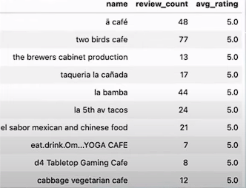
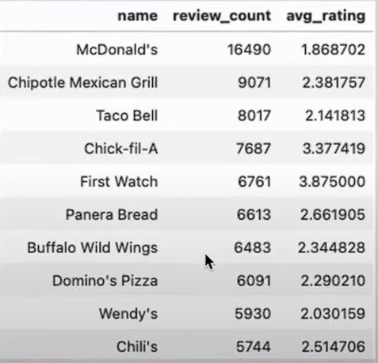
Highest Rating
Highest Review Count
﻿Higher ratings do not guarantee a higher review count, or vice versa.
Success of Restaurants is not solely determined by ratings or review counts.
Review count reflects user engagement but not necessarily overall customer satisfaction or business performance.

Slide 10
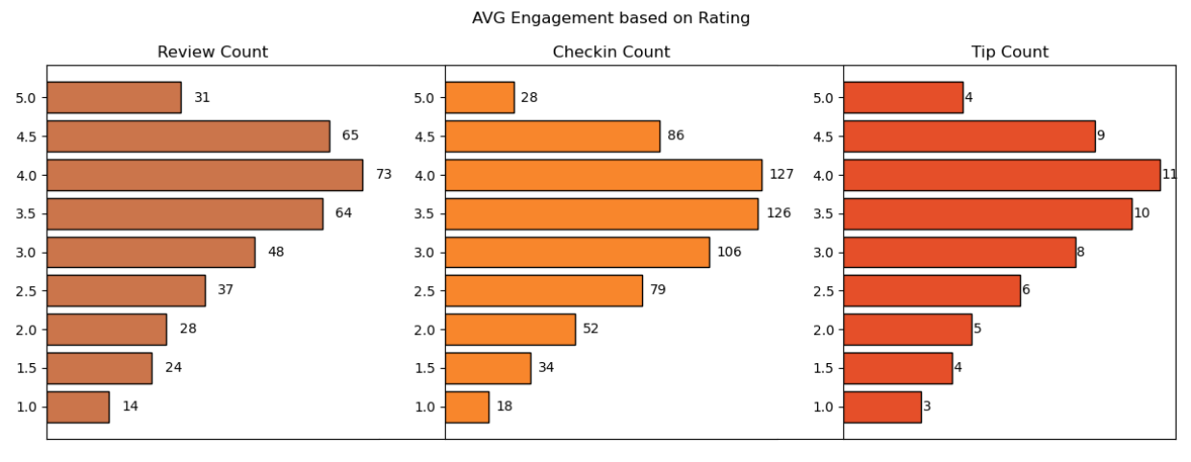
Do restaurants with higher engagement tend to have higher ratings?
Data shows a general increase in average review, check-in, and tip counts as ratings improve from 1 to 4 stars.
Restaurants rated 4 stars exhibit the highest engagement and shows a downward trend for rating above 4.
The drop in engagement at 5.0 stars might suggest either a saturation point where fewer customers feel compelled to add their reviews, or a selectivity where only a small, satisfied audience frequents these establishments.

Slide 11
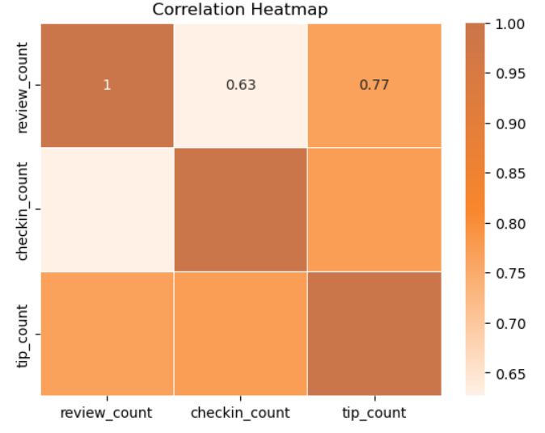
Is there a correlation between the number of reviews, tips, and check-ins for a business?
These correlations suggest that user engagement across different platforms (reviews, tips, and check-ins) is interlinked; higher activity in one area tends to be associated with higher activity in others.
Businesses should focus on strategies that boost all types of user engagement, as increases in one type of engagement are likely to drive increases in others, enhancing overall visibility and interaction with customers.

Slide 12
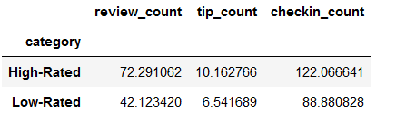
Is there a difference in the user engagement between high- rated and low-rated businesses?
Data indicates a clear correlation between higher ratings and increased user engagement across reviews, tips, and check-ins.
This pattern underscores the importance of maintaining high service and quality standards, as these appear to drive more reviews, check-ins, and tips, which are critical metrics of customer engagement and satisfaction.

Slide 13
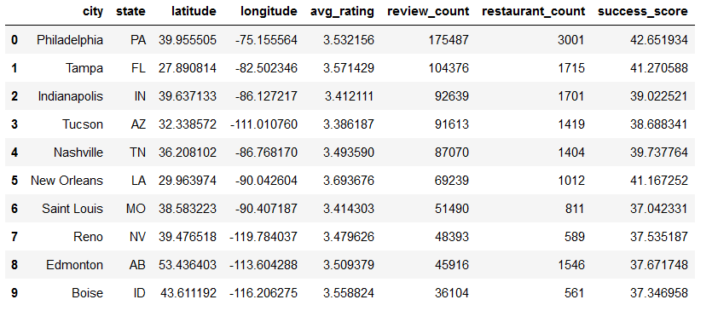
How do the success metrics of restaurants vary across different states and cities?
Philadelphia emerges as the top city with the highest success score, indicating a combination of high ratings and active user engagement.
Following Philadelphia, Tampa, Indianapolis, and Tucson rank among the top cities with significant success scores, suggesting thriving restaurant scenes in these areas.

Slide 14
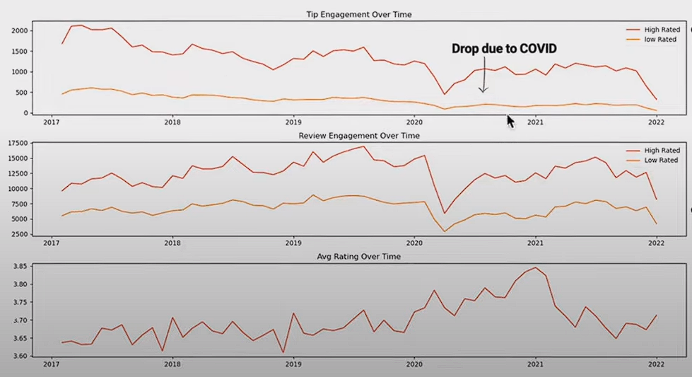
Are there any patterns in user engagement over time for successful businesses compared to less successful ones?
Successful businesses, particularly those with higher ratings (above 3.5), exhibit consistent and possibly increasing user engagement over time.
High rated restaurants maintain a steady or growing level of user engagement over time, reflecting ongoing customer interest and satisfaction.

Slide 15
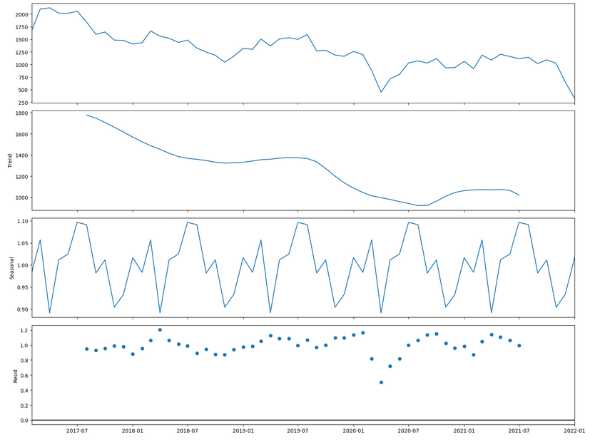
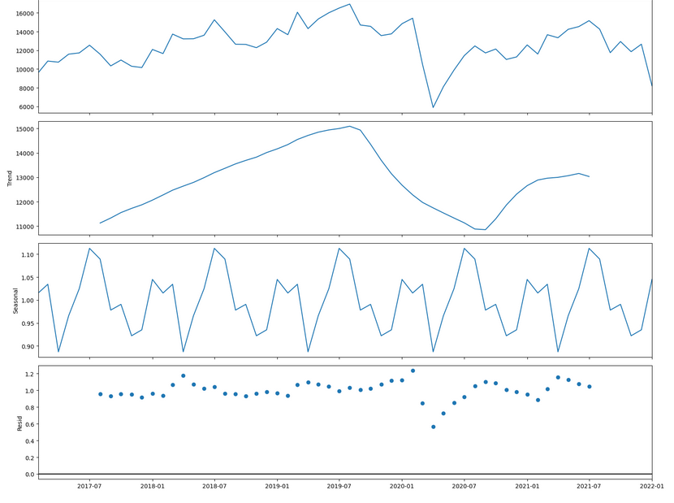
Trend and Seasonality Analysis
Tip Count
Review Count
Downward Trend
Upward Trend
Year Starting and ending(Nov-Mar) is Highly Engaging

Slide 16
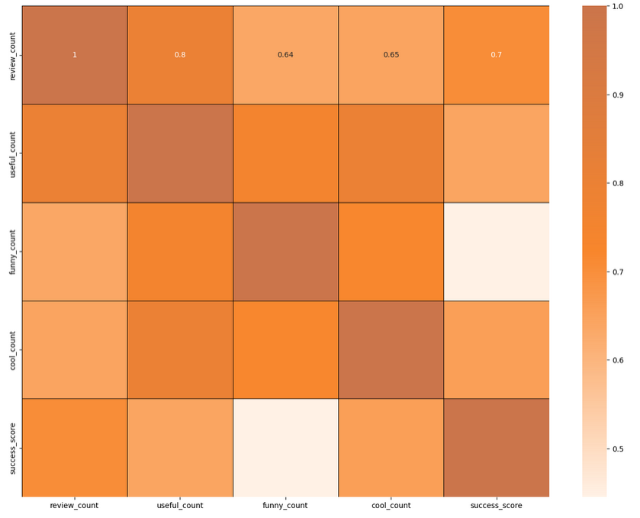
How does the sentiment of reviews and tips (useful, funny, cool) correlate with the success metrics of restaurants?
"useful," "funny," and "cool" are attributes associated with user reviews. They represent the feedback provided by users about the usefulness, humor, or coolness of a particular review.
Higher counts of useful, funny, and cool reviews suggest greater user engagement and satisfaction, which are key factors contributing success_score - to a restaurant's success.

Slide 17
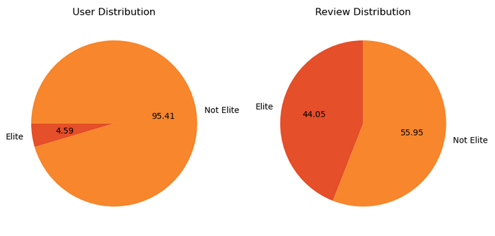
Is there any difference in engagement of elite users and non elite users?
Elite users are individuals who have been recognized and awarded the "Elite" status by Yelp for their active and high-quality contributions.
Elite users, despite being significantly fewer in number, contribute a substantial proportion of the total review count compared to non-elite users.
Establishing a positive relationship with elite users can lead to repeat visits and loyalty, as they are more likely to continue supporting businesses they have had good experiences with.

Slide 18
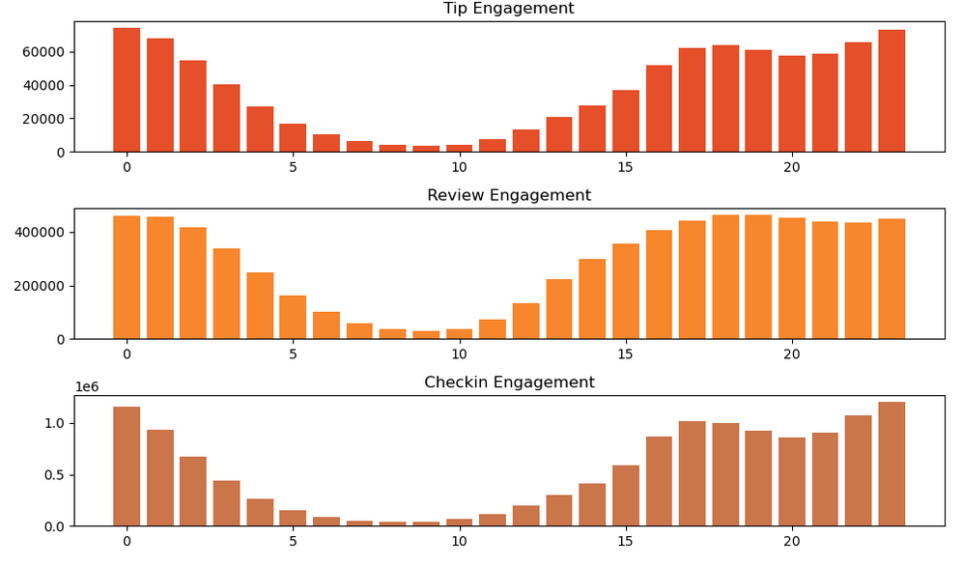
Busiest Hours
The busiest hours for restaurants, based on user engagement, span from 4 pm to 1am.
Knowing the peak hours allows businesses to optimize their staffing levels and resource allocation during these times to ensure efficient operations and quality service delivery.
The concentration of user engagement during the evening and night hours suggests a higher demand for dining out during these times, potentially driven by factors such as work schedules, social gatherings, and leisure activities.

