Slide 1
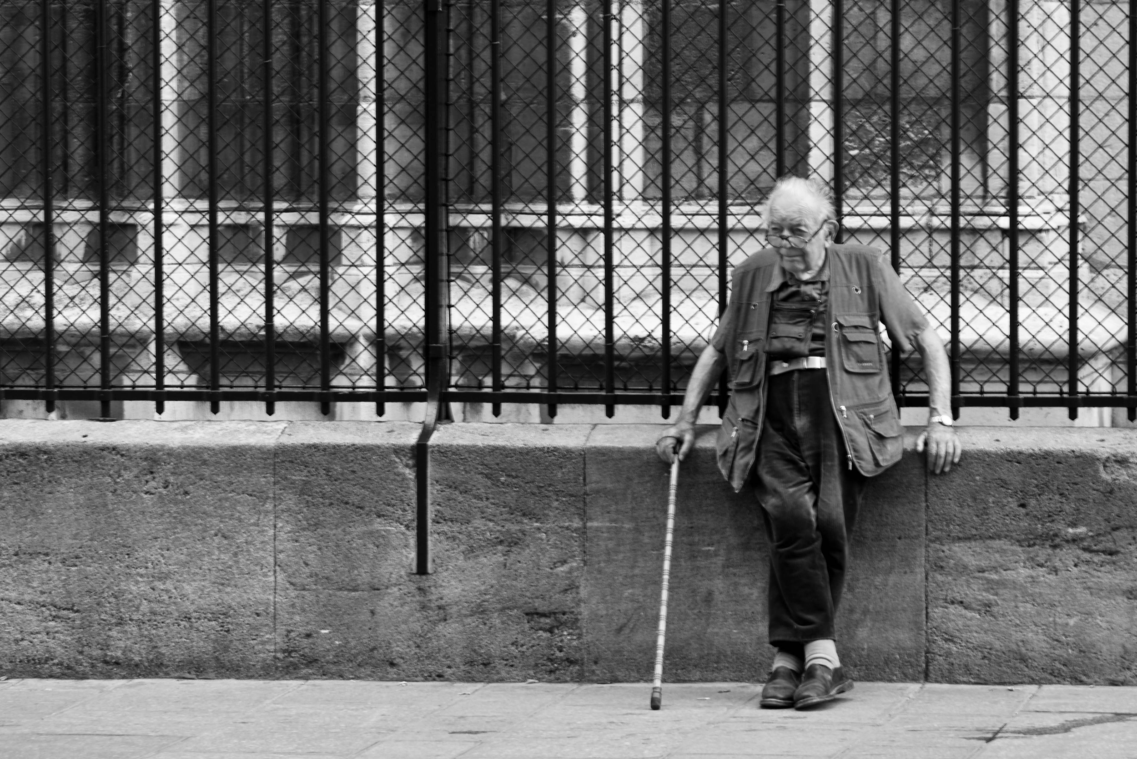
Door security system Care-center
Milo Cesar, Apostolis Christoulias, Danique Lummen, Jesper Simon, Suzanna Wentzel, Chris Witteveen

Slide 2
Content
Problem Definition
Requirements
Design Description
Demo

Slide 3
Small introduction
> Care-center
> New Keycard system
> Advantages:
User friendly
Secure
Easy adjustable

Slide 4
Problem Definition
> Help and protect clients
> Prevent non-authorized people from gaining UID’s

Slide 5
Requirements
> The door doesn’t open for unauthorized tags
> The door opens for authorized tags
> The door locks itself if the user closes the door
> All doors can be opened at once in case of emergency

Slide 6
Requirements
> All doors can be closed at once in case of emergency
> Roles, persons and doors can be added or deleted to the database
> Permission for persons or roles can be added or deleted to the database
> Door remains unlocked for 15 seconds, if the door is not opened
> Door unlocks within 3 seconds when card is presented to RFID reader

Slide 7
Design description
> Different blocks:
Tag
Arduino
Server
Database

Slide 8
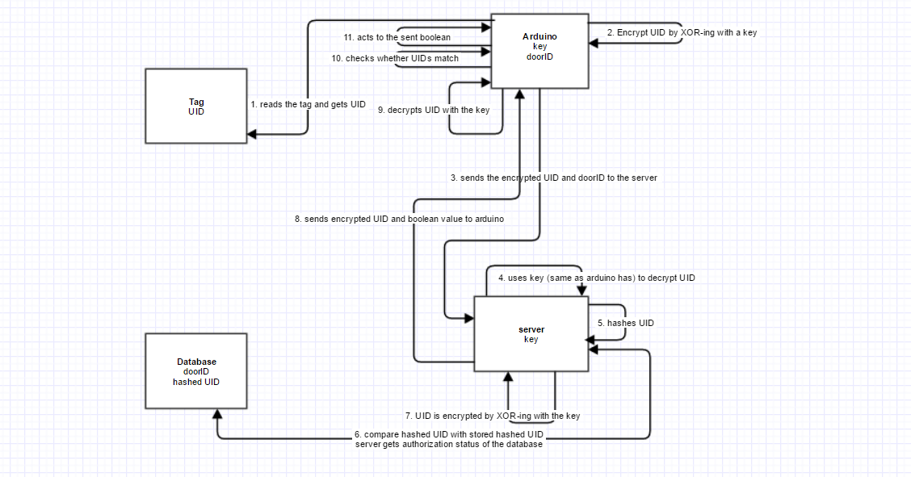

Slide 9
Demo time

