Slide 1
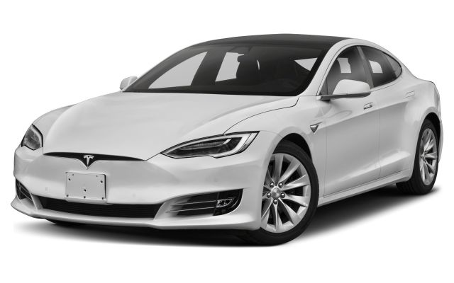
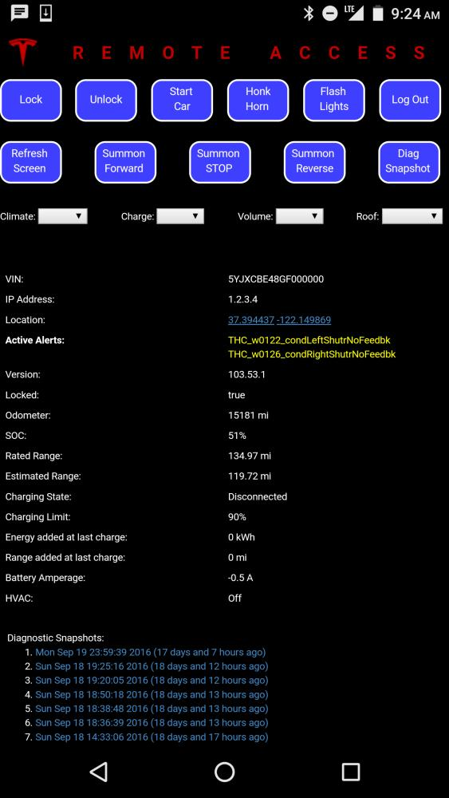
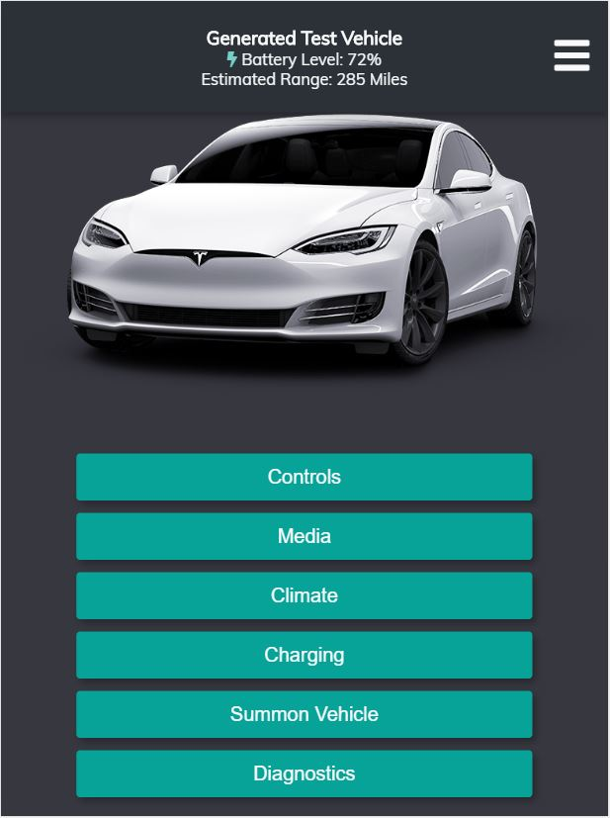
Group #22
Purpose: Grey Market Teslas
Tesla Web Application
Finished Result
In the event of a Tesla vehicle being involved in an accident and having damages totaling the vehicle, Tesla refuses to continue support, both physically and digitally. This is most evident in Tesla servers refusing to acknowledge requests to and from the mobile application.
Phil Sadow, of Ingineerix, has developed a very simple web app that gives back some functionality to the users. However, the app is dated and missing many features that many web apps have today.
Phil also requested that we update his back end since it was written in Perl. He wanted us to introduce a fleet feature that would allow users to have more than one vehicle registered to their account.
Another request Phil had was to make the app more pleasing to look at. He wanted the app to be more modern, and to closely resemble Tesla’s own app.
This application has restored the mobile functionality that is seen in the first party application by Tesla
Features Implemented:
Climate Control
Turn Car On/Off
Summon Car
Lock/Unlock Doors
View Diagnostics of the Car
Design is similar to that of Tesla’s own to help users become familiar with where features are and how features work
Even after a totaled Tesla vehicle is repaired, owners lose the ability to connect to their vehicle remotely. This application seeks to fix that.
STYLING & DESIGN
SERVER & COMMUNICATION
The front end of this application is built using ReactJS components. These components include things like header bars and side menus that combine to form the entire page. This made the page modular and easy to experiment with.
The styling of the page is done using Sass, which is compiled into CSS code.
Usability is one of the main goals of this application, and it uses dynamic page loading, graphics, and a mobile optimized view to ensure a good user experience.
We developed our server using the NodeJS framework, which had strong security boosts as well as a close connection to existing community infrastructure
We extensively used the TeslaJS library that encapsulates the Tesla RESTful API, which is the main API that Tesla vehicles use to connect to Tesla servers
There is an extensive mySQL database that holds a variety of diagnostic information, user statistics, and provides functionality for users, such as those who own fleets of these vehicles and want quick access to their different cars.

