Slide 1
ATP Visualization in System F
Kyle McDonald

Slide 2
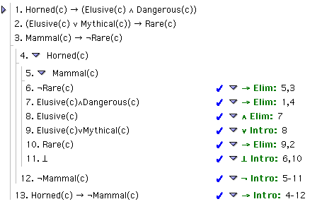
Introduction to the Idea
Consider:
Notes:
There are some easy things to automate in F.
For example, the first two steps (backward) in this proof.
But when you get the point of this contradiction, you’re at a bit of a standstill.
Your mindset is “Let’s see, there must be a contradiction lurking around here somewhere.”
So, the impetus from this project comes from that feeling…
I wanted to see if I could write an ATP that took would be able to show those mindsets.
This might come in useful in trying to teach F, but really I just wanted to see what it would look like.
The goal, essentially, is to develop a sort of model, by introspection, for theorem proving.

Slide 3
Initial Direction
Algorithm design and backend structure went hand in hand
Approach: very object oriented – like manipulating a proof in Fitch
Most time was spent writing the backend
Notes:
Obviously, I had to take into consideration that this was going to eventually be implemented on a computer.
From the beginning I was already imagining what the best programming approach would be.
I realized pretty quickly that I needed some sort of proof object that I could manipulate in the same way I might interact with Fitch.
Most of my time was actually spent writing this backend code that would let me implement the ATP.

Slide 4
Backend Design
main
Solver
Step
Proof
is a
Line
has a
Sentence
Parser
Literal
Operator
Predicate
Arguments
Notes:
The actual structure of the backend might be more interesting than the algorithm itself.
As I worked on this I felt a bit of sympathy for the programmers that wrote Fitch.
[Draw on the board showing different parts of the backend:
proof
line
sentence]
Give definition of Step (part of a proof… either a line or a sub proof).

Slide 5
Primary Backend Differences
Doesn’t assume two arguments per operand
  “A ∧ B ∧ C” is stored as (A ∧ B ∧ C),
  not ((A ∧ B) ∧ C)
Predicate support
Not just for an ATP
  Too much time spent on validity-checking
Notes:
Rebecca and I have been talking a bit about these projects, since we were both working with ATPs in F.
She was going to compare her ATP to mine, but I wasn’t ready in time, so I’ll mention some of the interesting differences between our approaches.
Besides little things, (like the way my parser is more lenient due to its use of regular expressions),
there is an essential difference in how we store arguments.
Rebecca has an ingeniously elegant method (describe)
But the reason I didn’t implement that is because I knew it would be a problem when comparing sentences or looking for sub-sentences.
So, instead, all my operators store their arguments in a vector, and I have a method for doing unordered comparison.
I was initially surprised at how many problems required predicates, so I modified my structure slightly to account for them.
Finally, there is a choice I made early on that I would have made differently.
Rebecca assumes that her ATP is always applying rules correctly.
This means she doesn’t have to write code to check for the validity of rules.
This would have been so much easier, I can now see I spent too much time working with validity.
But, it’s for a good reason…

Slide 6
Origin of the Algorithm
All the Intro to Logic proofs (that didn’t involve quantifiers)
Fundamental idea: walk backwards, attempt to support unsupported lines.
Notes:
In my proposal, I said I wanted the ATP to work on “textbook style” problems.
So, to get the foundation of the algorithm, I basically did every proof from Intro to logic again.
I watched myself very carefully and tried to categorize the decisions I was making.
If we think of a proof as a tree, the first thing I saw was that the invalid (unsupported) lines were the open branches.
This is why I spent so much time coding validity-checking rules, the ATP works by walking backwards through the proof, recursively, looking for unsupported rules.
This gives me the freedom to develop a sort of “Advanced Proving” tool, where you can have the ATP help you solve proofs, but I really should have left it alone for this project.

Slide 7
The Algorithm
Forwards
  Decompose (φ ∧ ψ ∧ …)
    Often, not always necessary
  Decompose (φ → ψ) and (φ ↔ ψ)
    Rare, invited
Backwards
  …depends on sentence
Notes:
So here’s the actual algorithm…
As I watched myself I noticed two things I was doing.
The first is so subtle you don’t even realize it: simply decomposing conjunctions into their conjuncts, and decomposing conditionals and biconditionals when possible. Decomposed conjunctions can provide “baggage” in the proof, but they simplify some other steps (and can be cleaned up later).
In practice, whenever you’re decomposing a conditional it’s “about time” for it to happen.
The backwards steps are much more intricate.

Slide 8
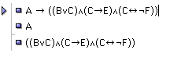
Similarities in Backwards
No one in their right mind would try and prove each of the conjuncts separately.
“Context Lookup”
Notes:
There is are some similarities between different scenarios going backwards.

Slide 9
Context Lookup
Almost always, you want to check if the argument is going “in the direction” you’re looking for.
If we think of a proof as a top-down, left to right tree, the “context” is all the statements above and to the left. Everything that is “accessible”.

Slide 10
Context Lookup
Look for the current sentence (φ) in the context
If it appears as:
  (φ ∧ ψ) use ∧ elim
  (ψ → φ) or (ψ ↔ φ) use → or ↔ elim, and add the line ψ above this one
  (φ ∨ ψ) use ∨ elim, and set up for a proof by cases
Notes:
This is the best order I found from tests.

Slide 11
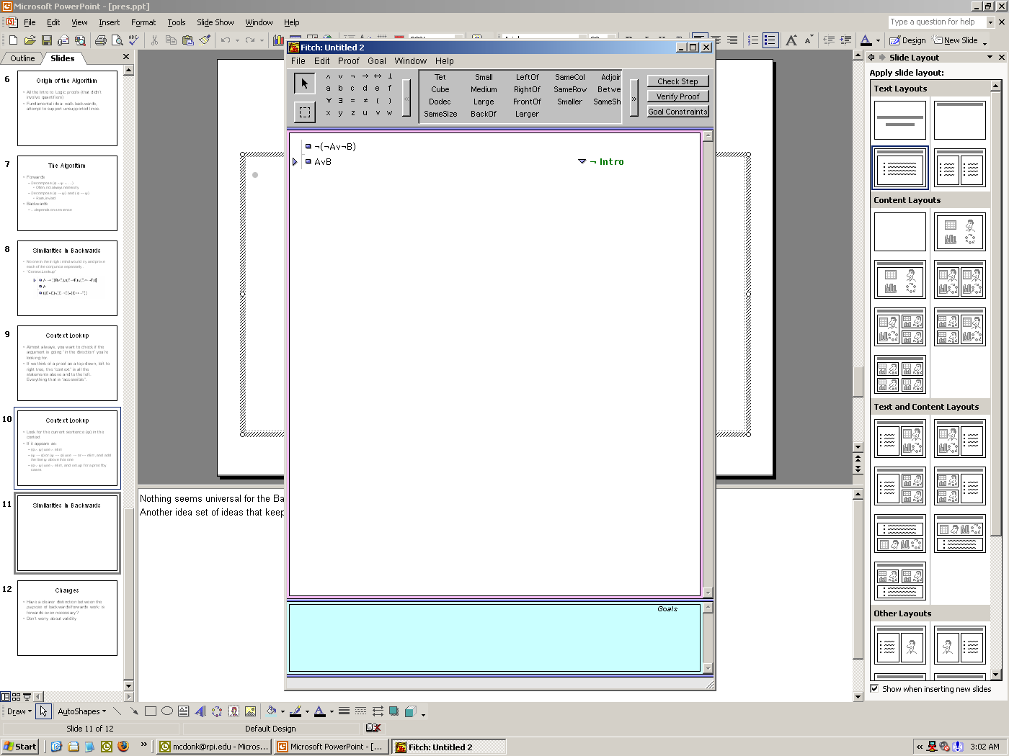
Similarities in Backwards
Looks simple – but what should we do?
“Last Resort”
Notes:
Nothing seems universal for the Backwards algorithm -- for example, Context Lookup cannot be used if you’re trying to find a contradiction.
Another idea set of ideas that keep popping up I’ve deemed the “Last Resort”

Slide 12
Last Resort
If there’s a disjunction in context, try proof by cases
  Good choice: proof by cases with similar sub-sentences (especially literals/predicates)
Proof by Contradiction
Notes:
Firstly, we make sure to try and proof by cases that’s been left laying around.
If there are a few, we’ll pick the one that has the most similar structure (most similar literals, etc).
If there aren’t any disjunctions in the current context, or we’ve already tried them (which I’ll get to later), set up a proof by contradiction.

Slide 13
Individual Methods
Each sentence type has its own approach
  ¬φ
  φ → ψ and φ ↔ ψ
  Predicates and Literals
  φ ∧ ψ
  φ ∨ ψ
  ⊥

Slide 14
¬φ
Context Lookup
Setup for ¬ intro (proof by contradiction)

Slide 15
φ → ψ and φ ↔ ψ
Context Lookup
Setup for → intro, or ↔ intro

Slide 16
Predicates and Literals
Context Lookup
Last Resort
Notes:
Nothing in between.

Slide 17
φ ∧ ψ
Context Lookup
Set up for ∧ intro

Slide 18
φ ∨ ψ
Context Lookup
Do Context Lookup on each disjunct
  e.g.: from φ, derive φ ∨ ψ
Last Resort
Notes:
This is the most ridiculous case.

Slide 19
⊥
Look for contradictions
  Directly
    φ and ¬φ
  Indirectly
    If there is a ¬(φ ∨ ψ), look for φ or ψ
    If there is a ¬(φ ∧ ψ), look for φ and ψ
    If there is a φ and ψ→¬φ, look for ψ
    …etc.
    Seems inelegant
Proof by Cases (first half of “Last Resort”)
Notes:
There is no clear way to find contradictions.

Slide 20
Mindsets
Each of these approaches, when carried through successfully, inscribes a “mindset” on the solver
Benefit to the ATP: don’t repeat the same mindset (e.g.: try a proof by cases twice on the same line)
It’s what can be visualized
  Show the mindsets as they are attempted
  Show connections to what “spurred” the mindset
Notes:
So now we get back to this idea of visualizing this entire process.
The fundamental notion I see worth tracking are the changing “mindsets”.
If we consider each of these approaches a “mindset”.

Slide 21
Mindsets
Further developments might involve ideas from neural networks and psychology – activation/priming for ambiguous situations.
  e.g.: Should I do a proof by contradiction on an entire conjunction, or each of its conjuncts? Which would be cleaner?

Slide 22
Visualization
Printing proofs
  HTML
Processing for visualizing mindsets
  Simple interface to Java

Slide 23
Changes
Have a clearer distinction between the purpose of backwards/forwards work: is forwards even necessary?
Don’t worry about validity as much
I’m not settled about “deeply hidden hints” / recursively obfuscated ideas
Notes:
There are some hints that I can derive from premises about the argument that aren’t manifest in the system yet (“deeply hidden hints”).
I should be able to “get at” some of these via recursion, but it’s not clear how (without doing imaginary proofs on a sketchpad of some sort).

