Slide 1
Capacity forecast on DALI data.
Spa
rk
Bram Vonk, JADS-Enexis, September 2021
context
status
outlook

Slide 2
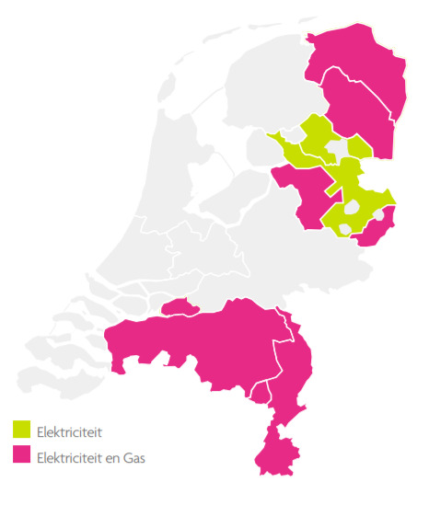
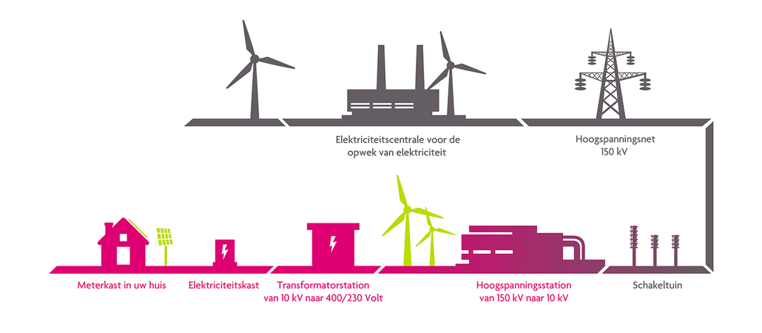
Grid management overhead line ← Enexis → your fusebox

Slide 3
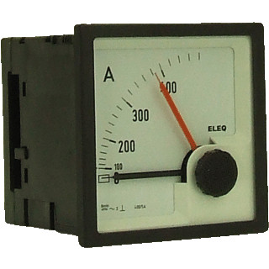
Capacity planning
Traditional method
Yearly loading assessed from drag pointer
Transformer towards limit → action (takes months)
Current situation
Energy transition → tranformer loading increases rapidly
Traditional method → overlading situations (reliability + safety issues)
But … 15 minute data on 10k/35k transformers available nowadays (a.k.a. DALI) …
Let’s use that data!

Slide 4
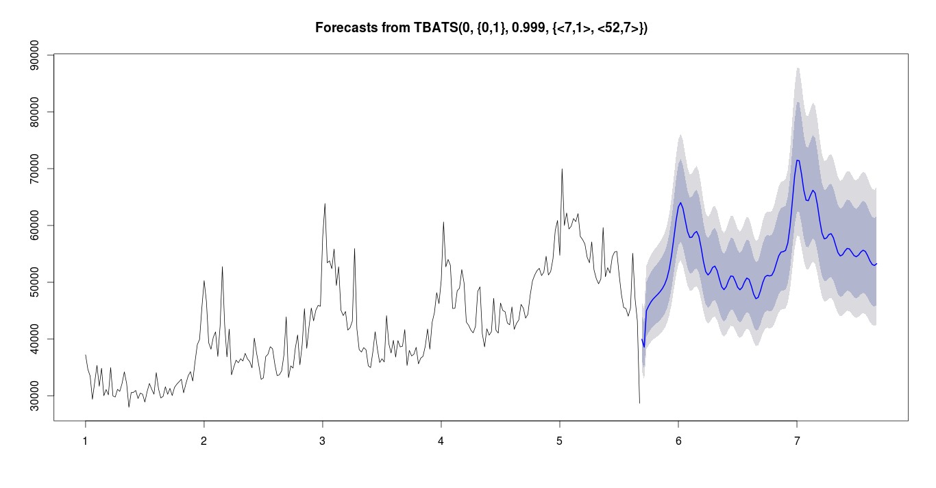
Goal of Spark project
Forecast capacity 6-12 months ahead
Example:
Predict in autumn a probability over overloading in spring.
transformer limit
transformer
loading
autumn
spring
historic data
forecast

Slide 5

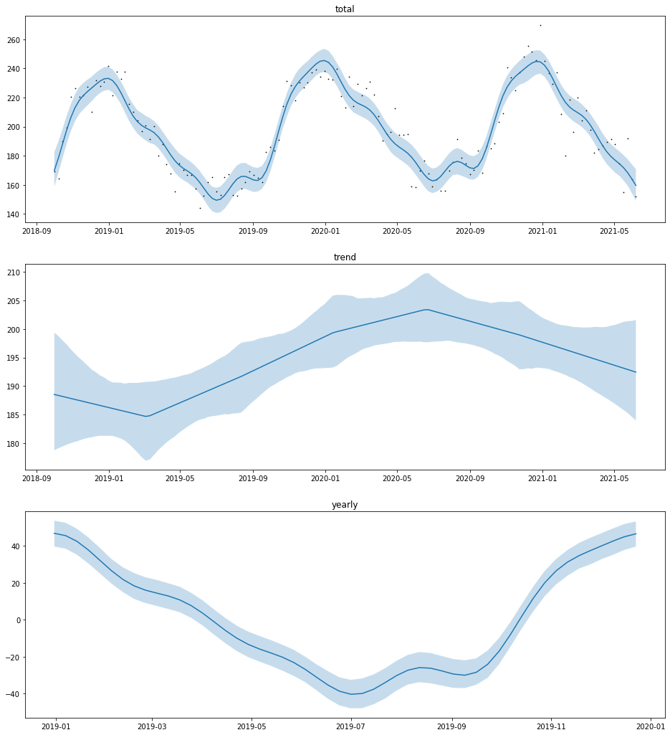
monthly / weekly
monthly
always
meta data
dashboard
weekly extremes
model
15 min data
week data
forecasts
Model: propabilistic additive model
total = trend + seasonaility
+ switch_load

Slide 6
backlog
Business Understanding
Data Understanding
Data Preparation
Modeling
Evaluation
Deployment
Transfer code to functions
Write forecast quantiles in DB
Backcast function for evaluation
Scheduled train + forecast
Reusable plot function
order / priority
Setup task for every month
Determine GUI with business
Deal with switch action in model
24/7 accessible tool
Dashboard results online
Model trend exponential function
Documentation online
Assess results with business
Scheduled data preprocessing
Detect max date specific week
Sorting algorithm for priority
Setup task for every week
Delete data from specific week
Export data for grid planning
Overload signaling
Shortcut to meetdata dashboard

Slide 7
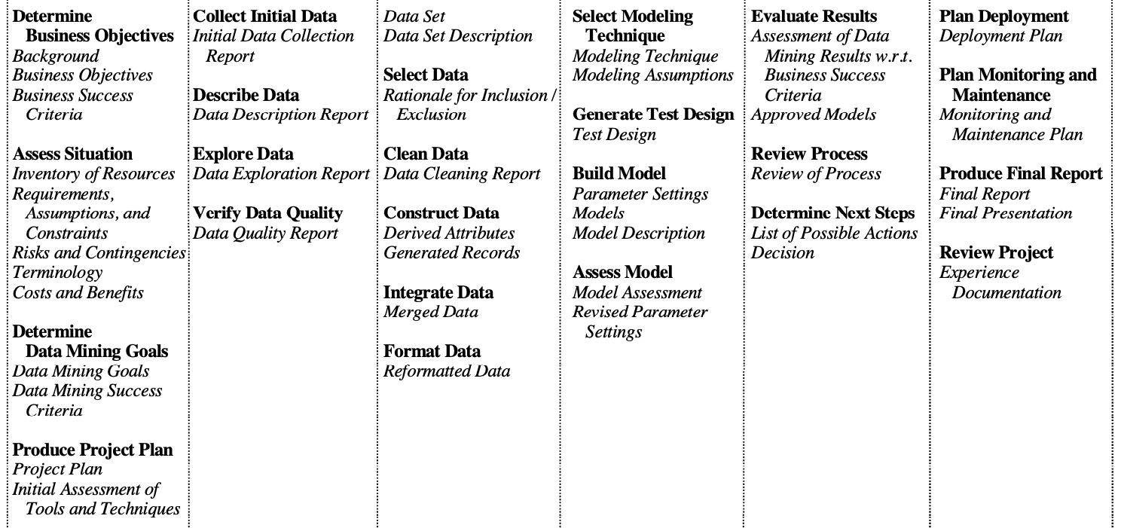
Way of Working vanuit Data Science/JADS: CRISP-DM
Business Understanding
Data Understanding
Data Preparation
Modeling
Evaluation
Deployment

Slide 8
Flow Down Business value
Business Value
Safety
Reliability
Affordability
Sustainability
Company KPI
Overloading
Outage
Claims
Ad hoc resources
Planned resources
Project KPI
Do nothing
Ad hoc replacement
Stop growth
Planned replacement
Possible actions
Optimal planning transformer replacement
Model Usage
Forecast Model
foreseeing transformer overload
Model result
Future power timeseries DALI
Y variables
Nominal power transformer
Historic power timeseries DALI
X Variables

Slide 9
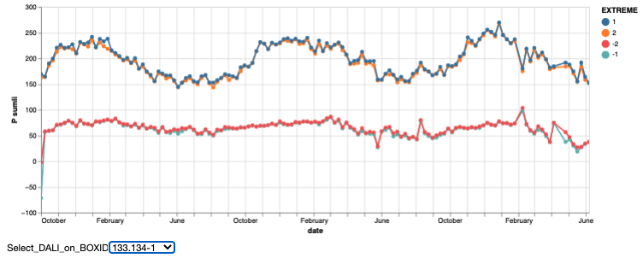
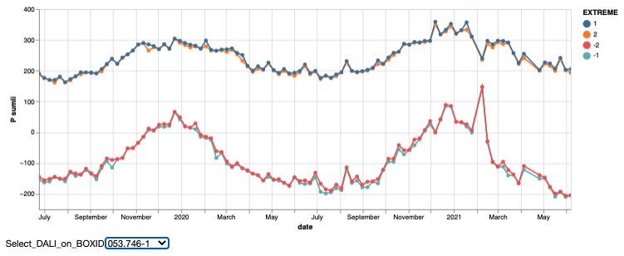
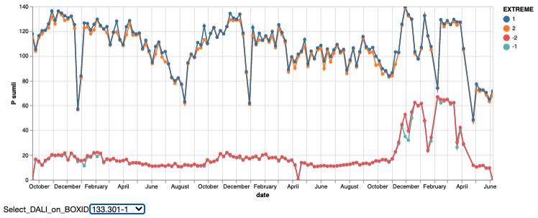
Data
10 random Dali trafo’s from metadata
7/10 existed in measurement table
4/10 had enough data (>2 year history)
General observations
Missing data draws extremes to mean
Completely missing weeks are interpolated
Weekly min and max are sufficient
No added value 2nd extreme (same as 1st)
Simplifies query
Sometimes weird situations (switching?)

Slide 10
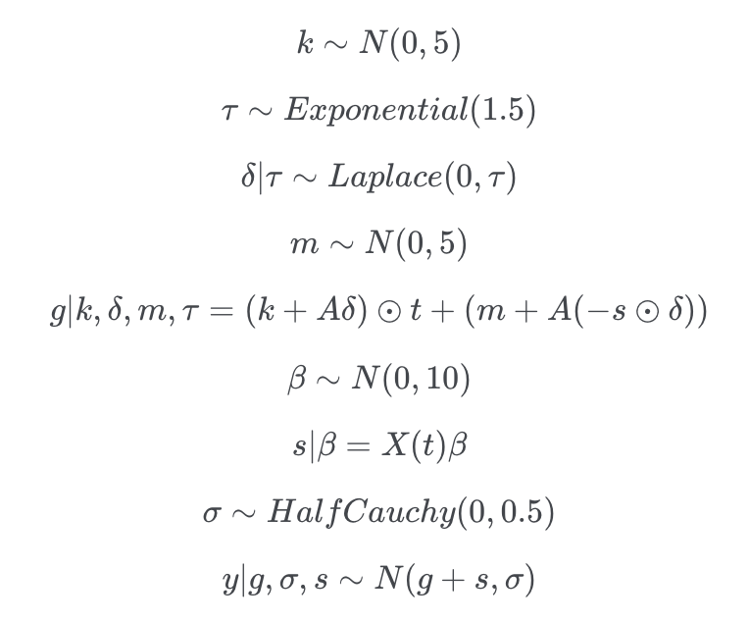
Model structure
Generalized Additive Model
Picked DALI box 133.134-1
Total = trend + year component

Slide 11
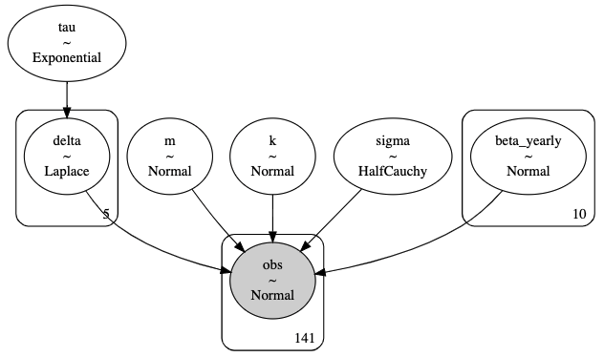
Model structure
Generalized Additive Model
Picked DALI box 133.134-1
Total = trend + year component

Slide 12
Model parameter estimation
On historic / observed data
95% quantile band (needs attention)
Issues with scaling of data for estimation

Slide 13
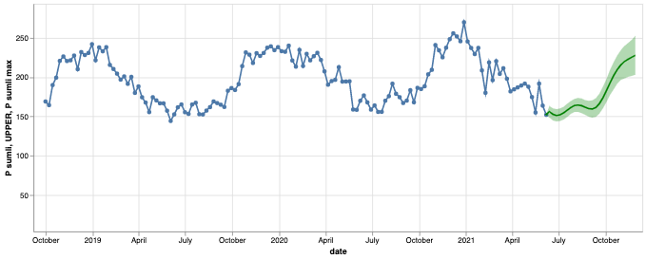
Forecasting with model
First impression → not too bad
Next step → validation with data
Request → overloading use cases

