Slide 1
Capacity forecast on DALI data.
Spa
rk
Bram Vonk, JADS-Enexis
June 21 2021

Slide 2
Slides on capacity forecast project (Spark)
Way of working throughout the project
Work first weeks
Current status
On DALI data (quality)
On model to be used.

Slide 3
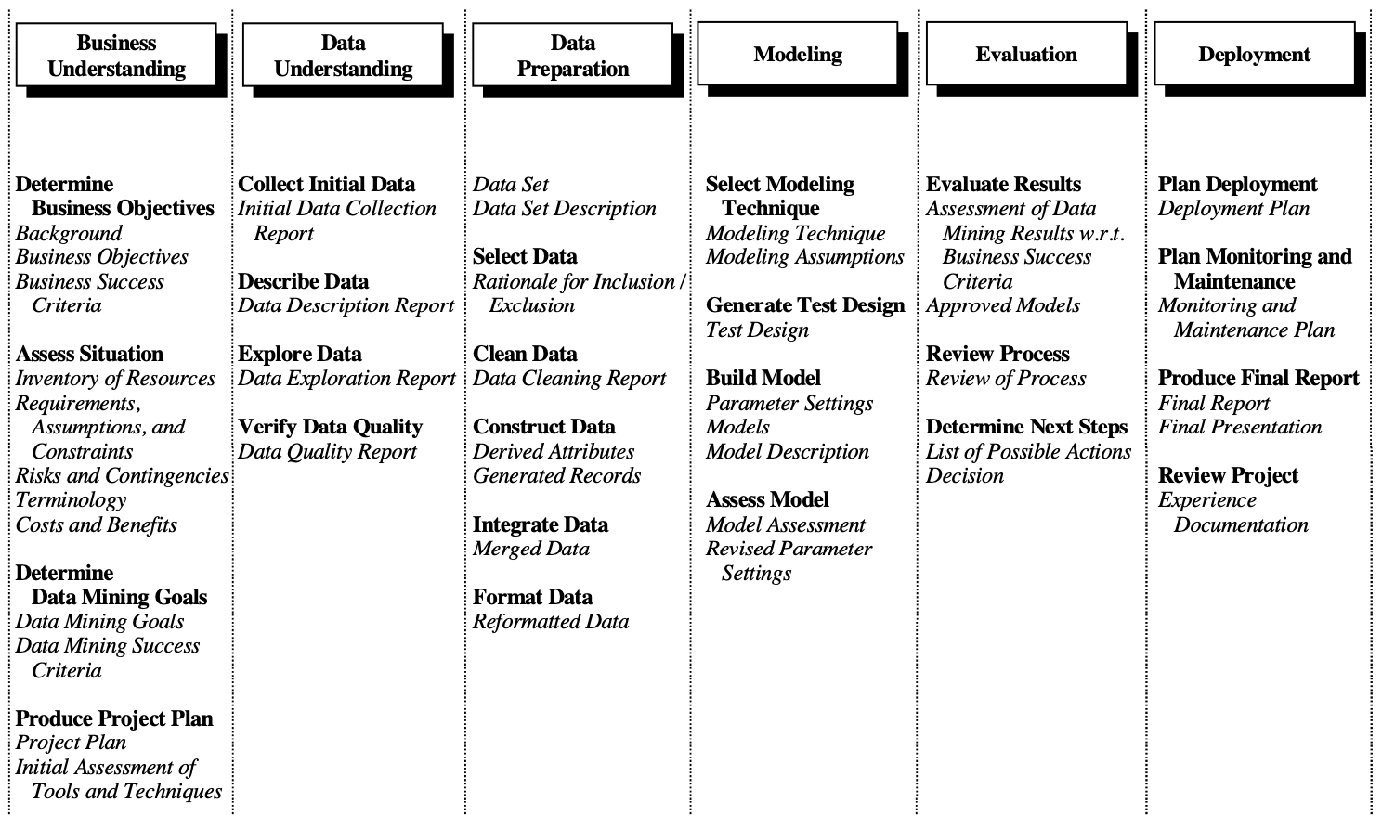
Way of Working vanuit Data Science/JADS: CRISP-DM
Business Understanding
Data Understanding
Data Preperation
Modeling
Evaluation
Deployment

Slide 4
Focus up to june 29
Business Understanding
Data Understanding
Actions Bram (partly done)
Check data access / quality
Suggestion for robustness data.
Input Grid Planners:
Tips / GO with suggested approach on data
Actions Bram
Report on Business Value
Flow down slides
Check from Grid Planners
Requirements
Flow down slide
Actions Bram (done)
First thoughts on modelling

Slide 5
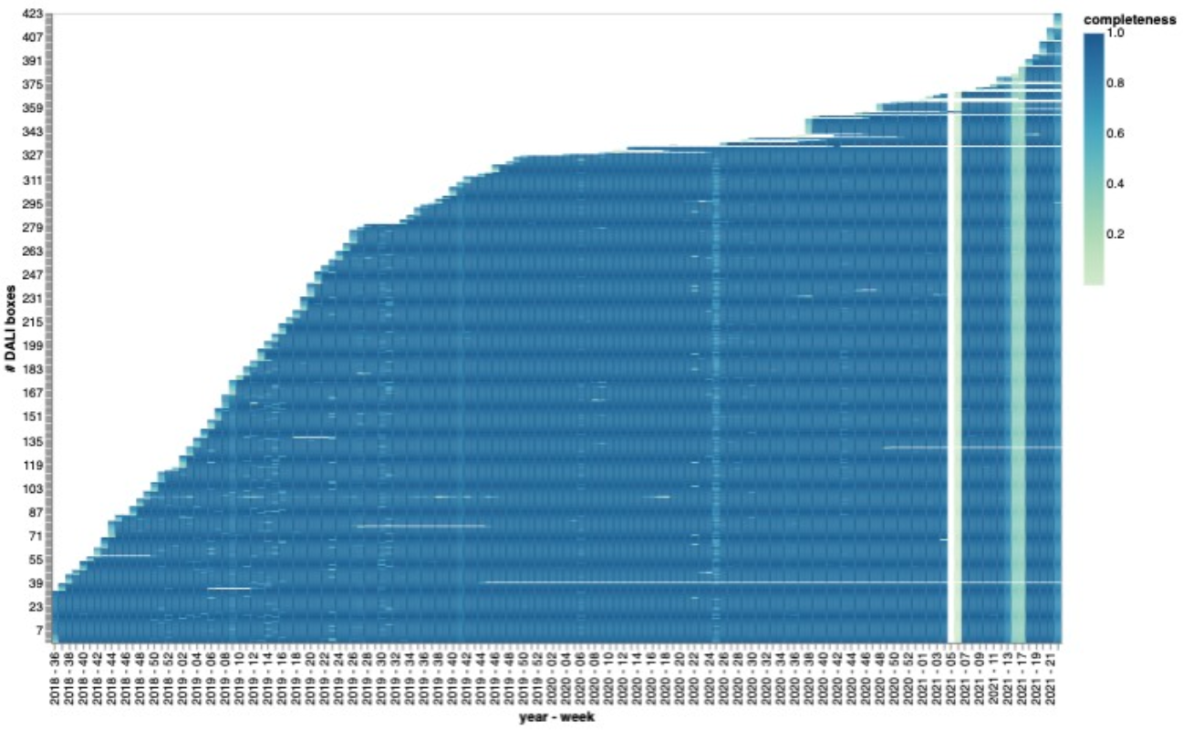
Data
(meta)data available (queried)
Source: Athena → Snowflake
15 minute averages (per phase and sum)
Data since 2018 (growing pop. → 8k)
Proposal:
10 transformers for PoC
Scale to 423 for development + test
End product testing on 8k (dummy 35k)
Data quality
± 400 DALI boxes in vestiging ‘Breda’?
Completeness issues
Loading issues snowflake, data expected to be there later.
Concept preprocessing:
3 most extreme values per week, transformer, phase
3 most extremes → more robust
Per week → more robust + eliminates week seasonality
Per phase → start with sum, but enable per phase later
Storage result: AWS S3, parquet for speed

Slide 6
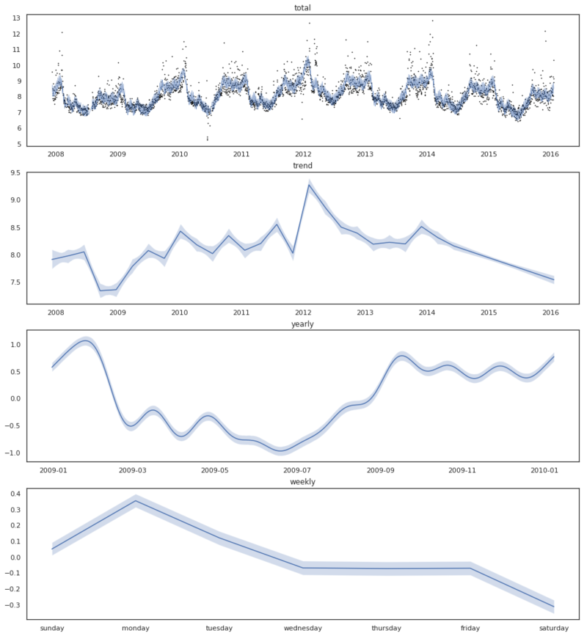
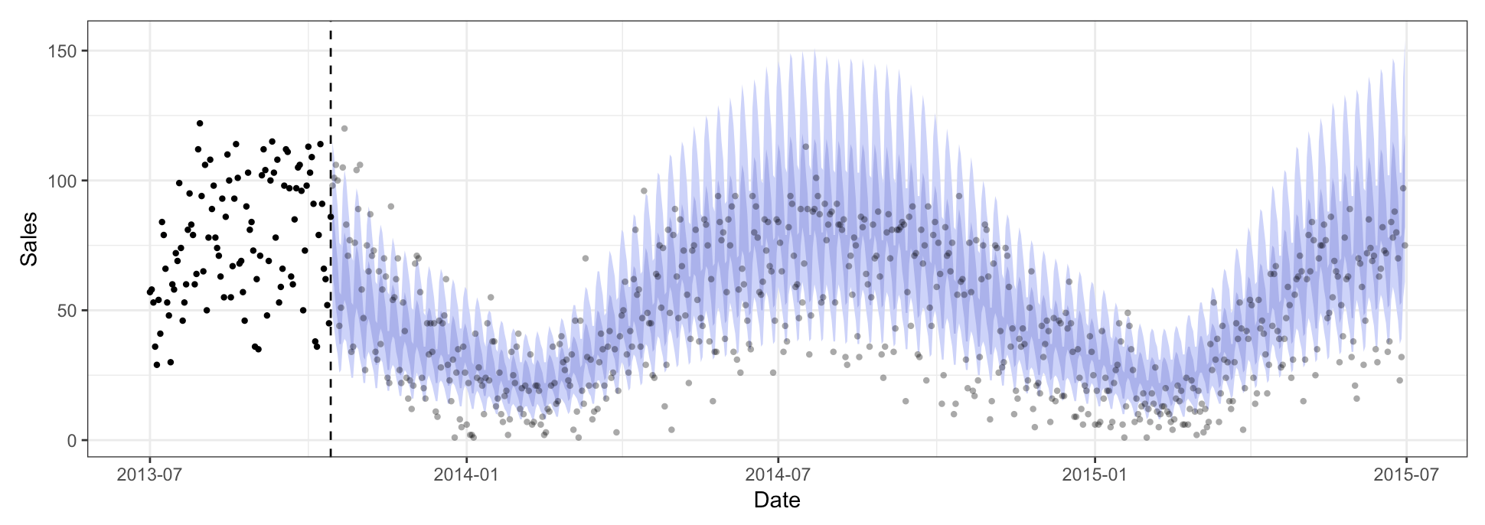
Probabilistic modelling
Probabilistic approach (bayesian)
Enables prediction interval
Risk: computational burden?
Able to deal with prior knowledge (from other boxes)
Generalized Additive Model
Decomposable
yearly season + piecewise trend + (error)
Explainable

Slide 7
Flow Down

