Slide 1
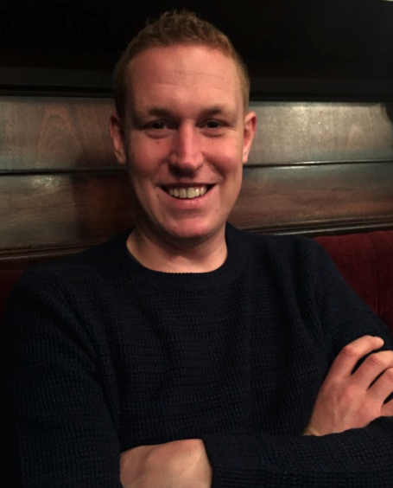
Short introduction
Bram Vonk
Background in electrical engineering (TU/e)
Ten years at Enexis
Innovatie, Infra EBS S&B, Data Science (now)
Currently enrolled in profesional education lead track of JADS:
Course of 7 months (ends in December 2021).
Involves leading and executing a Data Science project.
Project of interest is capacity planning.

Slide 2
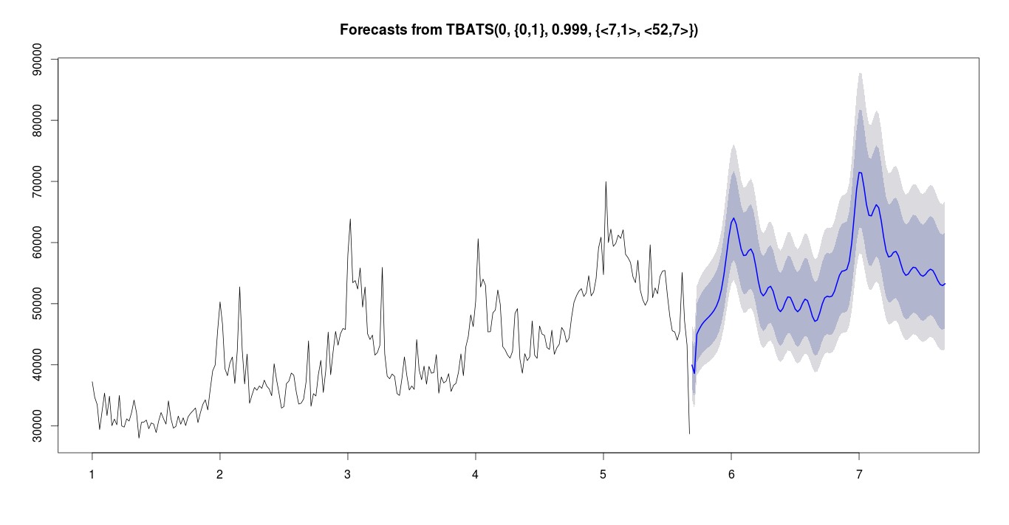
The case
Problem
Traditionally reactive management of ±35k distribution transformers.
Transformer loading towards capacity limit → mitigating actions.
Grid planners need time to arrange these actions.
Energy transition accelerates growth capacity demand
Too little time left to act.
Opportunity
Measurements of ±8k transformers
Use data to forecast possible issues
E.g. forecast in autumn issues in spring
transformer limit
transformer
loading
autumn
spring
historic data
forecast

Slide 3
The case
Grid planners needs
Forecasts available for thousands of transformers
Including uncertainty of forecast.
Scalable and maintanable within Enexis ICT landscape.
Low effort required
Little searching: ordered/coloured by priority / alarm thresholds.
Quick and easy visual inspection/validation (such as depicted in figure).
Outcomes exportable for eg. load flow calculations.
Nice to haves
Data/modeling
In case of short data history use data of peers.
*Recommend new measurements *separate study “case B” if time permits
Determine type of transformers that seem to have issues
Find similar unmeasured transformers to start measurements.
transformer limit
transformer
loading
autumn
spring
historic data
forecast

Slide 4









Collaboration
Synchronising work / updates / checks
When required, with end users (Grid Planners)
Informing, progress and feedback in general
Scrum like print review
Every 3 weeks.
All stakeholders welcome.
Support, when required:
PDEng for academic support
Data Engineering for technical support
supervision / support JADS
Grid Planners/Users
3wk
Academic Director
PDEng student
Me
support Data Science Team
3wk
Data Engineers
Business / Mngmnt

Slide 5
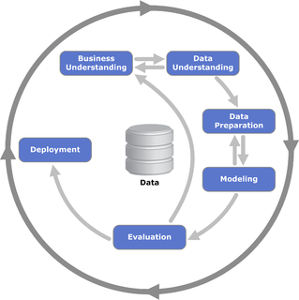
Project Setup A (main)
Way of working:
As scrum–like as possible
CRISP-DM
General steps:
data
transformer
measurements
transformer limits / meta
transfer learning
alarming
steps
data gathering & preperation
timeseries forecast
user presentation
scaling / deployment
reporting
prediction intervals
milestones
FB
FB
FB
FB

Slide 6
Project Setup B
When time permits:
Assessment of type of transformers with issues.
Extrapolate this type to unmeasured transformers.
Recommend/prioritise which transformers to meausure first.
General steps:
data
transformer
measurements
transformer limits / meta
alarming
recommend
to measure
steps
data gathering & preperation
timeseries forecast
user presentation
scaling / deployment
reporting

Slide 7
Full Project Charter: Capacity Forecast distribution grid
Context:
Enexis is a distribution grid operator for electricity and gas. This project focusses on optimal grid management in the department Asset Management of Enexis. Traditional grid planning methods and tools are not fulfilling the needs for engineers anymore due to a strong increase of renewable distributed energy resources such as photovoltaics. There is, however, nowadays data available of medium/low voltage transformers.
Goal:
The purpose of the project is to use this data to enable timely, effective, preventive grid measurements regarding capacity management.
For instance: Enable to forecast in autumn asset overloading in spring, which gives engineers time to implement preventive actions.
Deliverable
Data sources
Load measurements of distribution transformers.
Meta data of transformers (eg. maximum power capacity).
Geographical data (e.g. Central Bureau of Statics).
Analytics / model to be built
Querying extremes from data sources.
Timeseries forecast with prediction interval.
*Model which uses common seasonal knowledge in case only recent measurements are available.
*Alarming when overloading is foreseen.
User interface/dashboard.
Scalable cloud solution to 35k transformers.
Business value to be delivered
Timely signaling of overloading assets.
Enabling effective grid management.
* Optional steps depending on progress.
Execution
Key activities
Proof of concept [PoC] on 5 transformers/measurements.
Refactoring PoC to scalable solution.
Visualisation / dashboarding outcomes for users.
Integration into TAP environments Enexis.
Key resources & people & partners
End users → grid planners
Time → manager
Go on subject → product owner
Data engineers → TAP environments
Time planning (2 workdays/week)
May business + data understanding
June-July PoC incl. feedback business
August refactoring PoC
September to Test environment / upscaling
October visualisation + AP environment
November reporting
Conditions for success
Challenges
Data availability / extractability: 15 minute value measurements for already >8k transformers, but not all for extended periods of time.
Data quality (IT infrastructure, expertise, data, organizational, regulatory / legal)
In scope: capacity planning, transformer loading, electricity distribution grid.
Out of scope: gas/transport grid, power quality, short-term load forecasting.
Project management
Way of working: Scrum
Sprint reviews every 3 weeks.
Refinements when needed.
Review board
JADS supervisor
Manager Enexis
Grid planners
Stakeholders: Grid planners
Budget (time):
developer DS: 2 workdays a week for May-December 2021.
stakeholders + review board + support data engineers
Notes:
DATA SCIENCE PROJECT CHARTER

Slide 8
Sign off sponsors
JADS
Academic Director Industry
Jeroen de Mast
Enexis
Manager Data Science Team
Jaap Kohlmann
Grid Planners (end users)
Dirk van den Berg
René Bosch
Wout Maas (yet to confirm, on leave)
Robin van Wijngaarden
Data Scientist
Developer & Project Lead
Bram Vonk

