Slide 1
Skyscrapers

Slide 2
Rules of the Game
In Skyscrapers, the solver is presented with an n x n grid with some numbers filled in, and numbers around the edges.
Numbers in the grid represent a skyscraper of that height
Numbers on the edges represent no. of skyscrapers you can see in that row or column from that edge.
Each number 1 through n appear in each row and column once.

Slide 3
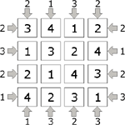
Example
Here is an example of a solved puzzle.
Lets take a closer look at one of the rows, shall we?

Slide 4
Vision
So, from the right side, two buildings can be seen; the three and the four.
Since the 1 and 2 are smaller than the 4 in front of them, they are concealed, and can’t be seen.
v

Slide 5
Vision, cont.
From the left side, two buildings can also be seen; the two and the four.
Since the 2 is in front of the 1, and is taller than it, the one is concealed. In a similar fashion, the 3 is concealed by the 4.
v

Slide 6
Rules for LEGUP
There is much overlap between Sudoku and Skyscrapers
Numbers 1 through n appear exactly once in each row/column
So, many of the LEGUP rules for Skyscrapers can be copied from the LEGUP rules for Sudoku

Slide 7
Rules for LEGUP

Slide 8
CASE Rules

Slide 9
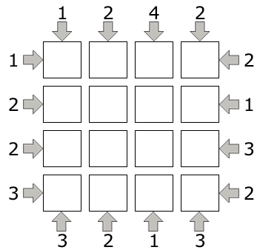
Case Rule: Possible Contents
Given a cell, the content is one of the numbers 1 through n
3
3
1
3
2
3
4

Slide 10
Case Rule: Possible Places
Given a row/column, the number n occurs in one of the cells of that row/column
3
2
3
3
2
3
2

Slide 11
CONTRADICTION Rules

Slide 12
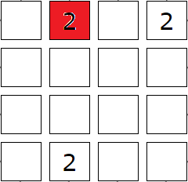
Contradiction: Duplicate Number
Number appears twice in the same row or column.

Slide 13
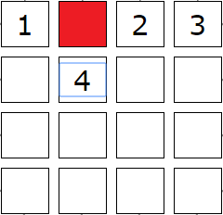
Contradiction: Unresolved Cell
Elimination leaves no possible number for a cell.

Slide 14
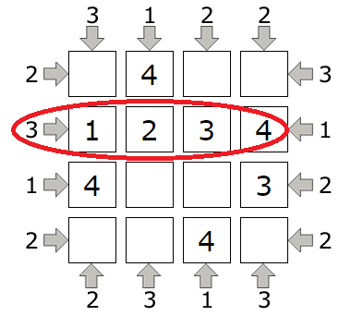
Contradiction: Exceeding Visibility
More skyscrapers are visible than there should be.

Slide 15
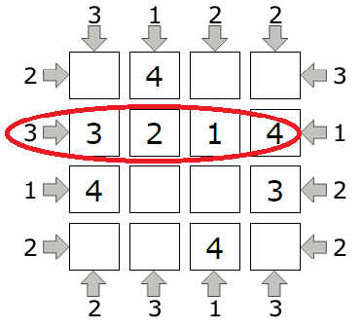
Contradiction: Insufficient Visibility
Less skyscrapers are visible than there should be.

Slide 16
BASIC Rules

Slide 17
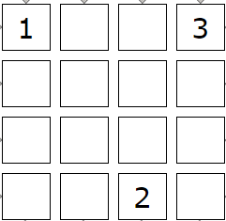
Basic Rule: Last Cell
A certain number must go in a certain cell, because that cell is the last place that number can appear in that row/column.
2

Slide 18
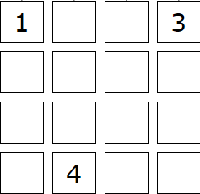
Basic Rule: Last Number
A certain cell must contain a certain number since that number is the only one that can possibly appear in that cell.
2

Slide 19
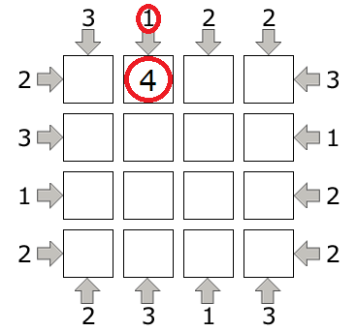
Basic Rule: 1-Edge
If you have a 1 on an edge, put n in the adjacent square.

Slide 20
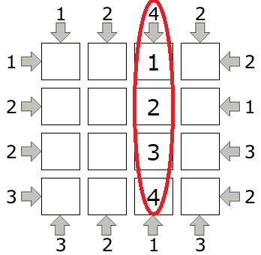
Basic Rule: N-Edge
If the maximum number appears on an edge, the row or column’s numbers appear in ascending order, starting at that edge.

Slide 21
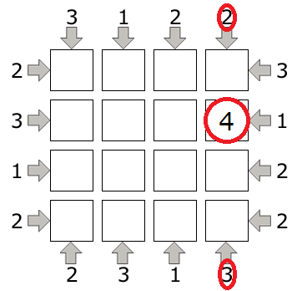
Basic Rule: Fixed Max
If the sum of two opposing edges is n+1, the maximum number appears at a position k spaces away from the edge, where k is the number at that edge.

Slide 22
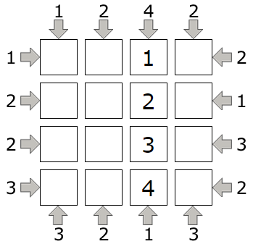
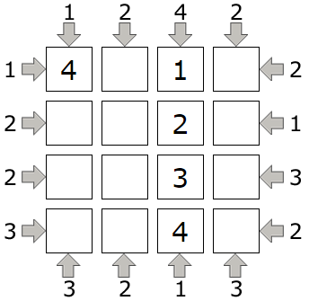
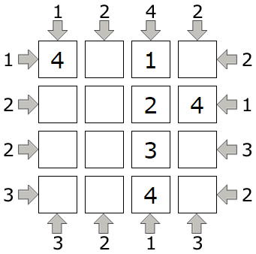
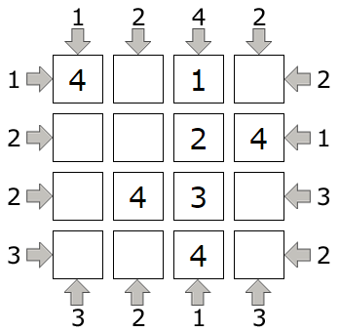
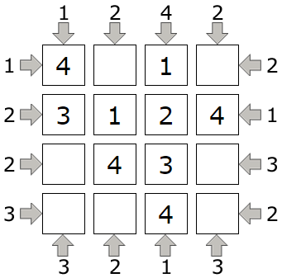
A quick example solve!
FM
1E
PP,
LC,
EV
1E
LC

Slide 23
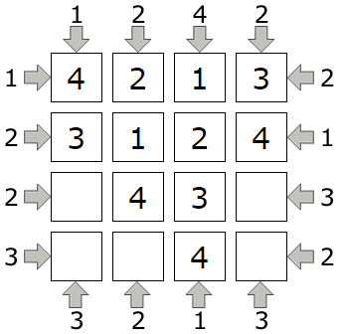
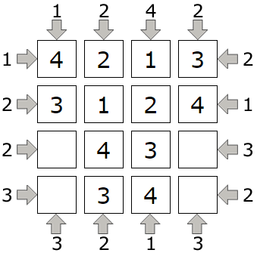
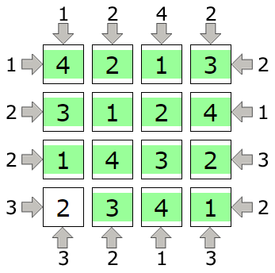
Solve, cont.
PP,
LC,
EV
LC
PP,
LC,
EV

Slide 24
FINISHED!

