Slide 1
Introduction to
Ripple Effect
Xitu Chen

Slide 2
Rules of the Game

Slide 3
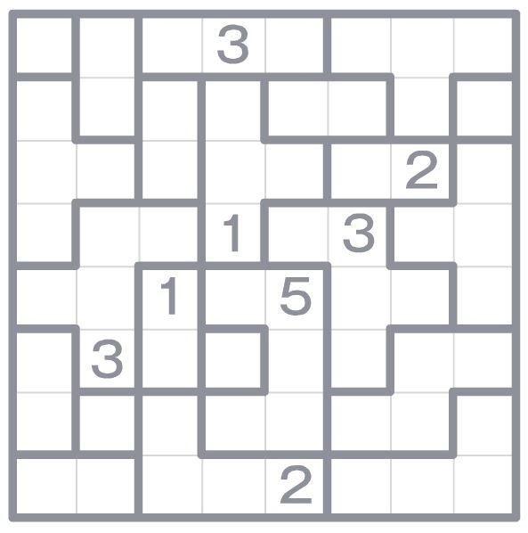

Slide 4
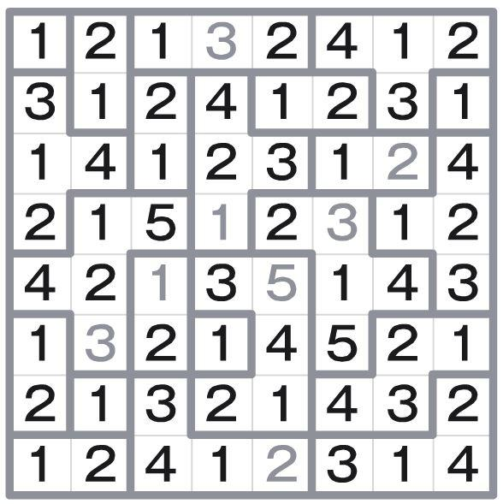
Goal:
Fill every blank cell with positive integers.
Adjacency regions within bolded borders are referred to as “rooms”

Slide 5
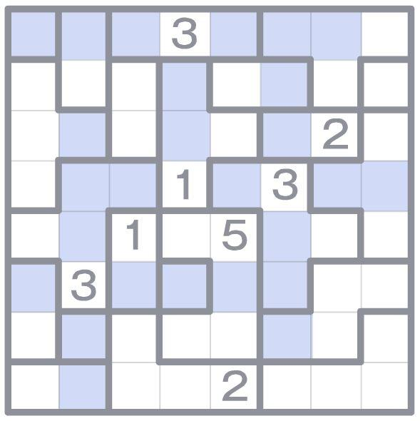
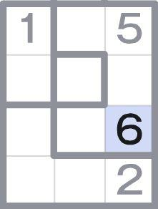
Rules:
R1.
Fit numbers 1 to n into cells in each room of size n, no duplicates.
R2.
When number v appeared twice in the same line, horizontally or vertically, they have to be separated by at least v cells.

Slide 6
Rules for LEGUP

Slide 7
Case Rules

Slide 8
1
Possible Values
Each cell must be a number in the range 1 to n (room size)
2
3

Slide 9
1
Possible Places
Each number in the range 1 to n (room size) must be somewhere in room
2
3

Slide 10
Contradiction Rules

Slide 11
4
Number Too High
number not in the range 1 to n inside an n-size room (violation of R1)
(interface constraints may prevent this from happening)

Slide 12
2
2
Duplicate Number
duplicate number in same room (violation of R1)
(interface constraints may prevent this from happening)

Slide 13
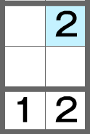
Spacing violation
too few cells between two occurrences of a number in a line (violation of R2)

Slide 14
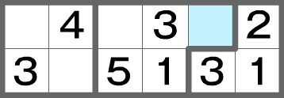
Unresolved Cell
following the rules yield no possible number for a cell (violation of combination of R1 and R2)

Slide 15
Basic Rules

Slide 16
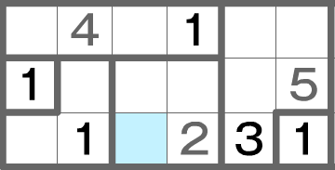
Last Number Standing:
current cell of room with size n cannot contain any number other than v in the range 1 to n (using R1 and R2)
4
(4 is placed in indicated square, since cell of that room cannot be 1, 2, or 3)

Slide 17
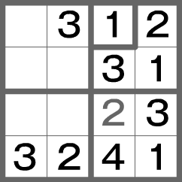
Only Cell Left:
number v in the range 1 to n cannot be placed in any other cell in room with size n (using R1 and R2)
(3 is placed in indicated square since 3 cannot go in any of the other cells of that room)

Slide 18
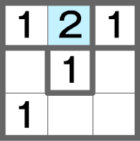
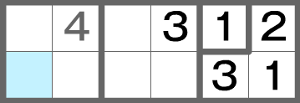
More Examples
(Only Cell: 2 is in indicated square since 2 cannot go in any of the other cells of that room
or
Only Number: indicated square has to be 2 since it is not 1)
(Only Cell: 3 is in indicated square since 3 cannot go in any of the other cells of that room)
Notes:
examples

Slide 19
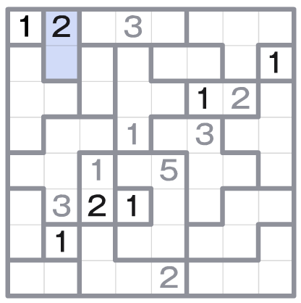
Special Cases:
If room contains only one blank cell and misses only one number, then cell contains that number
Special case of Only Number and Only Cell
Cell of room of size 1 must be 1
special case of special case above (and thus special case of Only Number and Only Cell)

Slide 20

Line Rule
Cells adjacent to and in line with the ends of an n-sized line shaped room cannot exceed n-1
(Highlighted cell cannot be larger than 1, in this case, it cannot be 2)

Slide 21
thank you!

