Slide 1
Battleship Puzzles
Also known as Battleship Solitaire
LEGUP

Slide 2
Game Rules
You are trying to determine the placement of ships on a board
Ships come in sizes with a width of 1 square and any length
No two ship segments from different ships can be next to eachother, even diagonally
The number of ship segments in each row and column is displayed on the right and bottom parts of the grid
Every puzzle has a specified number of ships of each size

Slide 3
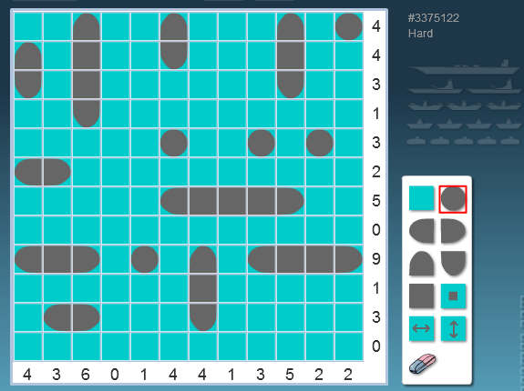
Game Rules (cont.)
An example of a solved battleship puzzle
(http://dkmgames.com/Yubotu.htm)

Slide 4
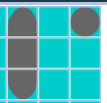
Game Rules (cont.)
Proving steps of a solution of Battleship will require not only proving whether or not there is a ship segment present, but also what kind of ship segment exists.
There are end segments, middle segments, and submarines (single-square ships).
End segment
Middle segment
Submarine

Slide 5




Basic Rules
Finish row/column (water) – All segments are accounted for, the rest must be water
Finish row/column (ships) – The number of undetermined squares is equal to the number of segments remaining
Does not guarantee type of segment

Slide 6
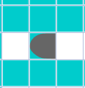
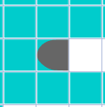
Basic Rules (cont.)
Prevent adjacent segments – All squares around a ship segment must be water unless they are a segment connected to it
Heavily dependent on the type of segment present
Diagonals are always guaranteed to be water

Slide 7
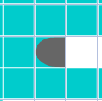
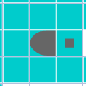
Basic Rules (cont.)
Continue ship – Square next to an unfinished ship must be another segment of that ship
Applies for end segments in one direction and middle segments in two directions
Does not guarantee type of segment

Slide 8
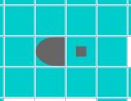
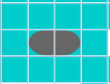
Basic Rules (cont.)
Determine segment type – Prove segment type based on adjacent tiles
Segment on zero sides – Submarine
Segment on one side and water on opposite side – End Segment
Segment on two sides – Middle Segment

Slide 9
Case Rules
A tile must be either water or a ship segment
A ship segment can be one of three types – submarine, end segment, or middle segment

Slide 10
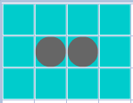
Contradictions
Adjacent Contradiction - Two unconnected ship segments are adjacent, or any two ship segments are diagonal
Too many ships – More ships of a specific type exist than the puzzle specifies
Not enough ships – Less ships of a specific type exist than the puzzle specifies and there is no place that one would fit

Slide 11
Contradictions (cont.)
Too many ship segments – The number of ship segments in a row/column is greater than the amount specified by the puzzle
Too few ship segments – The number of ship segments in a row/column is fewer than the amount specified by the puzzle and every square in the row/column is defined

Slide 12
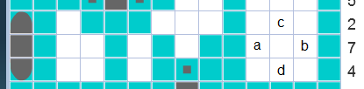
Misc. Information
The first case rule (ship or water) and the last contradiction (too few ships) are often used together to prove the location of the largest ship
In scenarios such as this,
We know that all but one of the squares in the row of 7 segments must be segments. Using the first case rule, a is either water or a segment. If a is a segment, then c and d are water by the prevent adjacent segments rule. If a is water, then b is a segment, so c and d are water by the same rule. This is used very often, and may be worth considering as its own rule to make proofs less tedious.

