Slide 1
Kakuro

Slide 2
Rules
In Kakuro, the solver is presented with a square grid
White box - Filled with digits between 1 and 9 inclusive
Clue Box - AKA Black numbered box, represents a sum
Unnumbered Black Box - Filler
The white boxes are filled so that the sum of the digits of each set of consecutive white boxes equals the number in the clue box to the left or above the set.
No set of consecutive white boxes cannot have repeated digits.

Slide 3
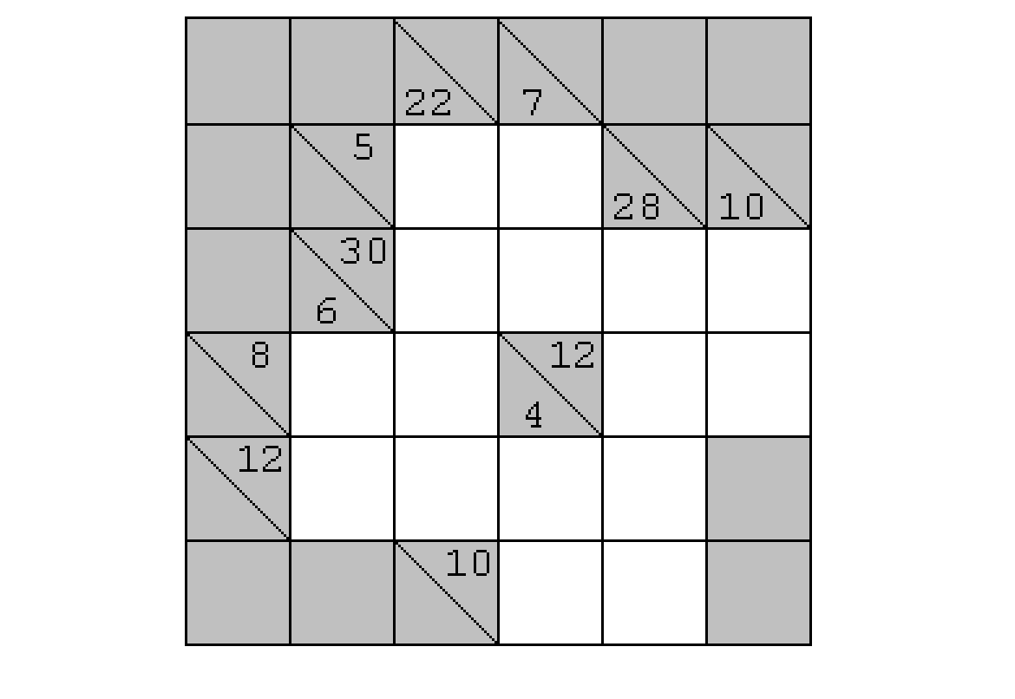
Example

Slide 4
Basic Rules

Slide 5
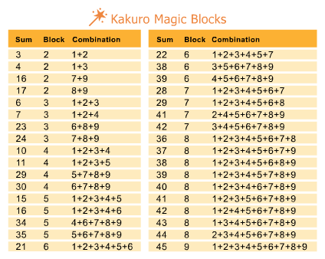
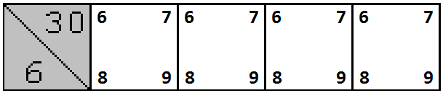
Magic Blocks
For some pairs of sum and number of white blocks, there is only one possible combinations of digits
This rule constrains all the blocks to certain digits, but does not determine order

Slide 6
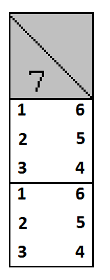
Certain Combinations
For all pairs of sum and number of white blocks, there are a limited number of digit combinations
This rule constrains the white blocks to certain digits

Slide 7
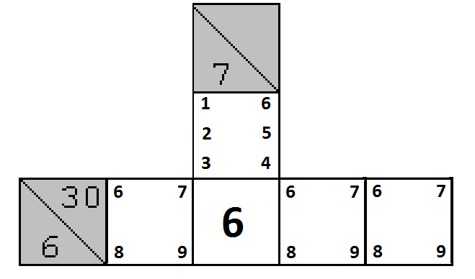
Intersection
If a white block is constrained by its row and column, the constraints can be combined to their intersection

Slide 8
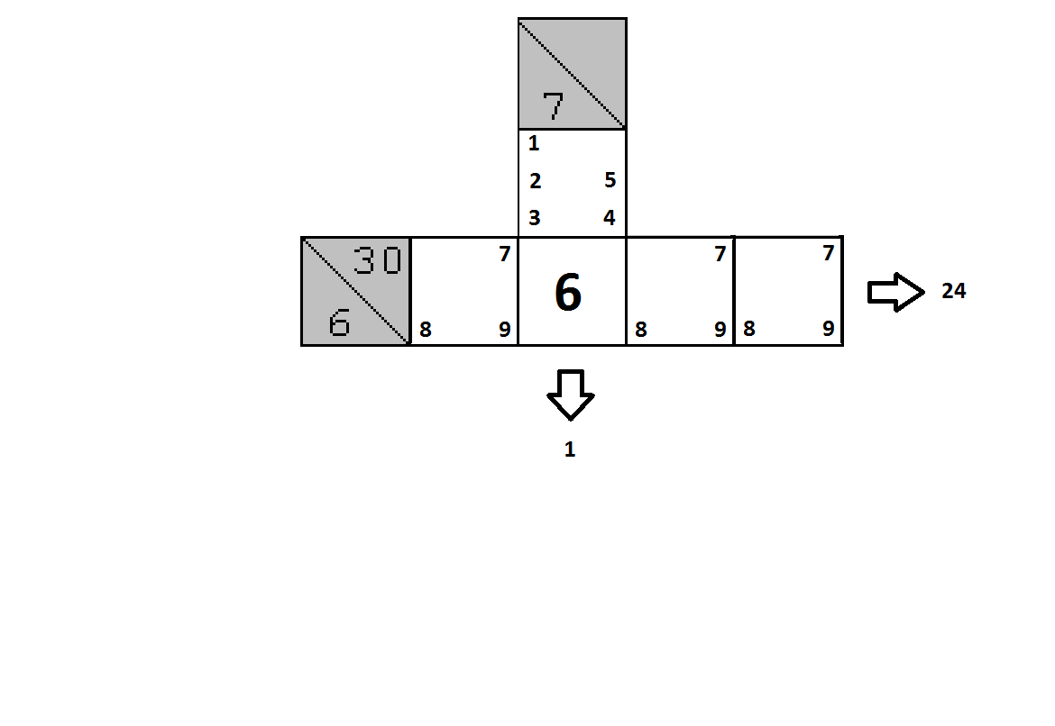
Subtraction
If a white block has a digit, the rest of the blocks in its row and column have to add up to the respective sum minus the determined number.

Slide 9
Elimination
The determined number cannot be placed in the row or column

Slide 10
Case Rules

Slide 11
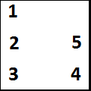
Possible Contents
Given a white block, the content is one of the numbers that is constrained to.
3
3
1
Content = 1,2,3,4, or 5
3

Slide 12
Contradictions

Slide 13

Repeat
Repeated digits in the same row or column.

Slide 14
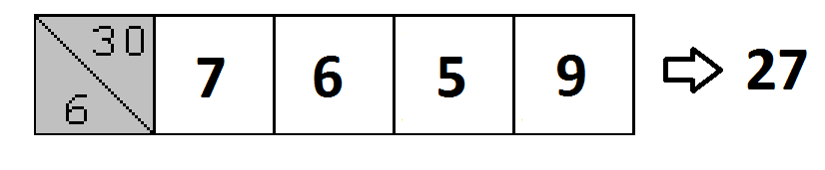
Invalid Sum
The row or column does not add up to the given sum

Slide 15
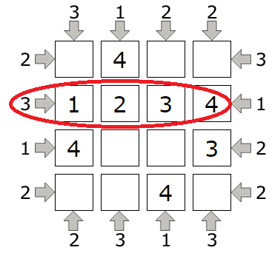
Contradiction: Exceeding Visibility
More skyscrapers are visible than there should be.

Slide 16
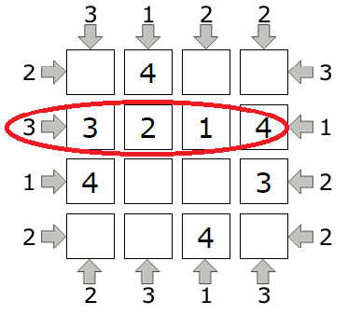
Contradiction: Insufficient Visibility
Less skyscrapers are visible than there should be.

Slide 17
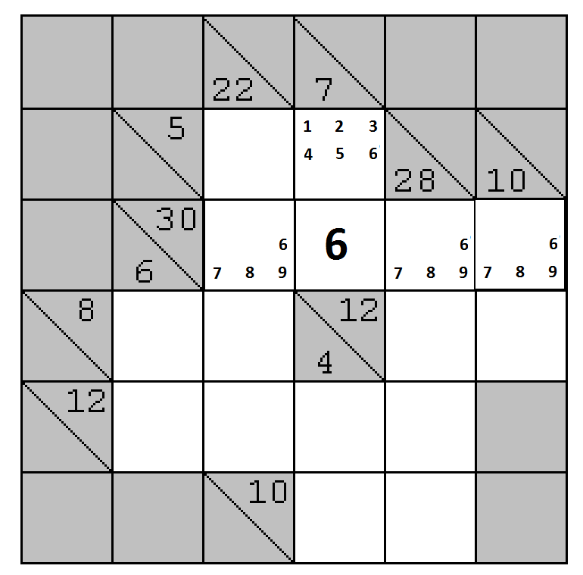
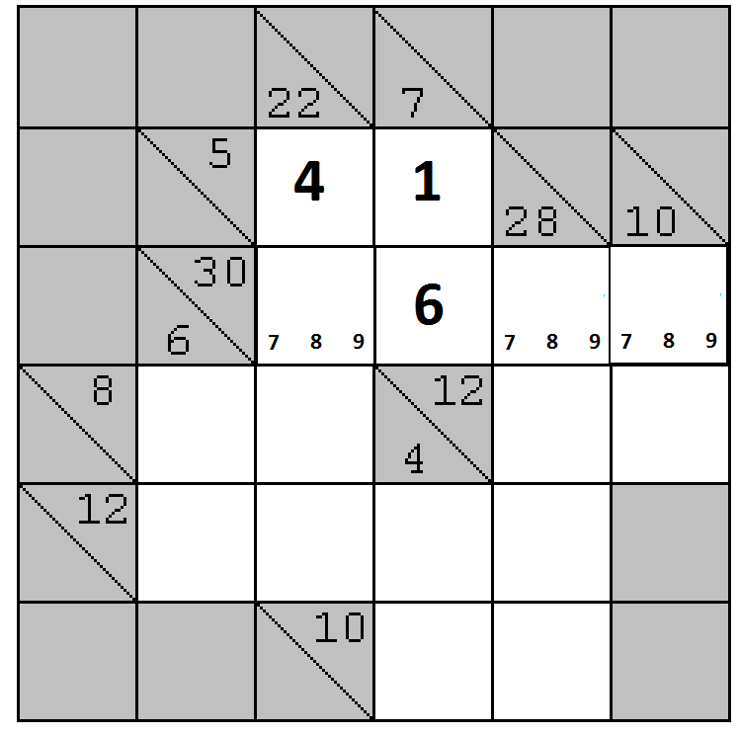
Example Solution
FM
1E
1E
LC

Slide 18
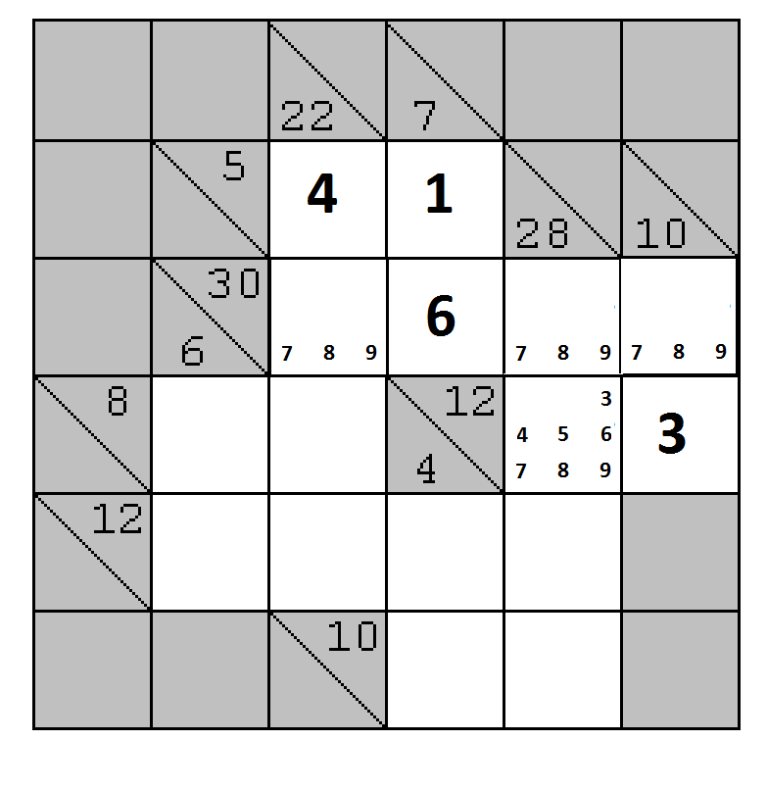
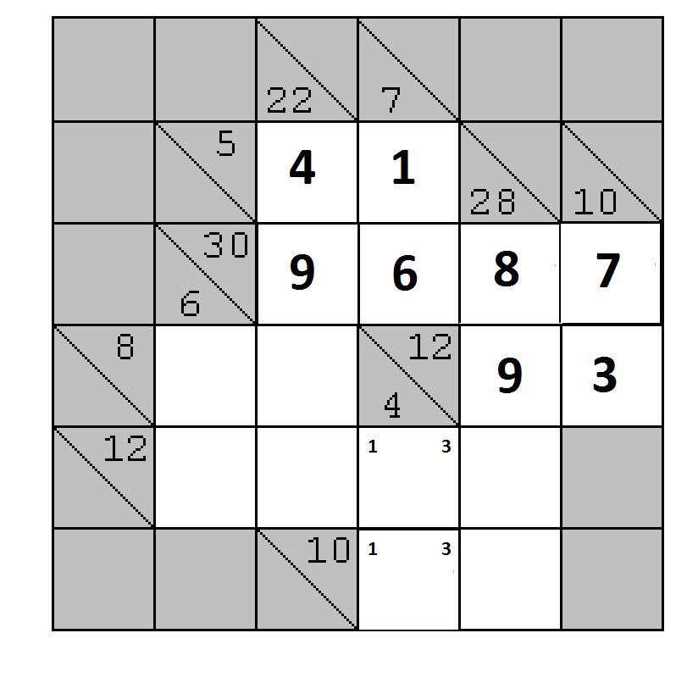

Example Solution
FM
1E
1E
LC

Slide 19


