Slide 1
Masyu
rules

Slide 2
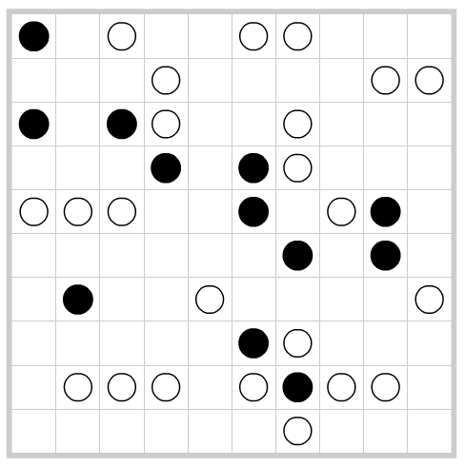
RULES of Masyu
Make one continuous line that goes through the centers of cells that never crosses itself, branches off, or goes through the same cell twice.
the line must pass through every white and black circle
for white circles - straight line through, then make a turn on at least one side of the white circle
black circles - the line passing through must make a turn in the cell, then it must go straight through the next cell (until the middle of the second cell) on both sides

Slide 3
RULES of Masyu
Contradictions
if there is more than one loop (1)
if a circle does not have a line through it (2)
if a white circle has a turn (3)
if the line is straight on both sides of the white circle (3)
if a black circle has a straight line passing through it (4)
if the line turns immediately after the black circle (4)
Make one continuous line that goes through the centers of cells that never crosses itself, branches off, or goes through the same cell twice.
the line must pass through every white and black circle
for white circles - straight line through, then make a turn on at least one side of the white circle
black circles - the line passing through must make a turn in the cell, then it must go straight through the next cell (until the middle of the second cell) on both sides

Slide 4
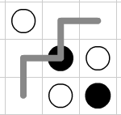



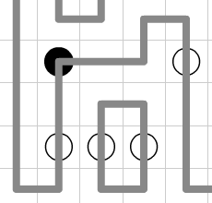
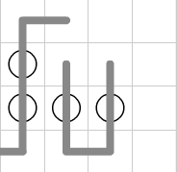
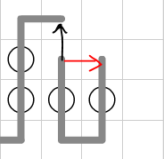
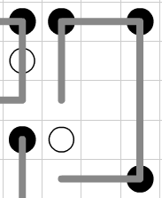
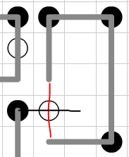
Contradictions
black turn in adjacent
white turns
black no turn
Multi-Loop (anti-short-circuit)
white no turn in adjacent

Slide 5
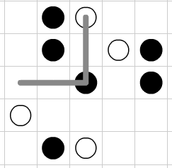
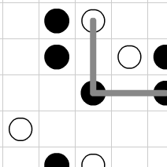
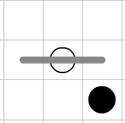
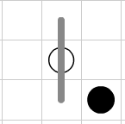
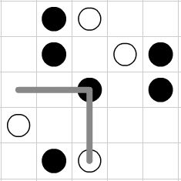
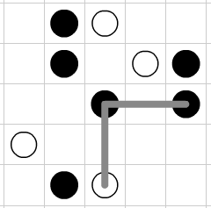
CASE rules
4 cases for black
2 cases for white

Slide 6

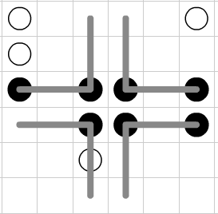
2 BLACKS (specific case)

Slide 7
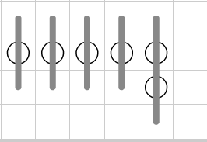
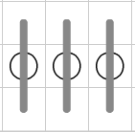
3 WHITES (specific case)

Slide 8

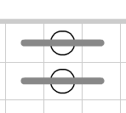
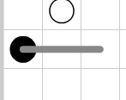
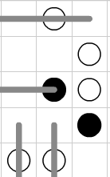
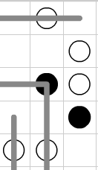
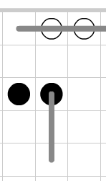
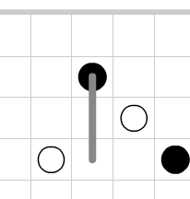
SOLID SIDE rule
by EDGE
by LINE

Slide 9
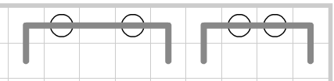
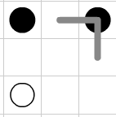
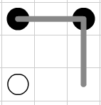
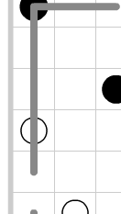
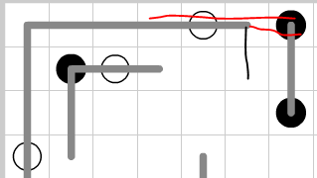
FORCE rule
White Must Turn
Black Must Go Straight

Slide 10
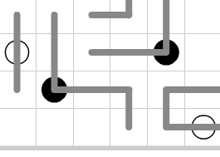
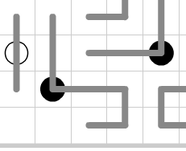
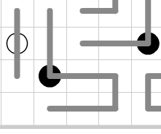
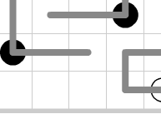
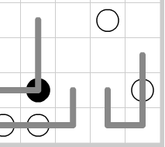
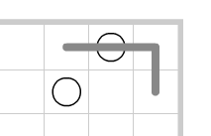
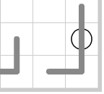
LAST CHOICE rule

Slide 11
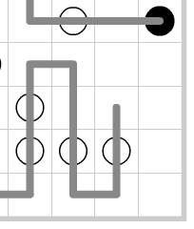
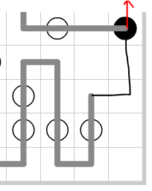
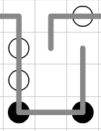
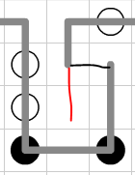
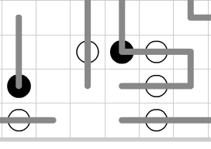
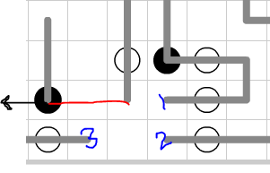
ANTI-ODD-ENDS
for each open region (boxes adjacent to each other that are not occupied by a partial or full line or circle) check all adjacent boxes for a partial line (indicating it is a tail) and count them.
trap an odd number of tails

