Slide 1
Skyscrapers

Slide 2
Basic Rules
In Skyscrapers, the solver is presented with an n x n grid with some numbers filled in, and numbers around the edges.
Numbers in the grid represent a skyscraper of that height
Numbers on the edges represent no. of skyscrapers you can see in that row or column from that edge.
Each number 1 through n appear in each row and column once.

Slide 3
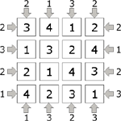
Basic Rules, elaborated.
Here is an example of a solved puzzle.
Lets take a closer look at one of the rows, shall we?

Slide 4
Vision
So, from the right side, two buildings can be seen; the three and the four.
Since the 1 and 2 are smaller than the 4 in front of them, they are concealed, and can’t be seen.
v

Slide 5
Vision, cont.
From the left side, two buildings can also be seen; the two and the four.
Since the 2 is in front of the 1, and is taller than it, the one is concealed. In a similar fashion, the 3 is concealed by the 4.
v

Slide 6
Basic Rules (It’s basically sudoku.)
To start, we can copy ALL the rules from sudoku, with a few changes.
So, we’ll start from the basic rules.

Slide 7
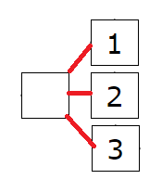
Case Rule: Possible Values
Each cell has a value between 1 and N.

Slide 8
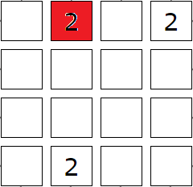
Contradiction: Board State Violation
Number appears twice in the same row or column.

Slide 9
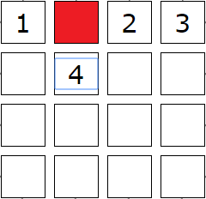
Contradiction: No Solution for Cell
Elimination leaves no possible number for a cell.

Slide 10
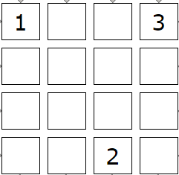
Basic Rule: Forced by Elimination
A certain number must go in a certain square, because it is the last place it can appear in that row/column.
2

Slide 11
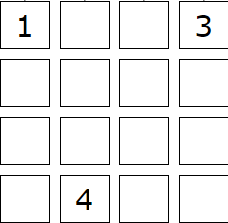
Basic Rule: Forced by Deduction
A certain number is the only one that can possibly appear in that square.
2

Slide 12
Non-clone rules:
1-Edge, N-Edge, Fixed Max
Exceeding Visibility, Insufficient Visibility

Slide 13
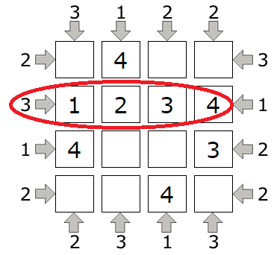
Contradiction: Exceeding Visibility
More skyscrapers are visible than there should be.

Slide 14
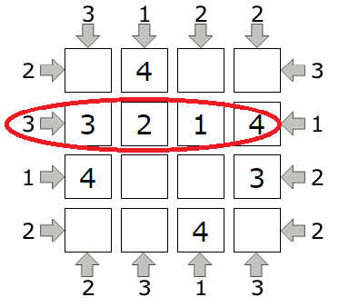
Contradiction: Insufficient Visibility
Less skyscrapers are visible than there should be.

Slide 15
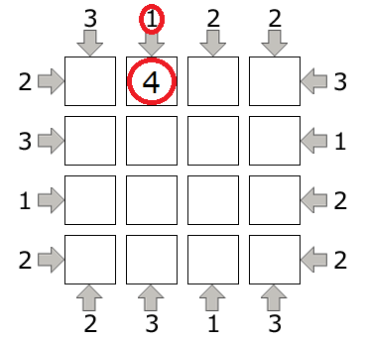
Basic Rule: 1-Edge
If you have a 1 on an edge, put n in the adjacent square.

Slide 16
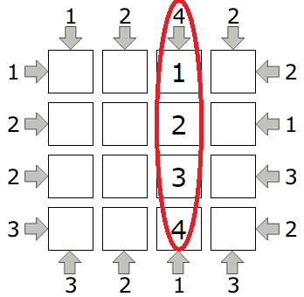
Basic Rule: N-Edge
If the maximum number appears on an edge, the row or column’s numbers appear in ascending order, starting at that edge.

Slide 17
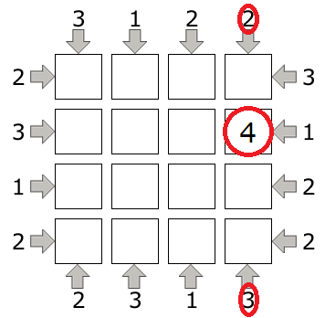
Basic Rule: Fixed Max
If the sum of two opposing edges is n+1, the maximum number appears at a position k spaces away from the edge, where k is the number at that edge.

Slide 18
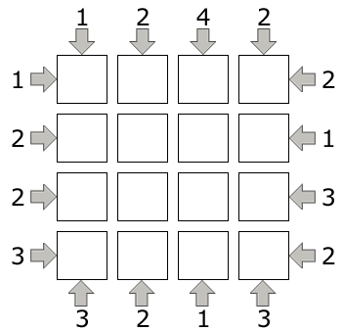
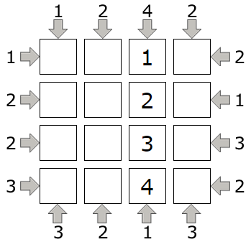
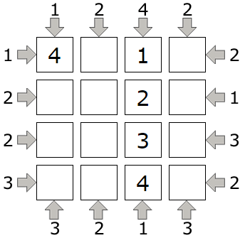
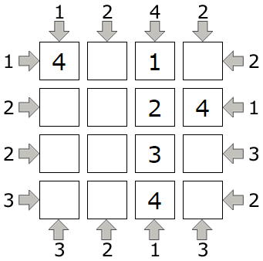
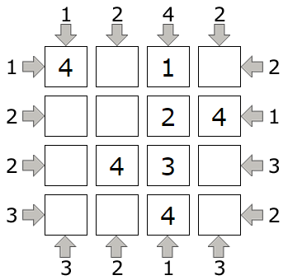
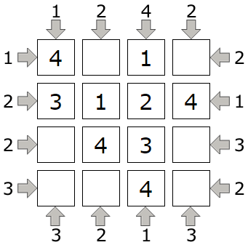
A quick example solve!

Slide 19
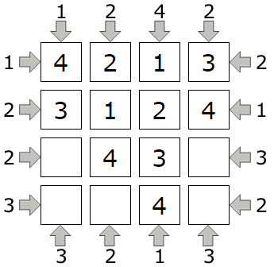
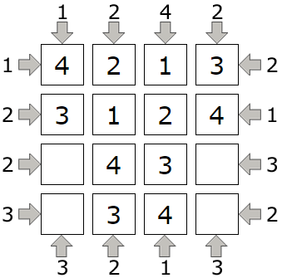
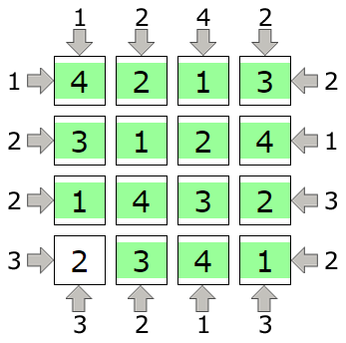
Solve, cont.

Slide 20
FINISHED!

