Slide 1
Link-A-Pix and Fill-A-Pix
  The lesser known relatives of Paint By Numbers

Slide 2
Fill-A-Pix Introduction
More fun from Conceptis
  http://www.conceptispuzzles.com
Essentially Minesweeper, except:
  Squares are not labeled “bombs,” but filled in
  Numbered squares may or may not be filled
  Number (0-9) tells how many of itself and the eight surrounding squares are filled
  Again, a picture is formed at the end!
Only works in black-and-white
Solution, of course, is always unique

Slide 3
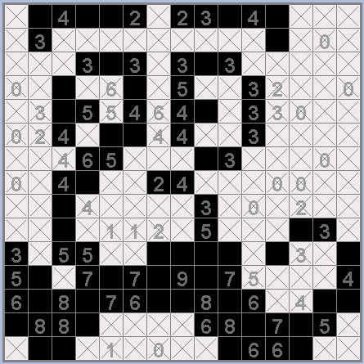
Fill-A-Pix Example

Slide 4
Rule #1: The Completion Rule
If the number of filled squares around a clue is equal to that clue, X out the other surrounding squares.
If the number of eliminated squares around a clue is equal to the number of surrounding squares minus the clue, fill in the other surrounding squares.
Trivial applications: Zeros and nines

Slide 5
Rule #2: The Sharing Rule
For two clues X and Y (X <= Y):
“Unshared” means adjacent to only one of X and Y
If this statement is true:
  Y – X = [Y's filled, unshared squares] + [Y's unknown, unshared squares] – [X's filled, unshared squares]
Then you can:
  Fill in Y's unknown, unshared squares
  Cross out X's unknown, unshared squares

Slide 6
Rule #3: The Uniqueness Rule
If there are two or more squares that touch EXACTLY the same set of clues (i.e. no square in the group has a clue that another does not), then those squares are either ALL filled or ALL empty.
Reasoning: If some of the squares are filled and others aren’t, there are no other numbers to tell us which are which, and thus the solution cannot be unique!

