Slide 1
Link-A-Pix and Fill-A-Pix
  The lesser known relatives of Paint By Numbers

Slide 2
Link-A-Pix Introduction
Another puzzle from Conceptis
  http://www.conceptispuzzles.com
Numbers appear inside the grid, rather than on the outside
Connect like numbers with paths of lengths equal to the numbers they link
The numbered squares themselves are counted in the path length

Slide 3
Link-A-Pix Introduction
Paths may not cross; each square can only be used once
Single- or multi-color; in the latter, colors of linked numbers must match as well
Puzzle is designed so the solution is unique
Coloring in the paths, obviously, yields a picture!

Slide 4
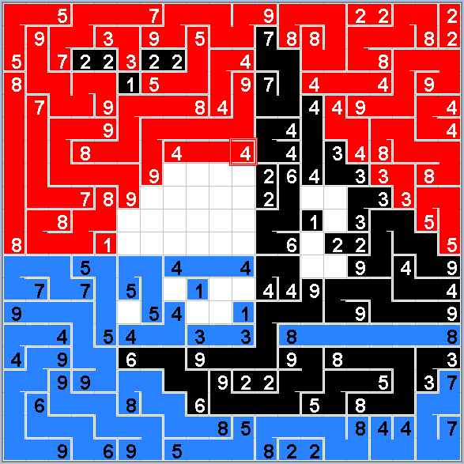
Link-A-Pix Example

Slide 5
Rule #1: The Elimination Rule
If there is only one way for two numbers to be linked with the correct length, draw it in!
Partial application: If there is only one possible start to a path out of one number, draw it in; the rest can be linked up later.
Most basic applications:
  1s: Are simply filled in
  2s: Are in orthogonally adjacent squares

Slide 6
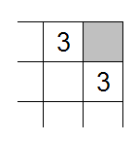
Rule #2: The Exclusion Rule
If:
  A square can possibly be used by ONLY one path, and
  The path using that square does not make other links impossible (in practice, this is usually easy to judge)
Then that path WILL use that square!
Most basic application at right
  Gray square will be used in 3 path

Slide 7
Rule #2 Reasoning
[Assuming Rule #2’s conditions exist]
Puzzle is crafted to have a unique answer
If the square in question is NOT used:
  At the end of the puzzle, that square would still be left blank
  This means that a second answer still exists for that path, so the whole solution is not unique!
  Contradiction!
Therefore, the square will be used.

