Slide 1
Sudoku Rules
Now in PowerPointVision!
Tyler “The Admiral” Hinman

Slide 2
Definitions
Square: A single cell of the grid.
Unit: A row, column, or 3x3 sector.
Z: The set of remaining possibilities for an unfilled square.
U: The set of all Z-sets associated with a particular unit.
R: Under 17 requires accompanying parent or adult guardian.

Slide 3
Game Rules
Every square in the 9x9 grid must each be filled with a single digit such that every unit contains the digits 1-9 exactly once each.
The Spy always loses unless he attacks the Marshal.
Whoops! Sorry! That’s one of the rules of Stratego. There are no more rules for sudoku. My bad.

Slide 4
Basic Contradiction Rules
A square contains zero or multiple digits.
A unit contains a digit more than once.
A unit omits a digit.
  This one isn’t strictly necessary, because this can’t be the case without one of the first two being the case too. Ah well.

Slide 5
Basic Case Rules
A blank square must be filled with a digit.
A square containing a digit should not be filled further.
  Duh.
For any blank square, the possibilities are all the digits from 1-9 that do not appear in any of the square’s three associated units (row, column, and 3x3 sector)

Slide 6
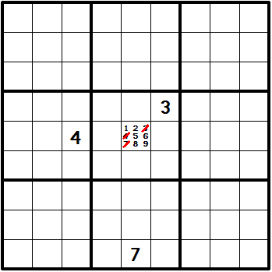
Derived Rule #1
Eliminate from Z any digit that appears in any other square in any of the three units to which it belongs.

Slide 7
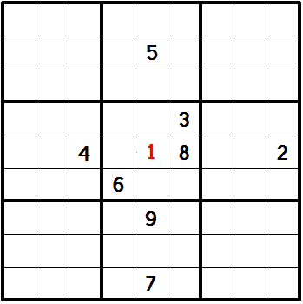
Derived Rule #2
If Z contains only one element, fill its square with that remaining digit.

Slide 8
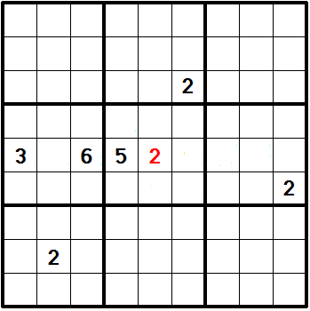
Derived Rule #3
If a particular digit is appears only once in U, put it into its square.

Slide 9
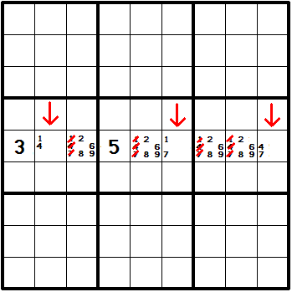
Derived Rule #4
If the union of N Z-sets from U contains exactly N different digits, those N digits may be eliminated from the other elements of U.

Slide 10
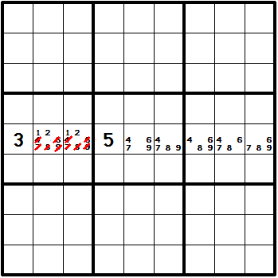
Derived Rule #5
If the union of N Z-sets from U accounts for all of U’s occurrences of N different digits, eliminate the other digits from those Z-sets.

Slide 11
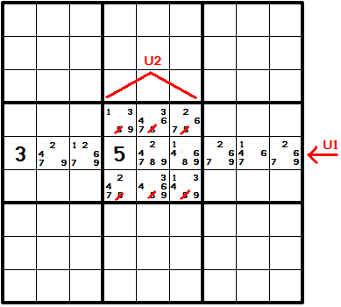
Derived Rule #6
If all the Z-sets in U1 that contain a certain digit are also members of U2, that digit can be eliminated from the other members of U2.

Slide 12
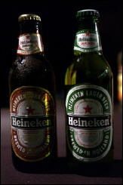
We’re done!
Beer me, nurse!

