Slide 1
Fathom It!©
A Compilation of Useful Rules,
Shortcuts, and Strategies
By Tim Tesluk

Slide 2
Fathom It!™ rules
Variables
  MAX = # of ship segments needed in this row/column
  CUR = # of ship segments currently in this row/coumn
  WAT = # of water segments currently in this row/column
  SIZE = # length of entire row/column (default 10)

Slide 3
Easy ones (duh)
Rest of row/column is water
  Automatic?
  If MAX – CUR = 0 then remaining unknowns must be water
Rest of row/column is ship segments
  If MAX – CUR = SIZE – CUR – WAT then remaining unkowns are ship segments (wildcards to be determined later)
  Usage: Click rule, the click appropriate row/column header

Slide 4
Simple
If we finalize a ship or ship segment, it must follow that the tiles surrounding it are water.
If we finalize a wildcard segment, and if it is surrounded completely by water, it must be a submarine.

Slide 5
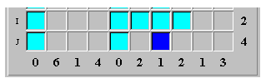
More immediate, forced actions
Fill in ship segments around middle ship segment
  If segment i is a (lone, unattached) middle ship segment, then
    If we find an adjacent water square, then the unknowns horizontally/vertically adjacent to it should be wildcard ship segment

Slide 6


Forced (cont.)
End segment has an adjacent wildcard

Slide 7
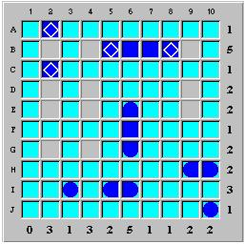
An Unbound ship was found
  For our default 10x10 board, this rule is simply making a battleship out of 4 anypieces
  Simple: four adjacent pieces, make the end pieces round if they aren't and make the segments in between middle segments.
  Usage: click this rule, then click any of the 4 adjacent pieces.

Slide 8
Tricky rule(s)
We talked about the notion of trying all legal placements (within the bounds of MAX) and seeing what conditions we could see in common, then merging the branches of the tree. The Fathom It! solver uses this technique in a few of the more intricate rules.

Slide 9
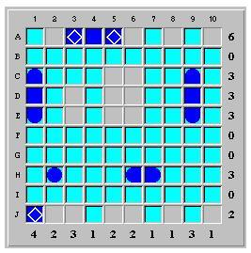
The Expand-O-Matic
Here we have a board in progress. Lets try to place all remaing destroyers just for fun.

Slide 10
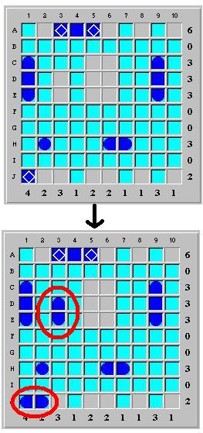
What luck! We didn't even have to branch because there is only one possibility!

Slide 11
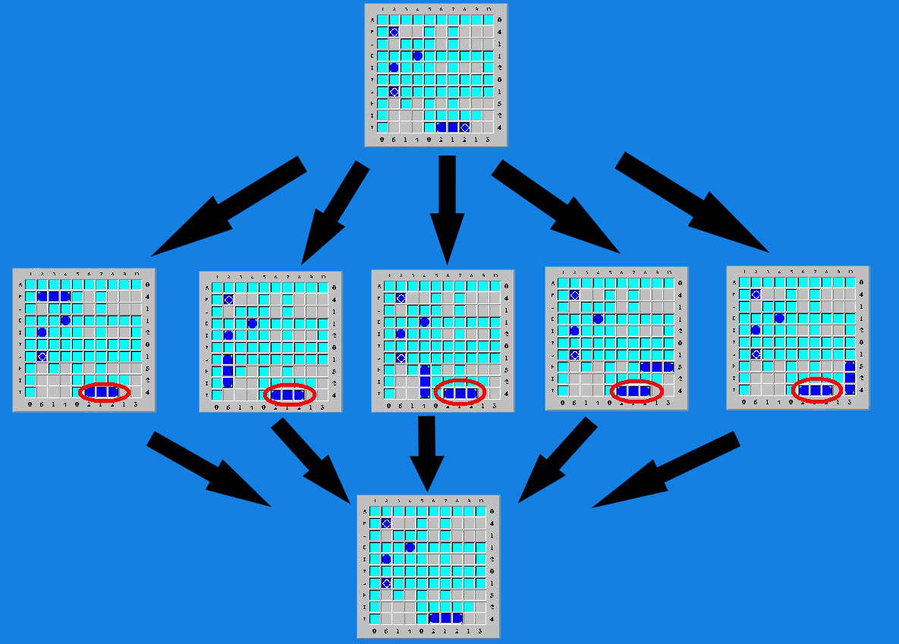
Not so simple example

Slide 12
Expand-O-Matic (cont.)
The Expand-O-Matic feature can be also applied to similar rules:
  Common ship segments found
    There are several candidate positions for the ship(s) and the positions overlap each other.
    Can finalize the overlapped squares as wildcards
  Common water segments found
    If wherever we try to place a certain ship or set of ships results in a square being water in every situation, that square definitely must be water.

Slide 13

Shortcut Rules
Fathom It! Solver provides a variety of other rules that actually lump together a series of common proof by contradictions. e.g.:
  “End Squares are Segment Wildcards
In the example above, the row has a tally of five. Since four water squares have been found, there is one remaining water square to locate. There are six non-water squares in a connected sequence: (I,5) to (I,10). The square (I,5) cannot be the last remaining water, as this would force a ship of length five in (I,6) to (I,10). Likewise, (I,10) cannot be water. This allows us to finalize the end squares as segment wildcards.

Slide 14

Shortcut Rules (cont.)
Resulting board above.
Notice how the reasoning is merely a compounded group of the guess (and check) rule. i.e. It is a proof by contradiction (2 of them, actually)

Slide 15

When do we close branches?
When some forced rule causes there to be too many ship segments in a row/column
When some forced rule causes there to be too few unkowns left in a row columns such that CUR cannot equal MAX
When some forced rule causes a ship that is too large to exist
When some forced rule causes there to be too many instances of a type of ship
When there are no places left to place a yet unplaced ship
If a middle ship segment is caused to be flanked by water both vertically and horizontally

Slide 16
An Issue
How will we represent coming to a contradiction and thus knowing that for whatever we originally guessed, the opposite is true? e.g. Guessed a tile was a water segment, came to a contradiction, it must be a ship segment.
  I suggest including this in the collapsible branches functionality:
    Hide the reasoning that lead to the conclusion and show just one arrow to the newly found conclusion

