Slide 1
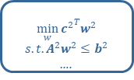


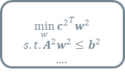




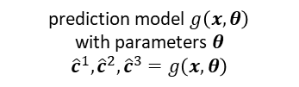





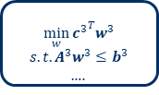

$$w_{{\hat{c}}^{1}}^{1∗}$$
$$\min_{w}{{c^{2}}^{T}w^{2}}$$
$$s.t.A^{2}w^{2}≤b^{2}$$
….
$$x^{1}$$
$${\hat{c}}^{1}$$
$$x^{2}$$
$${\hat{c}}^{2}$$
$$w_{{\hat{c}}^{2}}^{2∗}$$
$$\min_{w}{{c^{2}}^{T}w^{2}}$$
$$s.t.A^{2}w^{2}≤b^{2}$$
….
prediction model $g\left(x,θ\right)$
with parameters $θ$
$${\hat{c}}^{1},{\hat{c}}^{2}, {\hat{c}}^{3}=g\left(x,θ\right)$$
$$x^{3}$$
$${\hat{c}}^{t}$$
$$w_{{\hat{c}}^{t}}^{t∗}$$
$$\min_{w}{{c^{3}}^{T}w^{3}}$$
$$s.t.A^{3}w^{3}≤b^{3}$$
….
dataset $𝒟^{t}$ for task $t$
data points $\left(x^{t},c^{t}\right)$ or $\left(x^{t},w_{c}^{t∗}\right)$
optimization solver for task $t$
$$w_{c}^{t∗}=\underset{A^{t}w^{t}≤b^{t}}{argmin}{{{\hat{c}}^{t}}^{T}w^{t}}$$
loss function $l^{t}\left({\hat{c}}^{t},∙\right)$
to measure decision error

