Slide 1

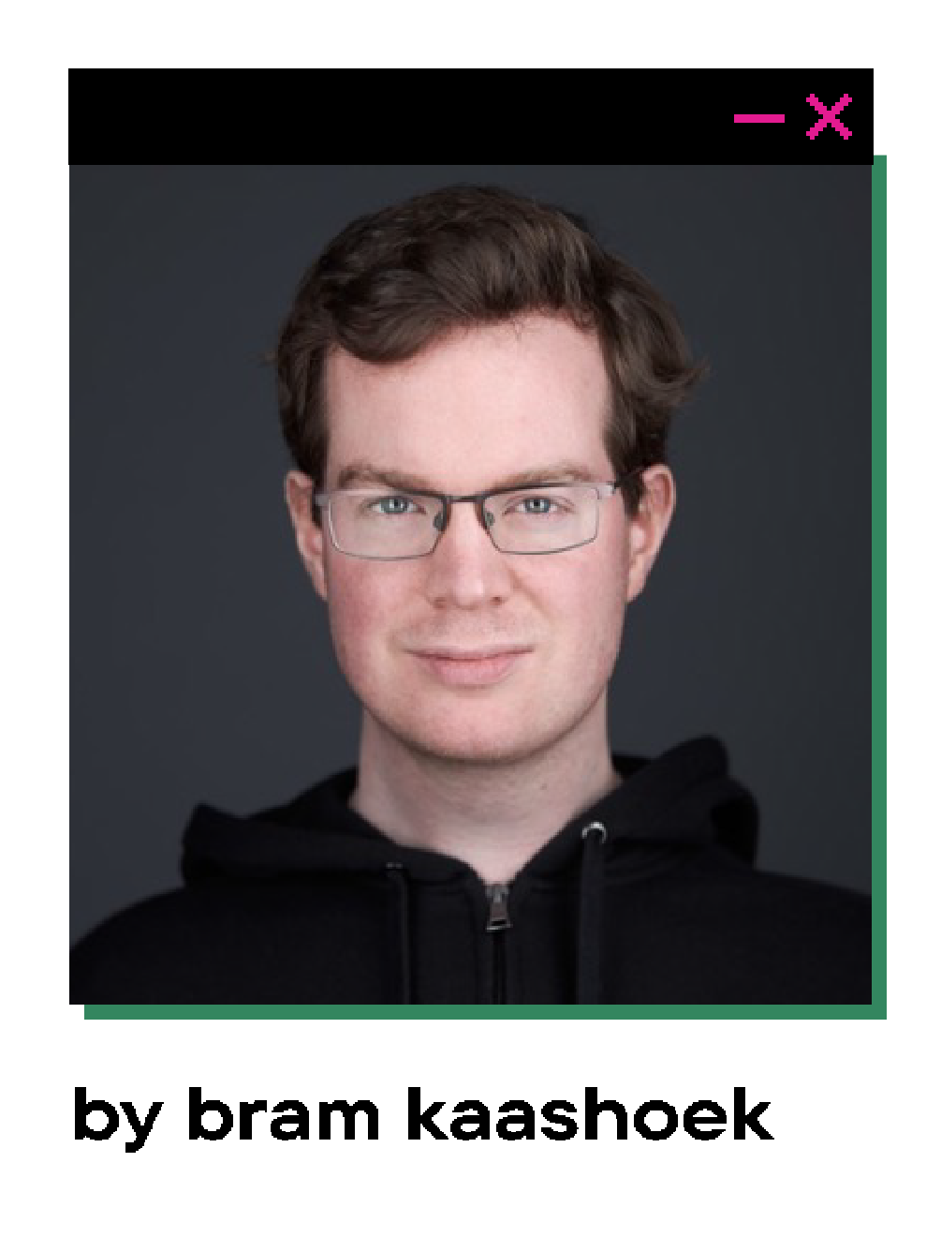
Notes:
Presentation about monitoring
- me, company
- fast talker, let me know

Slide 2
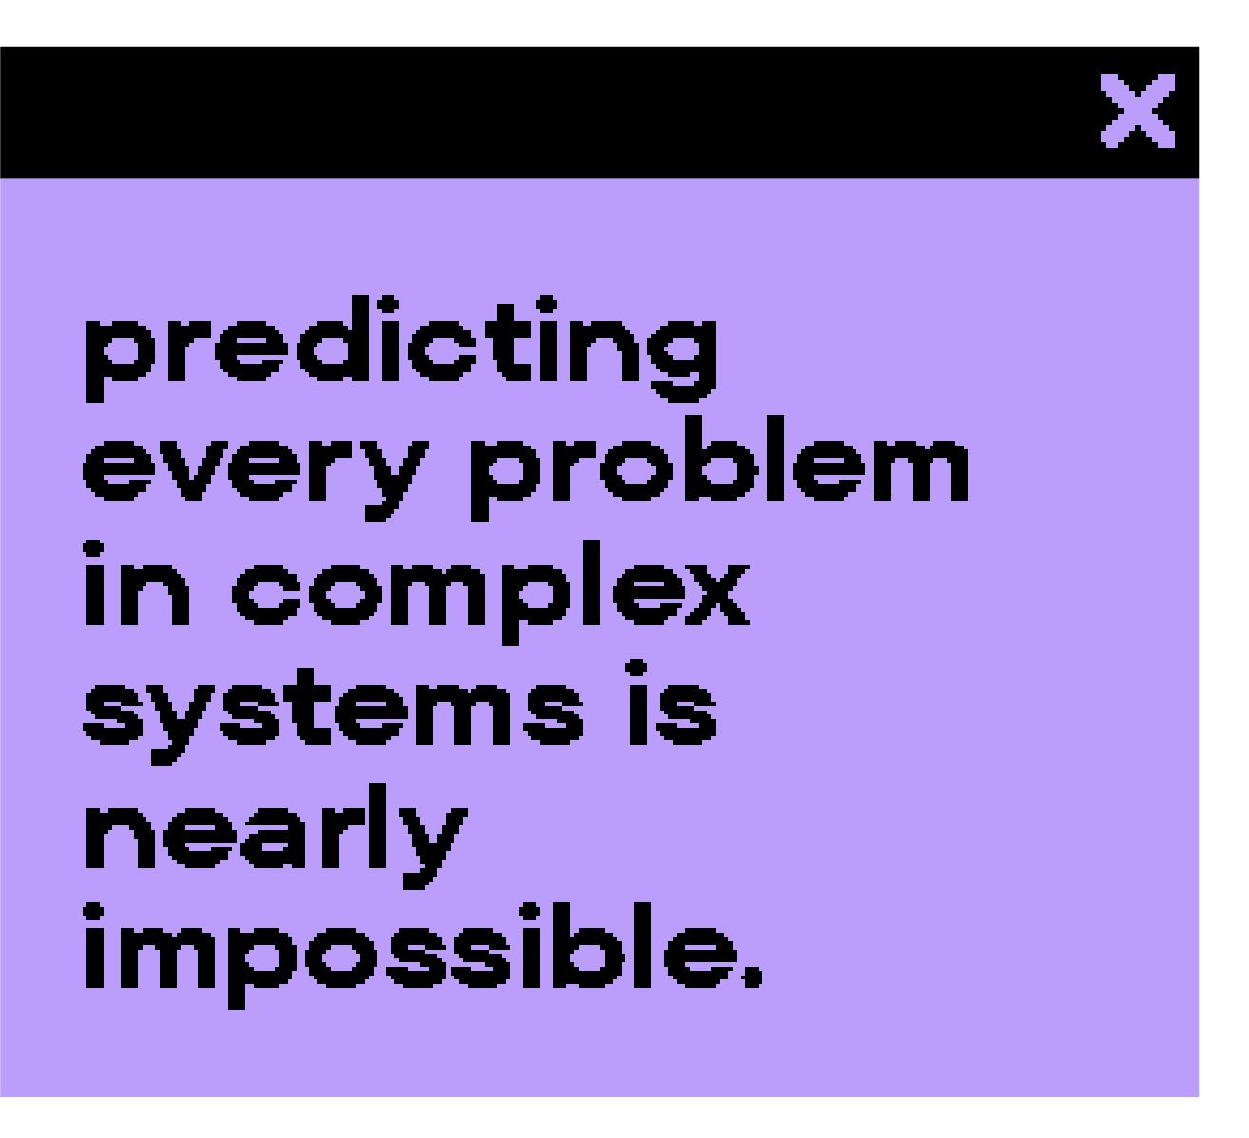


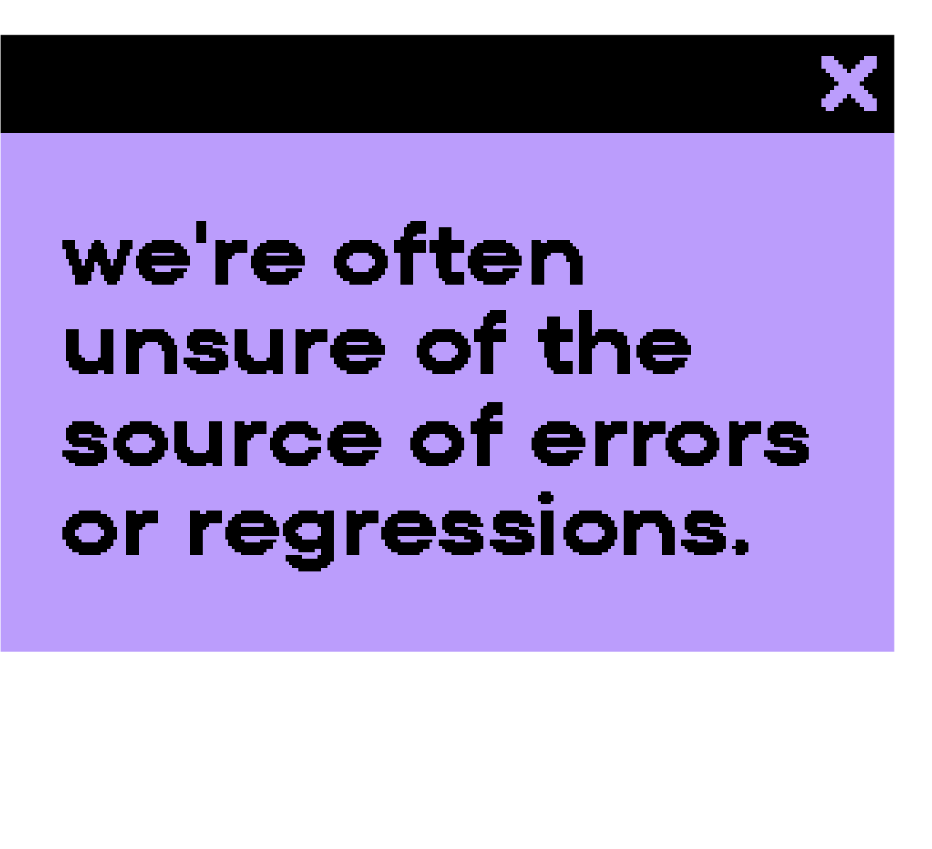
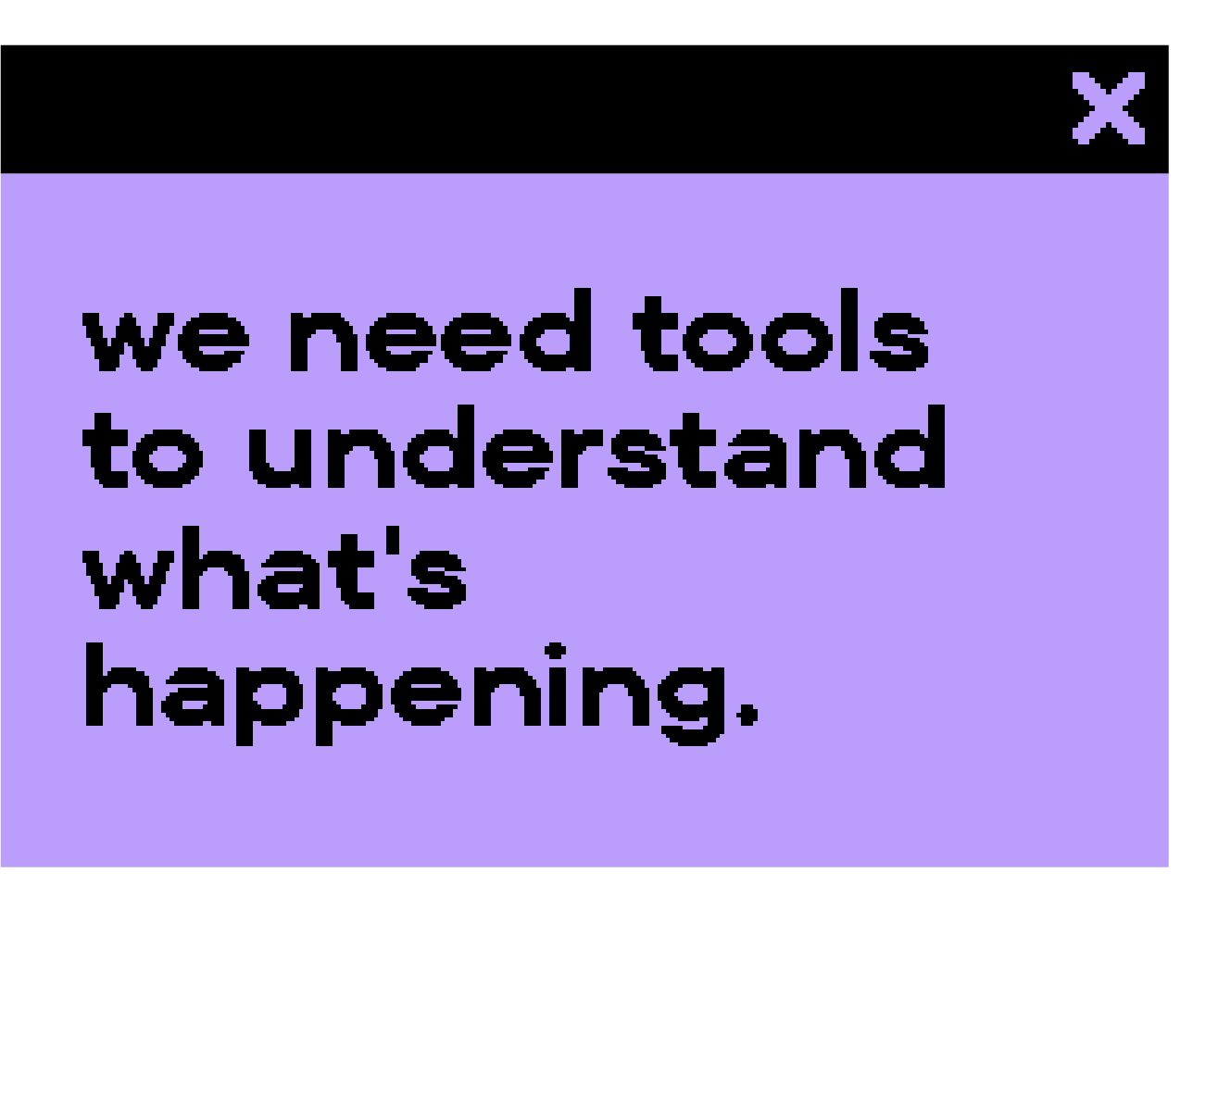
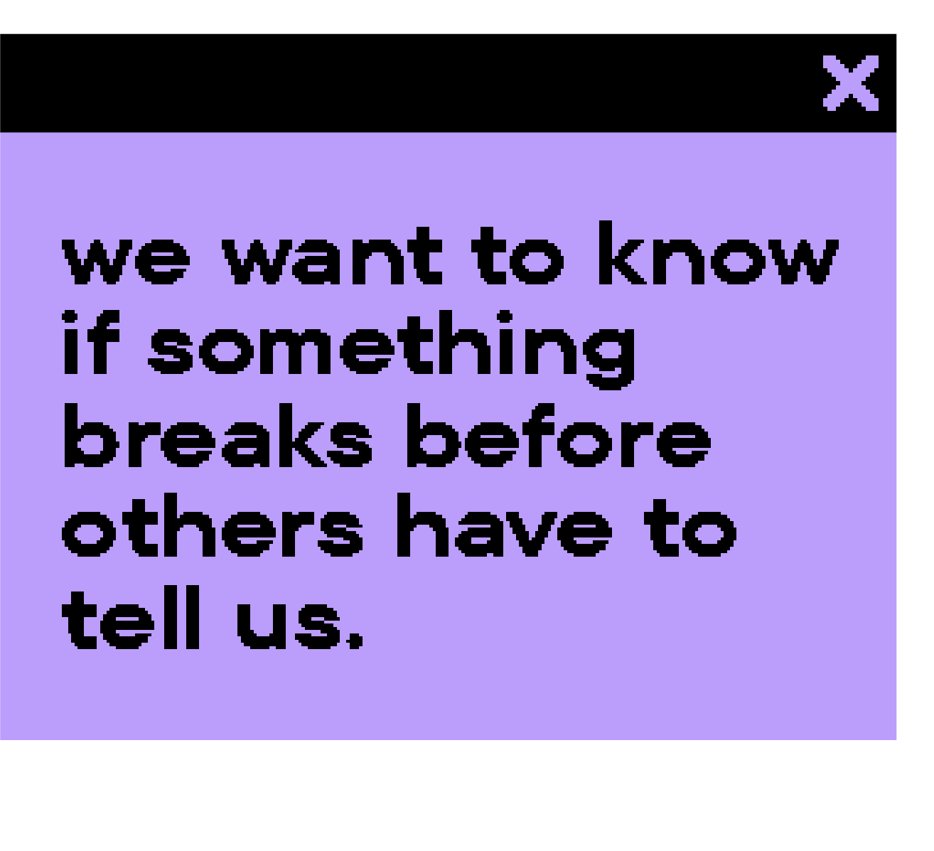
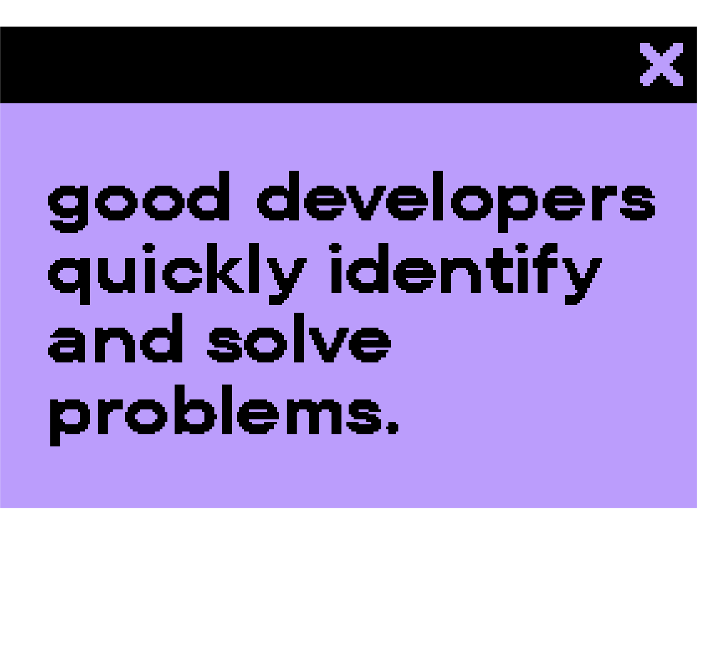

Slide 3

Notes:
Otel is a suite of tools/standards and SDK's that enables developers to monitor their projects
OpenTelemetry tracks a series of events (trace) and produces details about each event (span)
Walk -> Grab bottle -> Drink -> Walk

Slide 4
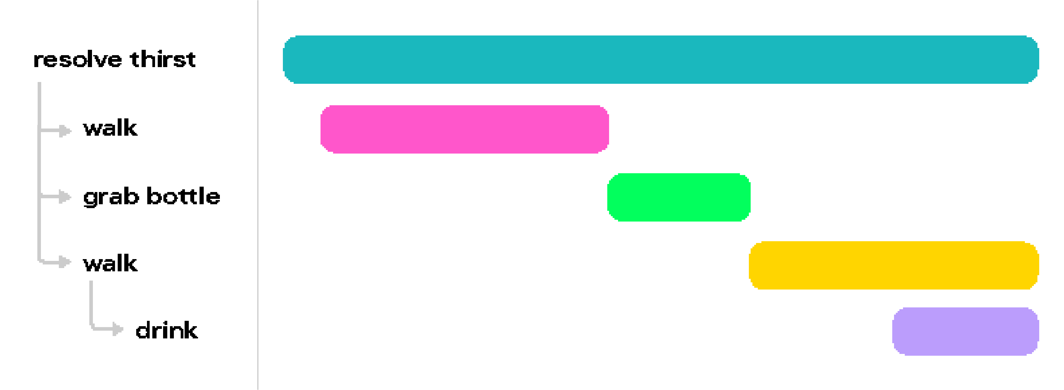



Slide 5



Slide 6


Slide 7



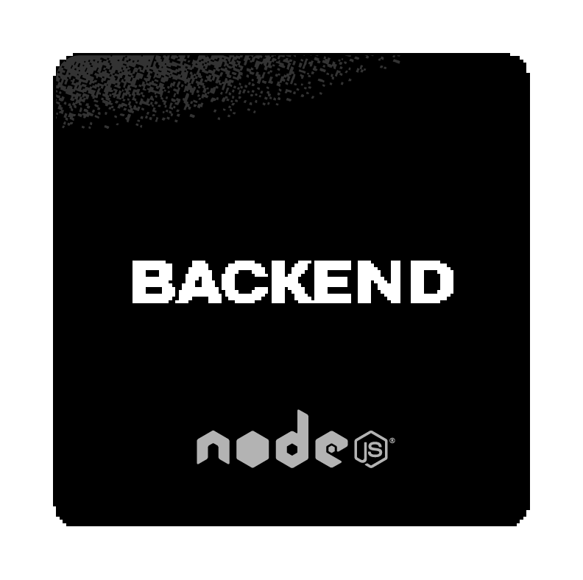

Slide 8
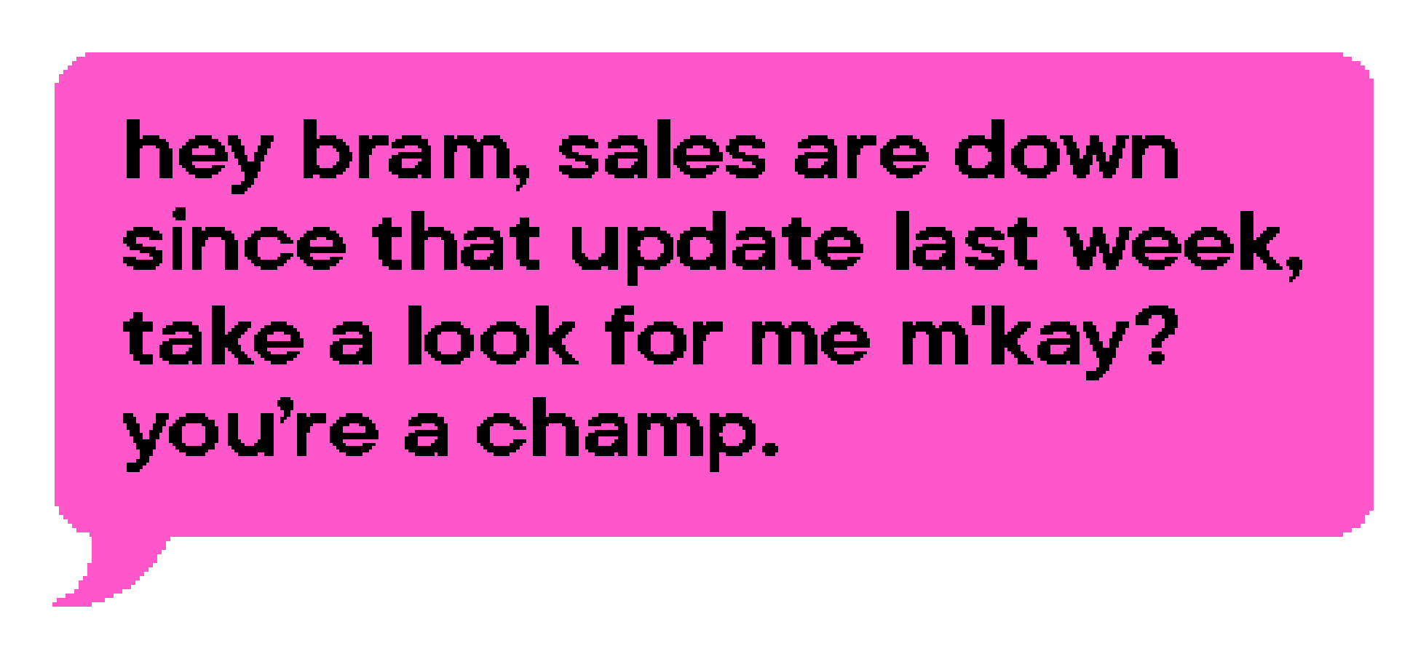


Slide 9






Slide 11

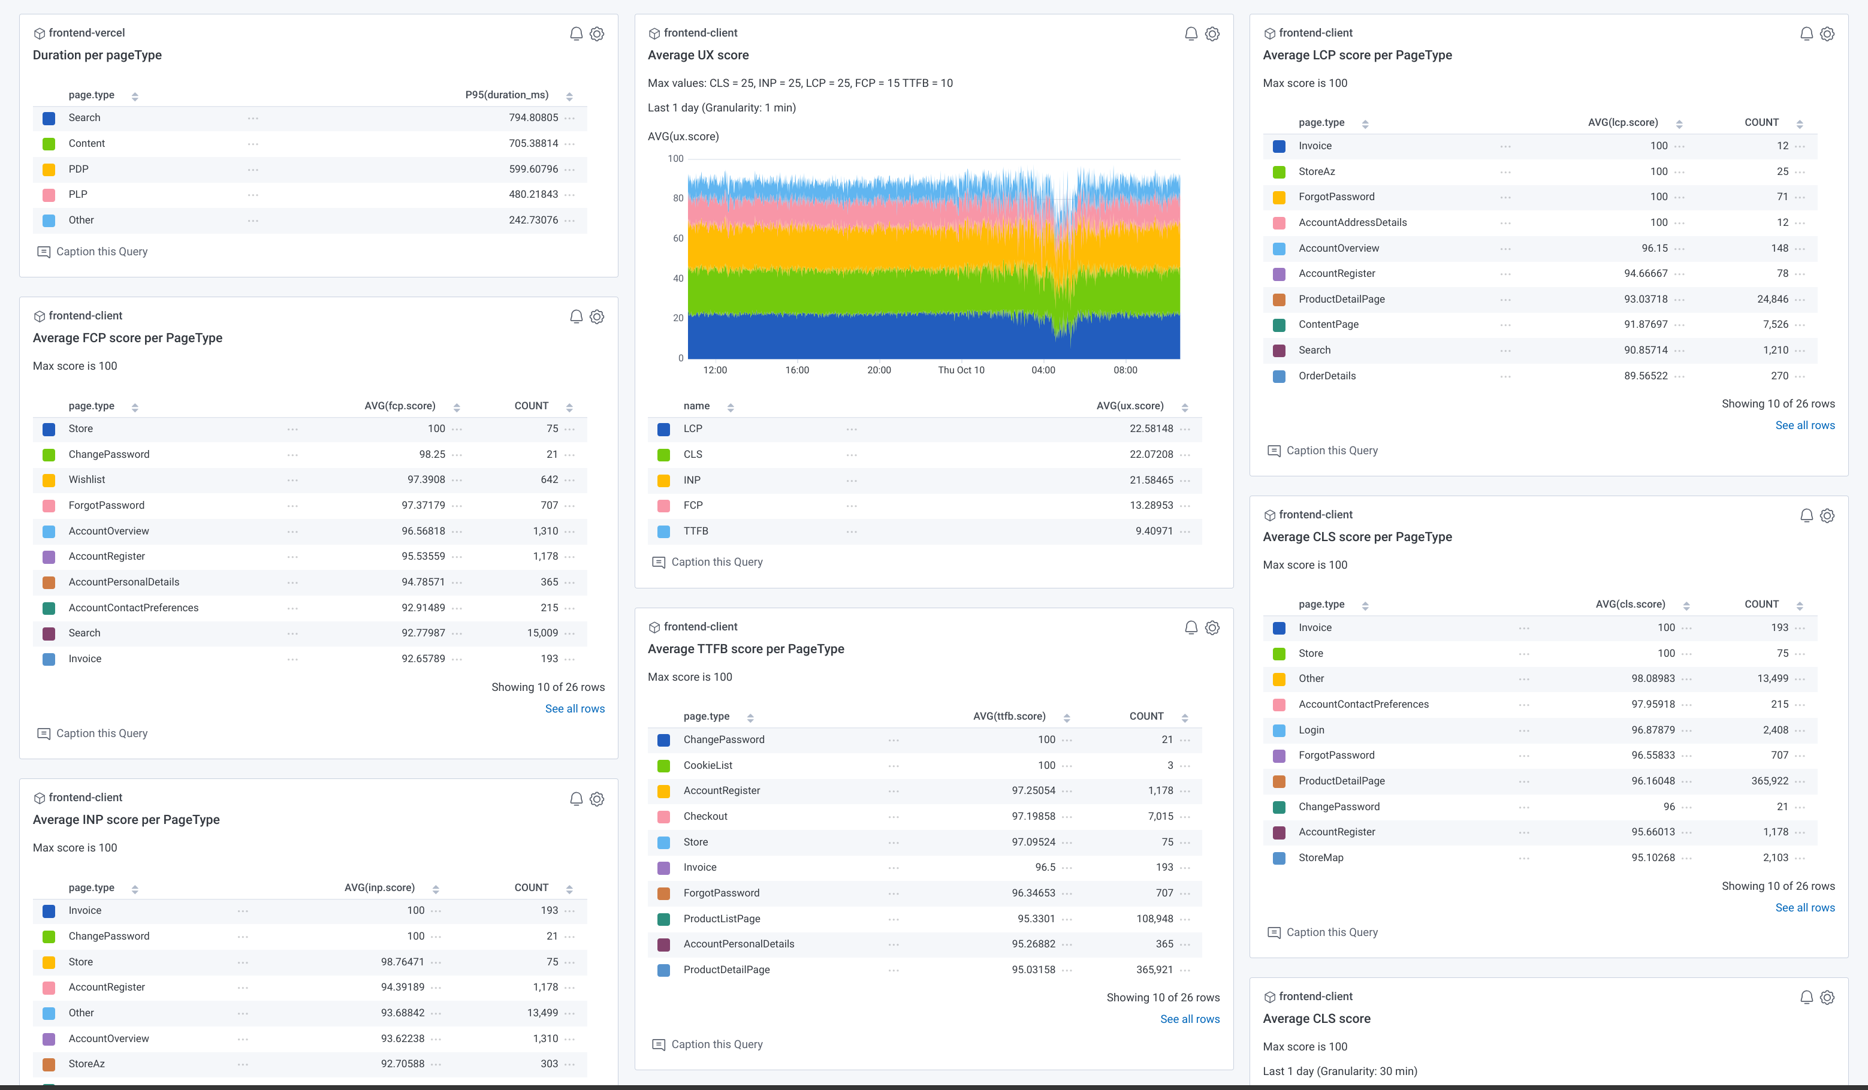

Slide 12
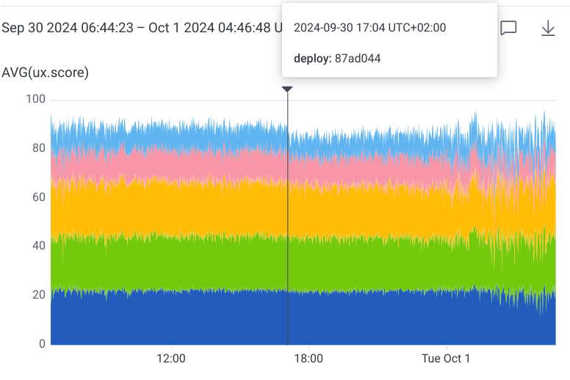
Notes:
Release markers to show when a release effects performance

Slide 13
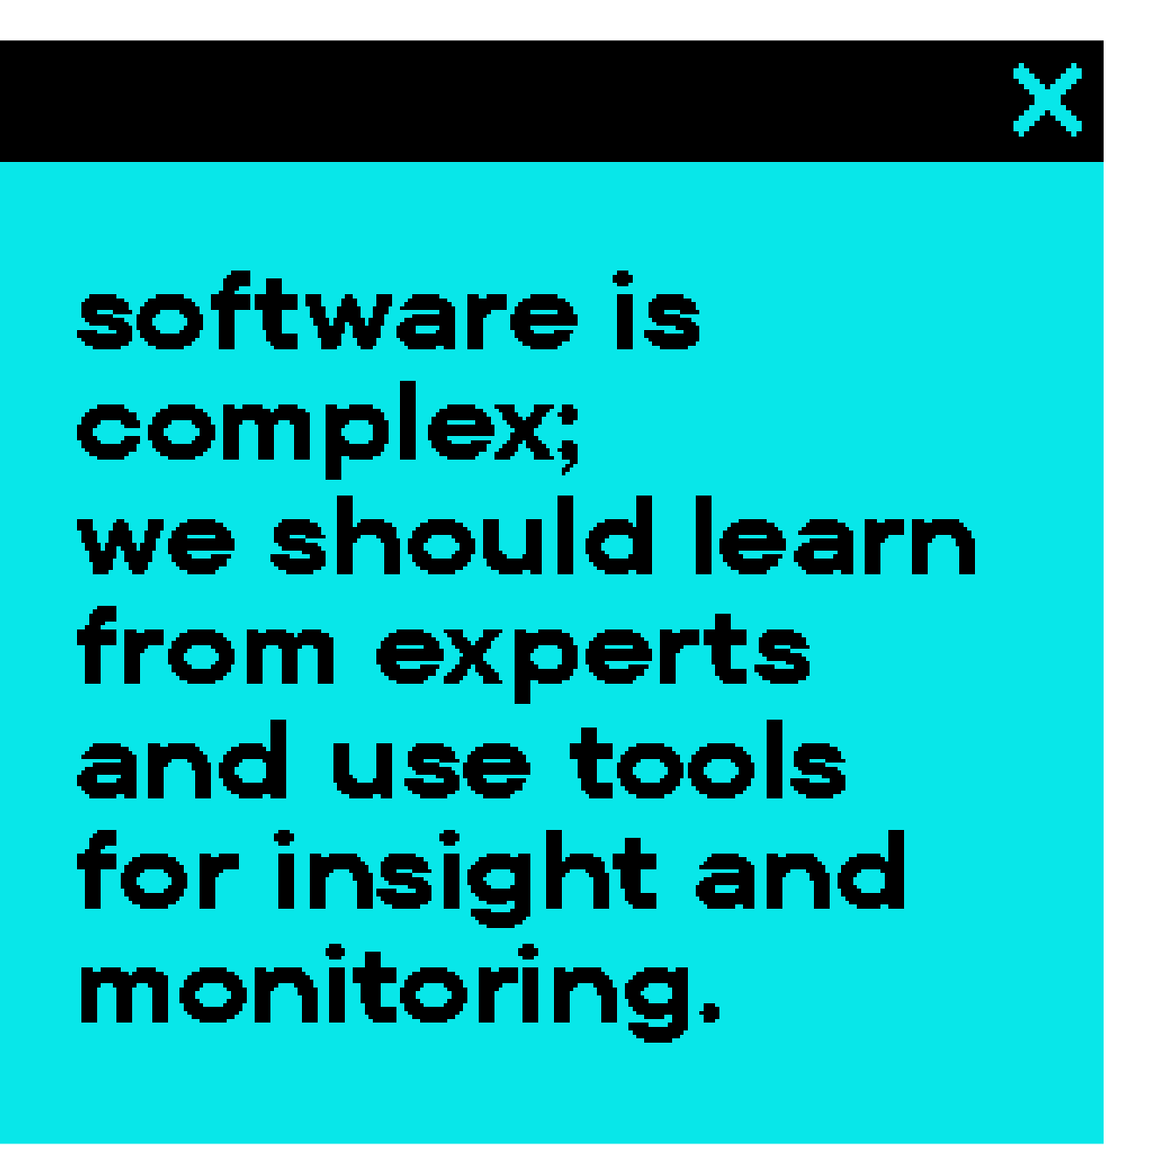
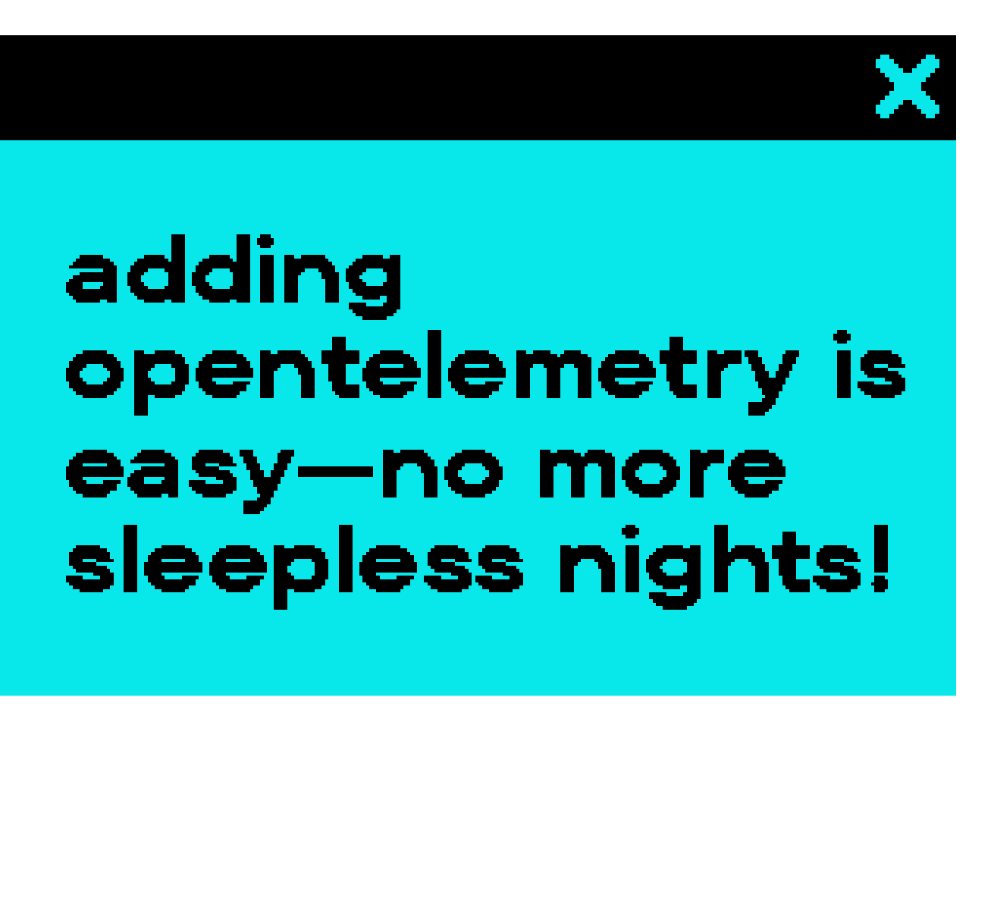

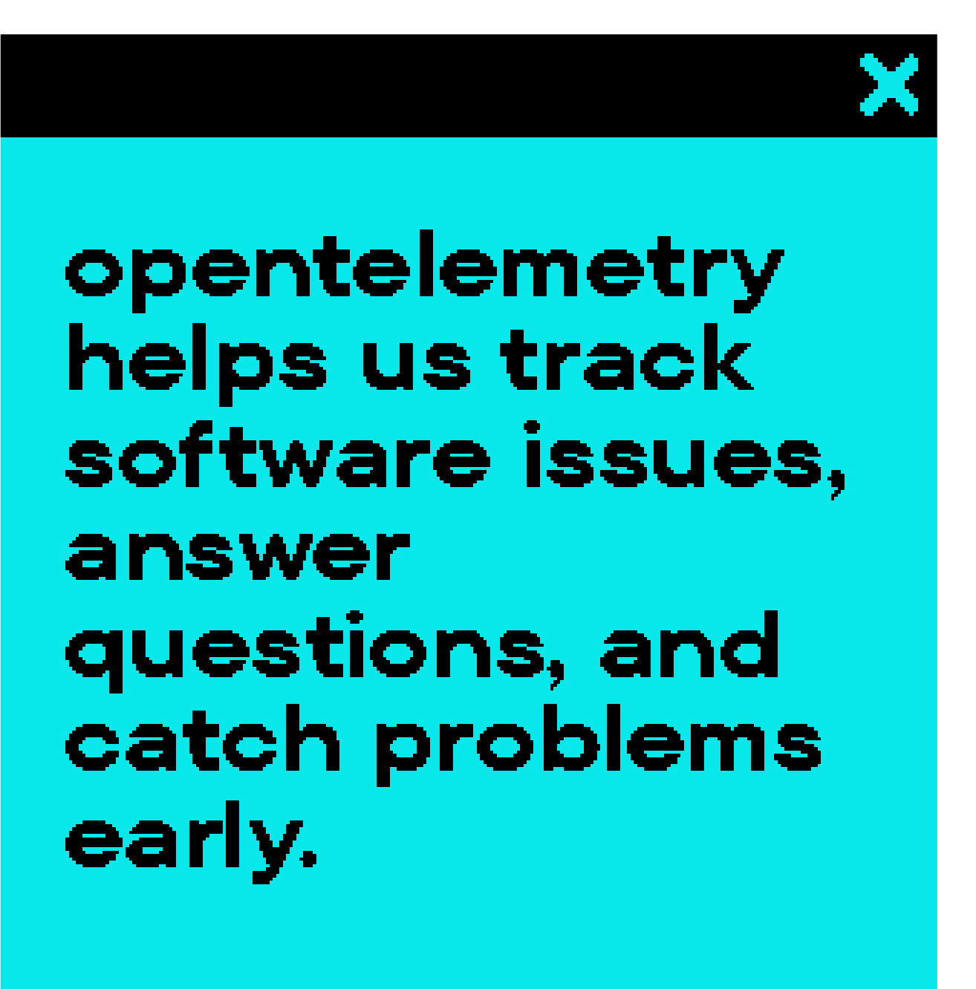

Slide 14



