Slide 1
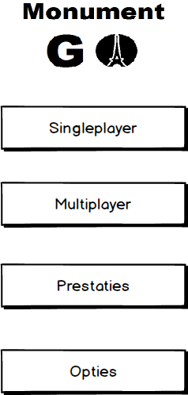
Startmenu

Slide 2
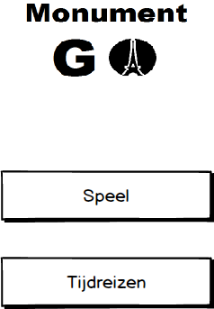

Singleplayer menu

Slide 3
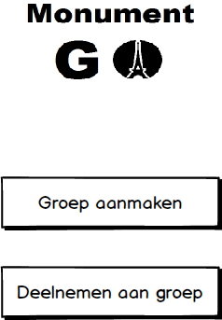
Multiplayer menu

Slide 4
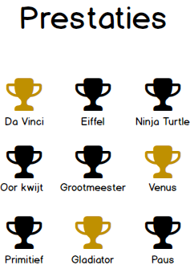
Prestaties

Slide 5
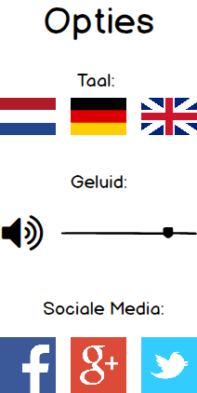
Opties

Slide 6
Opties

Slide 7
Opties

