Slide 1
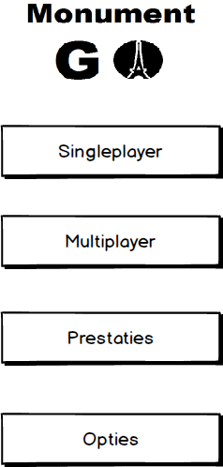
Startmenu

Slide 2
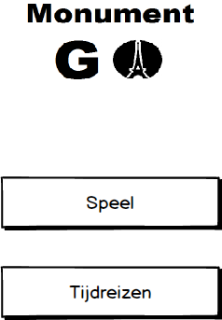

Singleplayer menu

Slide 3
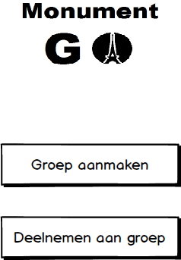
Multiplayer menu

Slide 4
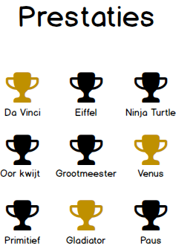
Prestaties

Slide 5
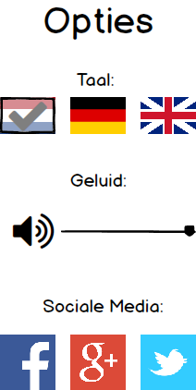
Opties Volume 100 Volume On NL

Slide 6
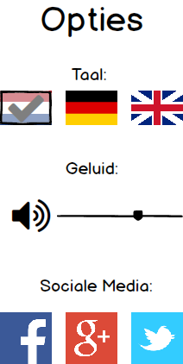
Opties Volume 66 Volume On NL

Slide 7
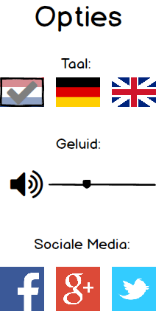
Opties Volume 34 Volume On NL

Slide 8
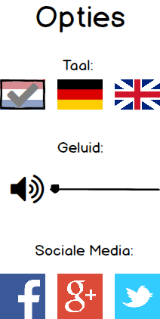
Opties Volume 0 Volume On NL

Slide 9
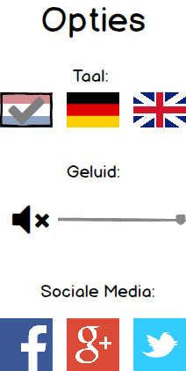
Opties Volume 100 Volume Off NL

Slide 10
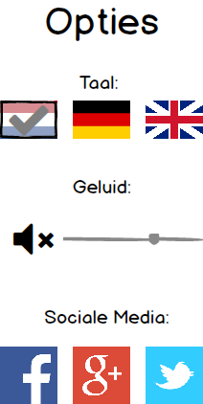
Opties Volume 66 Volume Off NL

Slide 11

Opties Volume 34 Volume Off NL

Slide 12

Opties Volume 0 Volume Off NL

Slide 13
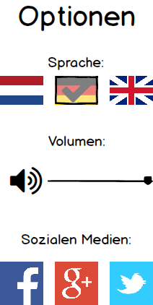
Opties Volume 100 Volume On DE

Slide 14
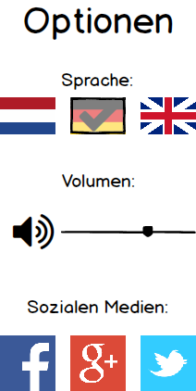
Opties Volume 66 Volume On DE

Slide 15
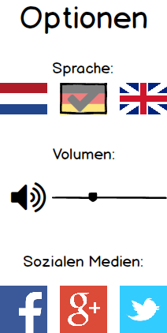
Opties Volume 34 Volume On DE

Slide 16
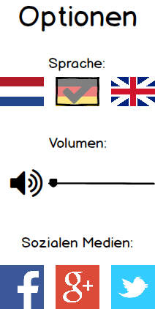
Opties Volume 0 Volume On DE

Slide 17
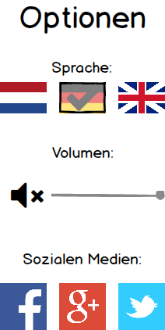
Opties Volume 100 Volume Off DE

Slide 18
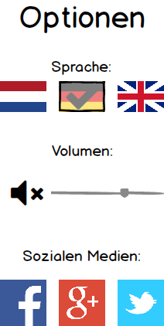
Opties Volume 66 Volume Off DE

Slide 19

Opties Volume 34 Volume Off DE

Slide 20

Opties Volume 0 Volume Off DE

Slide 21
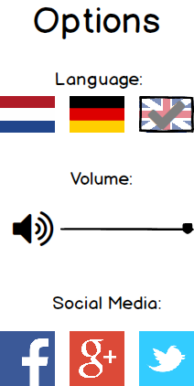
Opties Volume 100 Volume On EN

Slide 22
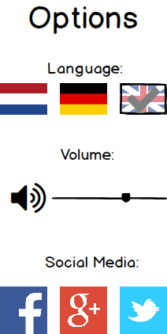
Opties Volume 66 Volume On EN

Slide 23
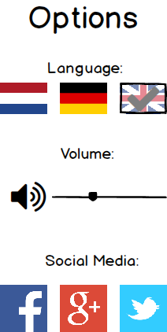
Opties Volume 34 Volume On EN

Slide 24
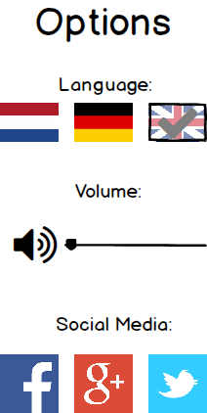
Opties Volume 0 Volume On EN

Slide 25

Opties Volume 100 Volume Off EN

Slide 26

Opties Volume 66 Volume Off EN

Slide 27

Opties Volume 34 Volume Off EN

Slide 28

Opties Volume 0 Volume Off EN

