Slide 1
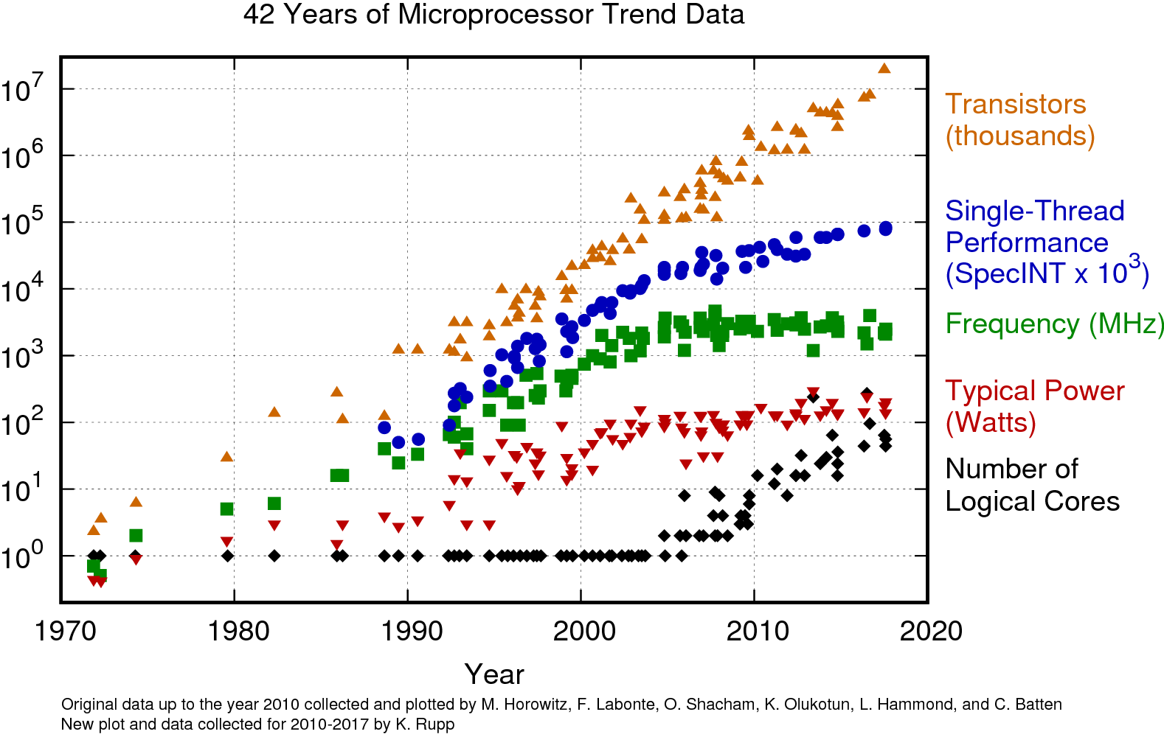
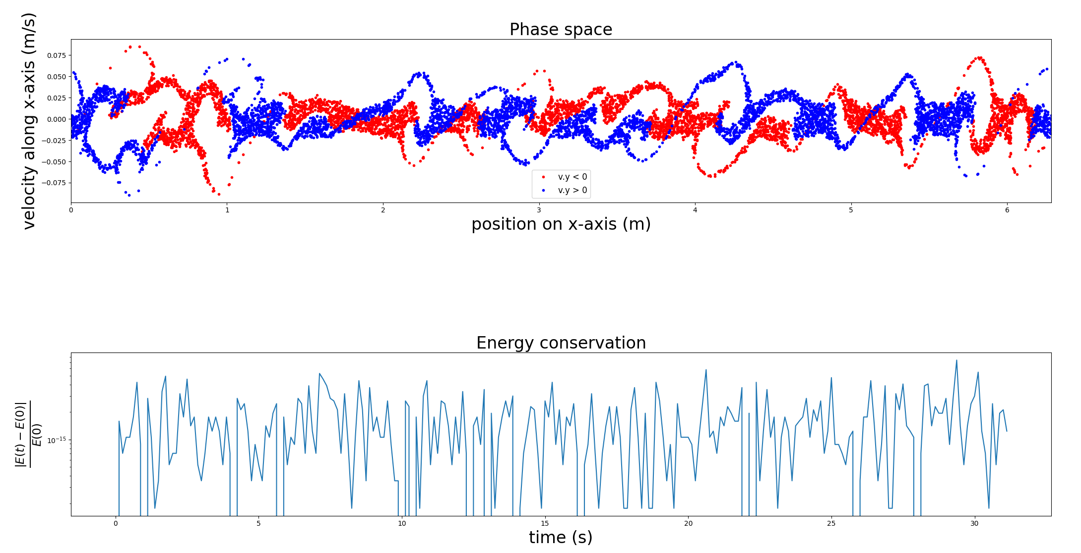

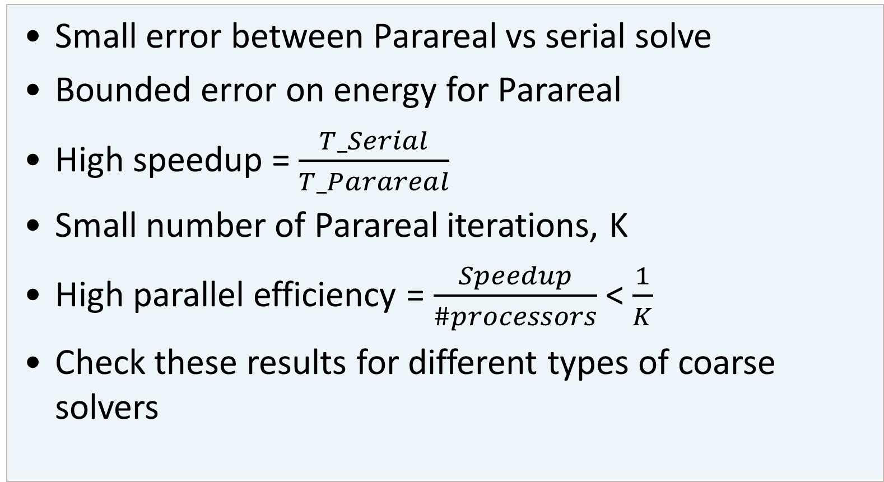
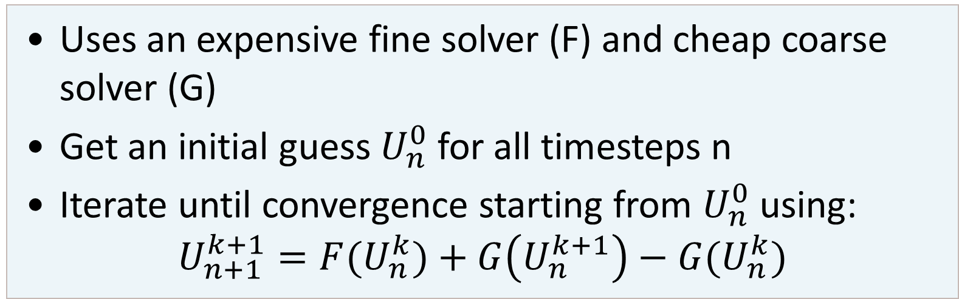
Parareal for particle-in-cell methods
Parallel-in-Time
Parallel-in-Time: Parareal
Results
Many problems involve solving differential equations
High-performance computing: many processors
Parallelisation in space saturates
➔ Parallelise in time
Uses an expensive fine solver (F) and cheap coarse solver (G)
Get an initial guess $U_{n}^{0}$ for all timesteps n
Iterate until convergence starting from $U_{n}^{0}$ using:
$$U_{n+1}^{k+1}={F(U}_{n}^{k})+G\left(U_{n}^{k+1}\right)−G(U_{n}^{k})$$
Temporal coarsening
The more costly the fine solver, the better the speedup/parallel efficiency
Linear Solvers
Direct vs iterative solvers for Maxwell’s equations
Fine solver: iterative
Coarse solver: iterative
Goals
Small error between Parareal vs serial solve
Bounded error on energy for Parareal
High speedup = $\frac{T_Serial}{T_Parareal}$
Small number of Parareal iterations, K
High parallel efficiency = $\frac{Speedup}{\#processors}$ < $\frac{1}{K}$
Check these results for different types of coarse solvers
[1] K. Rupp, “42 Years of Microprocessor Trend Data | Karl Rupp.”
Particle-in-cell (PIC) for plasma
99.9% of the observable universe is in a state of plasma
E.g. the sun, fusion reactors (Tokamaks and Stellarators), gas nebulae, etc.
Particle-in-cell methods can simulate macroscale phenomena without having to resolve small time scales
Simulates self-consistent interactions between particles and fields
Accurate while being reasonably computationally cheap
Take-home message
Parareal is viable to increase performance when spatial parallelism is exhausted
Performs best when cost(F) >> cost(G)
How accurate should solution be
Master of
Mathematical Engineering
Master’s thesis
Bram Leys
Supervisors
Giovanni Lapenta, Pranab J. Deka

