Slide 1
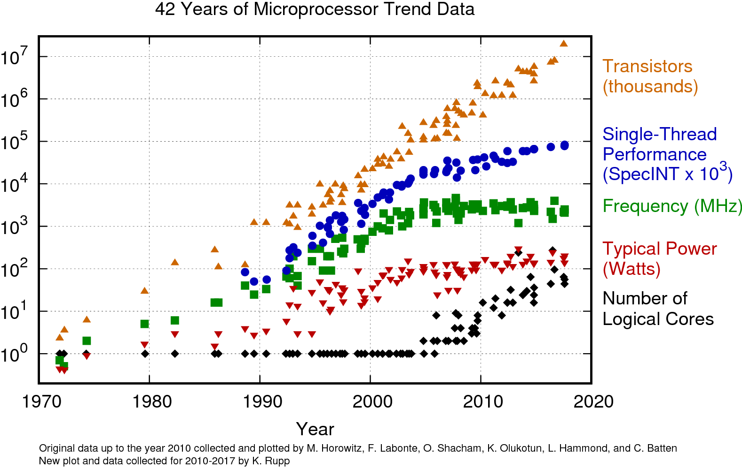
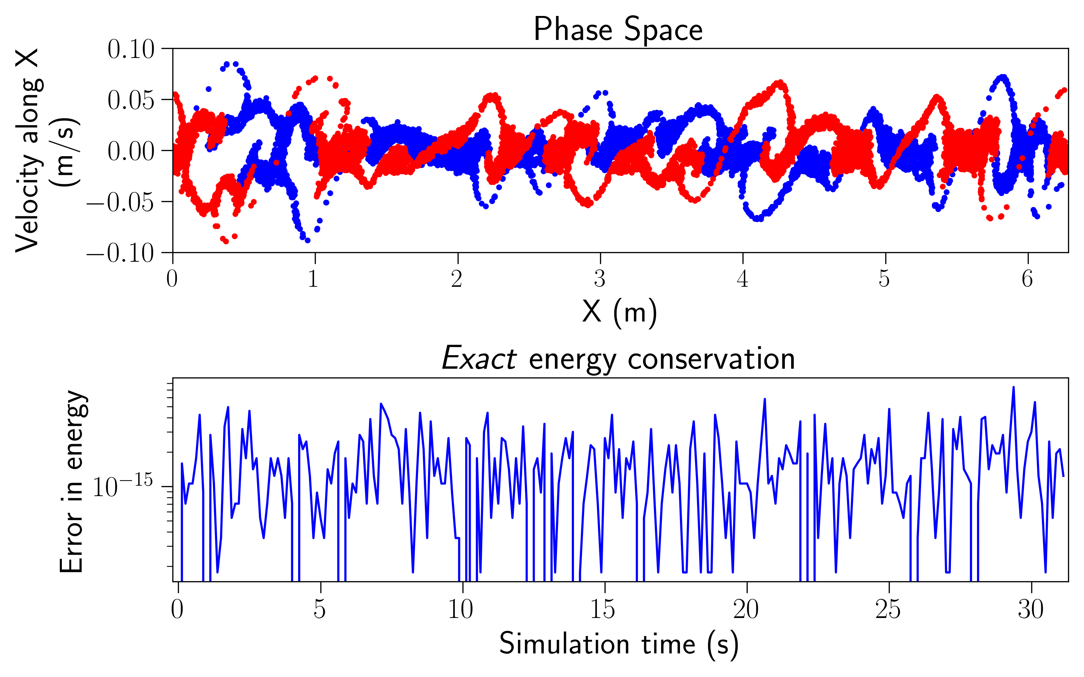

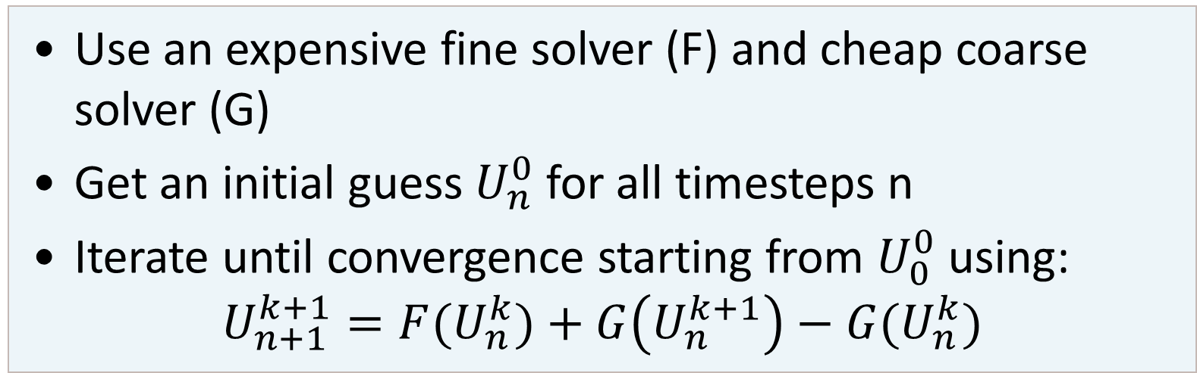
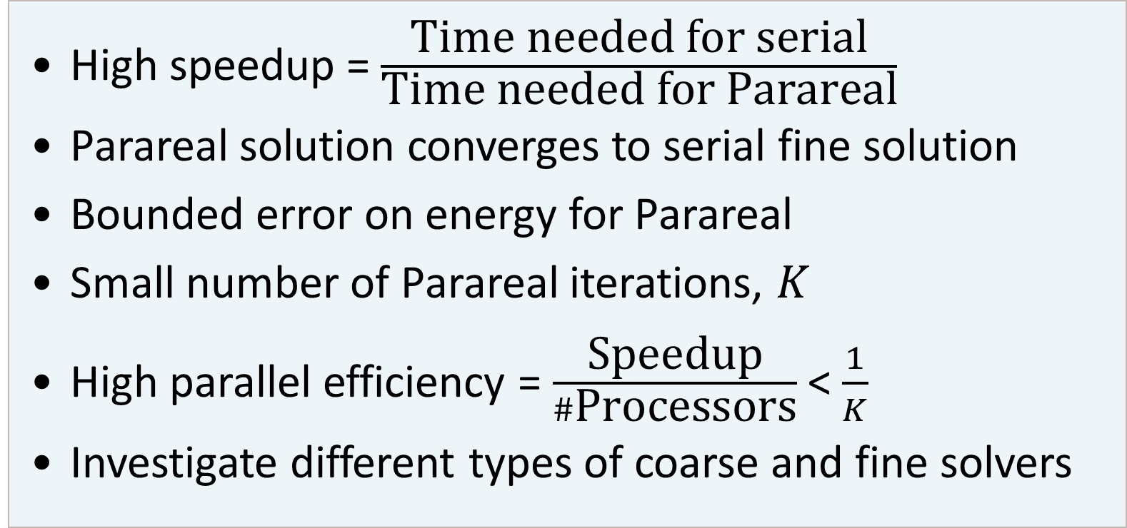
Parareal for particle-in-cell methods
Parallel-in-Time
Parallel-in-Time: Parareal
Results
Many problems involve solving differential equations
High-performance computing: many processors
If parallelisation in space saturates
➔ Parallelise in time
Use an expensive fine solver (F) and cheap coarse solver (G)
Get an initial guess $U_{n}^{0}$ for all timesteps n
Iterate until convergence starting from $U_{0}^{0}$ using:
$$U_{n+1}^{k+1}={F(U}_{n}^{k})+G\left(U_{n}^{k+1}\right)−G(U_{n}^{k})$$
Temporal coarsening
The cheaper the coarse solver, the better the speedup/parallel efficiency
Linear Solvers
Direct vs iterative solvers for Maxwell’s equations
Fine solver: iterative
Coarse solver: iterative, direct?
Depends on problem setting and size
Goals
High speedup = $\frac{\text{Time} \text{needed} \text{for} \text{serial}}{\text{Time} \text{needed} \text{for} \text{P}\text{arareal}}$
Parareal solution converges to serial fine solution
Bounded error on energy for Parareal
Small number of Parareal iterations, $K$
High parallel efficiency = $\frac{\text{Speedup}}{\#\text{P}\text{rocessors}}$ < $\frac{1}{K}$
Investigate different types of coarse and fine solvers
[1] K. Rupp, “42 Years of Microprocessor Trend Data | Karl Rupp.”
Particle-in-cell for plasma
99.9% of the observable universe is in a state of plasma
E.g., the Sun, fusion reactors (Tokamaks and Stellarators), gas nebulae, etc.
Particle-in-cell methods (implicit and semi-implicit) can simulate macroscale phenomena without having to resolve small time scales
Simulates self-consistent interactions between particles and fields
Highly accurate solutions but computationally expensive
Take-home message
Parareal is viable to increase performance when spatial parallelism is exhausted
Performs best when cost(G) << cost(F)
Depends on how accurate solution should be
Master of
Mathematical Engineering
Master’s thesis
Bram Leys
Supervisors
Giovanni Lapenta, Pranab J. Deka

