Slide 1
Master Thesis
Parallel in Time methods: supercomputing algorithms and efficient implementation of particle methods

Slide 2
Parallel in Time methods
Iterative or direct
Types:
Multiple shooting
Parareal
Domain decomposition/waveform relaxation
Multigrid
PFASST

Slide 3
Plasma simulations
Statistical representation <-> wave representation
Particle simulations:
Newton’s and Maxwell’s equations
Drifts
PIC
Strong <-> weak coupling

Slide 4
Plasma simulations
Statistical representation <-> wave representation
Particle simulations:
Newton’s and Maxwell’s equations
Drifts
PIC
Strong <-> weak coupling

Slide 5
ECSIM
Energy conserving
Only linear solver needed, no non-linear iterations
Most expensive addition = 3v mass matrices
Subcycle and smoothing possibilities

Slide 6
Coupling of parallel in time and plasma
Iterative schemes -> turbulent systems/non-linear chaotic systems might lead to issues
Parareal should still give statistically valid solutions
Different solution, but describing same dynamics
Due to boundedness of free energy in system
If solution at time t_i is converged, so are the previous chunk

Slide 7
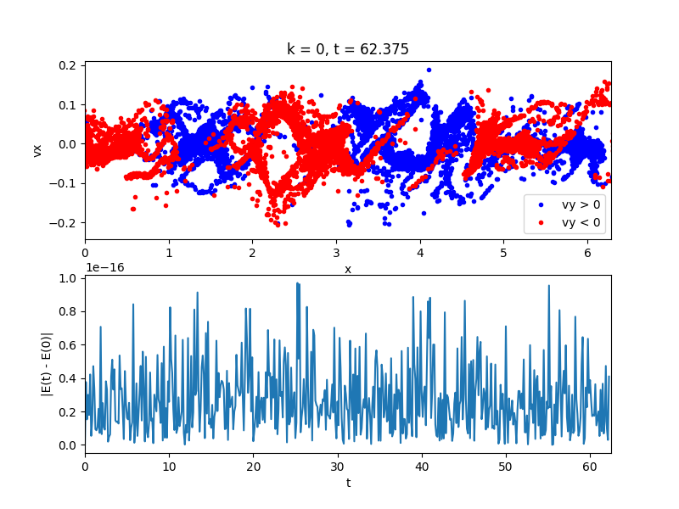
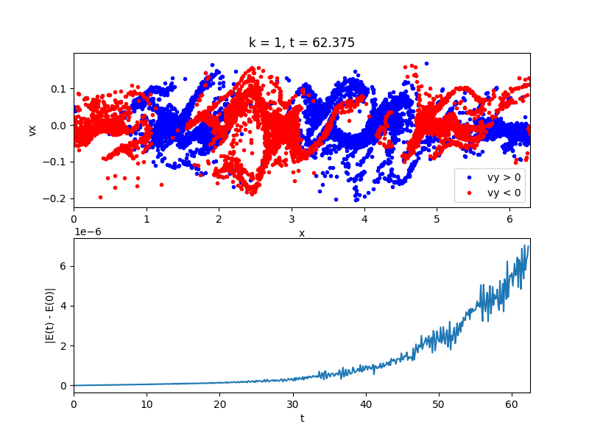
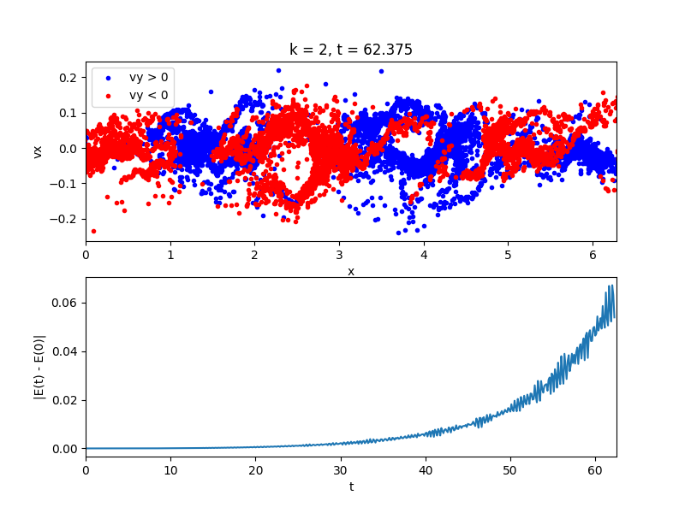
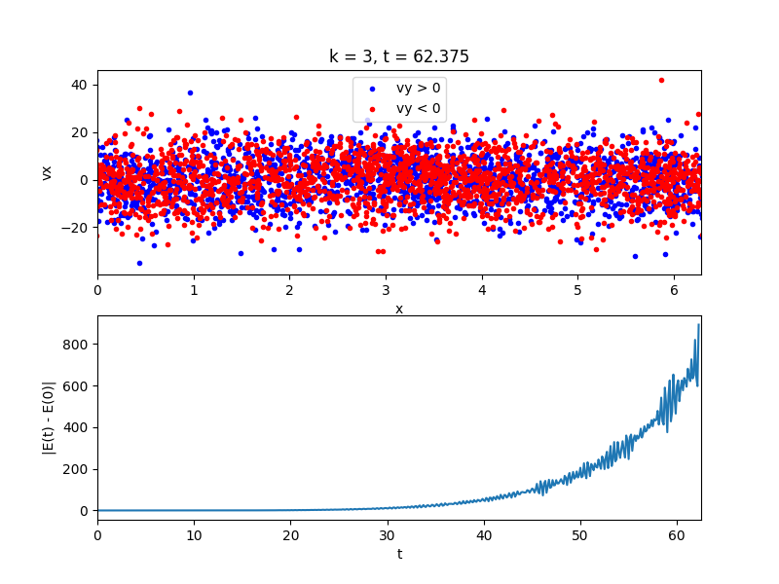
Recent results

