Slide 1
Backtrack search algorithm

Slide 2
Backtracking
Suppose you have to make a series of decisions, among various choices, where
You don’t have enough information to know what to choose
Each decision leads to a new set of choices
Some sequence of choices (possibly more than one) may be a solution to your problem
Backtracking is a methodical way of trying out various sequences of decisions, until you find the correct one that “works”.

Slide 3
Backtracking
Backtracking is used to solve problems in which a sequence of objects is chosen from a specified set so that the sequence satisfies some criterion.
Backtracking is a modified depth-first search of a tree.
It is the procedure whereby, after determining that a node can lead to nothing but dead nodes, we go back (“backtrack”) to the node’s parent and proceed with the search on the next child.

Slide 4
Backtrack Algorithm
Based on depth-first recursive search
Approach
Tests whether solution has been found
If found solution, return it
Else for each choice that can be made
Make that choice
Recursive
If recursion returns a solution, return it
If no choices remain, return failure
Some times called “search tree”

Slide 5
Improving Backtracking
Search pruning will help us to reduce the search space and hence get a solution faster.
The idea is to avoid those paths that may not lead to a solutions as early as possible by finding contradictions so that we can backtrack immediately without the need to build a hopeless solution vector.

Slide 6
Backtracking examples
The backtracking can be used in this cases:
Solving a maze
Coloring a map
Solving a puzzle
N queens problem etc.,

Slide 7
Backtracking EXAMPLE—8 Queens Problem
The 8-queens problem is a classical combinatorial problem in which it is required to place eight queens on an 8 x 8 chessboard so no two can attack each other.
A queen can attack another queen if it exists in the same row, column or diagonal as the queen.

Slide 8
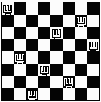
Backtracking EXAMPLE—8 Queens Problem(cont…)
This problem can be solved by trying to place the first queen, then the second queen so that it cannot attack the first, and then the third so that it is not conflicting with previously placed queens.

Slide 9

Backtracking EXAMPLE—8 Queens Problem(cont…)
It is an empty 8 x 8 chess board. We have to place the queens in this board.

Slide 10
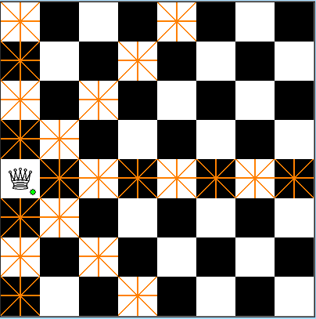
Backtracking EXAMPLE—8 Queens Problem(cont…)
We have placed the first queen on the chess board

Slide 11
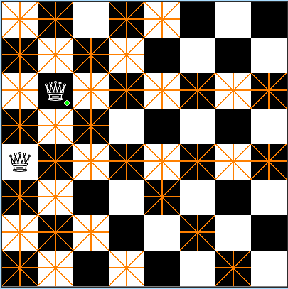
Backtracking EXAMPLE—8 Queens Problem(cont…)
Then we have placed the second queen on the board.
The darken place should not have the queens because they are horizontal, vertical, diagonal to the placed queens.

Slide 12

Backtracking EXAMPLE—8 Queens Problem(cont…)
We have placed the third queen on board.

Slide 13
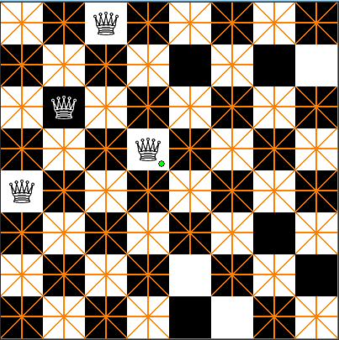
Backtracking EXAMPLE—8 Queens Problem(cont…)
We have placed the 4th queen on the board.
We have placed that in the wrong spot, so we backtrack and change the place of that one.

Slide 14

Backtracking EXAMPLE—8 Queens Problem(cont…)
In this way, we have to continue the process untill our is reached ie., we must place 8 queens on the board.

Slide 15
Backtracking EXAMPLE—8 Queens Problem(cont…)
Backtracking provides the hope to solve some problem instances of nontrivial sizes by pruning non-promising branches of the state-space tree.
The success of backtracking varies from problem to problem and from instance to instance.
Backtracking possibly generates all possible candidates in an exponentially growing state-space tree.

Slide 16
Parallelizing backtrack algorithm
First, we have to parallelize the root node of the algorithm.
Then the sub nodes and the child nodes should be parallelized independently using the other processors.
For example, if we take the 8 queens problem then it can be easily implemented in parallel.
The N-queens problem can be parallelized in this way.

Slide 17
Parallelizing backtrack algorithm
The solutions to the n-queens problem can be generated in parallel by using the master-worker technique.
The manager generates the upper portion of the search tree by generating those nodes of fixed depth d, for some d.
The manager dynamically passes each of these sequences to an idle worker, who in turn continues to search for sequences with n-queens property that contain the fixed subsequence of length d.
The master-worker technique is particularly well-suited for implementation with MPI

Slide 18
Parallelizing backtrack algorithm
Parallelizing the backtrack algorithm will gives us a good speedup and efficiency when compared to the normal algorithm.
The speedup and the efficiency will gets drastically increased when it is done in the parallel.

Slide 19
References
http://ieeexplore.ieee.org.libproxy.library.wmich.edu/search/srchabstract.jsp?tp=&arnumber=346127&openedRefinements%3D*%26filter%3DAND%28NOT%284283010803%29%29%26searchField%3DSearch+All%26queryText%3Dparallel+backtrack+algorithm&tag=1
http://www.mendeley.com/research/a-randomized-parallel-backtracking-algorithm/
http://www.arch.cs.titech.ac.jp/~kise/doc/paper/uec-is-2004-06.pdf

Slide 20
Thank You!!!

