Slide 1

Smart Apps Testing
Expensor – Bram Van Pevenage

Slide 2
React framework
Testing in react
Volgen van een crash course (React Testing Crash Course)
Unit Tests

Slide 3

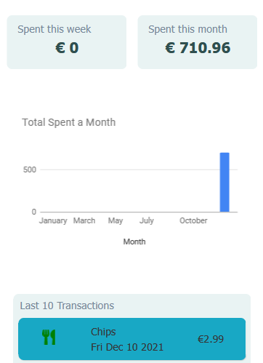
Expensor
Bijhouden van uitgaven
In groepen

Slide 4
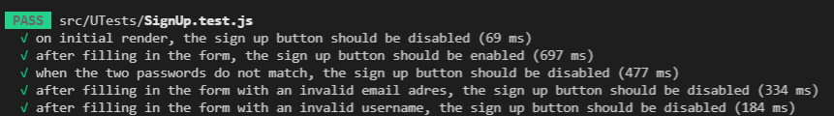
Sign Up Component
Testen van de form validatie.

Slide 5
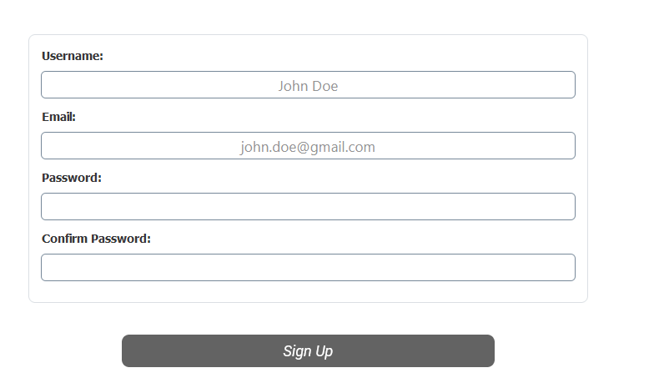
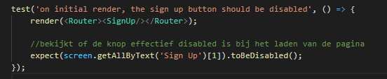
Test 01
on initial render, the sign-up button should be disabled

Slide 6
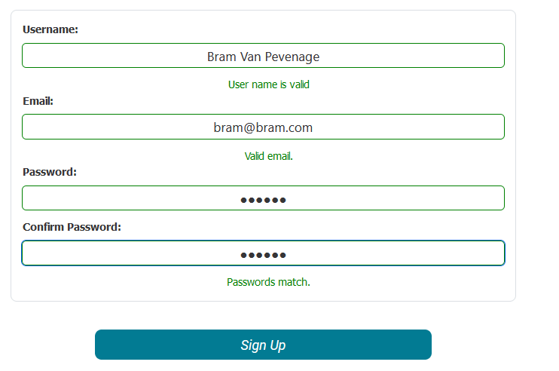
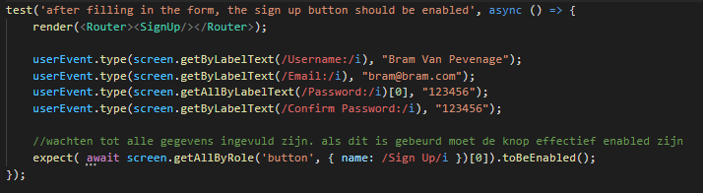
Test 02
after filling in the form, the sign-up button should be enabled

Slide 7
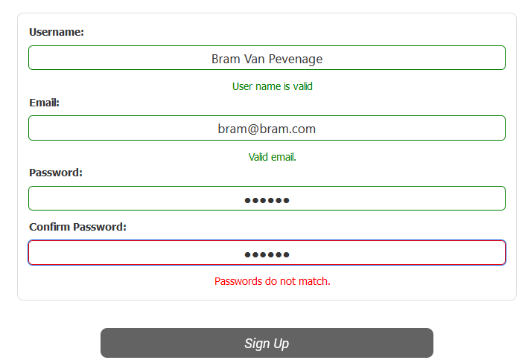
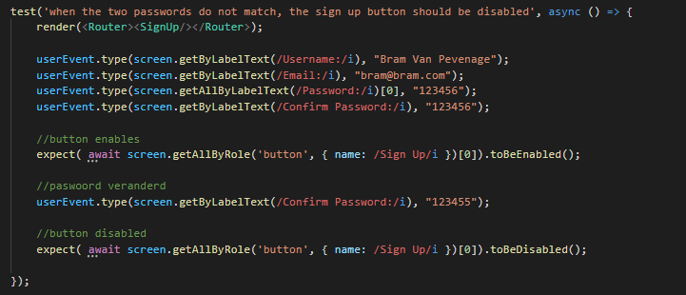
Test 03
when the two passwords do not match, the sign-up button should be disabled

Slide 8
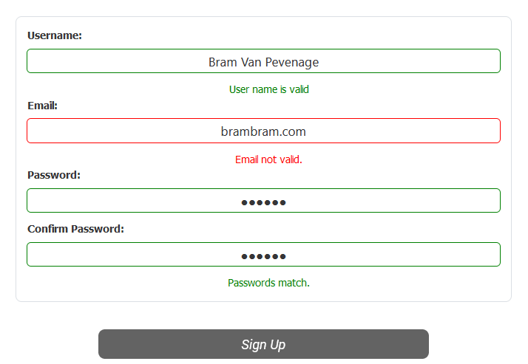
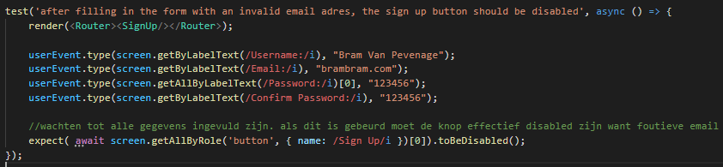
Test 04
after filling in the form with an invalid email adres, the sign-up button should be disabled

Slide 9
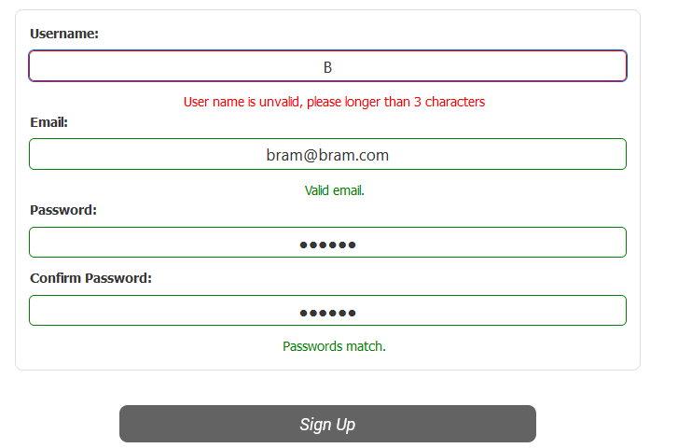
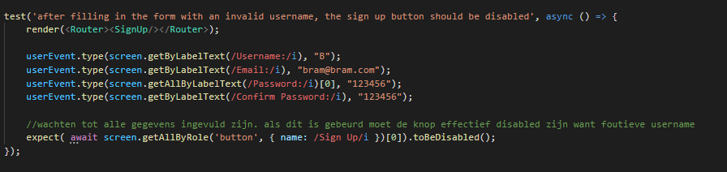
Test 05
after filling in the form with an invalid username, the sign-up button should be disabled

Slide 10
Demo
Expensor

