Slide 1

Not-Torch
This is an intro to my very own framework

Slide 2




Table of Contents
01
02
03
04
An idea
Functionality
How is it built?
Layers \ Losses,
Criterions \ Optimizers
Lab 5
Lab 6,7
7 segment - 4 outputs
7 segment - 10 outputs with visualization

Slide 3

An idea

Slide 4
It is a framework with which to build deep neural networks. Numpy is taken as a base.
The main layers are implemented:
Linear, BatchNorm, Dropout.
Activation function:
ReLU, LeakyReLU, Sigmoid, Softmax.
Losses:
MSE, Binary Cross-entropy (LogLoss).
Optimizers:
Adam, RMSProp, SGD.
LRDecay:
Exponential, Time-based, Step.

Slide 5
02
Functionality

Slide 6



LINEAR
We all know what it is. This is the reason to skip it. Just look at the picture

Slide 7


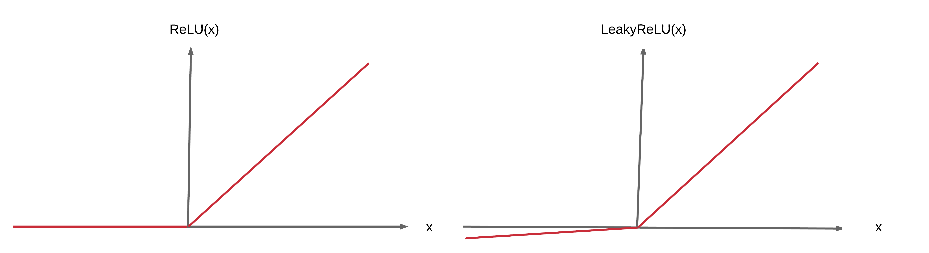
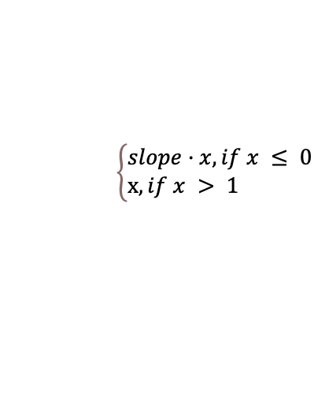
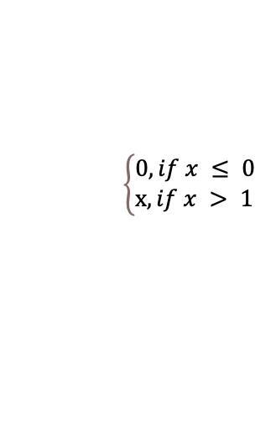
ReLU and LReLU
ReLU
LReLU
$$\left\{\begin{aligned}&0, if x ≤ 0 \\ &x, if x > 1\end{aligned}\right.$$
$$\left\{\begin{aligned}&slope·x, if x ≤ 0 \\ &x, if x > 1\end{aligned}\right.$$

Slide 8
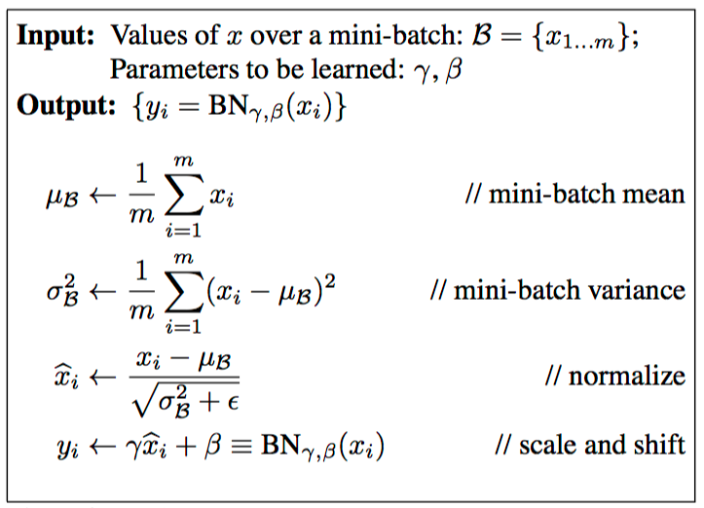
BatchNorm
The main idea of BatchNorm is this: for the current minibatch while training, in each hidden layer, we normalize the activations so that its distribution is Standard Normal (zero mean and one standard deviation).
https://wiseodd.github.io/techblog/2016/07/04/batchnorm/

Slide 9
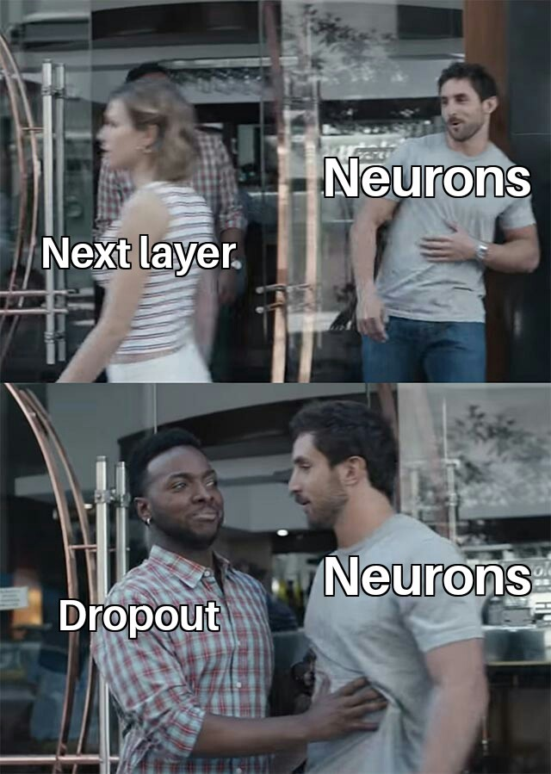
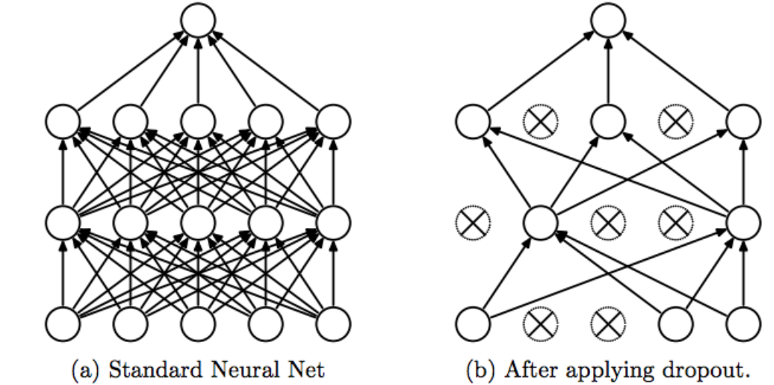
Dropout
Dropout regularization.
This layer randomly zeroes the input weights.
Behaves differently during training and evaluation.
https://www.cs.toronto.edu/~hinton/absps/JMLRdropout.pdf

Slide 10
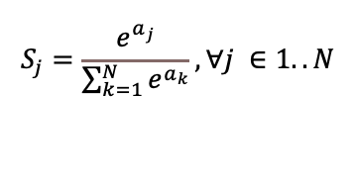

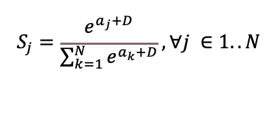
Softmax
Standard
The softmax function takes an N-dimensional vector of arbitrary real values and produces another N-dimensional vector with real values in the range (0, 1) that add up to 1.0.
$$S_{j}=\frac{e^{a_{j}}}{\sum_{k=1}^{N}{e^{a_{k}}}}, ∀j ∈1..N$$
Stable
https://eli.thegreenplace.net/2016/the-softmax-function-and-its-derivative/
$$S_{j}=\frac{e^{a_{j}+D}}{\sum_{k=1}^{N}{e^{a_{k}+D}}}, ∀j ∈1..N$$
$D=−max⁡(a_{1},a_{2}$, $a_{3}$,…, $a_{n}$)

Slide 11
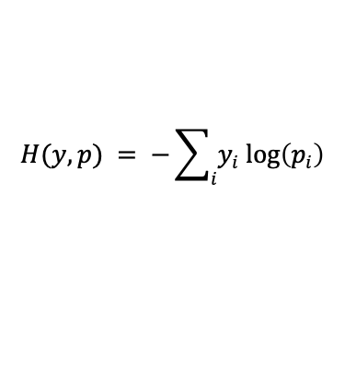

LogLoss
Formula
$$H(y,p) = −\sum_{i}{y_{i} log\left(p_{i}\right)}$$
Cross entropy indicates the distance between what the model believes the output distribution should be, and what the original distribution really is.
Derivative
https://deepnotes.io/softmax-crossentropy
$$\frac{∂L}{∂o_{i}}=p_{i}−y$$

Slide 12
03
Lab 5
7 segment - 4 outputs

Slide 13
04
Lab 6,7
7 segment - 10 outputs with visualization

Slide 14

AWESOME! THANK YOU!

