Slide 1

ATTRITION ANALYSIS
GROUP #2
Brandon Mata
Jeff Garcia
Susan Espinosa
Aleysa
Vignesh Chiranai
Aditi Garg

Slide 2
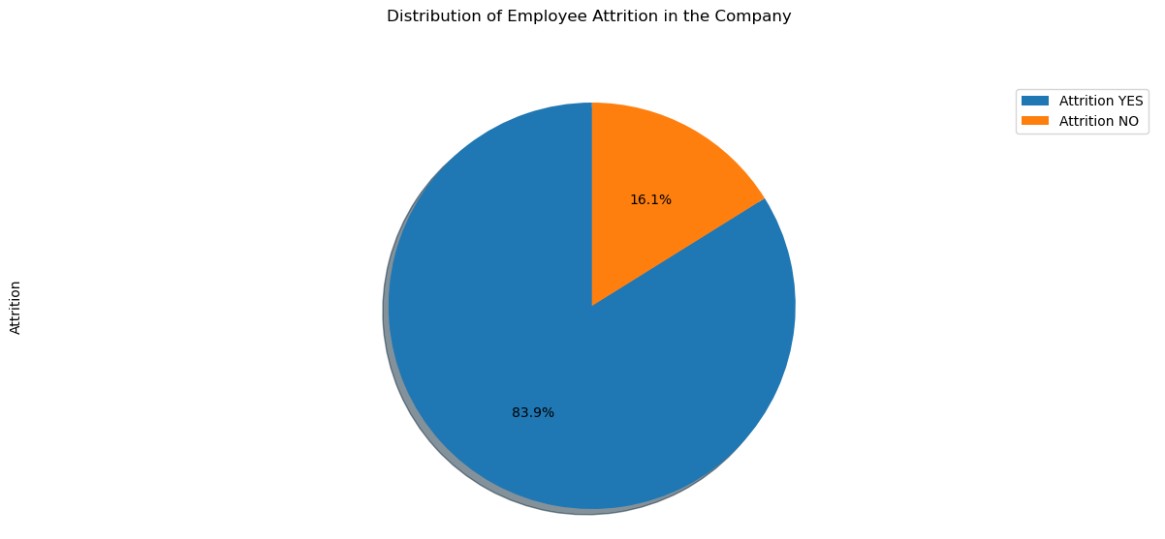
Distribution of employee attrition in the company
Analysis
According the Pie Chart, we can say that out of 1470 employees, 16.1% of the employees left their job; while the other 83.9% of the employees preferred to stay at their jobs
ABC

