Slide 1

CSCI 331- Project 2
Rajveer Singh (leader)
Eliyahu Roth
Meet Patel(Backup Leader)
Mashiur Rahman
Brandon Scott

Slide 2
Project Management
This section will demonstrate project organization and layout
The project plan
Meeting Notes
Group Collaborations
To-Do lists For each member
Gannt Chart

Slide 3
The Project Plan
Hold meetings to grasp the understanding of the projects objectives
Restore the BIClass database and add columns to each table
Work on assigned procedures
Put together all the procedures into one master copy of the database and debug for issues
Group leader creates powerpoint for group to record with

Slide 4
Meeting notes
Meeting Notes for 4/2
Meeting Notes for 4/5
Meeting Notes for 4/7

Slide 5
Meeting notes for 4/2
Attendees: Rajveer, Eli, Meet
(Meeting was recorded for everyone that could not attend)
Notes:
Our first meeting regarding the project
Went over the project instructions and how to setup the tables in SSMS
Discusses how to implement the stored procedures for the project

Slide 6
Meeting notes for 4/5
Attendees: All members were present during this meeting
(Rajveer, Eli, Meet, Mashiur, Brandon)
Notes
Discussed how to set up the User Authorization Table and the trackworkflow tables
Discussed some issues that the group members had with the code and helped fix / debug them
Discussed how to implement and start the stored procedures as a group

Slide 7
Meeting notes for 4/7
Attendees: Mashiur, Rajveer, Eli, Meet
(meeting was recorded so all group members can watch it)
Notes
Discussed all the group members progress and where everyone is at currently with their tasks
Had discussions regarding project tasks
Went over stored procedures as a group and helped address any issues implementing them

Slide 8
Group Collaborations
We utilized discord to communicate with each other
Created multiple threads to organize project discussions
Members of the group can Ping other members for assistance when running into problems or need to share information

Slide 9
To-Do Lists and Gantt Chart

Slide 10
To-Do list: Rajveer Singh

Slide 11
To-Do list: Eliyahu Roth

Slide 12
To-Do list: Meet Patel

Slide 13
To-Do list: Mashiur Rahman

Slide 14
To-Do list: Brandon Scott

Slide 15
Gantt Chart

Slide 16
Stored Procedures
This segment of the presentation will go over created stored procedures
Screenshot of the procedures
Execution time for each procedures and the WorkFlowSteps Entry
JDBC Outputs of the view created by the procedures

Slide 17
Rajveer Singh’s Procedures
Project2.Load_Data
Project2.Load_DimTerritory

Slide 18
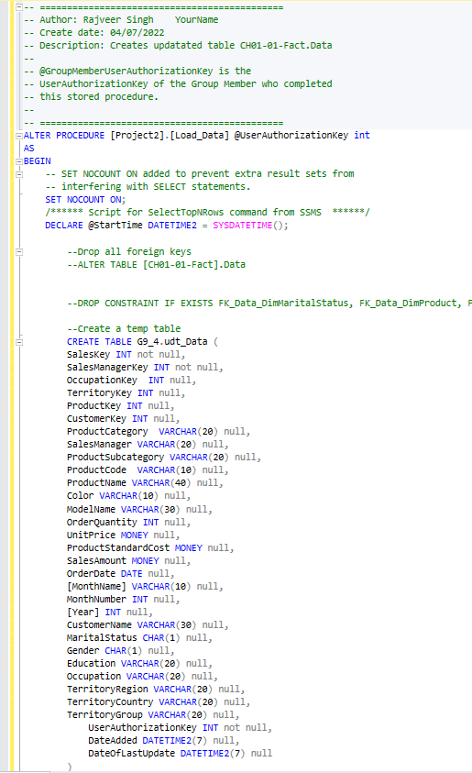
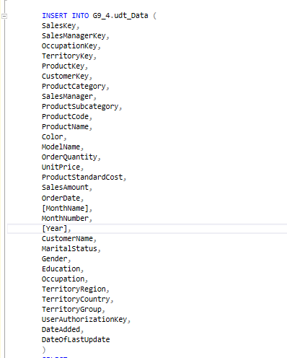
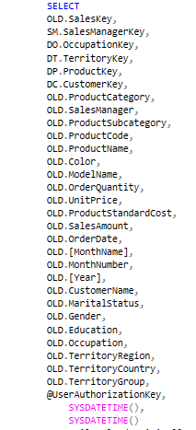
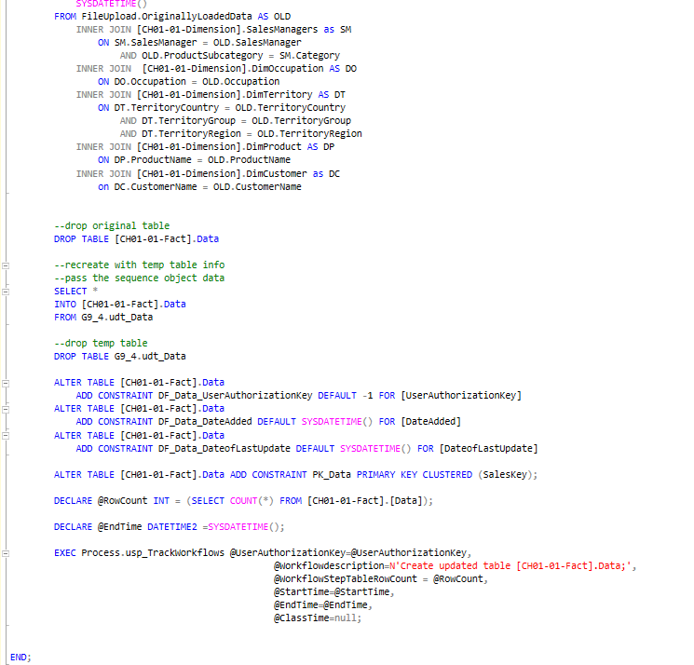
Project2.Load_Data

Slide 19
WorkFlowSteps and Execution

Slide 20
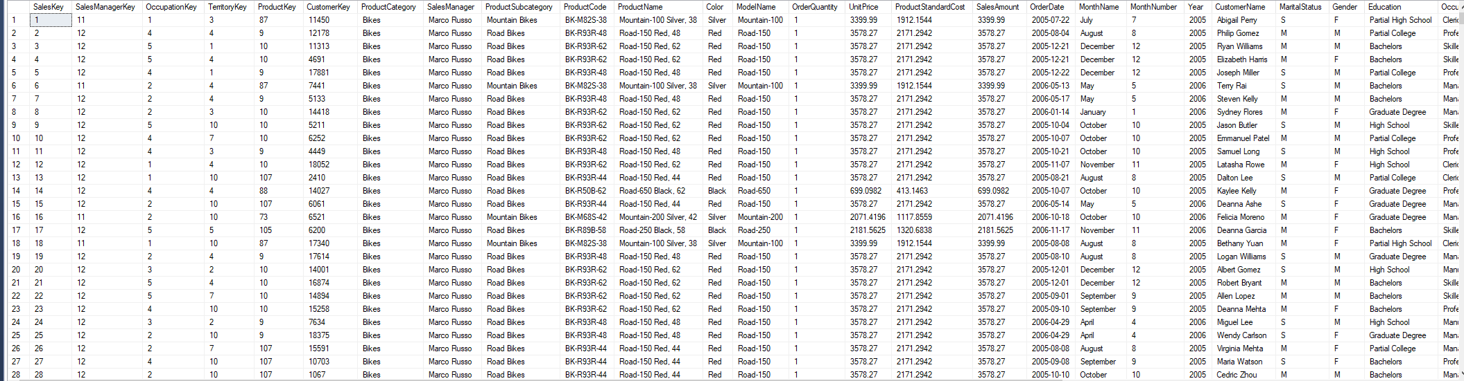
SSMS Output

Slide 21
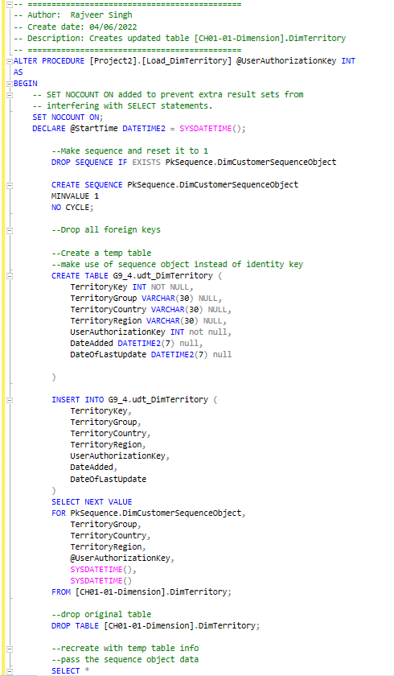
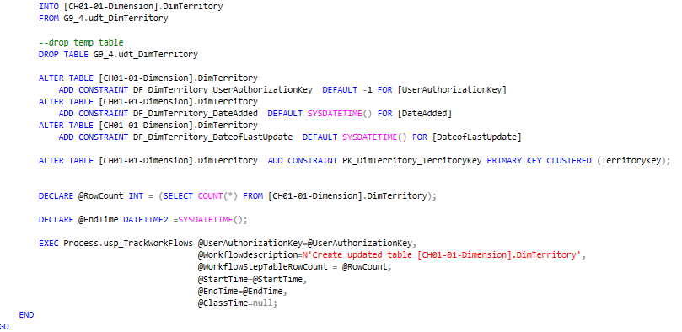
Project2.Load_DimTerritory

Slide 22
WorkFlowSteps and Execution

Slide 23
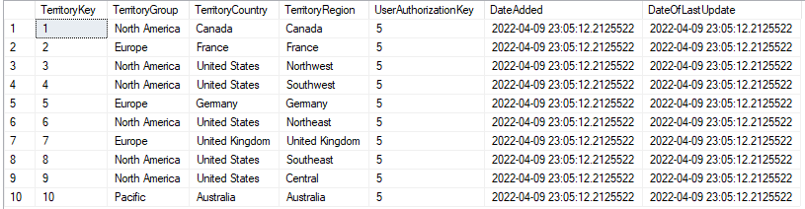
SSMS Output

Slide 24
Meet Patel Procedures
Process.usp_TrackWorkFlow
Project2.LoadStarSchemaTable
Project2.TruncateStarSchemaTable
Project2.Load_DimCustomer
Project2.Load_DimProductCategory
Project2.Load_DimProductSubCategory
Project2.ShowTableStatusRowCount

Slide 25
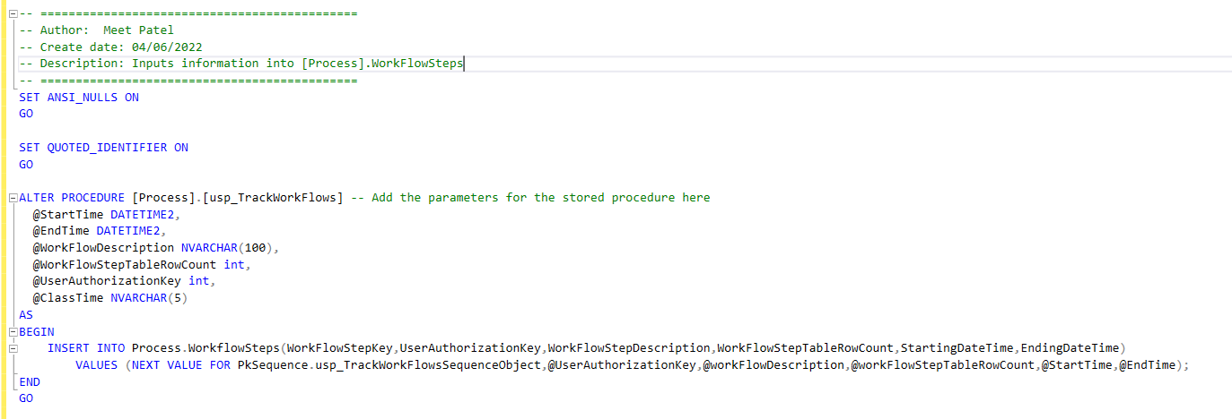
Process.usp_TrackWorkFlow

Slide 26
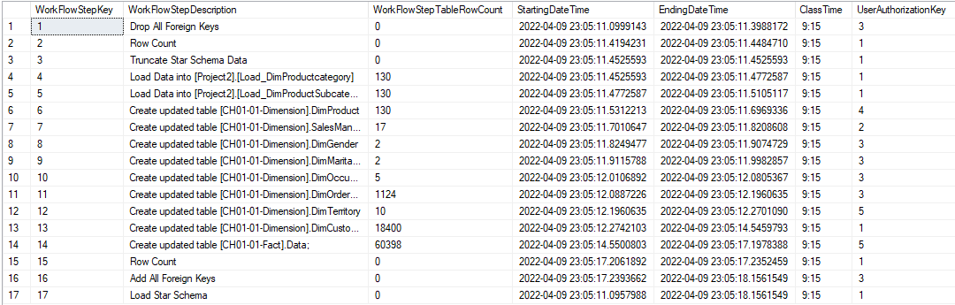
WorkFlowSteps and Execution

Slide 27
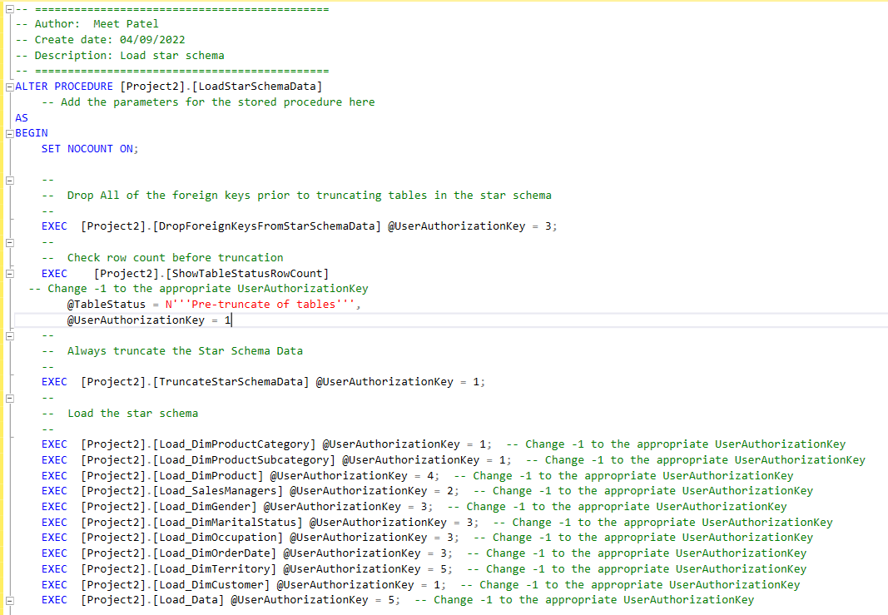
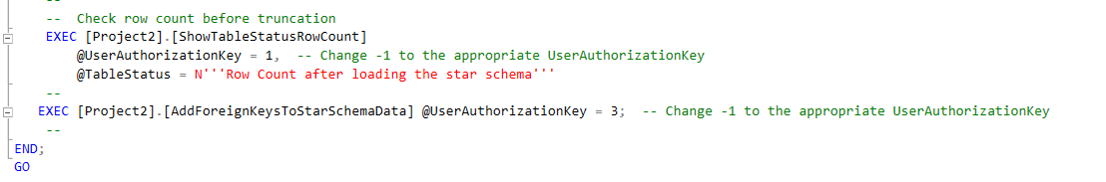
Project2.LoadStarSchemaTable

Slide 28
WorkFlowSteps and Execution

Slide 29
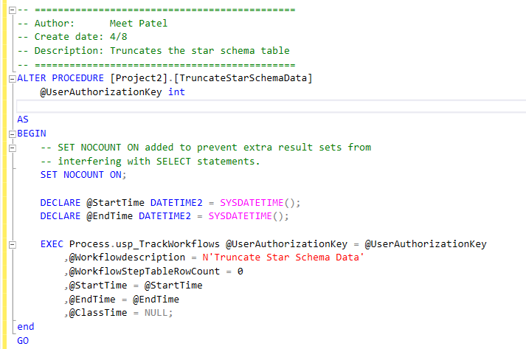
Project2.TruncateStarSchemaTable

Slide 30
WorkFlowSteps and Execution

Slide 31
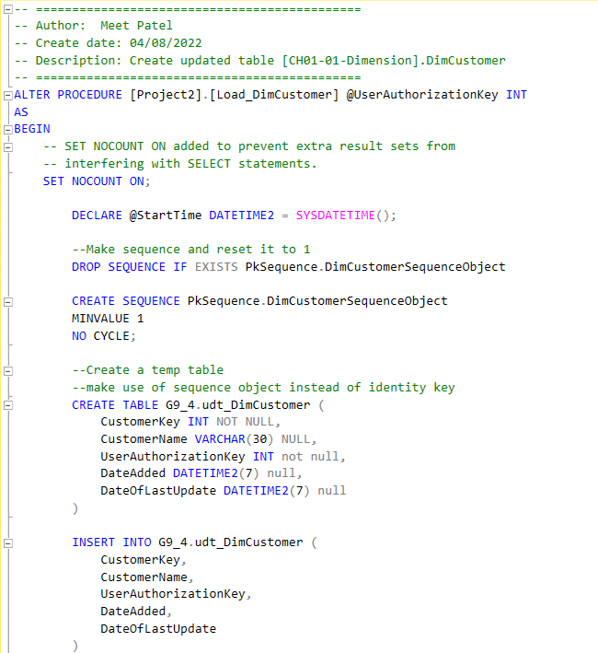
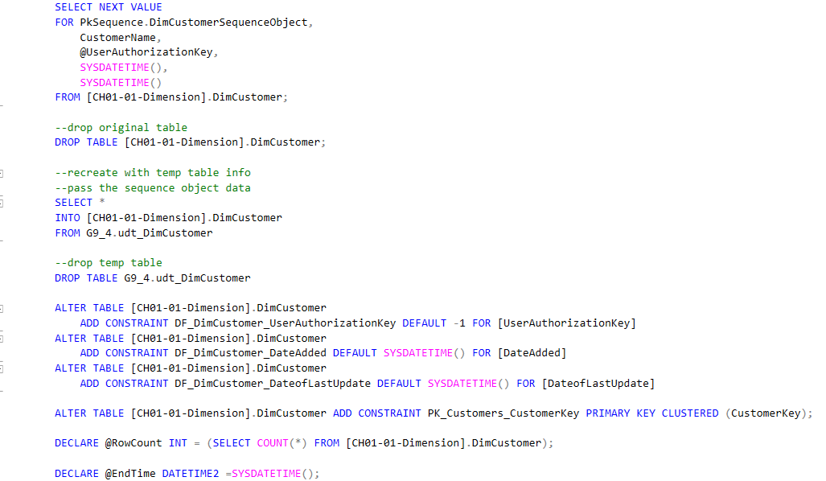
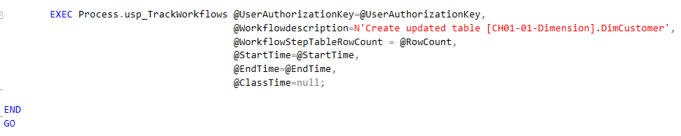
Project2.Load_DimCustomer

Slide 32
WorkFlowSteps and Execution

Slide 33
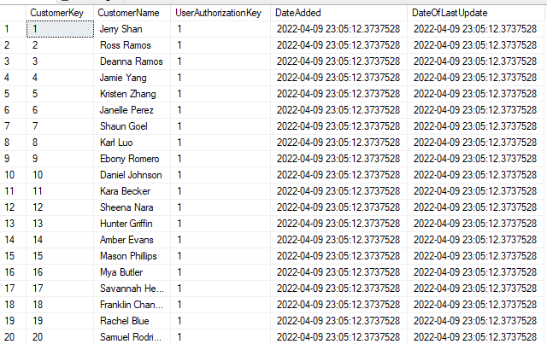
SSMS Output

Slide 34
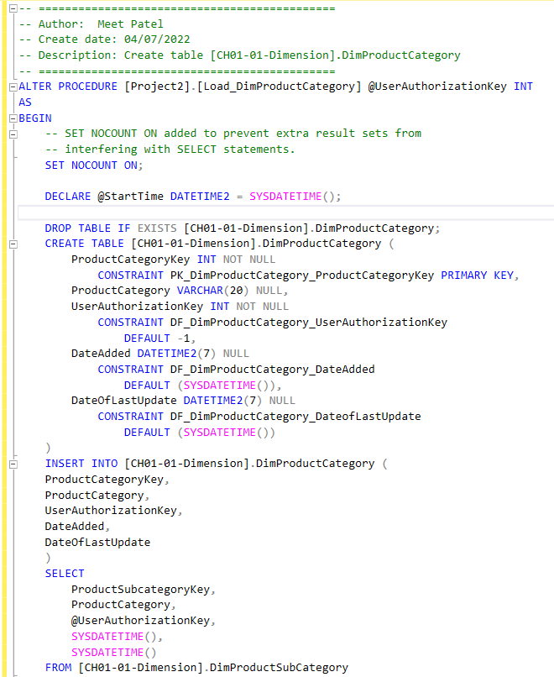
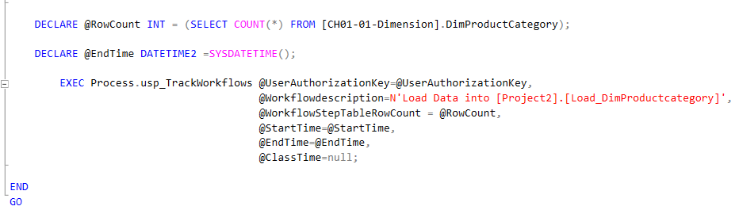
Project2.Load_DimProductCategory

Slide 35
WorkFlowSteps and Execution

Slide 36
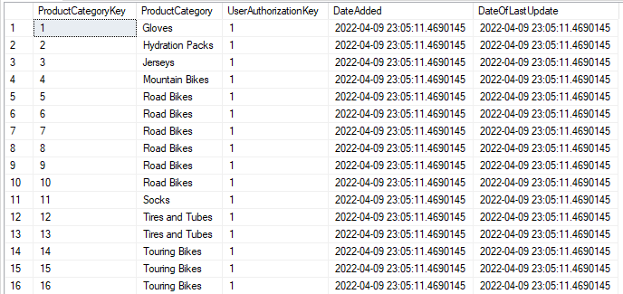
SSMS Output

Slide 37
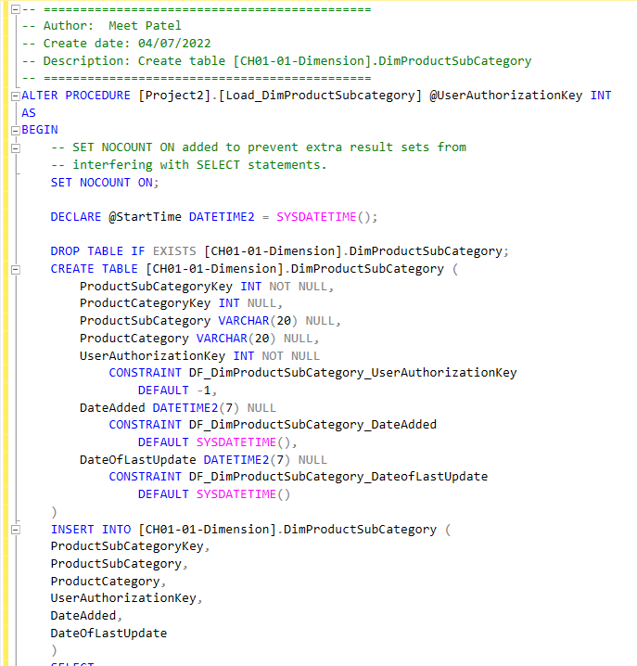
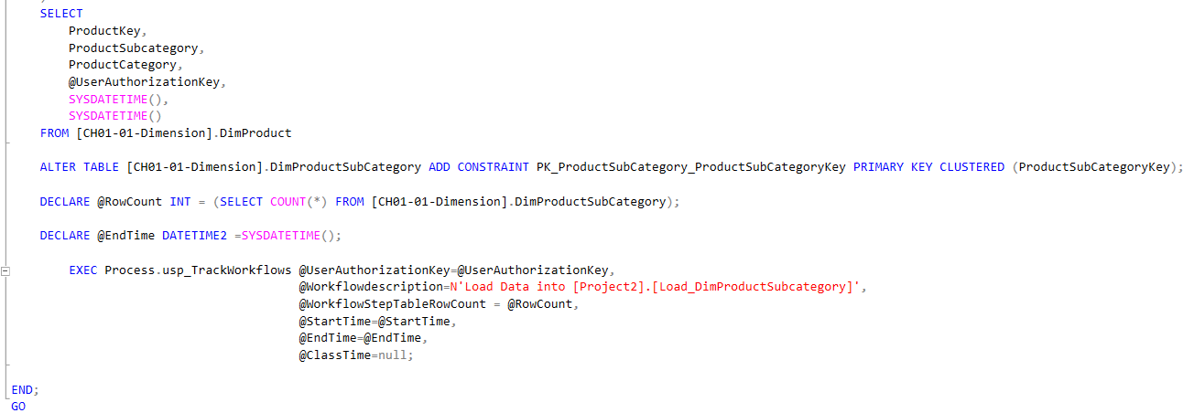
Project2.Load_DimProductSubCategory

Slide 38
WorkFlowSteps and Execution

Slide 39
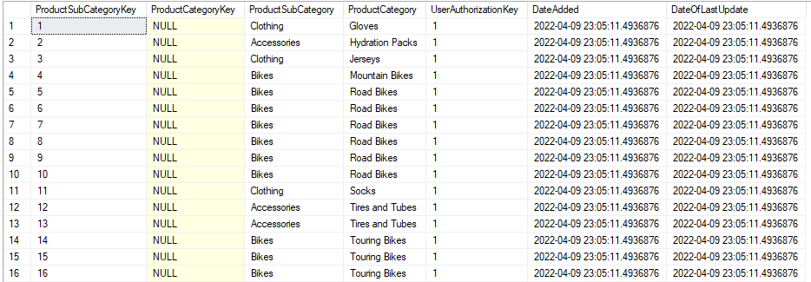
SSMS Output

Slide 40
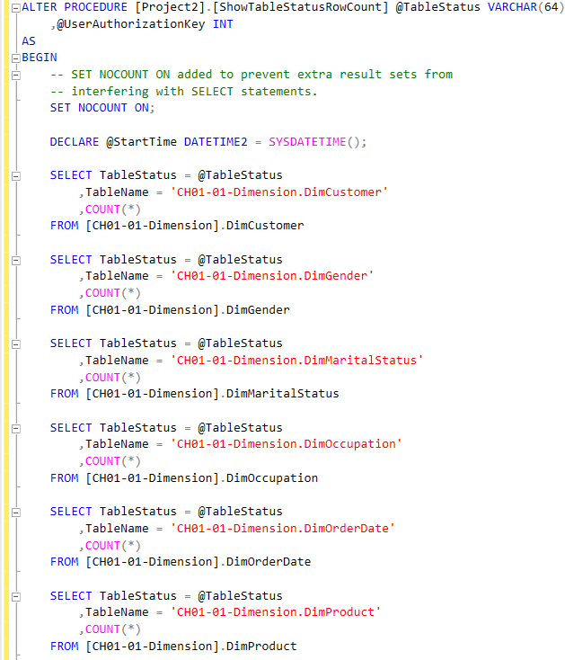
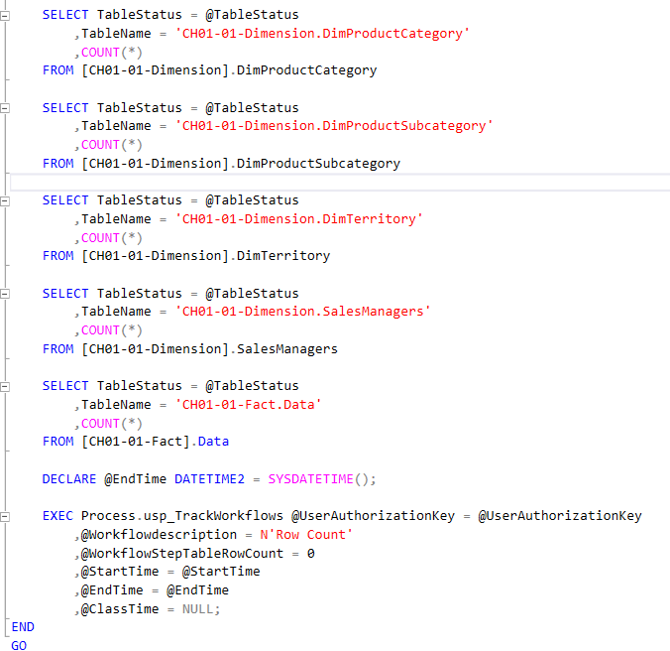
Project2.ShowTableStatusRowCount

Slide 41
WorkFlowSteps and Execution

Slide 42
Eliyahu Roth Procedures
Project2.DropForeignKeysFromStarSchemaData
Project2.AddForeignKeysToStarSchemaData
Project2.Load_DimMaritalStatus
Project2.Load_DimOccupation
Project2.Load_DimOrderDate
Project2.Load_DimGender
Utils.DropProcsInCSCI331FinalProject

Slide 43
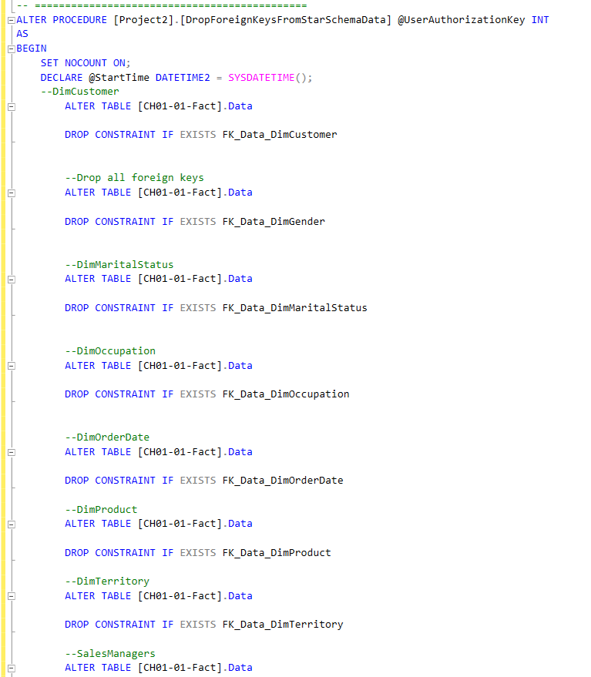
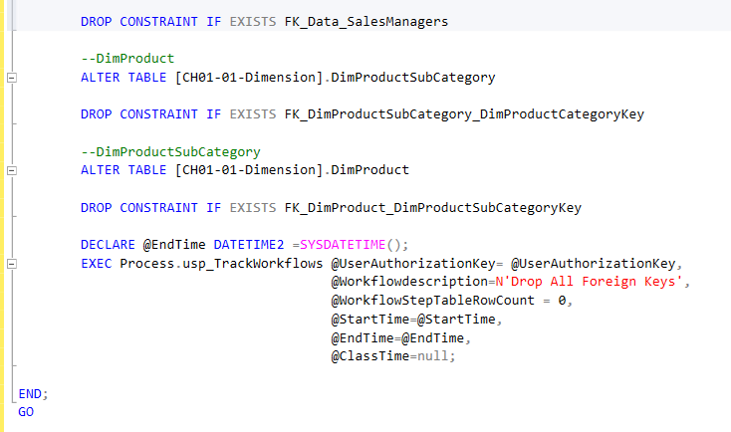
Project2.DropForeignKeysFromStarSchemaData

Slide 44
WorkFlowSteps and Execution

Slide 45
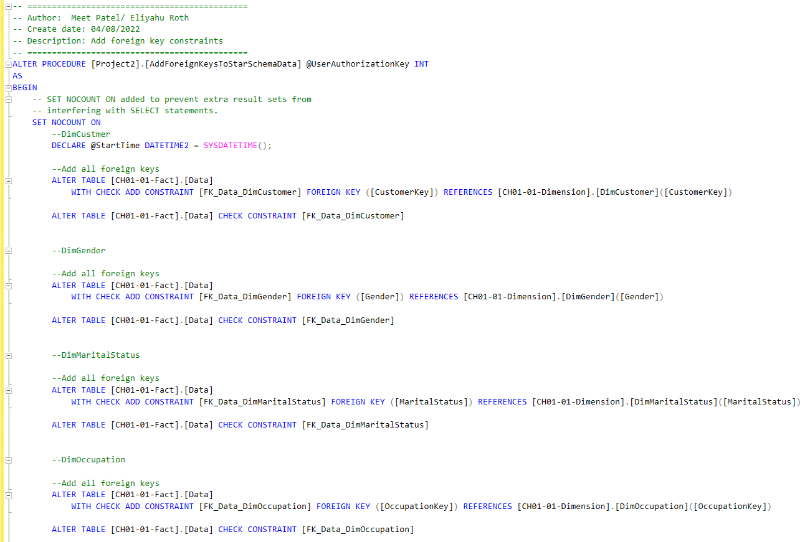
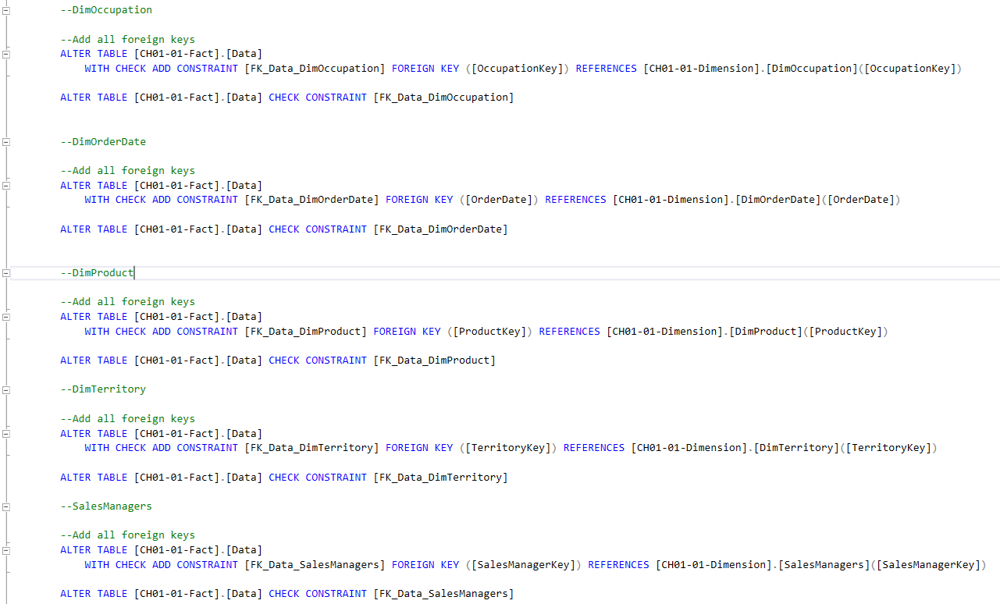
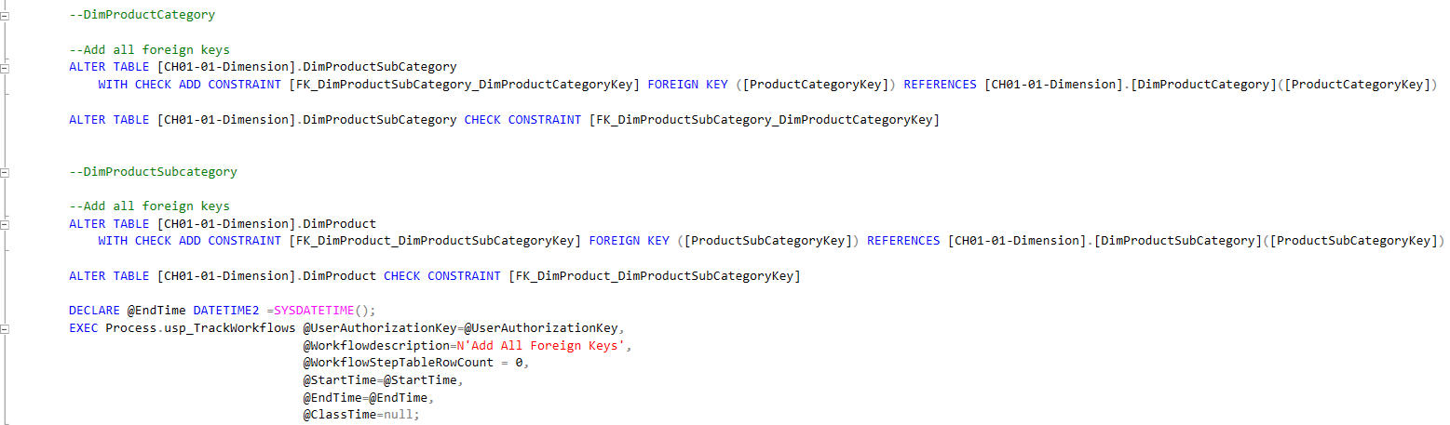
Project2.AddForeignKeysToStarSchemaData

Slide 46
WorkFlowSteps and Execution

Slide 47
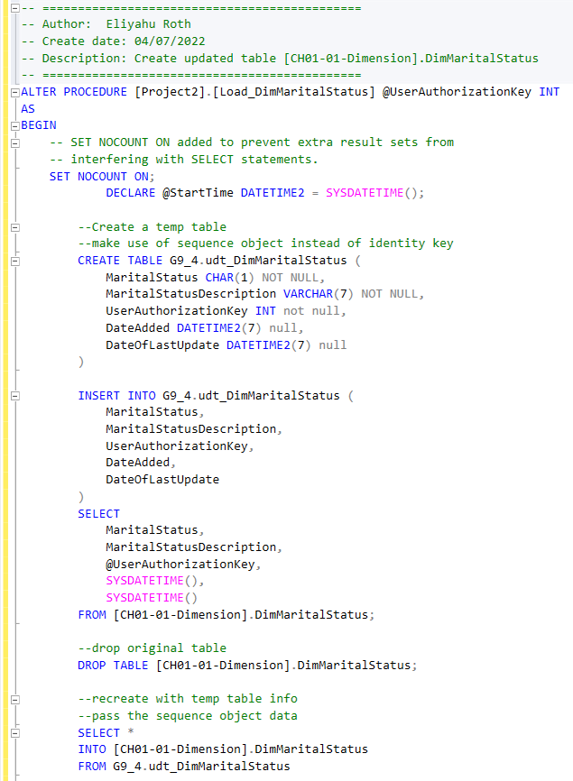
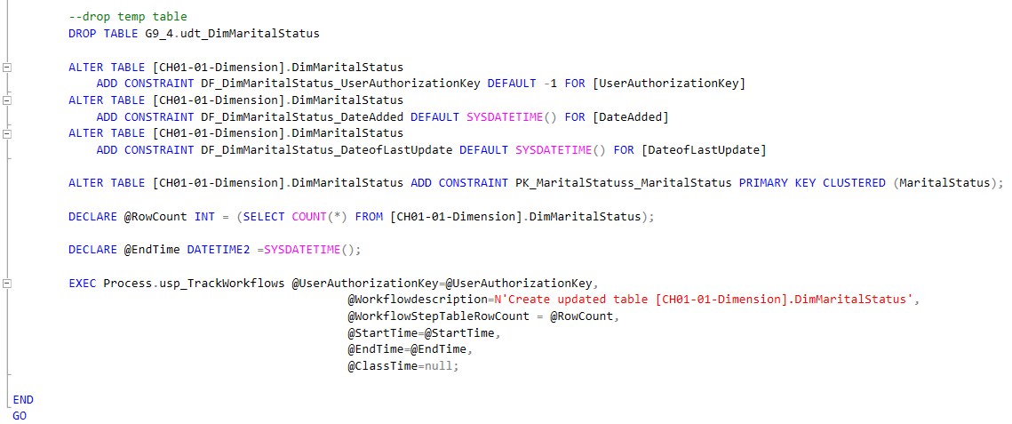
Project2.Load_DimMaritalStatus

Slide 48
WorkFlowSteps and Execution

Slide 49
SSMS Output

Slide 50
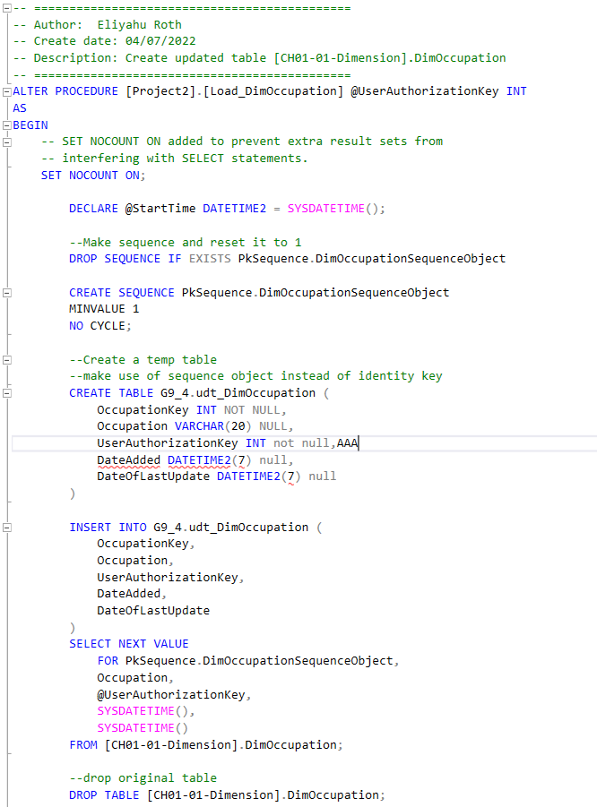
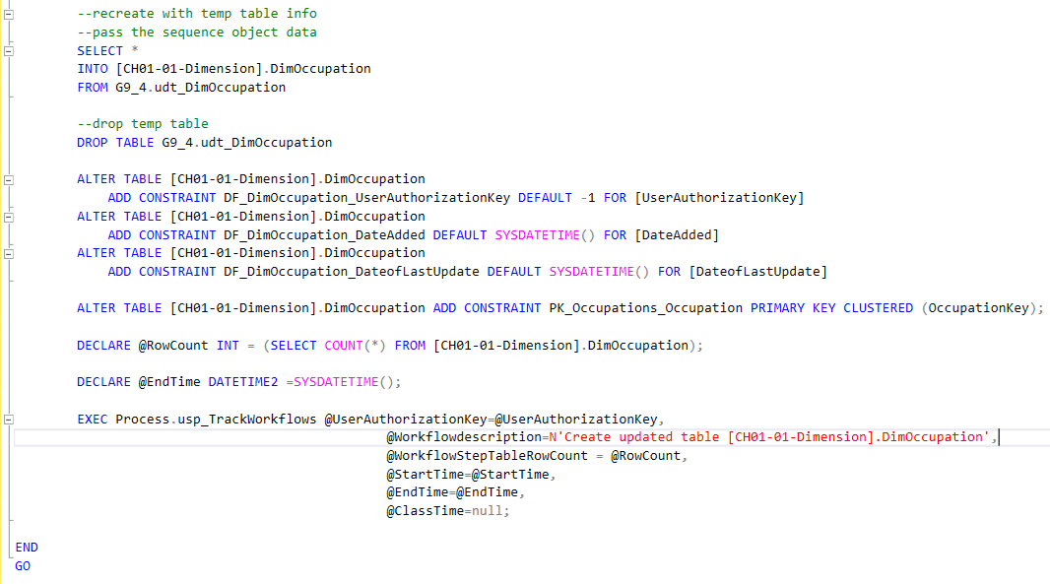
Project2.Load_DimOccupation

Slide 51
WorkFlowSteps and Execution

Slide 52
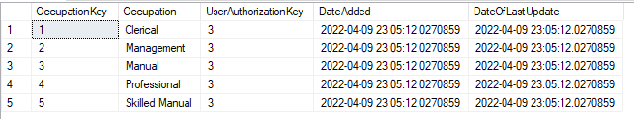
SSMS Output

Slide 53
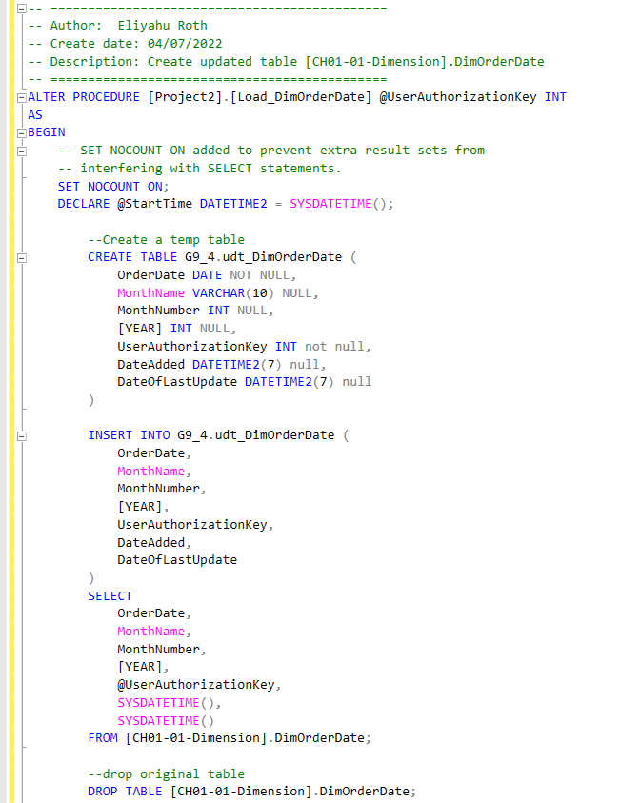
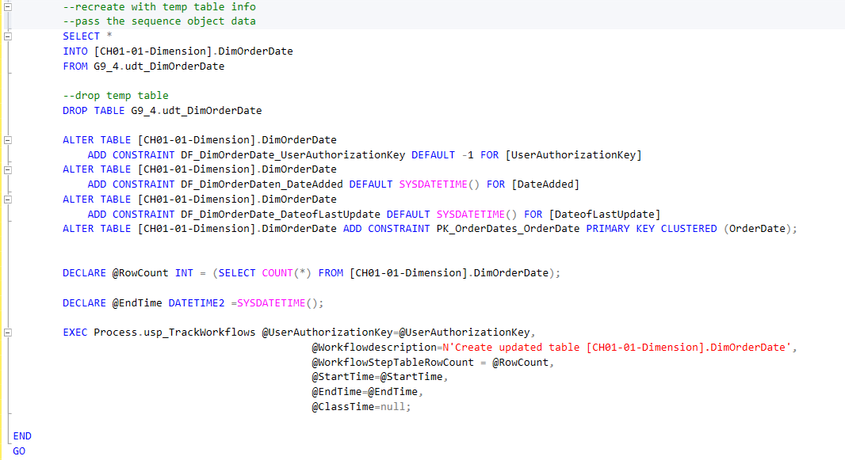
Project2.Load_DimOrderDate

Slide 54
WorkFlowSteps and Execution

Slide 55
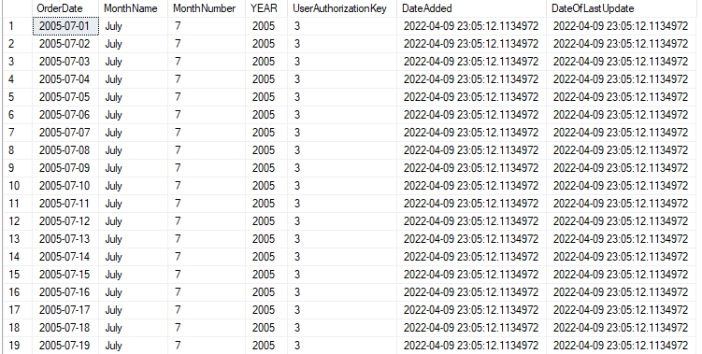
SSMS Output

Slide 56
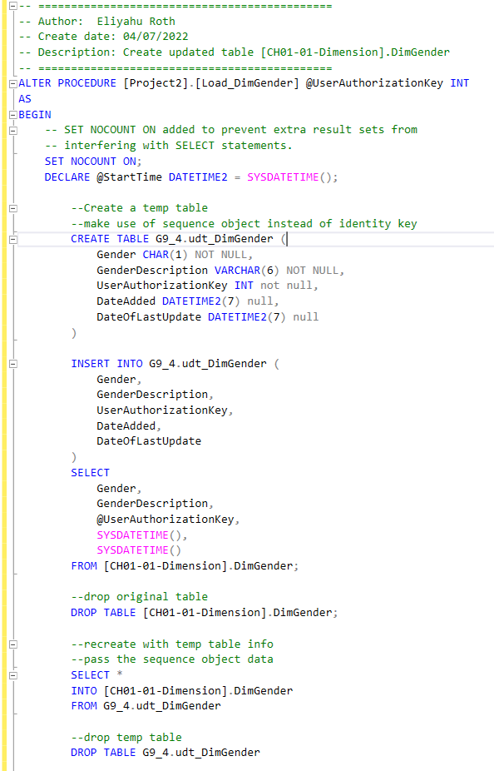
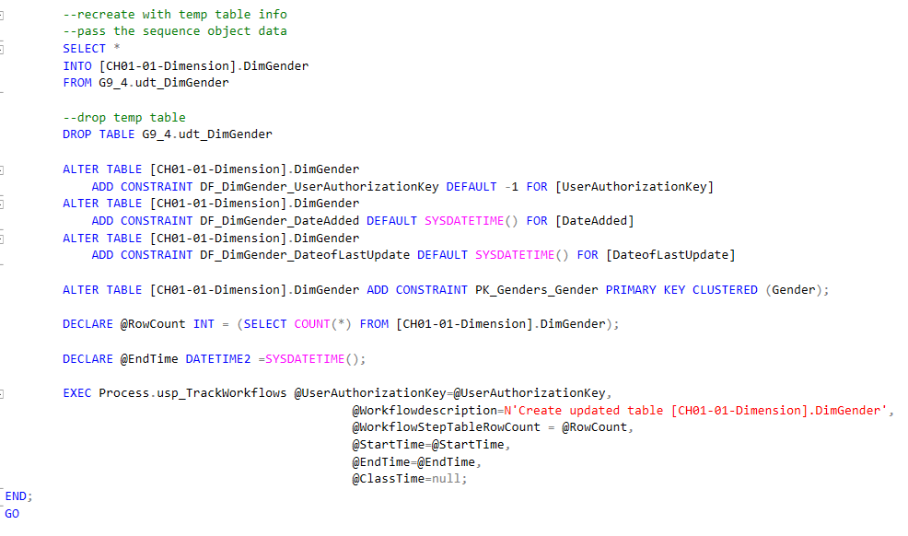
Project2.Load_DimGender

Slide 57
WorkFlowSteps and Execution

Slide 58
SSMS Output

Slide 59
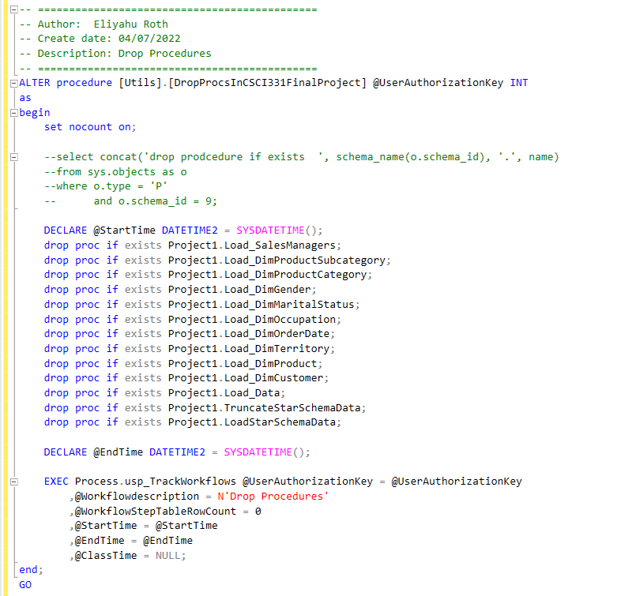
Utils.DropProcsInCSCI331FinalProject

Slide 60
Mashiur Rahman Procedures
Project2.Load_DimSalesManager

Slide 61
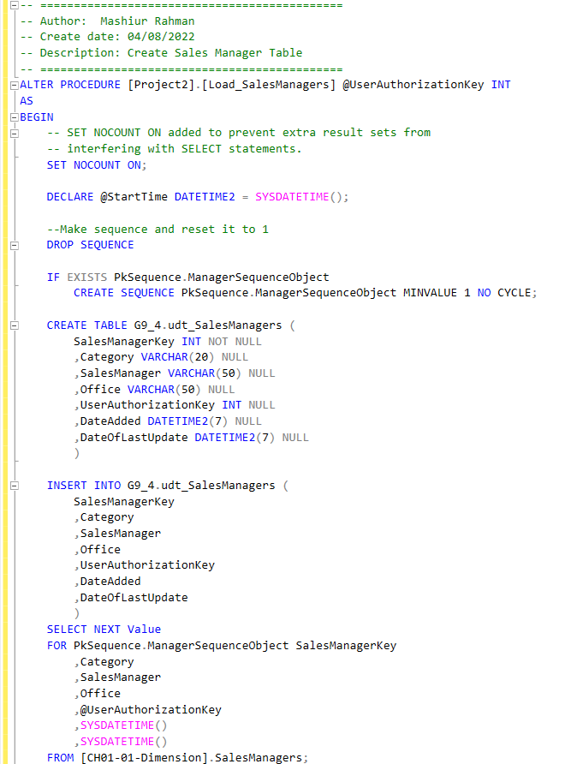
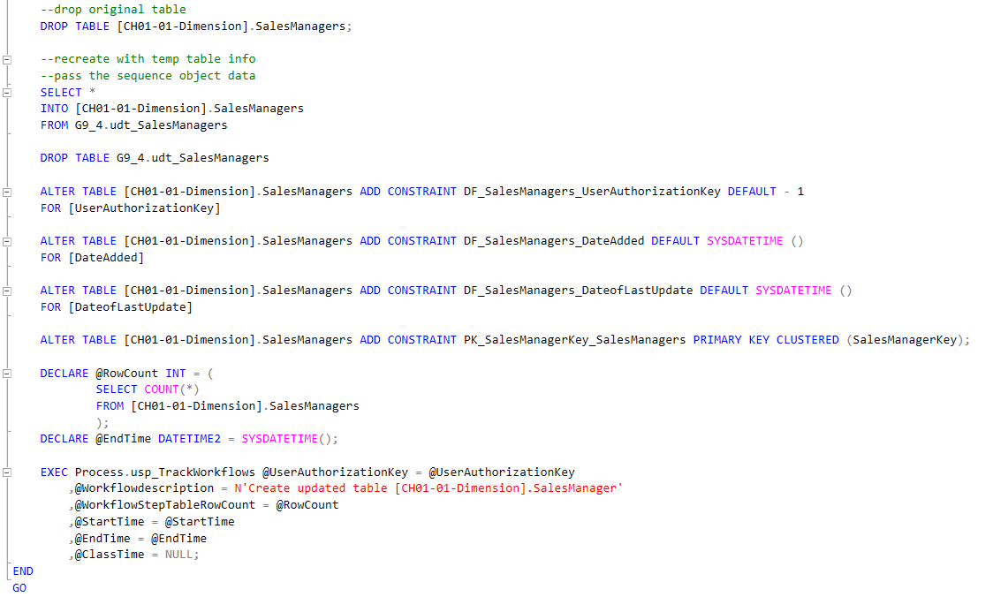
Project2.Load_DimSalesManager

Slide 62
WorkFlowSteps and Execution

Slide 63
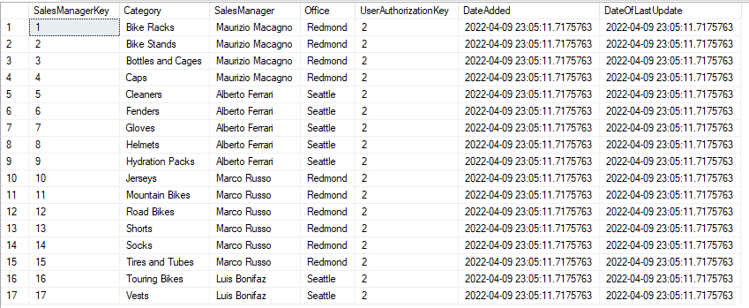
SSMS Output

Slide 64
Brandon Scott Procedures
Project2.Load_DimProduct

Slide 65
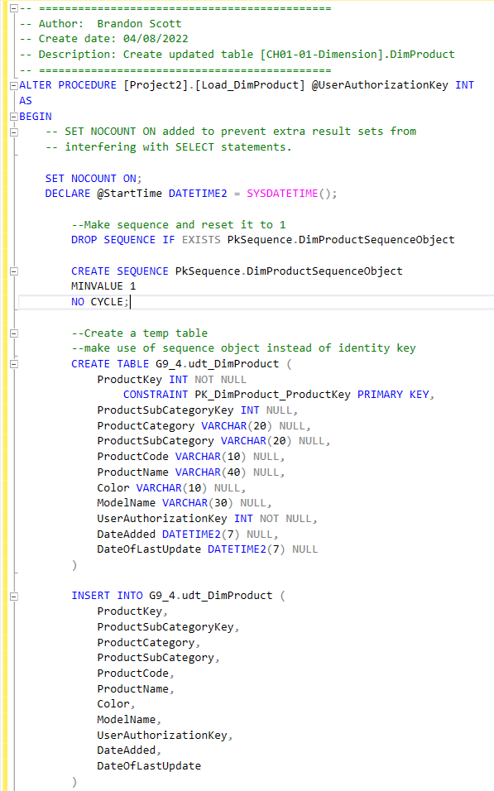
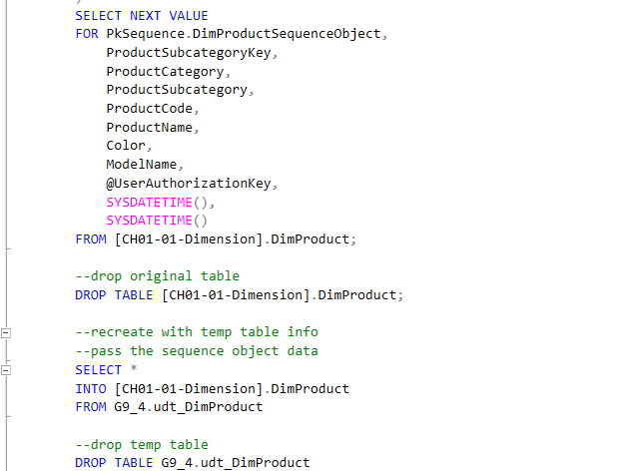
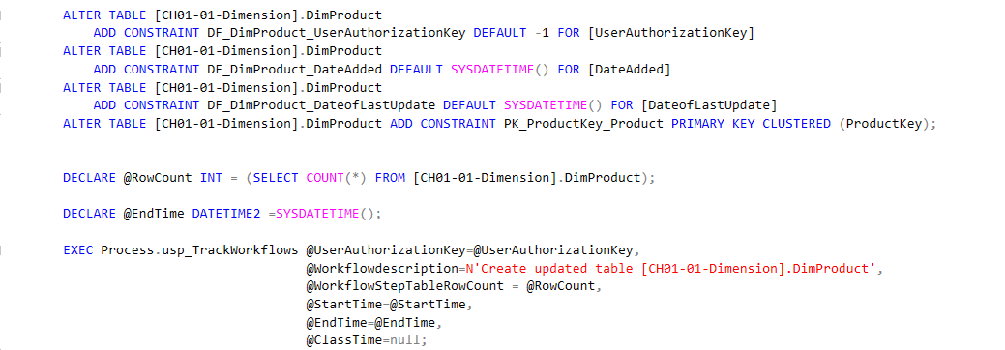
Project2.Load_DimProduct

Slide 66
WorkFlowSteps and Execution

Slide 67
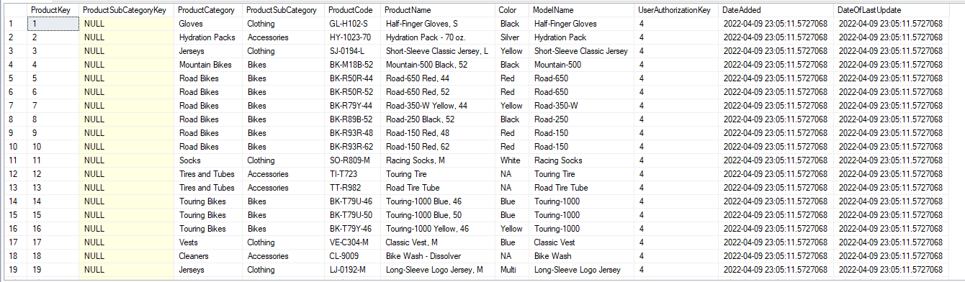
SSMS Output

