Slide 1

CONTACT
MANAGER
COP4331 Group 1

Slide 2
CONTRIBUTORS
Joshua Chappelle
Ishan Patel
Front End
Database
API
Alvin Abraham
Alexander Lokhanov
API
API
Christian Gomez
Brandon Stewart
Front End
Project Manager

Slide 3







Organization
Communication
TECHNOLOGY
USED
JIRA
GitHub
Discord
LAMP stack
Linux
Apache
MySQL
PHP

Slide 4
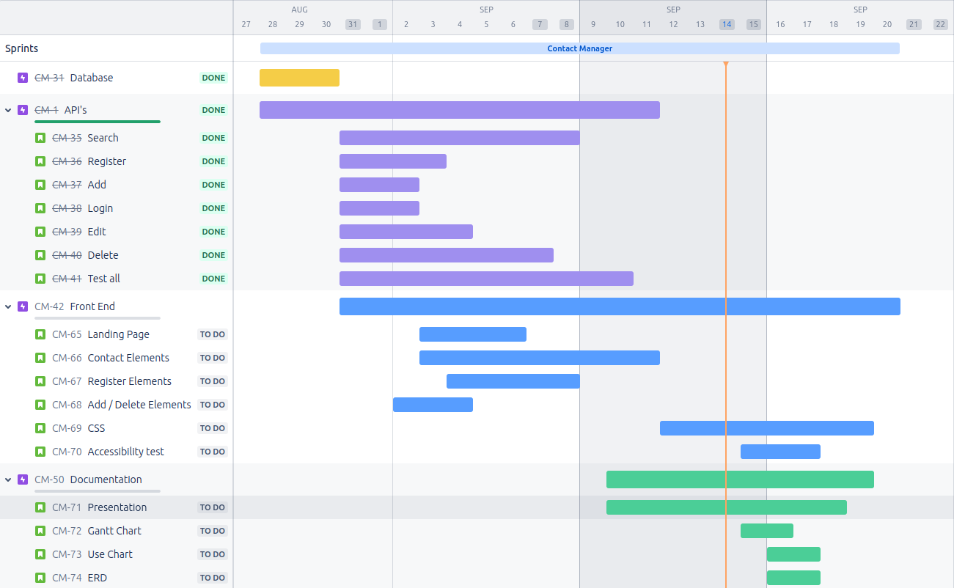
GANTT CHART
API Team
Alex
Alvin
8/28/24 - 8/31/24
12fsfsd
Front end Team
Josh
Chris
Project Manager
Brandon
Database Team
Ishan

Slide 5
PROJECT MANAGER
THE GOOD
THE BAD
Great Communication
Quick responses
Availability
Meetings
Difficulty getting everyone on a call at the same time
Teamwork
Helped each other with knowledge gaps
Everyone quickly took on and learned their roles
Cross Discipline
Knowledge gap when trying to help mid project
Great Communication
Quick responses
Constructive Criticism

Slide 6
FRONT END
THE GOOD
THE BAD
Learning Curve
Learning JS as we had no experience with it
Dealing with many interconnected files
Design
Customization and layout came together easily
Satisfying
It was nice to see website come together one bit at a time
Debugging
Debugging problems took quite a while sometimes
Problems with database saving use info and contacts. Specifically User ID

Slide 7
API
THE GOOD
THE BAD
Teamwork
Problems were solved through collaboration
New Technology
Learning curve for necessary languages and technology.
PHP
A very robust language once you understand it
PHP Structure
Could be very finicky at times

Slide 8
DATABASE
THE GOOD
THE BAD
Familiarity with SQL
Previous experience
Knowledge of commands
Sharing Work On Git
Dumping database on git to share
Syntax
Easy to find any needed information online
Initial Connection to Server
SQL workbench connection with server did not work initially

Slide 9
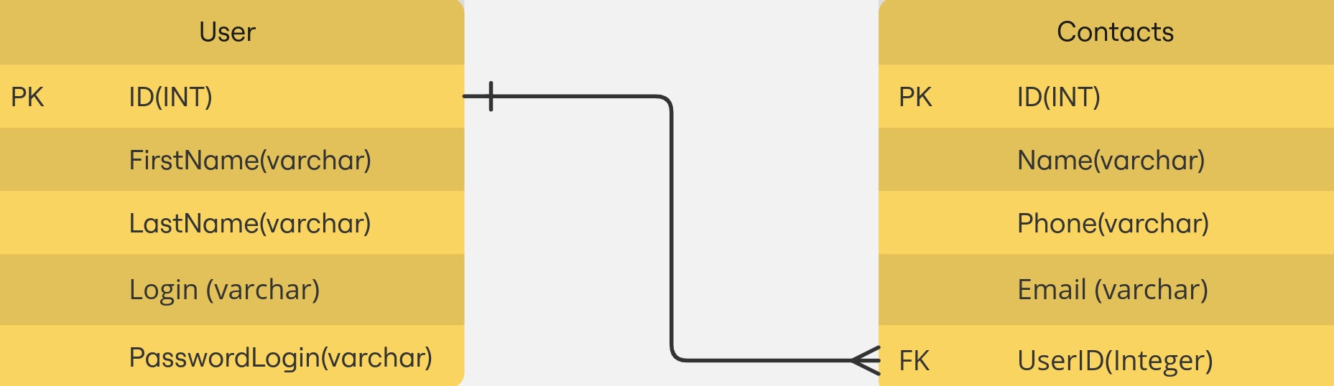
ERD

Slide 10


User Error
Search Contact
Register
<extends>
<includes>
Create Contact
Login information
<extends>
Authenticate
<includes>
Update Contact
USER
Login
DATABASE
Delete Contact
Log Out

Slide 11

LIGHTHOUSE SCORE
100
96
79
90
Best
Practices
Performance
Accessibility
SEO

Slide 12
API DEMONSTRATION
DEMO

Slide 13
APP DEMONSTRATION
DEMO

Slide 14
QUESTIONS?

