Slide 1
Inconsistency of U.S. healthcare costs
Team Viper – UC San Diego - Data Science
Tyler Adams | Brendan Steinke | Ron Javor
September 2019

Slide 2
Overview
Healthcare Charges and Costs have long been opaque
Starting in January 2019, federal law requires transparency
Hospitals are required to publish their chargemasters
Medicare now disclosing hospital reimbursement data (data.gov)
Data still incomplete for many hospitals, and outpatient costs not yet published
Data will be analyzed from data.gov, cms.gov for cost-variance
Examining Top 2 quasi-facility-electable procedures: DRG 470 (Major Joint Replacement), DRG 638 (Diabetes with Complications)
View national differences by state, drill down as needed to root-cause & correlate
Compare with other data from socrata.com, census.gov

Slide 3
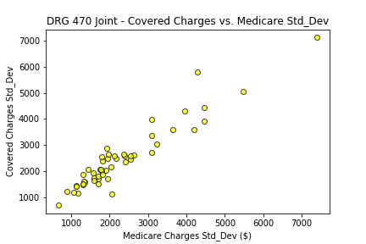
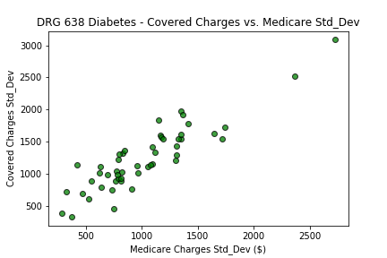
Covered vs. Medicare Charge Variance
Well-correlated, close to 1:1
Accounts for differences in Medicare vs. Supplemental coverage and Deductibles
Does not factor in private insurance
Medicare Charges = What Medicare reimbursed the hospital
Covered Charges = Medicare reimbursement + supplemental insurance + deductibles

Slide 4
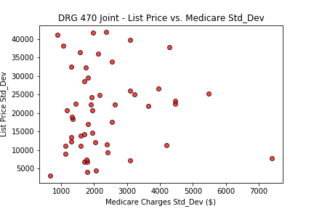
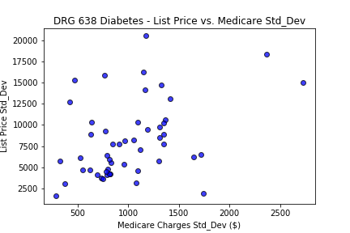
‘List Price’ vs. Medicare Charge Variance
BAD CORRELATION
Tremendous Variance in ‘List Prices’ – does not linearly relate
Private insurance negotiates down from the ‘List Price’ -> Medicare Charge
This is where the problem begins
Medicare Charges = What Medicare reimbursed the hospital
List Price = Hospital ‘List Price’ for a given DRG code procedure

Slide 5
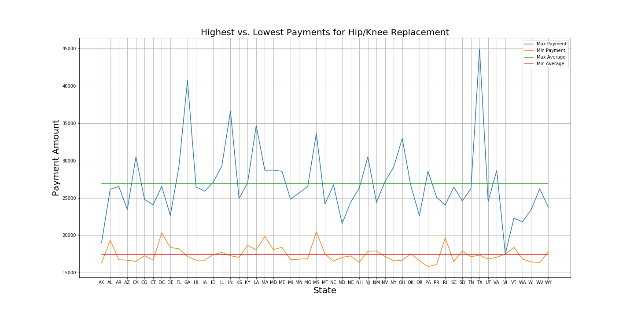
The Difference Exists
Min/Max payments for Hip/Knee replacements found in each state.
The average difference in cost is $9,520.15 for these common procedures.
https://healthdata.gov/dataset/payment-and-value-care-hospital

Slide 6

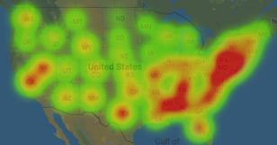
National Variance
Hotspots for high ‘List Price’ standard deviation
Three key areas: Tri-State Area (NJ/NY/PA), Deep South (MS/AL), California
Diabetes – DRG470
Joint – DRG638

Slide 7
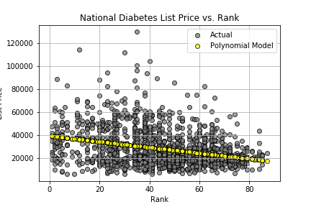
Hypothesis 1: There is a significant difference between hospital rating and the cost of medical procedures.
TRUE
(nationally)
T-Test: T-Value = -73.18081389444465, pvalue = 0.0
Linear Regression: Slope = -247.8486204326963, Intercept = 39475.26258752547
Pvalue = 5.870203165162494e-36, R^2=0.09468995132269074
Polynomial Regression: -247.8 x + 3.948e+04 [ -247.84862043 39475.26258753]

Slide 8
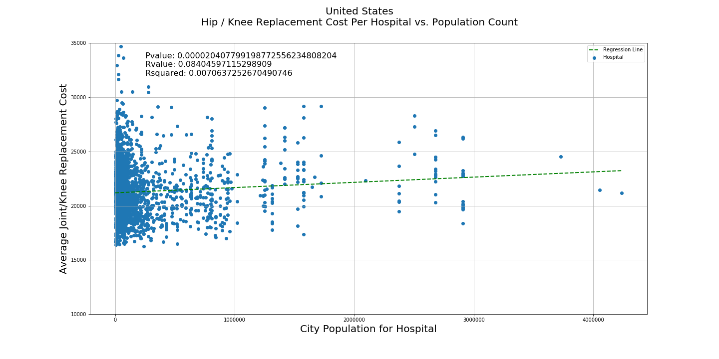
Hypothesis 2: There is a significant difference between population and medical procedure cost.
Looking at the USA, population count correlates with the cost of Hip/Knee replacement procedures.
TRUE
(nationally)

Slide 9
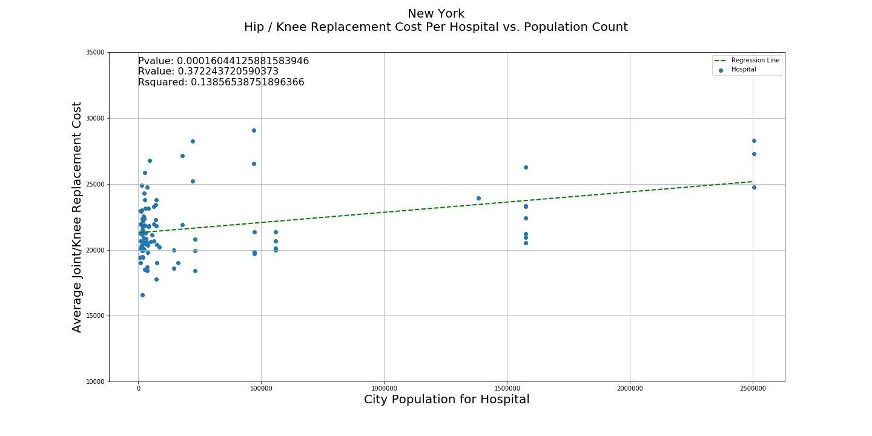
Hypothesis 2a: There is a significant difference between population and medical procedure cost.
New York shows a significant trend when looking at hip/knee replacements across the state. More populated areas tend to have higher costs for the same procedure
TRUE
(NY)

Slide 10
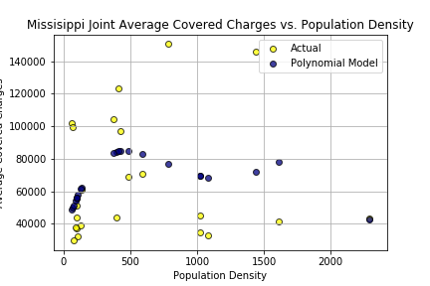
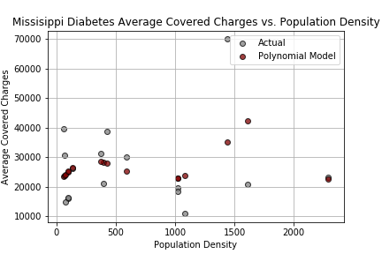
Hypothesis 2a: There is a significant difference between population(density) and medical procedure cost.
T-Test: The groups are not correlated as evidenced by high-T magnitude with good confidence (very low p-value)
Linear Regression: high p-value and low R^2 indicate bad fit. Polynomial fit not good
FALSE
T-Test: T-Value = -8.435976191821668, pvalue = 2.4096964561007347e-08
Linear Regression: Slope = 2.8376244389968734, Intercept = 65167.56099879802,
Pvalue = 0.8381376720055401, R^2=0.002032867482902925
Polynomial Regression: -6.902e-08 x ^4+ 0.0003221 x ^3- 0.4963 x^2 + 279.9 x + 3.305e+04
T-Test: T-Value = -7.330113910577341, pvalue = 2.4202410480315282e-06
Linear Regression: Slope = 2.387899055961176, Intercept = 25168.00982295613,
Pvalue = 0.6779137724186564, R^2=0.012686186738626407
Polynomial Regression: -3.707e-08 x ^4+ 0.0001527 x^3 - 0.1875 x ^2+ 75.04 x + 1.955e+04

Slide 11
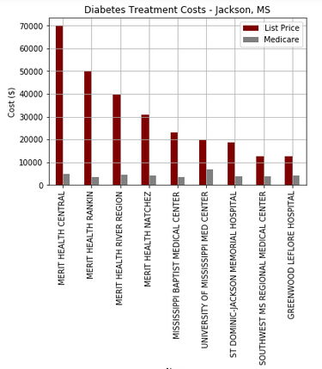
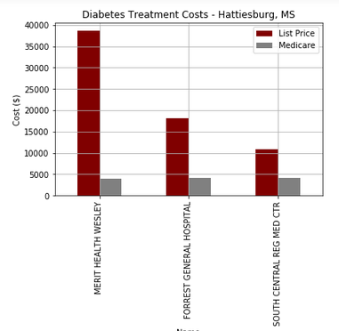
Mississippi – Deep Dive on Charges - Diabetes
Two distinct “metro” areas: Jackson (Capital City), Hattiesburg showed wide variances
Merit Health shows dramatic differences on ‘List Price’ vs. Alternatives.

Slide 12
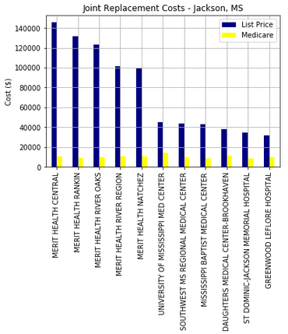
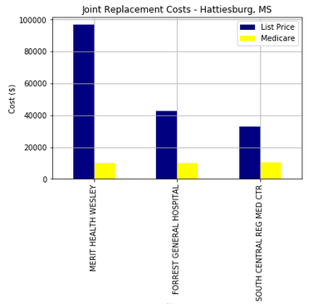
Mississippi – Deep Dive on Charges – Joint Replacement
Merit Healthcare is vastly overpriced vs. Alternatives
Medicare reimbursement costs remain constant

Slide 13
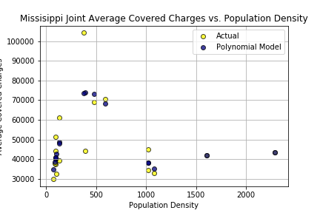
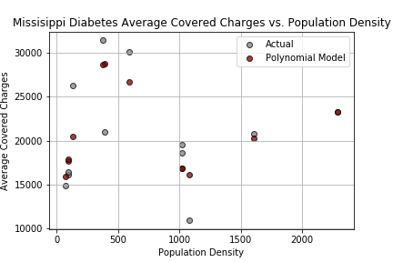
Mississippi - Removing ‘Aberrantly-Priced’ Merit Healthcare
Now ‘more predictable’ with a lower order polynomial
Null Hypothesis holds - Mississippi not correlating list prices to population density
T-Test: T-Value = -10.393641445884066, pvalue = 1.5653853256619052e-08
Linear Regression: Slope = -2.585994347816789, Intercept = 49622.395839073986, Pvalue = 0.7385288340811982, R^2=0.007650270572038645
Polynomial Regression:.0004238 x^3 - 0.6764 x^2 + 366.3 x + 1.079e+04
T-Test: T-Value = -11.24463528438743, pvalue = 1.7856502073931564e-07
Linear Regression: Slope = 0.09737376883056005, Intercept = 20709.282317061916,
Pvalue = 0.972821015998601, R^2=0.0001220131303265545
Polynomial Regression: 0.0001452 x^3 + 0.2283 x^2 + 121.8 x + 8002

Slide 14
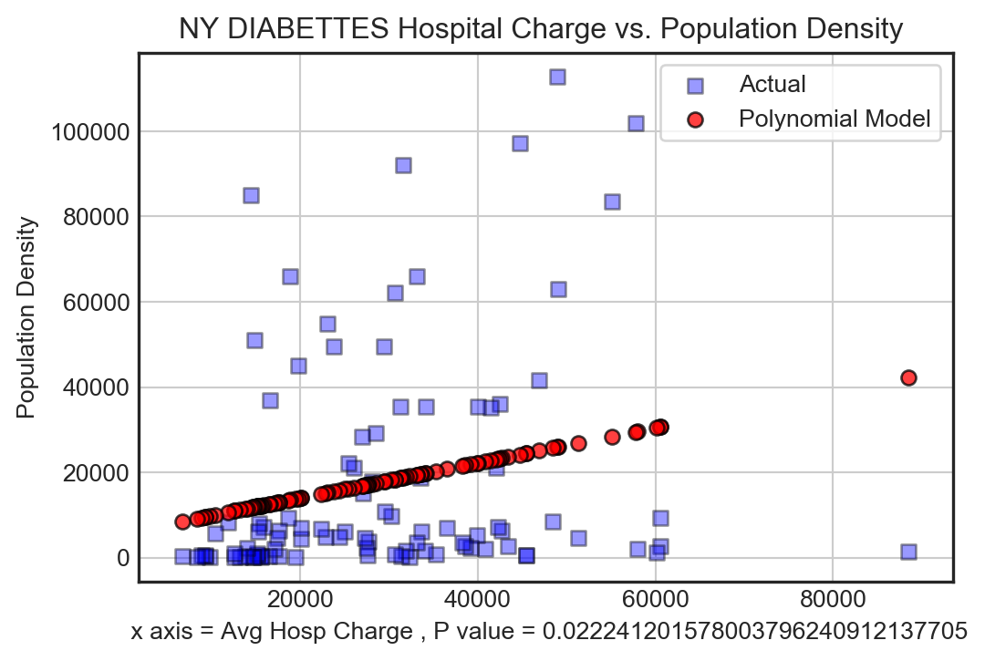
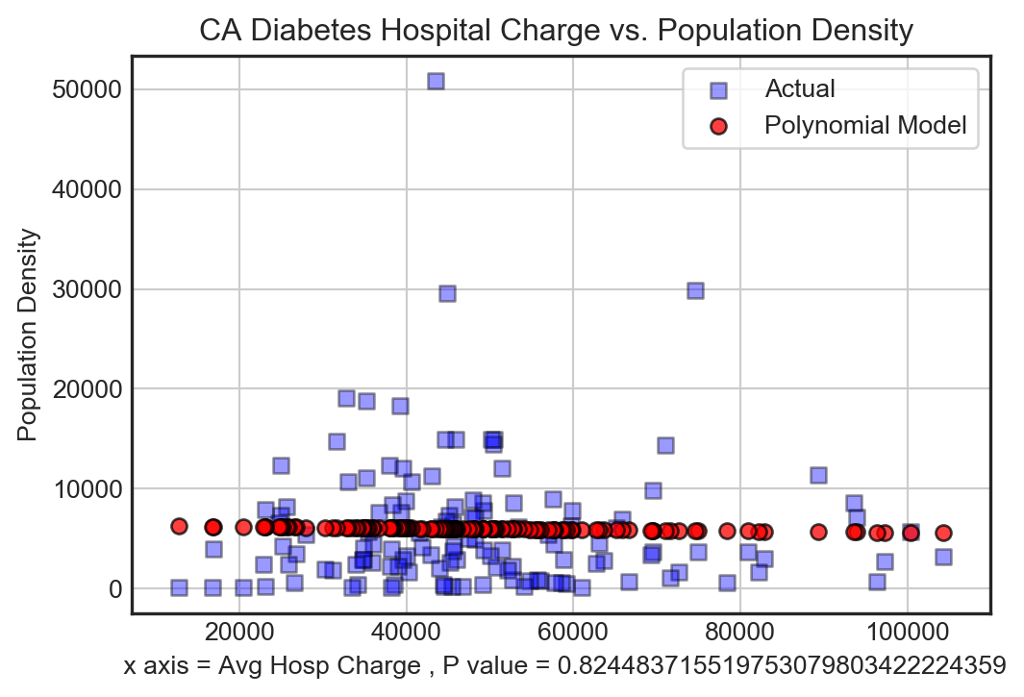
NY vs. CA – ‘List Price’ vs. Population Density - Diabetes
New York – TRUE
California - FALSE

Slide 15
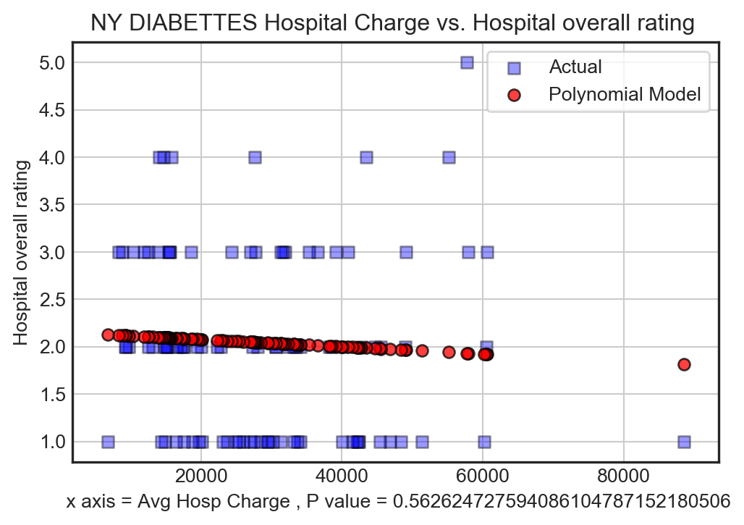
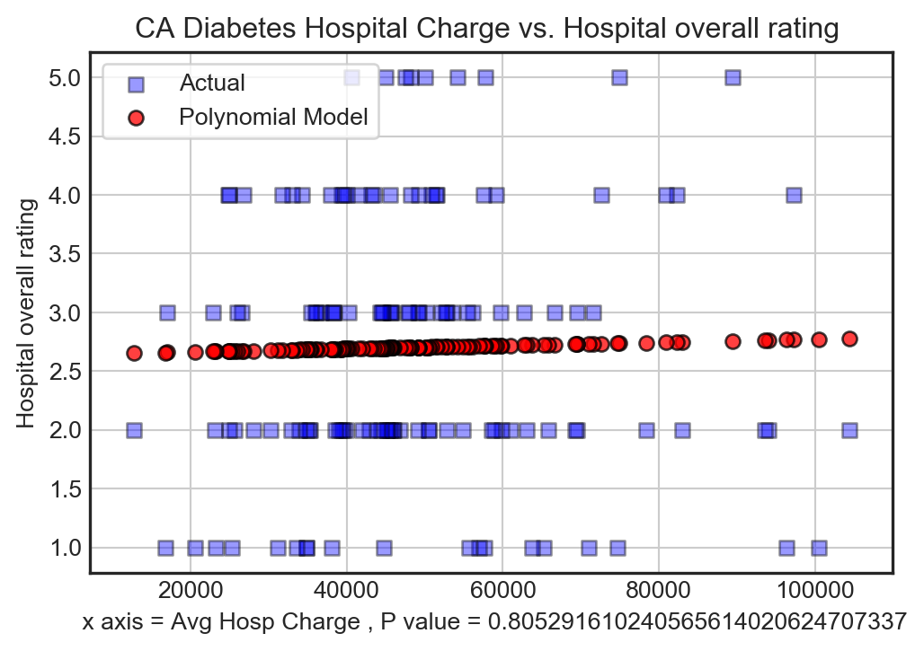
NY vs. CA – ‘List Price’ vs. Hospital Rating - Diabetes
New York – FALSE
California - FALSE

Slide 16
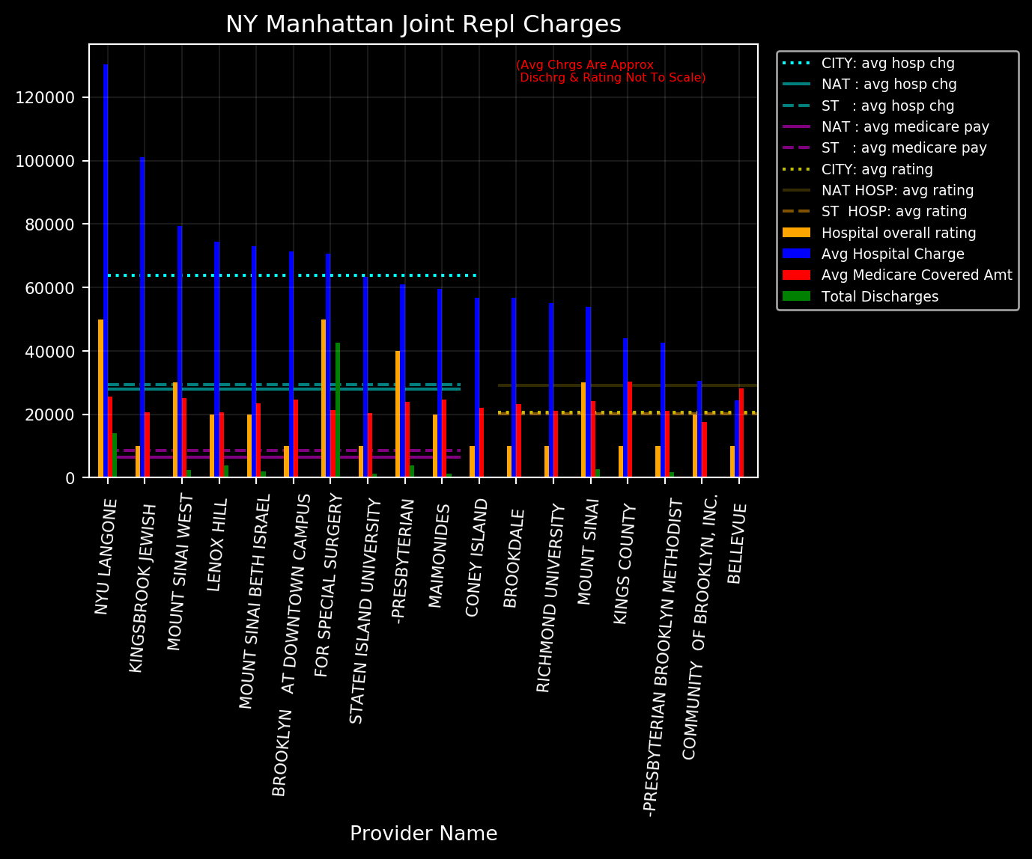
New York – Deep Dive on Charges – Joint Replacement

Slide 17
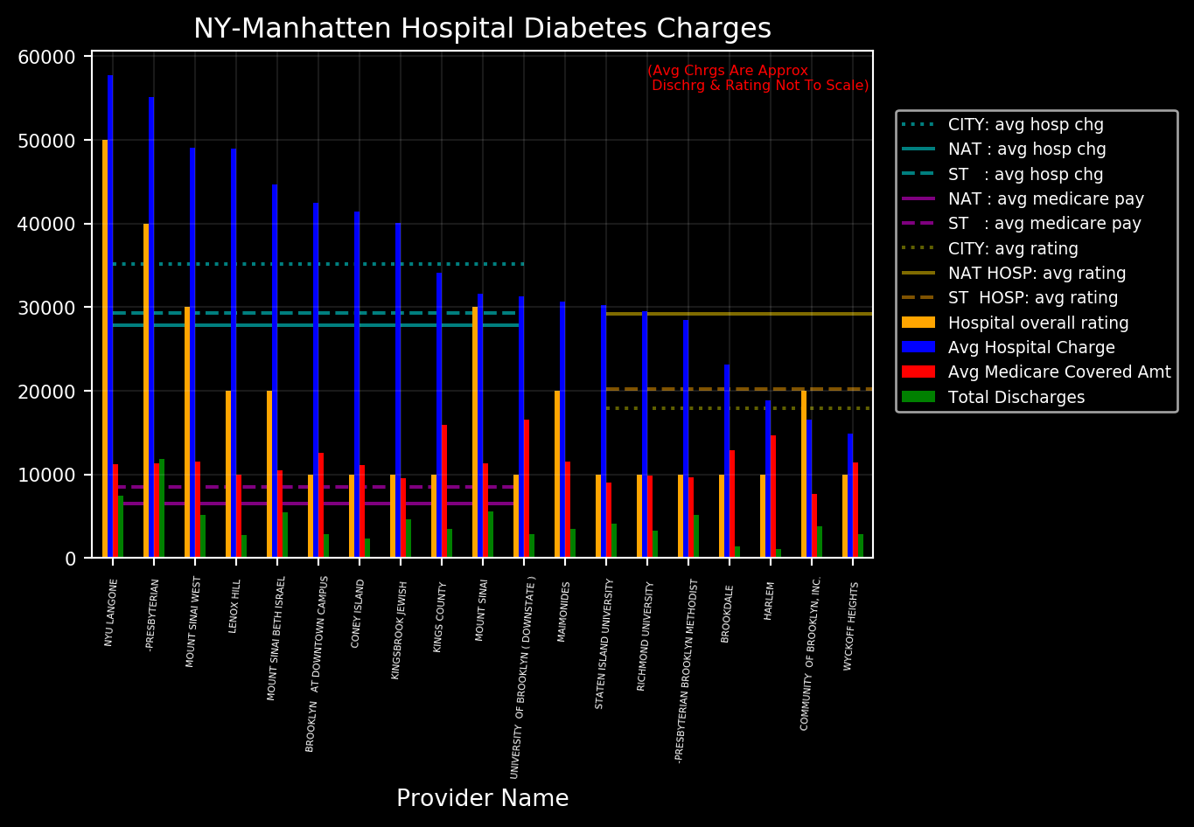
New York – Deep Dive on Charges – Diabetes

Slide 18
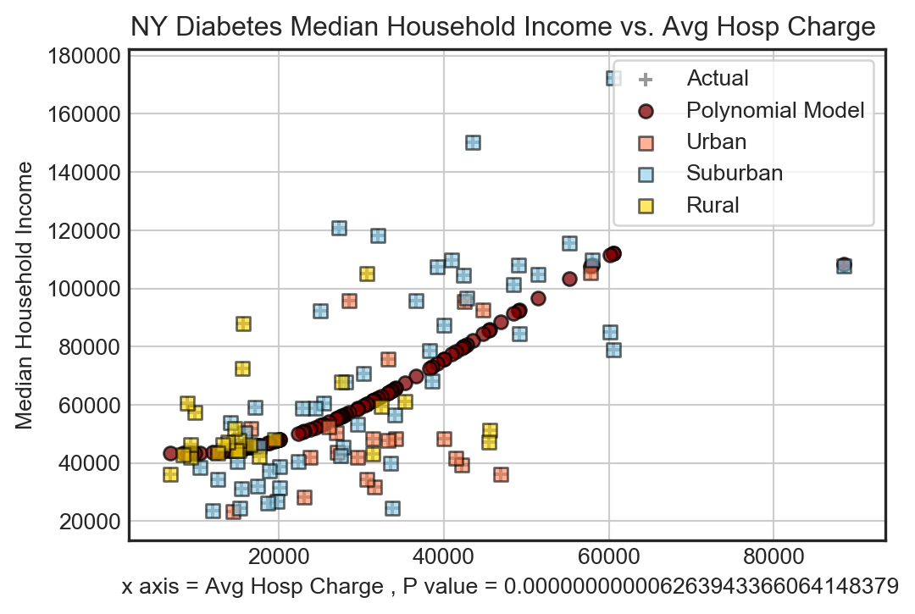
NY – ‘List Price’ vs. Income - Diabetes
TRUE

Slide 19
Summary
Hypothesis 1: There is a significant difference in ‘List Price’ vs. Hospital Rating. TRUE Nationally (p= 5x10^-36)
Hypothesis 2: There is a significant difference in ‘List Price’ vs. Population Density. TRUE Nationally (p=0.00002) FALSE Locally

Slide 20
Observations & Implications
Available data on cost by DRG code is sparse and inconsistent outside of data.gov / medicare.gov – Despite Federal Regulations!
Outpatient DRG-coded data not immediately available
Hospital Charges can vary wildly within a single healthcare provider in a single metro area – differing cost structures?
Expect the ‘List Price’ vs. ‘Medicare Price’ gap to significantly narrow in the future due to market forces – consumers can effectively shop around

Slide 21
References
GitHub:
Key Directories
Key Files
Notes

