Slide 1
Inconsistency of U.S. healthcare costs
Team Viper – UC San Diego - Data Science
September 2019

Slide 2
Overview
Healthcare Charges and Costs have long been opaque
Starting in January 2019, federal law requires transparency
Hospitals are required to publish their chargemasters
Medicare now disclosing hospital reimbursement data (data.gov)
Data still incomplete for many hospitals, and outpatient costs not yet published
Data will be analyzed from data.gov and [other sites] for cost-variance
Examining Top 2 quasi-facility-electable procedures: DRG 470 (Major Joint Replacement), DRG 638 (Diabetes with Complications)
View national differences by state, drill down as needed to root-cause & correlate
Compare with other data from Census, [other sites]

Slide 3
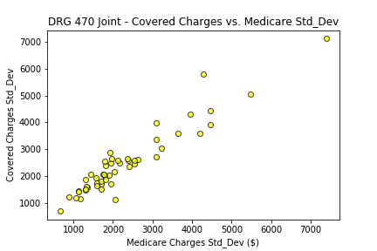
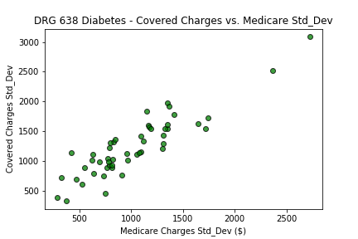
Covered vs. Medicare Charge Variance
Well-correlated, close to 1:1
Accounts for differences in Medicare vs. Supplemental coverage and Deductibles
Does not factor in private insurance
Medicare Charges = What Medicare reimbursed the hospital
Covered Charges = Medicare reimbursement + supplemental insurance + deductibles

Slide 4
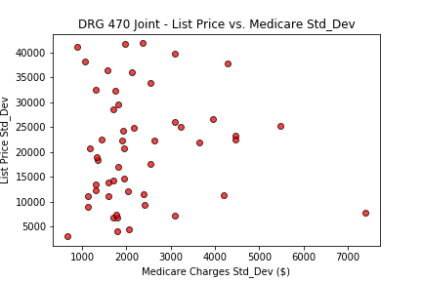
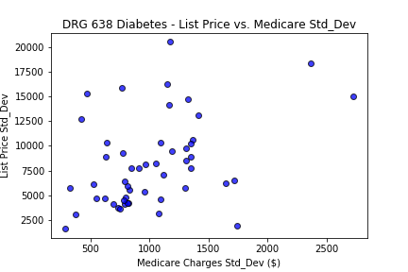
‘List Price’ vs. Medicare Charge Variance
BAD CORRELATION
Tremendous Variance in ‘List Prices’ – does not linearly relate
Private insurance negotiates down from the ‘List Price’ -> Medicare Charge
This is where the problem begins
Medicare Charges = What Medicare reimbursed the hospital
List Price = Hospital ‘List Price’ for a given DRG code procedure

Slide 5
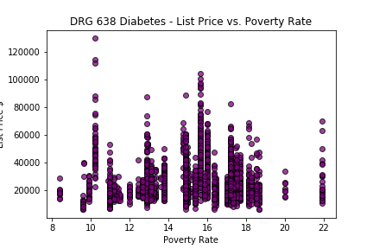
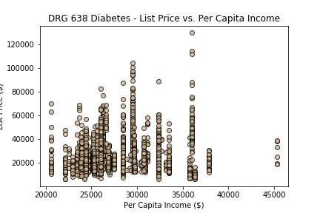
‘List Price’ vs. Census Demographics
No obvious ‘List Price’ correlation with Poverty Rate or Per Capita Income

Slide 6


National Variance
Hotspots for high ‘List Price’ standard deviation
Three key areas: Tri-State Area (NJ/NY/PA), Deep South (MS/AL), California
Diabetes – DRG470
Joint – DRG638

Slide 7
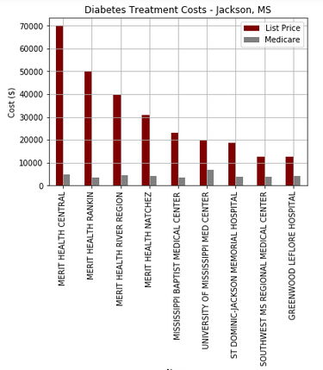
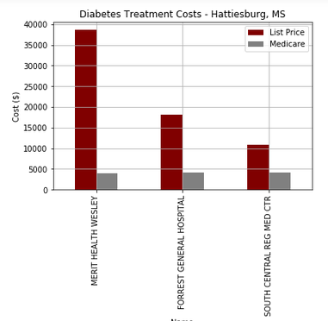
Mississippi – Deep Dive on Charges - Diabetes
Two distinct “metro” areas: Jackson (Capital City), Hattiesburg showed wide variances
Merit Health shows dramatic differences on ‘List Price’ vs. Alternatives.

Slide 8
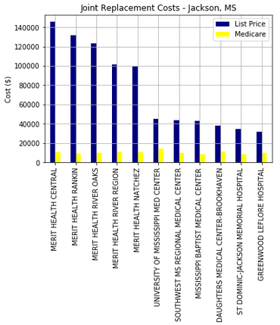
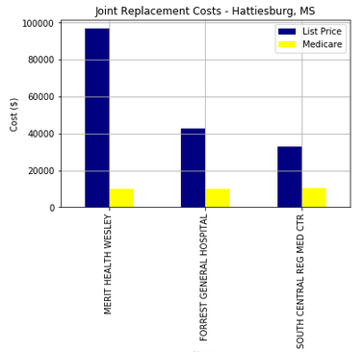
Mississippi – Deep Dive on Charges – Joint Replacement
Merit Healthcare is vastly overpriced vs. Alternatives
Medicare reimbursement costs remain constant

Slide 9
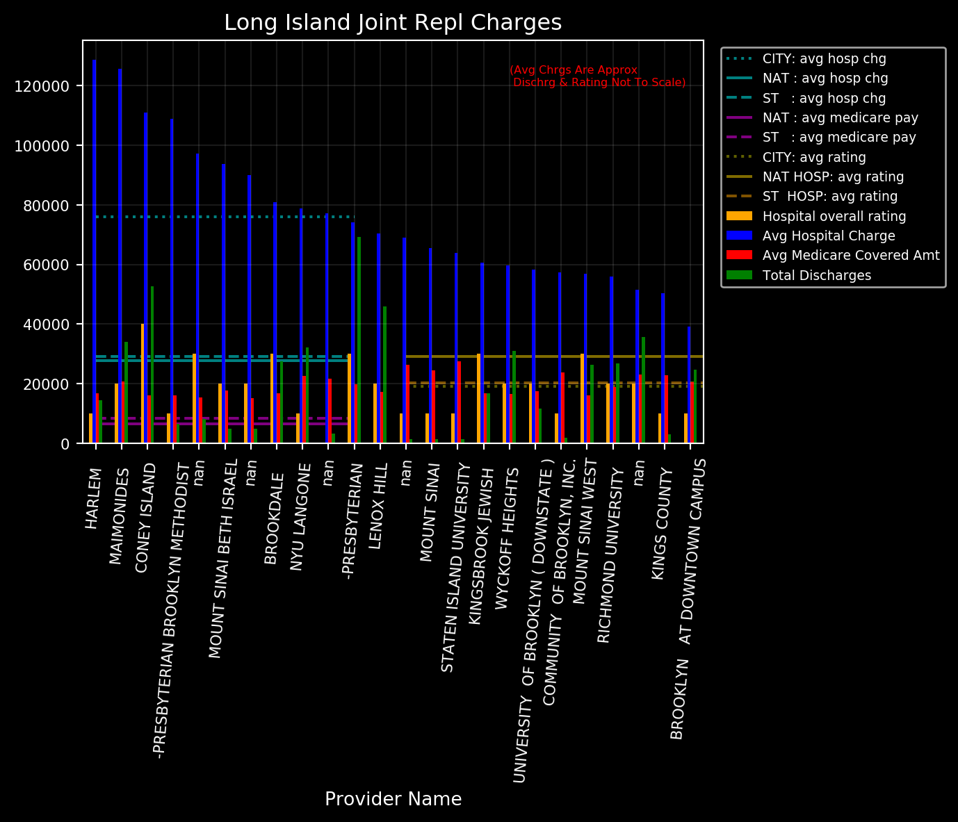
New York – Deep Dive on Charges – Joint Replacement

Slide 10
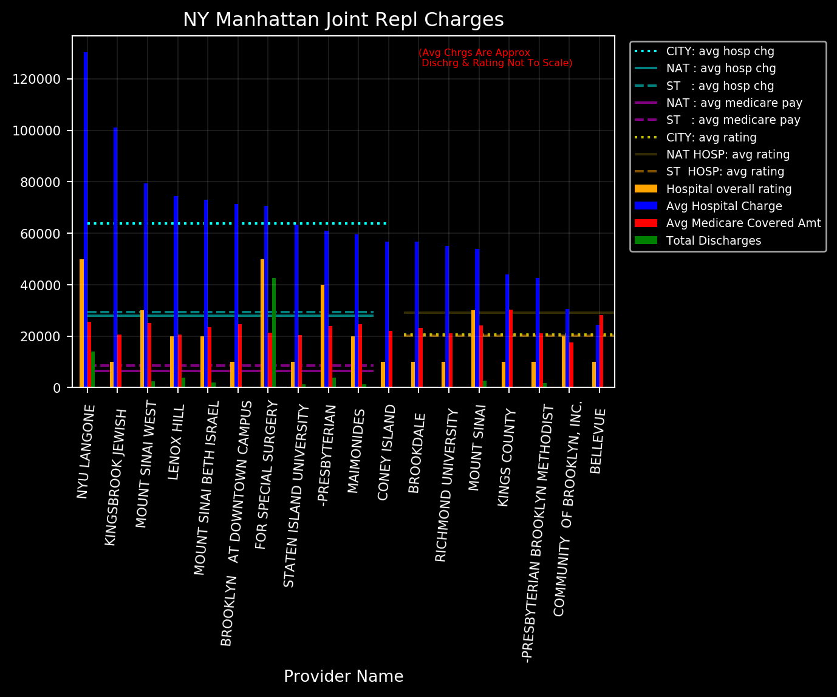
New York – Deep Dive on Charges – Joint Replacement

Slide 11
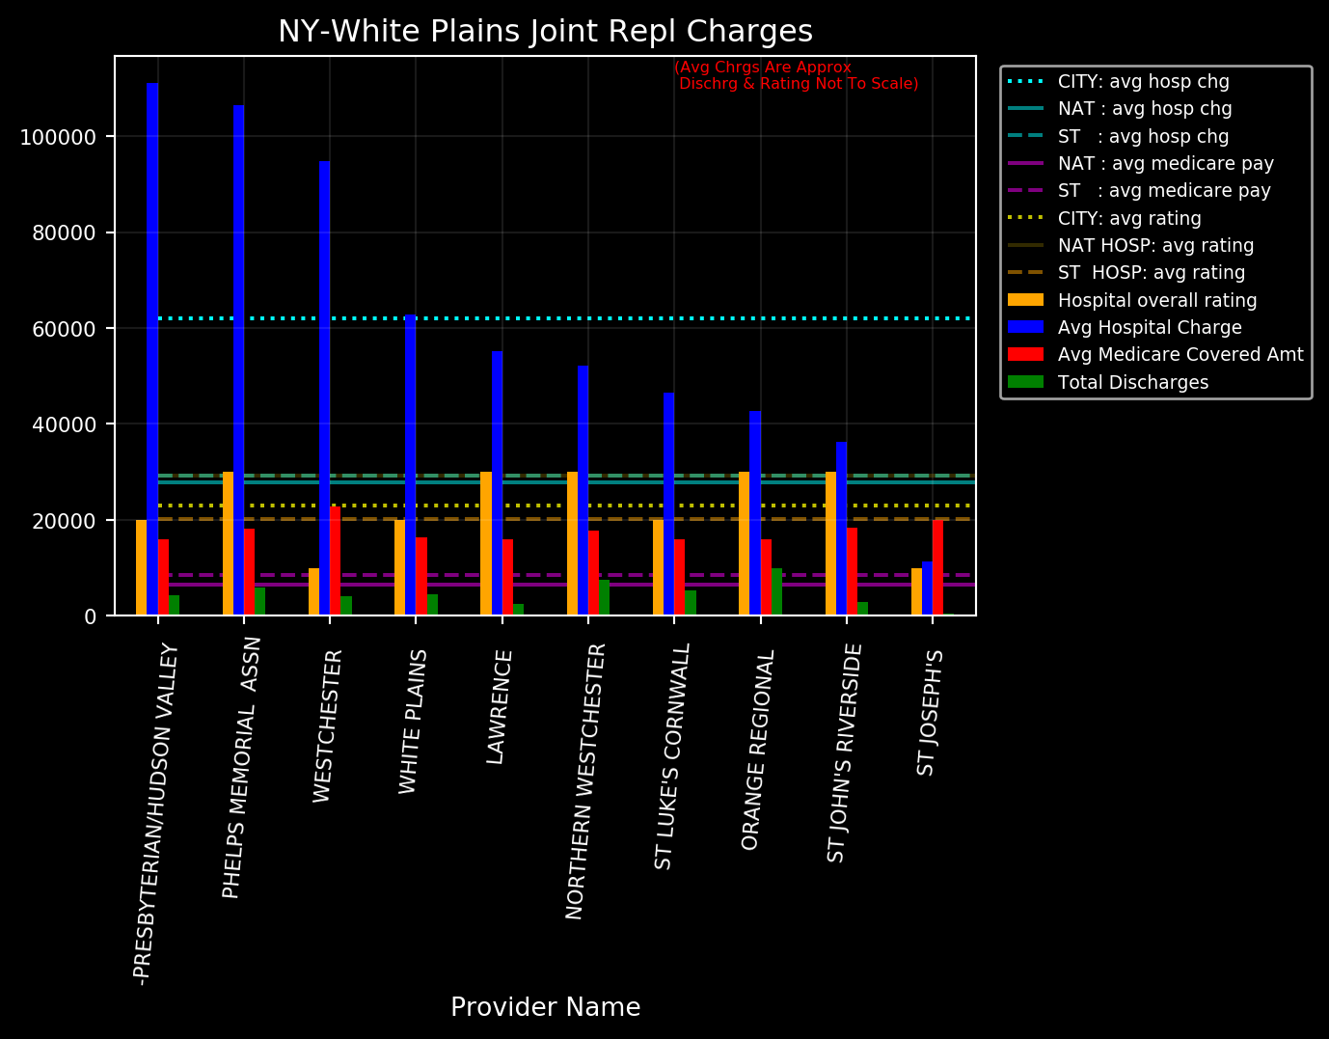
New York – Deep Dive on Charges – Joint Replacement

Slide 12
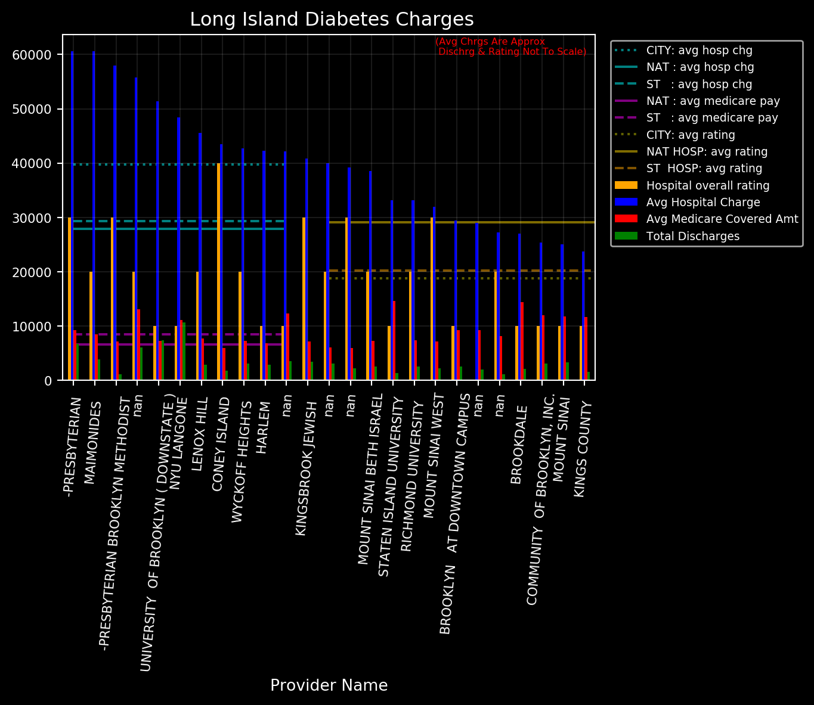
New York – Deep Dive on Charges – Diabetes
xyz

Slide 13
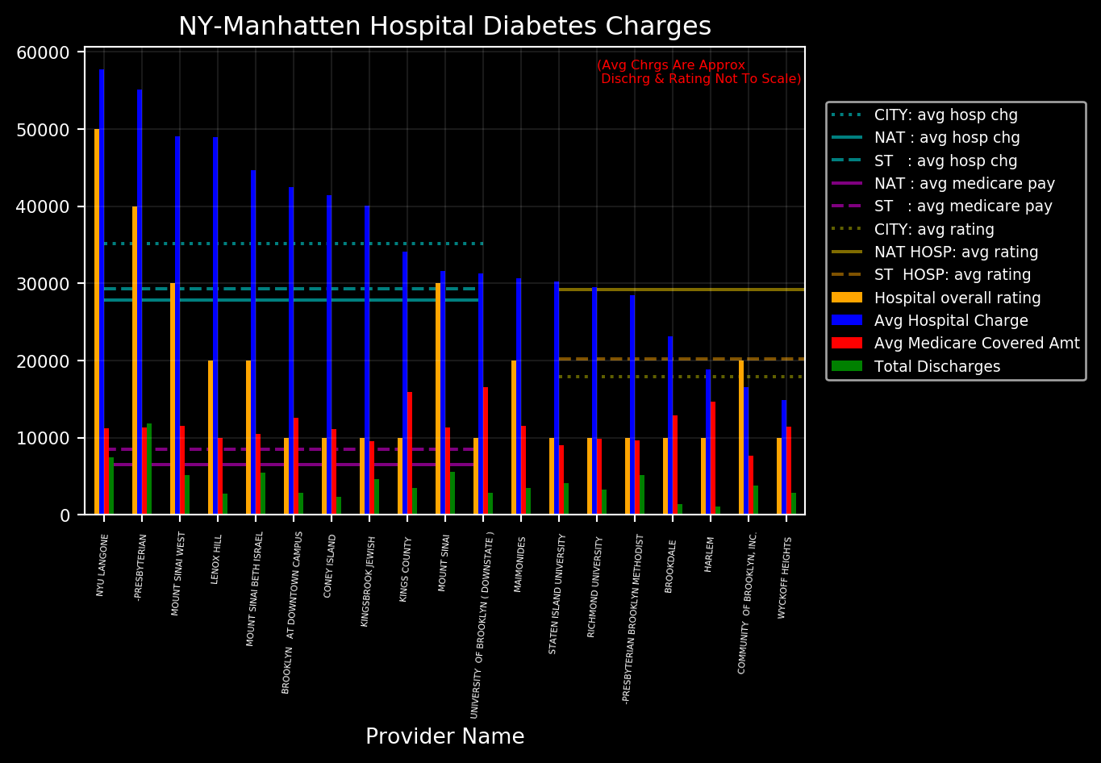
New York – Deep Dive on Charges – Diabetes
xyz

Slide 14
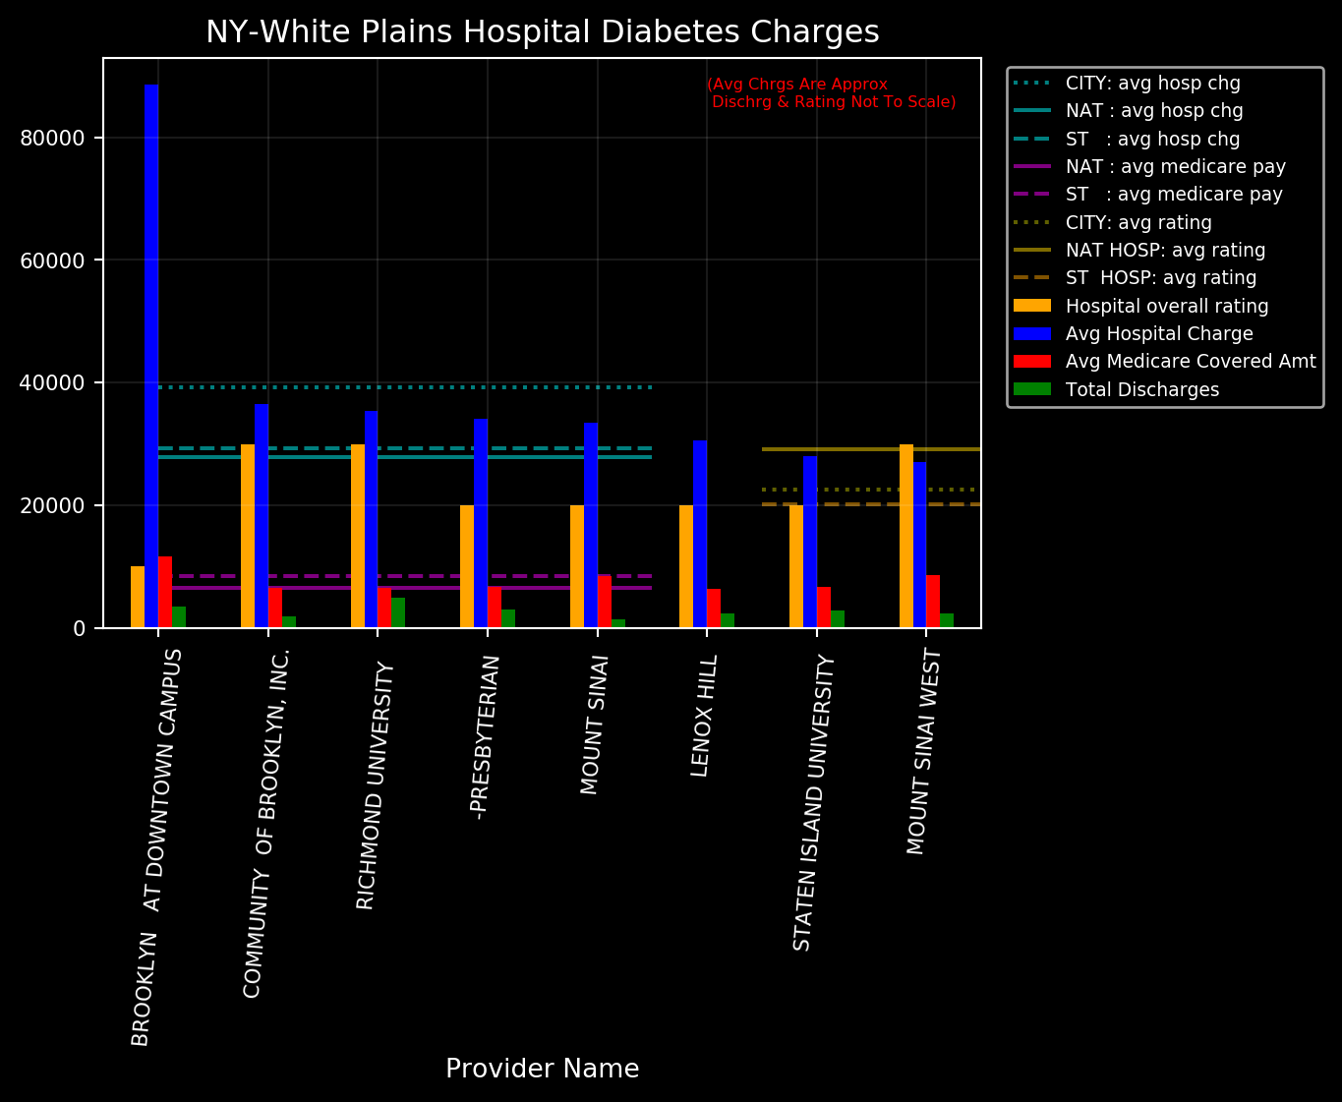
New York – Deep Dive on Charges – Diabetes
xyz

Slide 15
Brandon - Other
xyz

Slide 16
Tyler – CA
xyz

Slide 17
Tyler – Ranking, customer satisfaction
xyz

Slide 18
Tyler – Hypothesis Testing
xyz

Slide 19
Summary
xyz

Slide 20
References
GitHub:
Key Directories
Key Files
Notes

