Slide 1
Inconsistency of U.S. healthcare costs
Team Viper – UC San Diego - Data Science
September 2019

Slide 2
Overview
Healthcare Charges and Costs have long been opaque
Starting in January 2019, federal law requires transparency
Hospitals are required to publish their chargemasters
Medicare now disclosing hospital reimbursement data (data.gov)
Data still incomplete for many hospitals, and outpatient costs not yet published
Data will be analyzed from data.gov and [other sites] for cost-variance
Examining Top 2 quasi-facility-electable procedures: DRG 470 (Major Joint Replacement), DRG 638 (Diabetes with Complications)
View national differences by state, drill down as needed to root-cause & correlate
Compare with other data from [other sites]

Slide 3
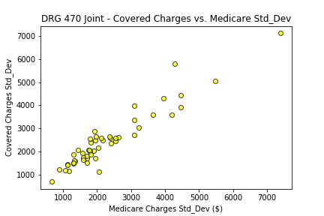
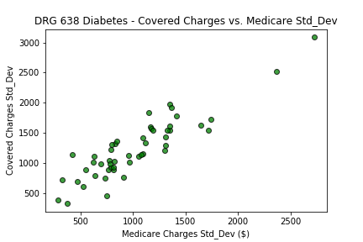
Covered vs. Medicare Charge Variance
Well-correlated, close to 1:1
Accounts for differences in Medicare vs. Supplemental coverage and Deductibles
Does not factor in private insurance
Medicare Charges = What Medicare reimbursed the hospital
Covered Charges = Medicare reimbursement + supplemental insurance + deductibles

Slide 4
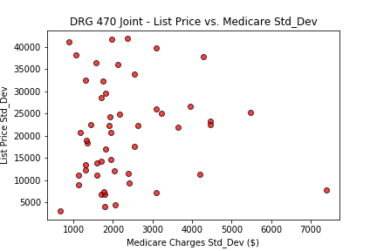
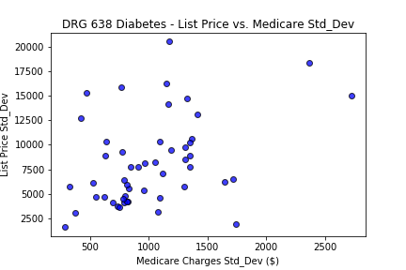
‘List Price’ vs. Medicare Charge Variance
BAD CORRELATION
Tremendous Variance in ‘List Prices’ – does not linearly relate
Private insurance negotiates down from the ‘List Price’ -> Medicare Charge
This is where the problem begins
Medicare Charges = What Medicare reimbursed the hospital
List Price = Hospital ‘List Price’ for a given DRG code procedure

Slide 5
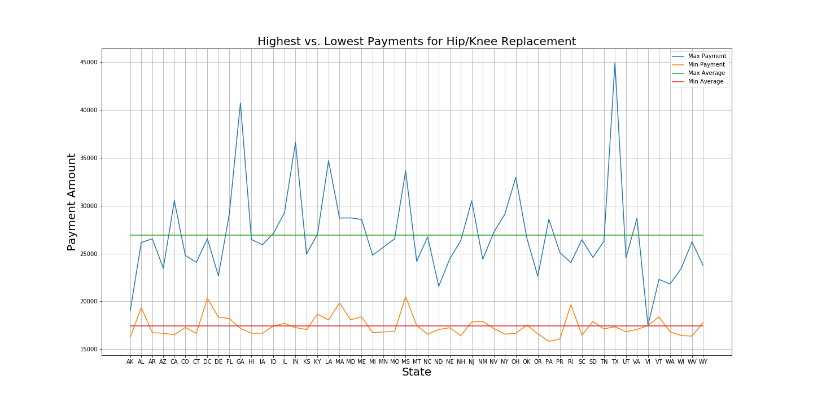
The Difference Exists
The below graph shows minimum and maximum payments for Hip/Knee replacements found in each state. The average difference in cost is $9,520.15 for these common procedures.
https://healthdata.gov/dataset/payment-and-value-care-hospital

Slide 6


National Variance
Hotspots for high ‘List Price’ standard deviation
Three key areas: Tri-State Area (NJ/NY/PA), Deep South (MS/AL), California
Diabetes – DRG470
Joint – DRG638

Slide 7
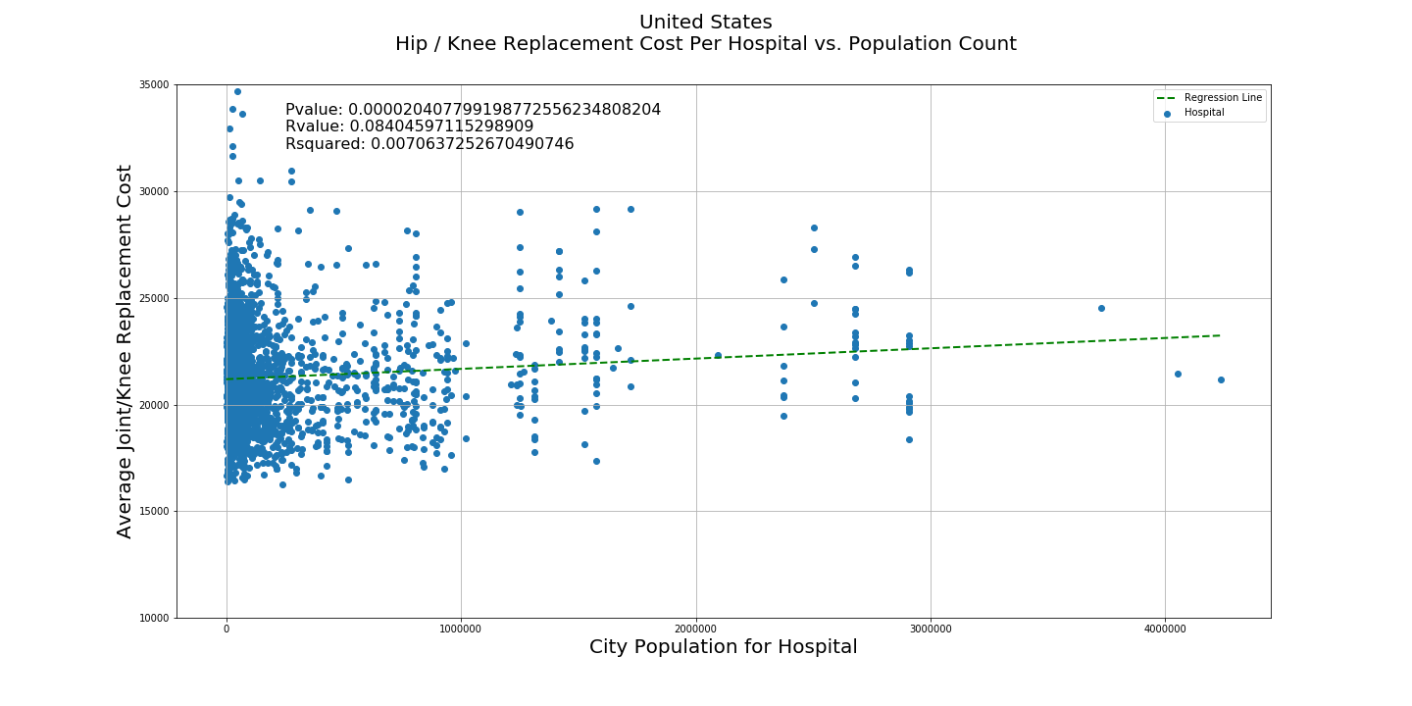
Hypothesis 1: There is a significant difference between population and medical procedure cost.
Looking at the USA, population count correlates with the cost of Hip/Knee replacement procedures.

Slide 8
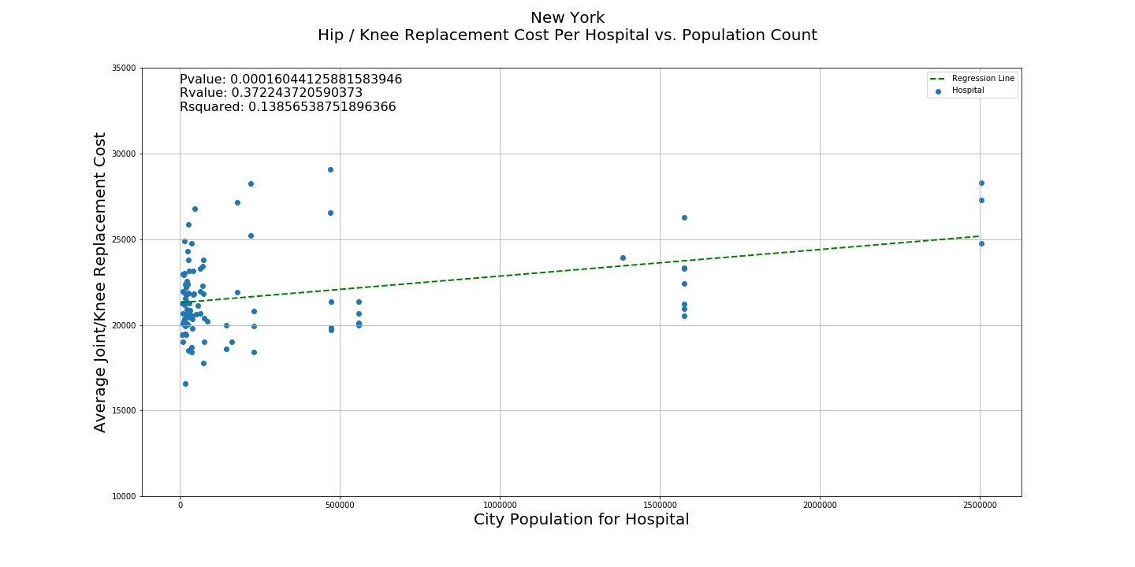
Hypothesis 1: There is a significant difference between population and medical procedure cost.
New York shows a significant trend when looking at hip/knee replacements across the state. More populated areas tend to have higher costs for the same procedure

Slide 9
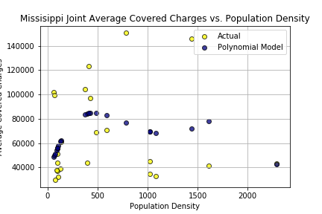
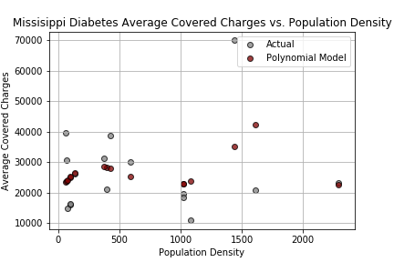
Hypothesis 1a: There is a significant difference between population(density) and medical procedure cost.
Examining Mississippi – The statistics fail to prove the hypothesis.
T-Test: The groups are not correlated as evidenced by high-T magnitude with good confidence (very low p-value)
Linear Regression: high p-value and low R^2 indicate bad fit. Polynomial fit not good
T-Test: T-Value = -8.435976191821668, pvalue = 2.4096964561007347e-08
Linear Regression: Slope = 2.8376244389968734, Intercept = 65167.56099879802,
Pvalue = 0.8381376720055401, R^2=0.002032867482902925
Polynomial Regression: -6.902e-08 x ^4+ 0.0003221 x ^3- 0.4963 x^2 + 279.9 x + 3.305e+04
T-Test: T-Value = -7.330113910577341, pvalue = 2.4202410480315282e-06
Linear Regression: Slope = 2.387899055961176, Intercept = 25168.00982295613,
Pvalue = 0.6779137724186564, R^2=0.012686186738626407
Polynomial Regression: -3.707e-08 x ^4+ 0.0001527 x^3 - 0.1875 x ^2+ 75.04 x + 1.955e+04

Slide 10
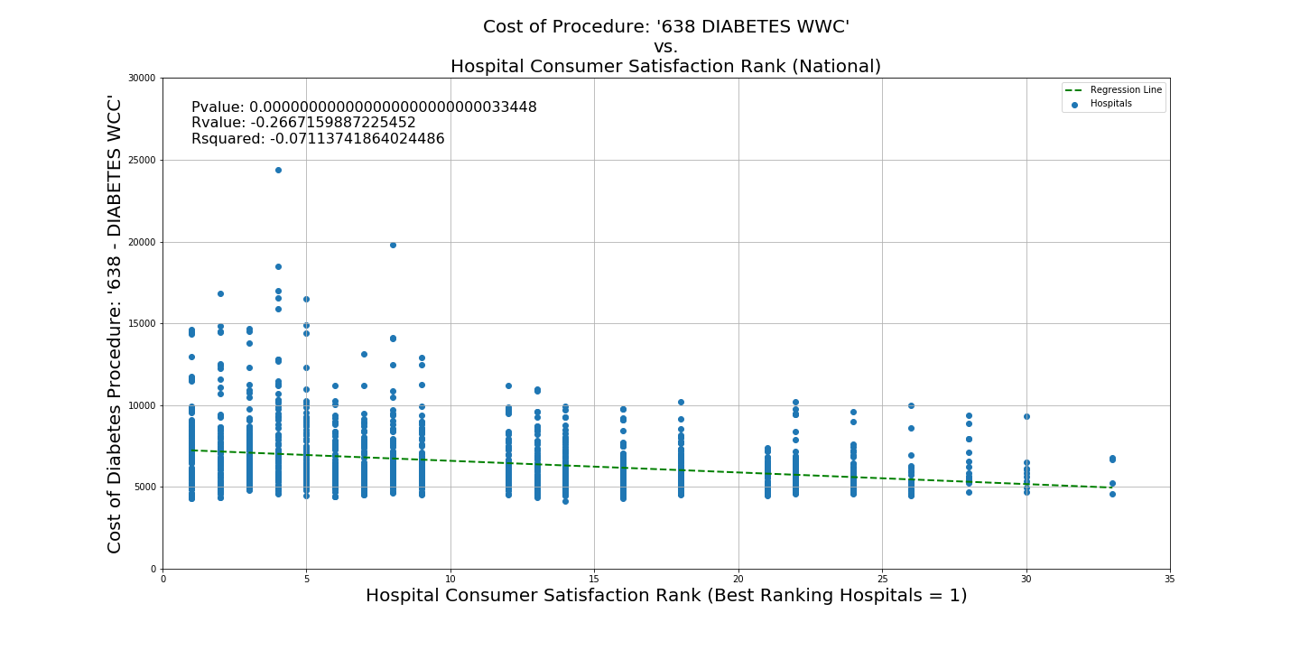
Hypothesis 2: There is a significant difference between consumer satisfaction hospital ranks and the cost of medical procedures.
The graph below shows all recorded payments for the specific procedure “638 – DIABETES WCC” versus hospital consumer satisfaction ranking (Low = Better)

Slide 11
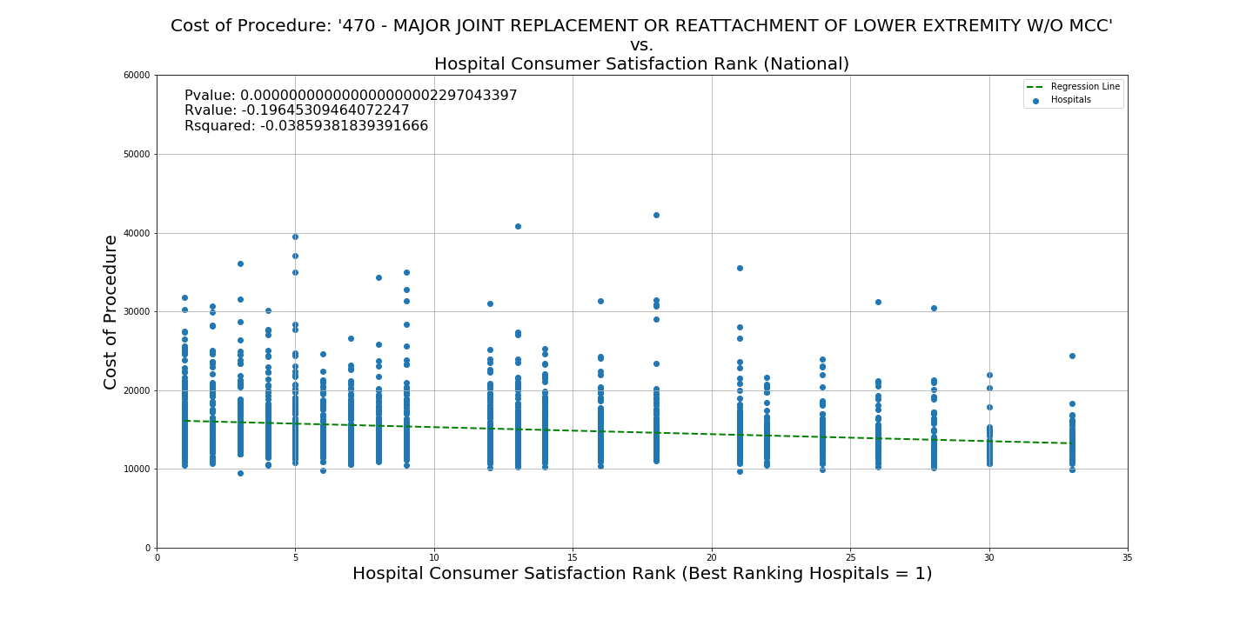
Hypothesis 2: There is a significant difference between consumer satisfaction hospital ranks and the cost of medical procedures.
The graph below shows all recorded payments for the specific procedure “470 - MAJOR JOINT REPLACEMENT OR REATTACHMENT OF LOWER EXTREMITY W/O MCC” versus hospital consumer satisfaction ranking (Low = Better)

Slide 12
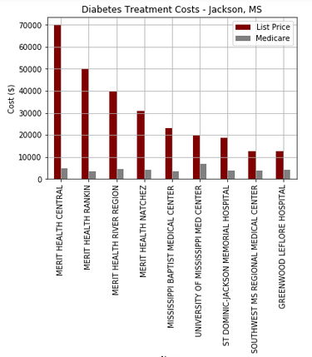
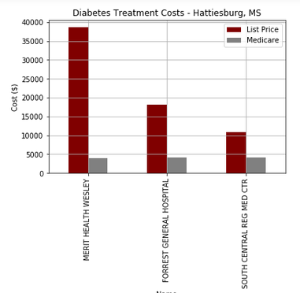
Mississippi – Deep Dive on Charges - Diabetes
Two distinct “metro” areas: Jackson (Capital City), Hattiesburg showed wide variances
Merit Health shows dramatic differences on ‘List Price’ vs. Alternatives.

Slide 13
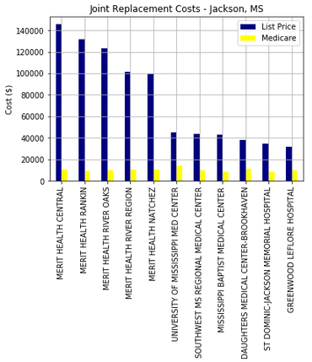
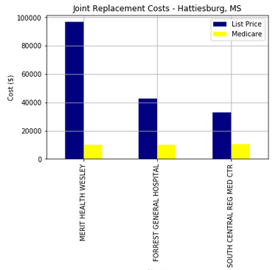
Mississippi – Deep Dive on Charges – Joint Replacement
Merit Healthcare is vastly overpriced vs. Alternatives
Medicare reimbursement costs remain constant

Slide 14
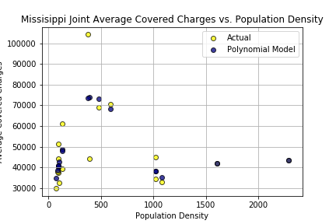
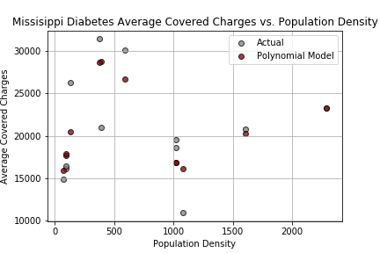
Mississippi - Removing ‘Aberrantly-Priced’ Merit Healthcare
Now ‘more predictable’ with a lower order polynomial
Null Hypothesis holds - Mississippi not correlating list prices to population density
T-Test: T-Value = -10.393641445884066, pvalue = 1.5653853256619052e-08
Linear Regression: Slope = -2.585994347816789, Intercept = 49622.395839073986, Pvalue = 0.7385288340811982, R^2=0.007650270572038645
Polynomial Regression:.0004238 x^3 - 0.6764 x^2 + 366.3 x + 1.079e+04
T-Test: T-Value = -11.24463528438743, pvalue = 1.7856502073931564e-07
Linear Regression: Slope = 0.09737376883056005, Intercept = 20709.282317061916,
Pvalue = 0.972821015998601, R^2=0.0001220131303265545
Polynomial Regression: 0.0001452 x^3 + 0.2283 x^2 + 121.8 x + 8002

Slide 15
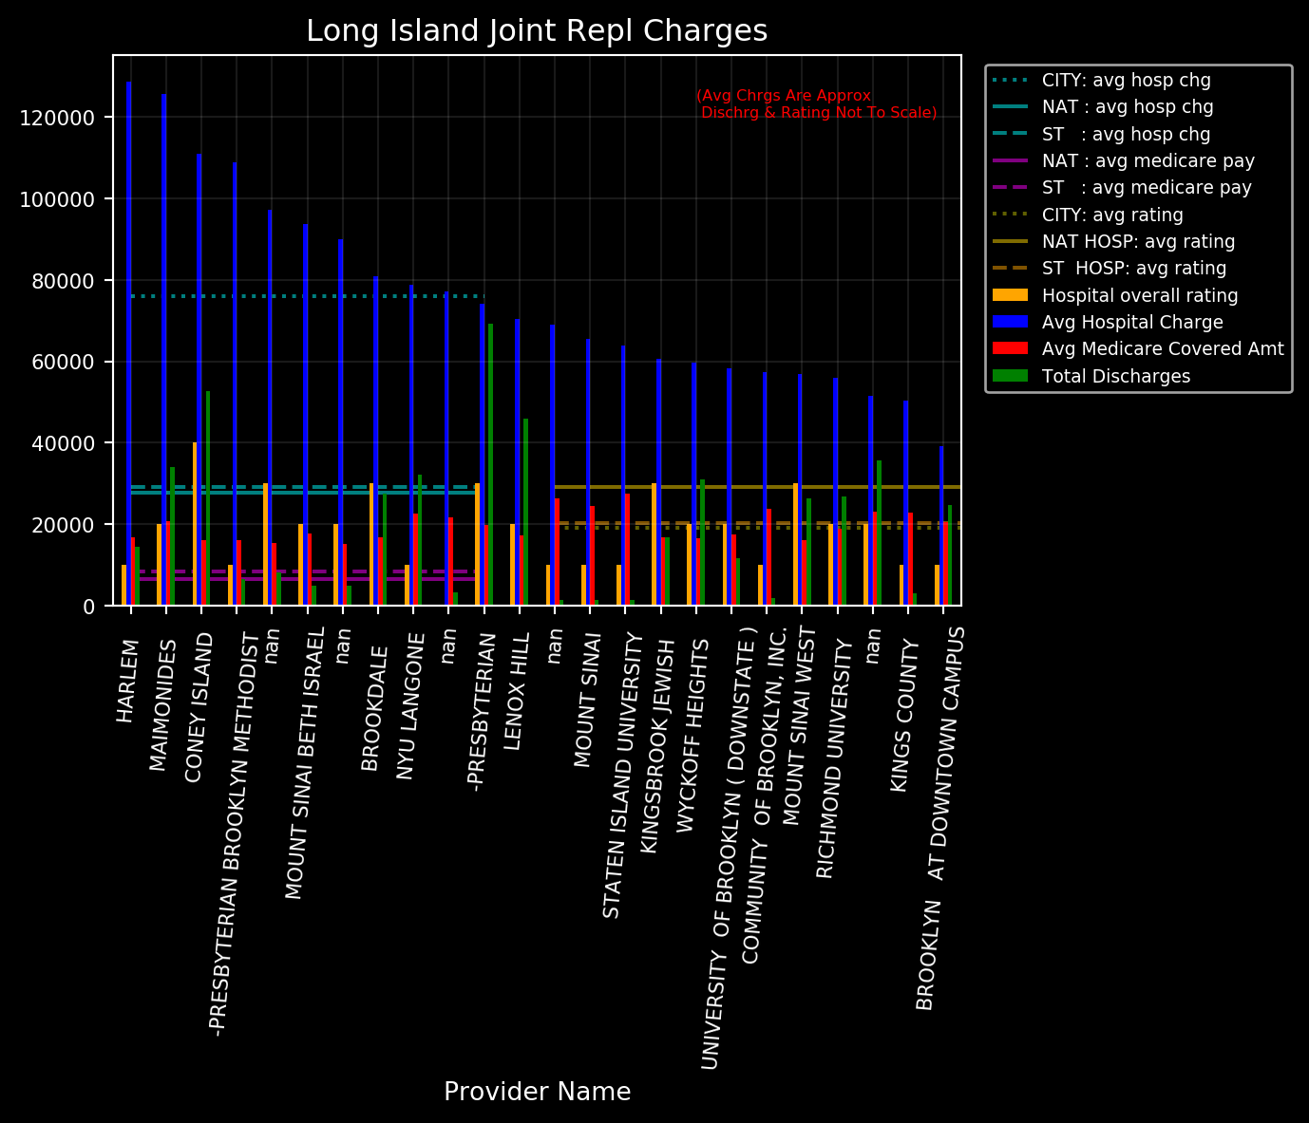
New York – Deep Dive on Charges – Joint Replacement

Slide 16
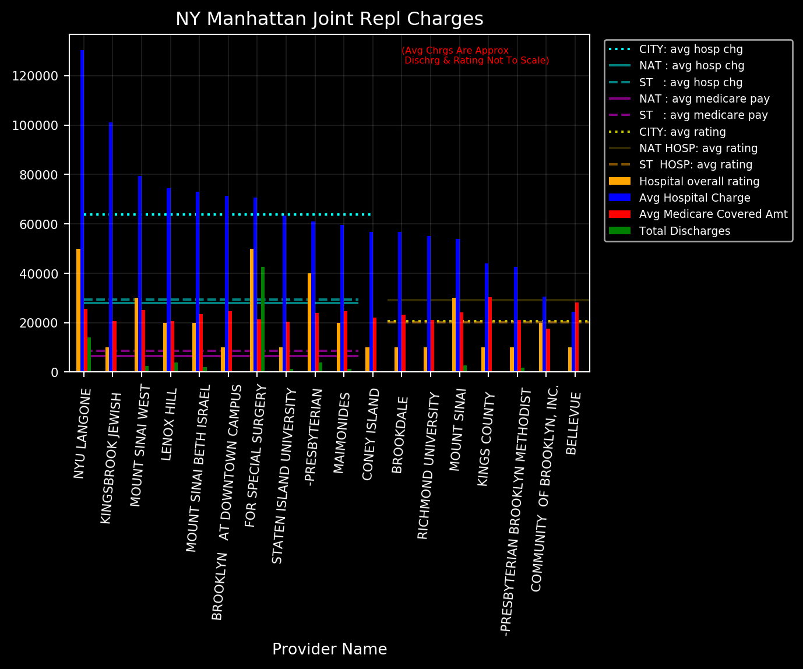
New York – Deep Dive on Charges – Joint Replacement

Slide 17
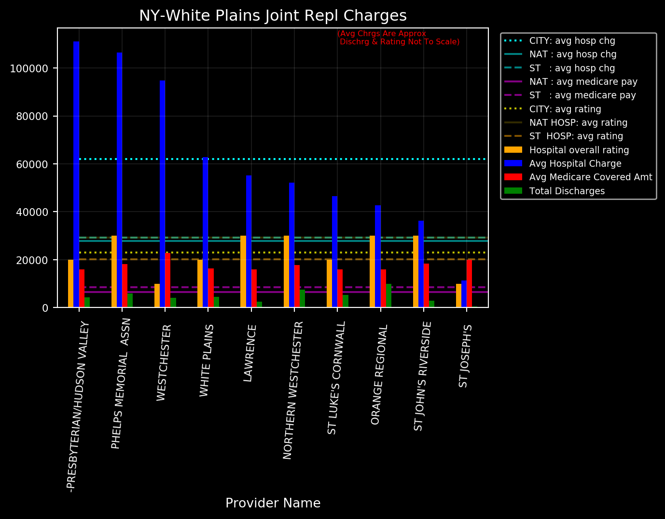
New York – Deep Dive on Charges – Joint Replacement

Slide 18
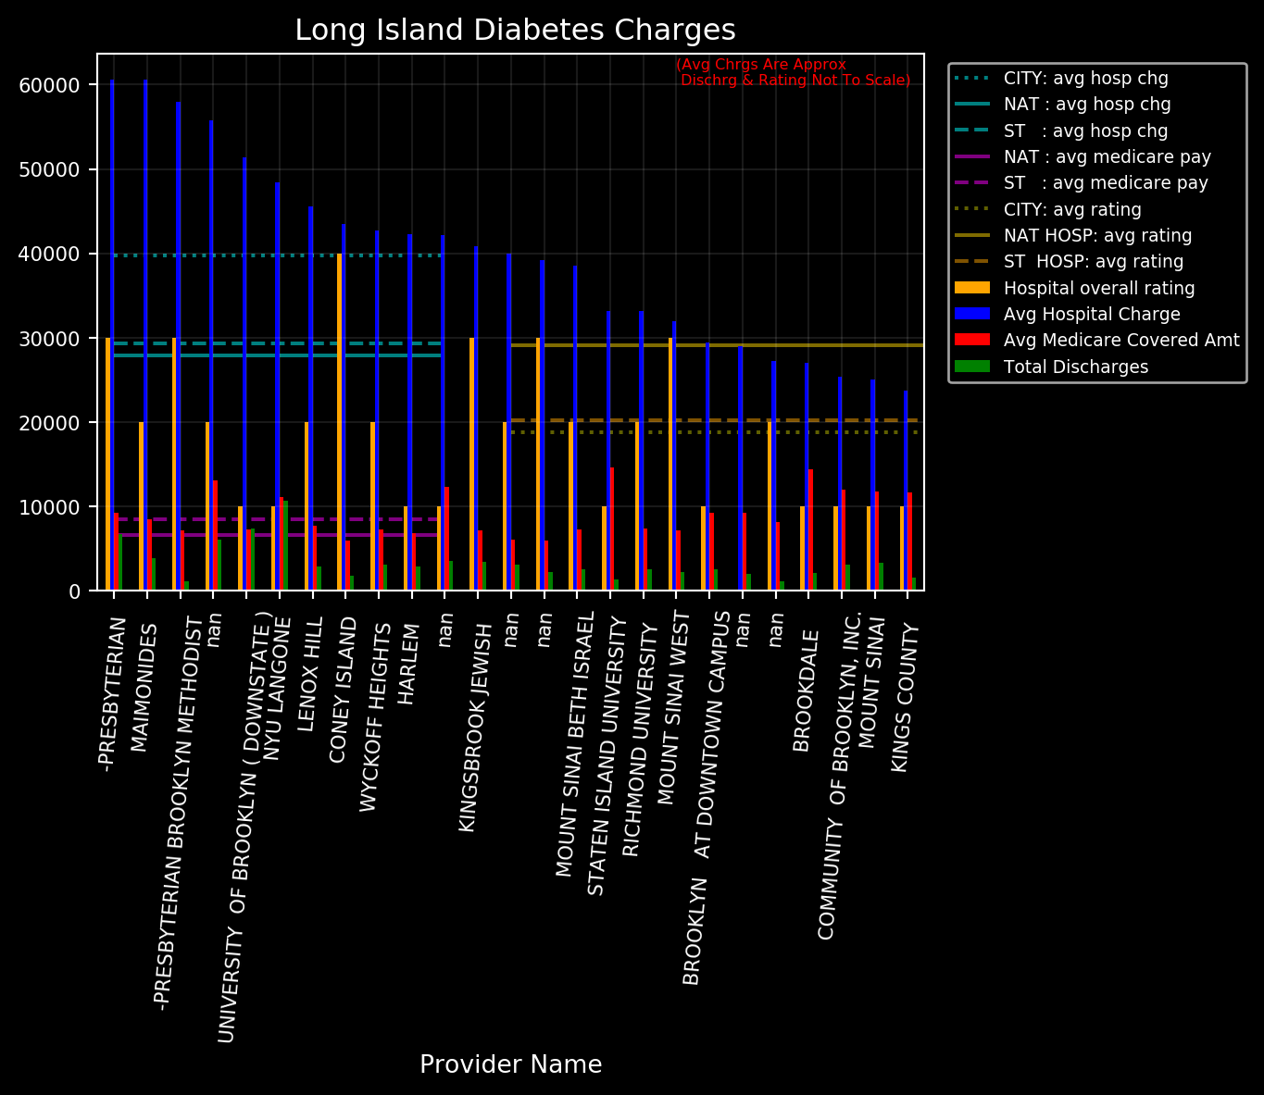
New York – Deep Dive on Charges – Diabetes
xyz

Slide 19
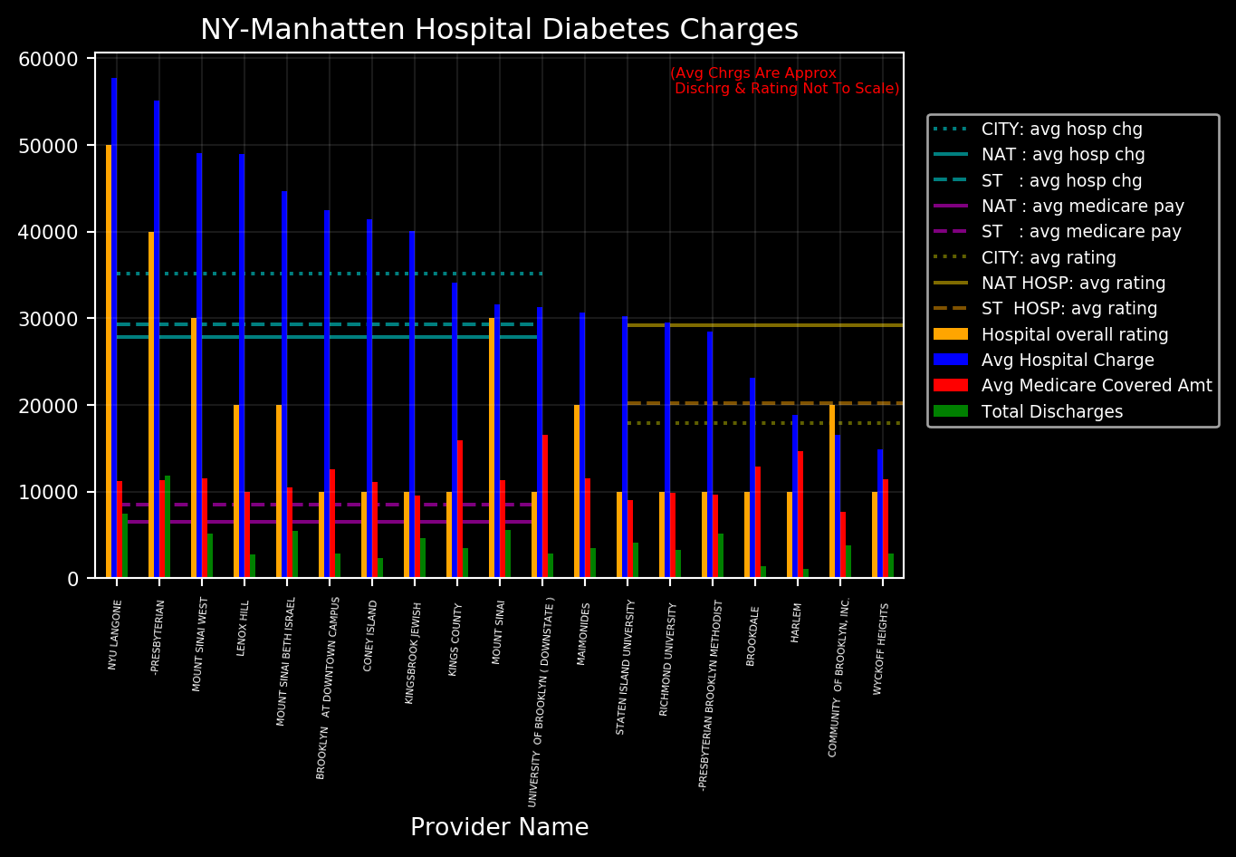
New York – Deep Dive on Charges – Diabetes
xyz

Slide 20
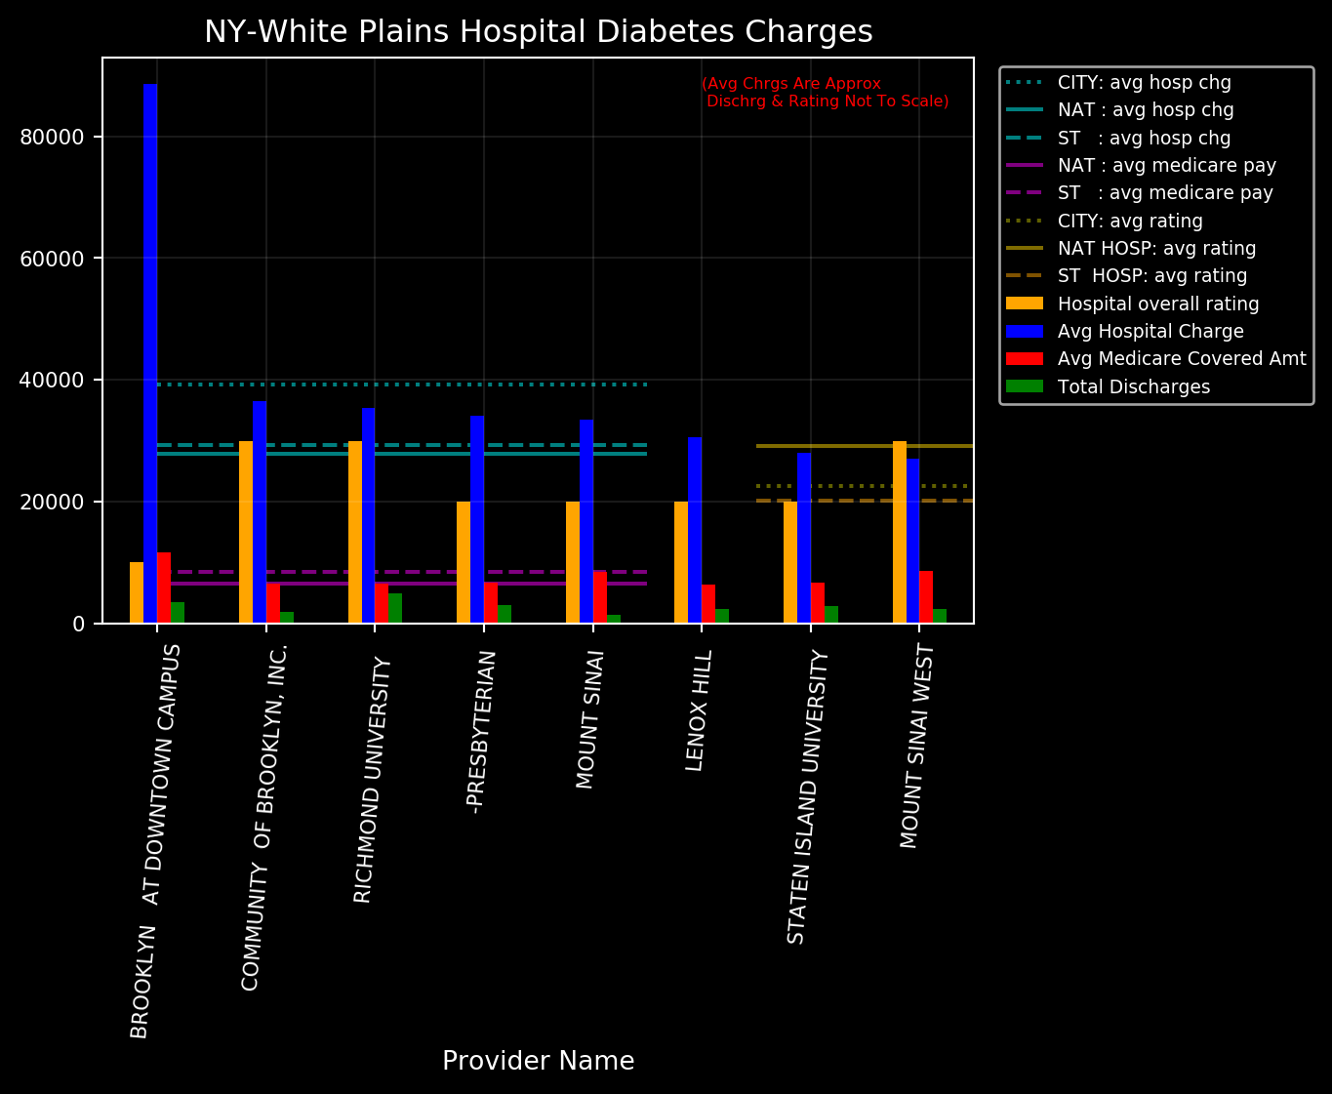
New York – Deep Dive on Charges – Diabetes
xyz

Slide 21
Summary Null Hypothesis 1: There is not a significant difference between population and medical procedure cost.
Null Hypothesis 2: There is not a significant difference between consumer satisfaction hospital ranks and the cost of medical procedures.
We are able to reject both of the above null hypothesizes since p-values < 0.05, however the correlation coefficients (r-value) are too low to make practical conclusions.

Slide 22
Brandon - Other
xyz

Slide 23
Tyler – Ranking, customer satisfaction
xyz

Slide 24
Tyler – Hypothesis Testing
xyz

Slide 25
Summary
xyz

Slide 26
References
GitHub:
Key Directories
Key Files
Notes

