Slide 1


Team W.A.R.I.S

Slide 2


Introduction
Team W.A.R.I.S
Project Background
Client Requirements
Solution
System Overview
Demonstration
Extensibility
Current Status
Conclusion
Questions & Answers

Slide 3
Team W.A.R.I.S.
Raymond Forster – Team Leader
Brandon Ashworth
Mitch Askew
Ross Johnson
Welsley Lui
Tim Matisons

Slide 4
Project Background
Client – Mr Shri Rai
Supervisor – Dr Mohd Fairuz Shiratuddin
Wearable Augmented Reality Information System (WARIS)
Provide information on locations within the school
Access building & staff information
Persistent on-screen information
Challenges
How to display reality in real-time on a mobile device?
How to interact with on-screen information?

Slide 5
Client’s Requirements
How should the system fulfill the requirements?
Provides visual display of wearer’s view
Geo-location trigger provides information
GUI allows user interactivity
Wireless interaction device
Information system stores and allows access to data
Extensibility

Slide 6
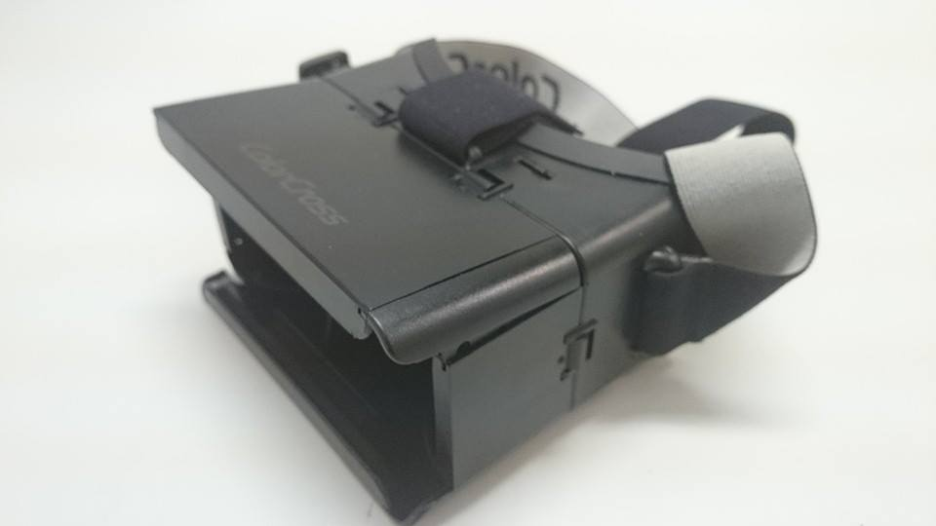
Solution
Mobile Augmented Reality System
Visual display with GUI overlay
Information system for building, staff and lecture information
Unity game engine
Deployment to Android device
Agile development methodology
Iterative approach
Paired programming

Slide 7
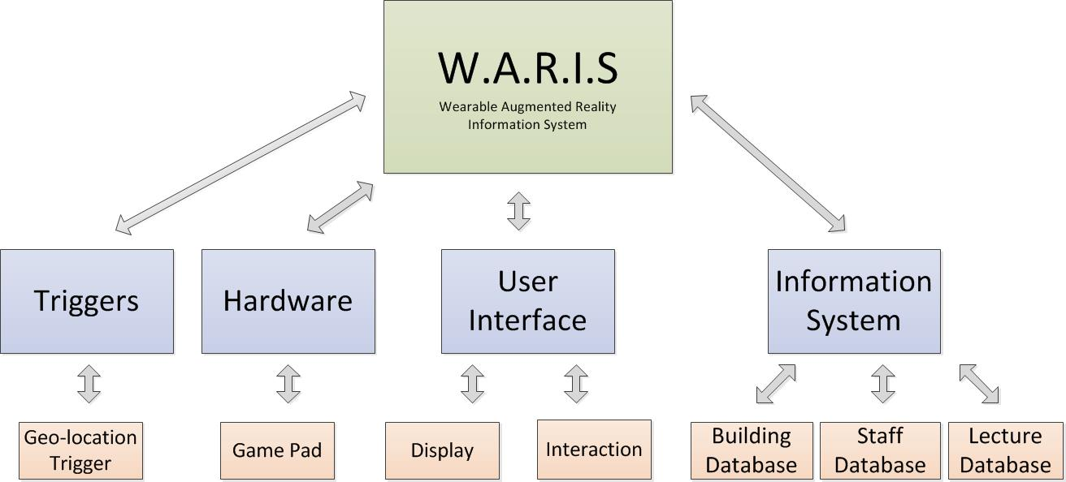
System Overview

Slide 8
Milestones
Milestone | Features | Expected date | Actual date achieved
Display | Split screen display | 17/9/2014 | 24/9/2014
 | User Interface | 17/9/2014 | 17/9/2014
 | User Interaction | 17/9/2014 | 17/9/2014
2. Geo-location Trigger | Device GPS Location | 8/10/2014 | 8/10/2014
 | Device Orientation | 8/10/2014 | 24/10/2014
3. Information System | Building Datastore | 24/10/2014 | 27/10/2014
 | Staff Datastore
 | Lecture Schedule Datastore

Slide 9
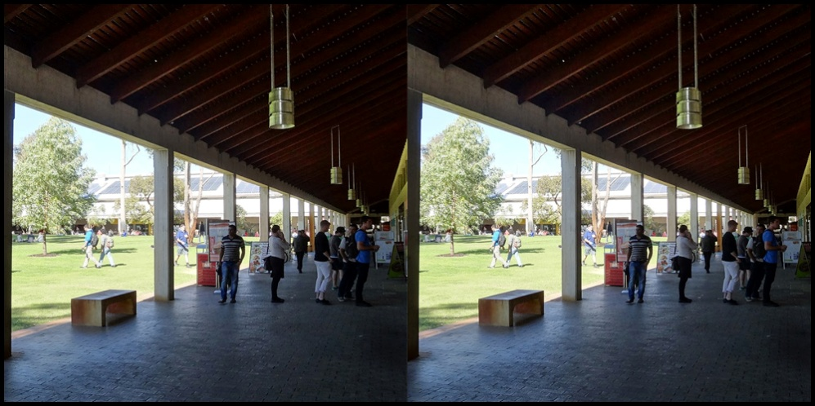
Visual Display
How to provide a view in 3D using a head-mounted display headset?
Stereoscopic display, with lenses to create a sense of 3D

Slide 10
Triggers
When should information be displayed?
Geo-location trigger
Use mobile device GPS data and orientation to determine whether or not a building is in the user’s range.
Device Orientation
Use mobile device compass orientation to determine whether or not a building is in the user’s field of view.

Slide 11
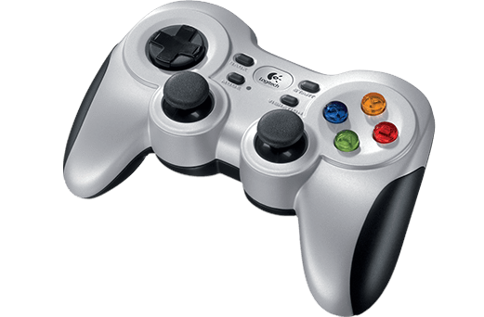
User Interaction
How does the user interact with the information system?
Wireless Logitech game pad with a USB nano-receiver
Left thumbstick to control cursor Right thumbstick to use
scrolling text-fields
Face buttons to press buttons

Slide 12
Information System [1]
How does the system access information?
Building database
Stores information about each building on campus. E.g. Building number, building name, list of occupant’s offices.
Queried by the trigger handler requesting information for a given building.

Slide 13
Information System [2]
Staff database
Stores information about each staff member with offices in buildings. E.g.. Name, phone, email, office number.
Queried by the UI when the user asks for further information about the staff member from the building’s occupants list.
Lecture database
Stores information about lecture schedules. E.g.. Unit Code, lecture room, topic, duration.
Queried by the trigger handler requesting information for a given lecture theatre.

Slide 14
Demonstration

Slide 15
Extensibility
Component based development
New components can be easily added
Triggers
Facial recognition
Voice recognition
Devices
Sensors for gesture recognition changing how users interact with the GUI
Data
Interface with the Murdoch database

Slide 16
Current Status
User interactivity and display
Geo-location
Data structures/information system
Known issues
Graphical (cursor vs. visual)
Information longevity
Data loading

Slide 17
Conclusion
Does W.A.R.I.S meet the client requirements?
Provides visual display of wearer’s view
Geo-location trigger provides information
Information system stores and allows access to data
GUI allows user interactivity

Slide 18
Questions?
Name | Phone | Email
Brandon Ashworth |  | darkness-surrounding1992@hotmail.com
Mitchell Askew |  | 31242511@student.murdoch.edu.au
Raymond Forster | 0403 302 403 | rforster79@gmail.com
Ross Johnson |  | hades_shade_6@hotmail.com
Timothy Matisons |  | timzangelic@hotmail.com
Welsley Lui |  | welsleylui_ackty.bit48@hotmail.com

