Slide 1
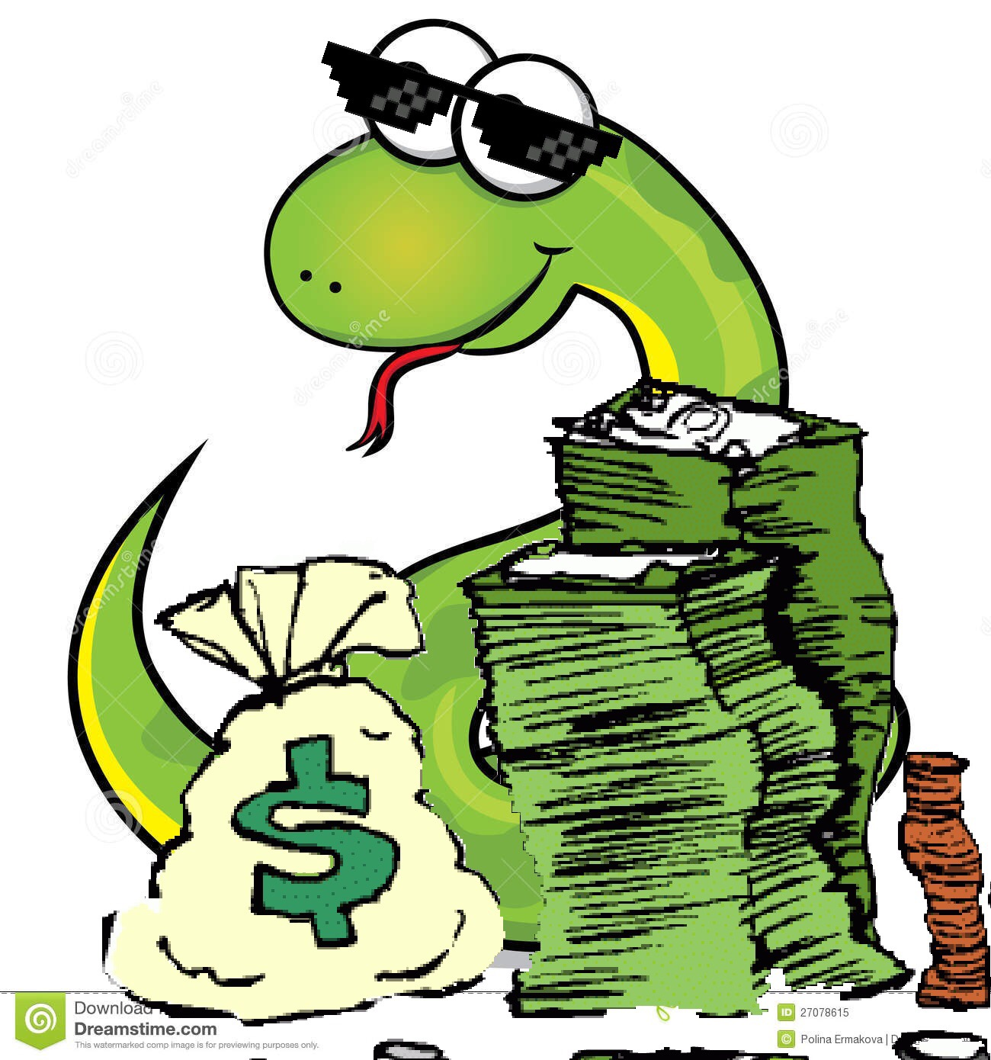
The Snake Game
By Brandon Banks

Slide 2
Snake
Snake is the common name for a videogame concept where the player maneuvers a line which grows in length, with the line itself being a primary obstacle. The concept originated in the 1976 arcade game Blockade, and the ease of implementing Snake has led to hundreds of versions (some of which have the word snake or worm in the title) for many platforms. There are over 300 for iOS alone.

Slide 3
What Is My Project?
I decided that my project should be something fun, that any age can enjoy. My code runs a game similar to the early models of Snake, since it is the easiest model to make.

Slide 4
Requirements
This program needed only ~175 lines of code
The knowledge gained over the course of this semester
A computer AND a keyboard
The internet
Hands for typing and a mind for thinking

Slide 5
Challenges
The biggest difficulty, that I actually thought was going to be one of the easiest things, was making the snake move around in the field. It wasn’t too difficult of code in the end, but it took a while to get there. Another thing I ran into was the border in the game. In the original game, if you run into the border the game was over. I found it was a much more fun game if you could just go through the border and pop out the other side, just like in Pac-Man.

Slide 6
Solutions
Patience was one of the biggest virtues needed to make sure this code would run without hiccups. I condensed my code to a minimal, to make it the most efficient code I could. After watching tutorials, researching the interwebs, and getting help from a lot of upperclassmen, I was able to bump out all of the dents in my code.

Slide 7
The “Cool” Factor
The main selling point for the cool factor is the fact that it is a video game. It might now break into the top charts on Steam, but it is still playable. Now I know what you’re thinking, “But Brandon! Snake has been done thousands of times! What makes your’s any different?”. The answer: Mine you are gathering money instead of food. (Give time for everyone’s blown minds to recollect themselves)

Slide 8
THe Spirit of Competition

