Slide 1
Prosight Storyboard
Assignment 3

Slide 2

Assignment 5

Slide 3


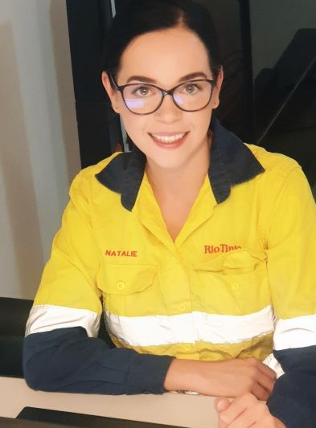

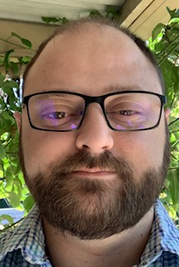
Group A12
Brandon
Moroney
s3832081
Alex
Barron
s3831619
Natalie
Ogilvie
s3831618
Emily
Petrie
s3655611
Shane
Miller
s3427238

Slide 4


Slide 5
Brandon Moroney – Lead Web Engineer – Prosight
Natalie Ogilvie – Lead Designer – Prosight
Emily Petrie – Lead Test Engineer – Prosight
Shane Miller – Lead Data Engineer – Prosight

Slide 6
Key points
Include colour and graphics
Intro
Structure, logical progression
Be engaging
Style – as per info

Slide 7
Introduction – 15 seconds
Intro and what we are going to talk about
A 2018 report titled Programme for International Student Assessment (PISA) details the long-term decline in Australian students in Science, Reading and Mathematics subjects in comparison to Chinese students. Specifically, the report details that Australian students are on average 3.5 years behind Chinese students in mathematics.
we’re joined by X from Prosight to talk to us about some of the challenges facing students today

Slide 8
Introduction – Script - Alex
Hi, I’m Alex Barron and thanks for joining us for our education segment today. Recently, we’ve been looking at the standards of education in Australia and I’m pleased to be joined by the team from Prosight today.
Prosight is a new company that’s working with learners to change the way they learn. We’re joined today by Brandon, Emily, Shane and Natalie to talk through some of the challenges that we’re seeing with Australian education.
Brandon, thanks for joining us, can you tell us a bit about the problems that you’re seeing today with online learners?

Slide 9
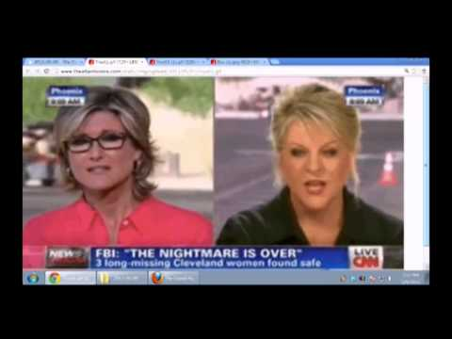
What is the problem – 60 seconds
Split screen interview style
Script along the lines of “What is the problem being faced by online learners, here is X member from prosight”
Prosight member X to illustrate the challenges of online learning

Slide 10
What is the problem – Script - Brandon
Talk about the problems being faced today, eg A 2018 report titled Programme for International Student Assessment (PISA) details the long-term decline in Australian students in Science, Reading and Mathematics subjects in comparison to Chinese students. Specifically, the report details that Australian students are on average 3.5 years behind Chinese students in mathematics.
Online learning is harder, people don’t know how to learn best etc. With classrooms, students learn in different ways etc.

Slide 11
What is the problem – Script - Alex
Thanks Brandon, that’s a really good overview of some of the issues that students are seeing. I can see that there is a real gap that we’re missing here in Australia.
This can’t be a new problem though, online learning has been around for a number of years now. What have people been doing up to now?
We have one of the lead researchers XXXX from Prosight here with us today. XXXX, what are we doing right now to address these issues?

Slide 12
What steps are we taking as Australians? – 60 seconds
Split screen interview style
Illustrate the points that there are solutions out there, however none of them are really understanding the needs of the student and are bespoke

Slide 13
What steps are we taking as Australians? – Script - Natalie
Talk about existing platforms, learning quizzes, all classroom education is the same, not really helping people. Plenty of things out there, but you have to go and look for it.

Slide 14
What steps are we taking as Australians? – Script - Alex
Thanks for that, very informative. So there is plenty of things there, but it seems like it’s a bit of a free for all. What are we doing about it? XXXX from the Prosight team, can you give us a bit of a rundown about how we’re going to address this problem?

Slide 15
So what is being done? - 90 seconds
Split screen interview style
Pitch Prosight’s study tool as the answer, why it fills the gap available and how amazing it is
How does it work, explain how students can use it.

Slide 16
So what is being done? – Script - Shane
Right now, there isn’t much, this is why we have created our platform etc.
Describe how it works, what it does, why you’d use, how its very simple, free etc

Slide 17
So what is being done? – Script - Alex
That sounds great! Its sounds like you’ve really got a good grasp on what the issues are and you’ve got an answer that can really help students here achieve their potential!
You said this is a free service, that sounds great. What motivated you as a team to go ahead and start to create this? XXXX tell me a little about that?

Slide 18
Why is the team doing this ?- 30 seconds
Split screen interview style
Explain our motivations
How it can change lives

Slide 19
Why is the team doing this? – Script - Emily
Talk about the motivations for doing this, why we chose this as a project.

Slide 20
So what is being done? – Script - Alex
Brilliant, you’re doing great work, how can we find out more?

Slide 21
How can I find out more? 30 seconds
Split screen interview style
Cover off cost (free)
Cover off that it will be launching soon for Australia, later in the rest of the world

Slide 22
How can I find out more? – Script - Emily
We’ll be launching soon, keep an eye out for our website launch etc

Slide 23
How can I find out more? – Script - Alex
Definitely keep us up to date, we’ll look forward to having you back on to talk about the success!
Thanks everyone for joining us today, its been a real insight into some of the innovation coming into the market.
You can join us next week for our education segment where we’ll be talking about why do magicians do so well in school? Is it because they are good at trick questions? Join us to find out.

Slide 24
Outro – 15 seconds
Thanks everyone
Don’t forget you can find out more at www.pro-sight.com.au

