Slide 1

FoodFox
A mobile app that help locate food stores with
minimal time and effort

Slide 2

Mission
To become the preferred food-finder application amongst other competitors
To become an app that use on all nation worldwide

Slide 3
Our Team
Khoo Zhi Yan App Developer
Chuah Li Ze Web Developer
Brandon Tan UI/Graphic Designer
Lee Wei Sheng Finance and Accounts Manager
Lau Yit Chin Android Developer

Slide 4
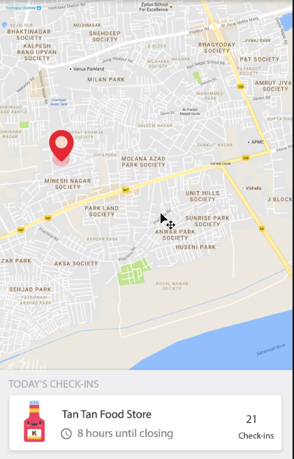
Features
Generates a map of local proximity upon launch
Shows all available food stores nearby
Highlight stores that are having promotions and discounts

Slide 5
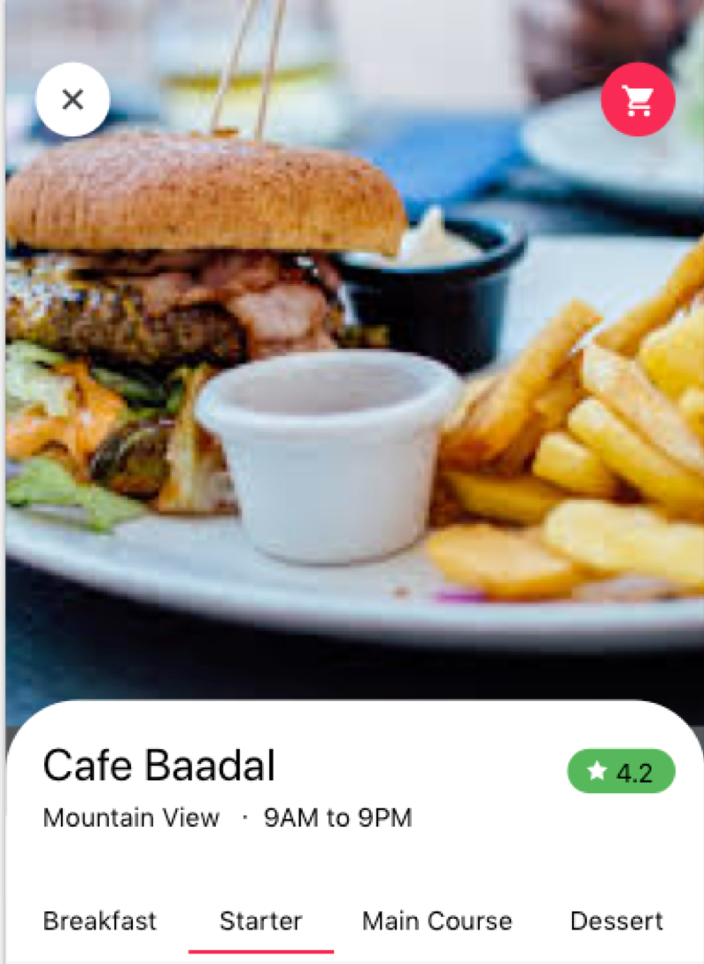
Features
View store menu and reviews
View store promotions and discounts
Ability to see if the store is closed or open

Slide 6
Market Segmentation
Geography (customer location, region etc.,)

Slide 7
Market Research
53 percent of respondents had used their phone to find a restaurant location
49 percent had done so to browse a restaurant’s menu
http://www.adweek.com/digital/survey-25-of-users-have-at-least-one-restaurant-app-on-their-phone/

Slide 8
Competition
Yelp
Over 53 million reviews
120 million monthly unique visitors
Good mobile web and app experience
FourSquare
45 million users . One of the largest databases of user generated geolocation in the world
Encourages users to leave “tips” or single phrase/sentence reviews
Strong mobile web and app experience
Allows for smart advertising

Slide 9
Future Plan
Food Delivery Services
Might expand to different categories such as clothes, electronics and many more

Slide 10
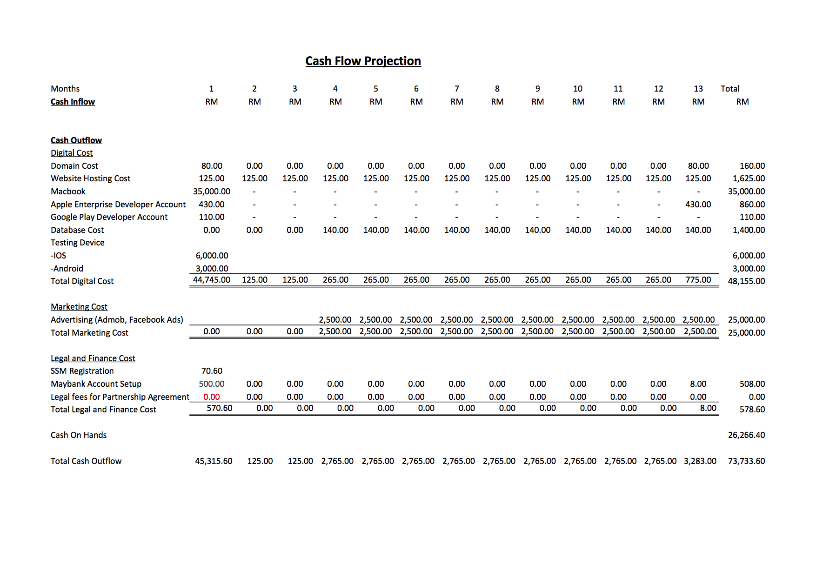
Personnel Summary

Slide 11
The End

